Slide 1
Forensic Chemist
Lance Lietzau

Slide 2
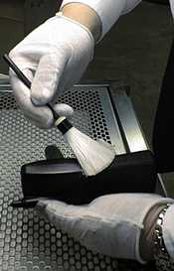
What is a Forensic Chemist?
An individual who analyzes evidence brought in from a crime scene and in some situations maybe be required to testify in court.
Don’t actually participate in investigation process…only responsible for collecting and analyzing samples.

Slide 3
Education and Skills
Bachelors degree preferred in science.
Good speaking skills, should be fluent in public speaking and communication.
Exceptional note taking ability.
Ability to read, write and understand a scientific report.

Slide 4
Salary and Outlook
The salary ranges depending on experience and type of degree, but a general range is between $60,000-80,000 a year.
Job outlook is good and expected to grow because unfortunately crime is part of our society.

Slide 5
