Slide 1
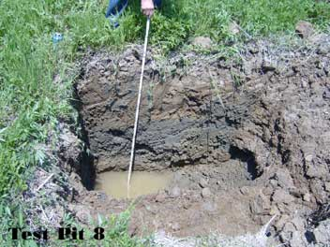
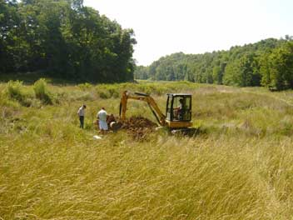
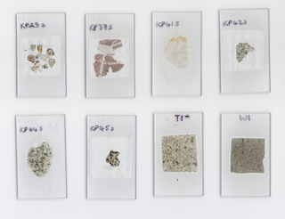
Forensic Geology Forensic Geology is the scientific application of earth sciences used to answer questions raised by the legal system (www.geoforensics.com).
Brandon Harris

Slide 2
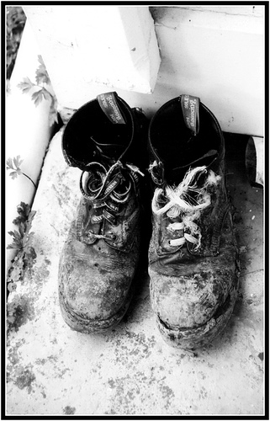
Forensic Geologists
A forensic geologist identifies, analyzes, and compares earth materials, such as soil, rocks, minerals, and fossils found on or in a suspect, a vehicle or other medium of transfer, such as water, to possible source areas such as a crime scene, an alibi location, and/or a point of disposal or release. The goal of these comparisons is to establish the degree of probability that the material was or was not derived from a particular location (www.geoforensics.com).

Slide 3
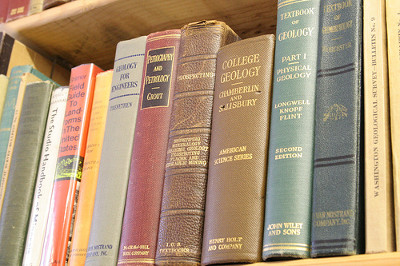
Education & Skill Requirements
Bachelor’s Degree in Geology.

Slide 4
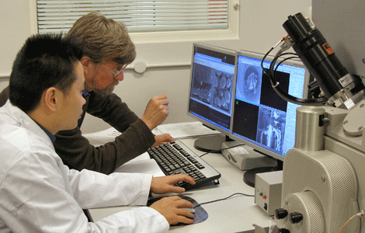
Employment
Science technicians held a total of approximately 198,000 jobs in 2000. Forensic Science technicians held only 6,400 of those jobs. (www.worldwidelearn.com).

