Slide 1
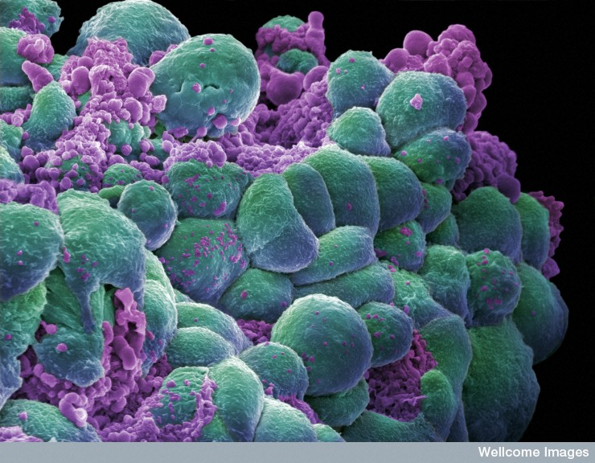
Forensic Pathology
By: Megan Shafer
http://www.iayork.com/Images/2007/11-12-07/BreastCancerCells.jpg

Slide 2
What is Forensic Pathology?
It is the subspecialty of pathology that focuses on the medical investigation of sudden or unexpected death.

Slide 3
Two Main Branches of Pathology
Anatomic: involves evaluation of tissues removed from living or dead individuals. Examples are autopsy, surgical, and cytopathology.
Clinical: involves the evaluation of the body fluids by laboratory means. Examples are hematology, microbiology, blood banking, toxicology, and immunology.

Slide 4
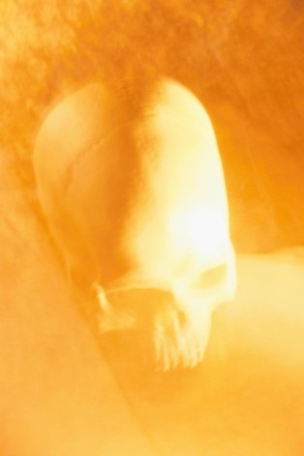
Roles of a Forensic Pathologist
The doctor is responsible for a forensic pathology autopsy and post mortem examinations to examine a dead body and determine the cause of death. The process involves examining the body for injury or death that directly or indirectly through a course of events causes the death of the individual. The autopsy also helps in establishing the identity of the dead body if it is not known.
The forensic pathologists work with the legal authorities and help determine the cause of sudden and unexpected deaths.
Serve as an expert witness and testifies in civil or criminal law cases.
http://www.buzzle.com/articles/forensic-pathology.html

Slide 5
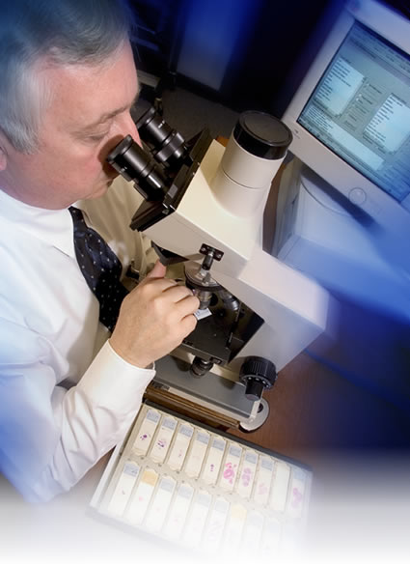
Education Required
Complete a 4 year college degree,
Complete 4 years in medical school.
3 to 5 years residency training in general pathology.
Concentration is generally on core sciences such as biology, chemistry, physics, and psychology. English classes are also very important .
Outlook for jobs? Pretty decent, forensic pathologists are hired by regional, state, and local laboratories as well as private firms, colleges, military and federal agencies.
http://www.mpiresearch.com/images/MainPagePhotos/Pathology.jpg

Slide 6
Good skills to have
Communications: half the job is writing reports and giving testimony.
Management: a forensic pathologist has to work with many people and lead them in investigations.
Intestinal fortitude: meaning you have a strong stomach.
Confidence: a pathologist must be able to defend their conclusions against lawyers, the media, and victims families.

