Slide 1
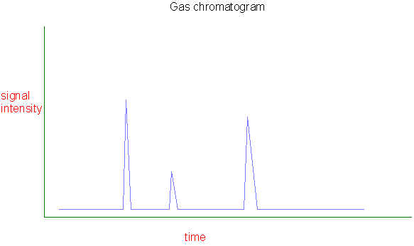
Types of Chromatography
Liquid chromatography versus gas chromatography? Applications?
Volatile → GC
Non-volatile → LC

Slide 2
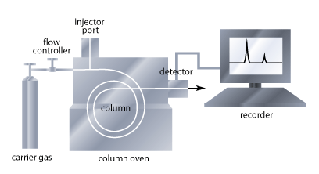
Gas Chromatography
Mixture of compounds is placed onto stationary phase
Mobile phase is passed through system
Injected samples are vaporized
Samples pass over stationary phase in temperature controlled oven
Each compound spends a different time in mobile & stationary phase as it passes through system
Separation based on polarity and boiling point
Notes:
Trace path through instrument, talk about volume of sample needed, why injector is so hot = it vaporizes the sample immediately and loads the sample onto the stationary phase
Talk about capillary column, size, and coating show one why is it kept in an oven, and then it reaches a detector

Slide 3
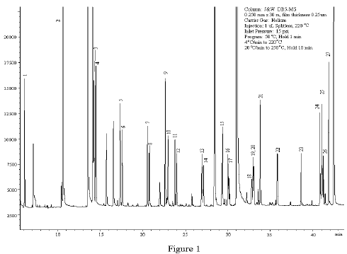
Gas Chromatography
When each compound reaches detector, it triggers a response proportional to compound’s concentration
Retention time: Time from injection to the time the peak comes to the detector

Slide 4
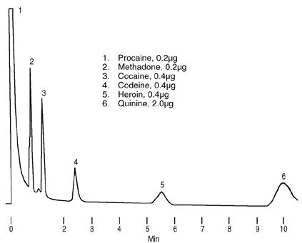
Example Problem
Alkaloid drugs were analyzed by GC. On this chromatogram, peaks 3 and 5 are heroin and cocaine. The boiling point of cocaine is 187ºC, heroin 272ºC. Which is which?
Methadone is peak 2, what is its relative b.p.?
Codeine is peak 4 what is its approximate b.p.?

Slide 5
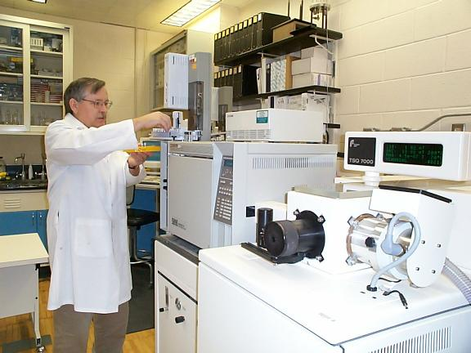
Mass Spectrometry
One of most powerful instruments a forensic chemist can use → Can tell exactly what a substance is
Can be used a s a detector in GC, LC, or ICP
Movie

Slide 6
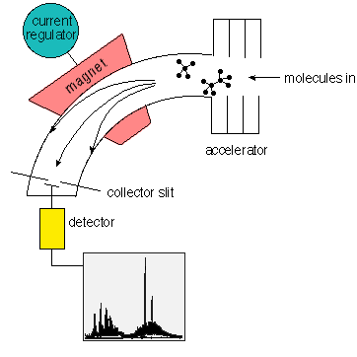
How a Mass Spectrometer Works
Ions are created with electron beam
Ions enter vacuum
Ions pass metal plates with high voltages, causes acceleration
Magnetic field applied to ions in curved path, ions of ‘correct’ weight are detected

Slide 7
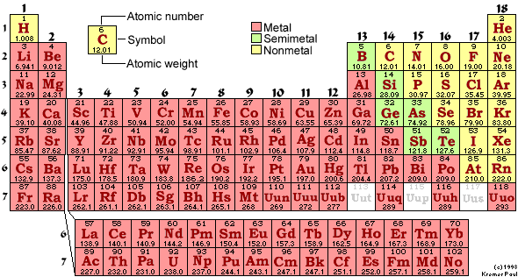
Interpretation of MS
All ions have a certain weight determined by what they are made of
Weights are given by periodic table
What would the weight of CCl₄ be?
C₈H₁₈?
C₆H₁₂O₆?

Slide 8
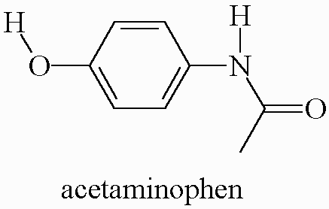
Organic Structures/ MS Interpretation
What is the molecular weight of acetaminophen?
Notes:
MW = 151g/mol

Slide 9
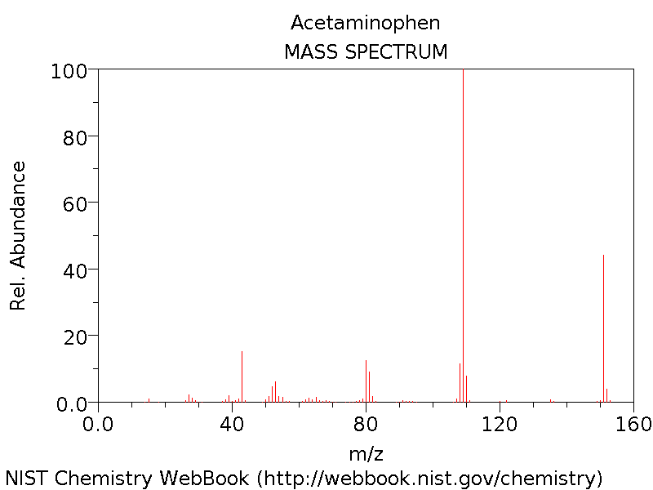

Slide 10
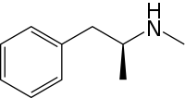
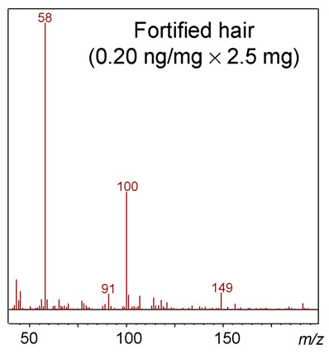
Example
Given the structure of methamphetamine shown here, which part of the MS is due to unbroken apart meth? How do you know?

Slide 11
Drug Toxicology
Meth video

