Slide 1
Forensic Applications of Geology

Slide 2
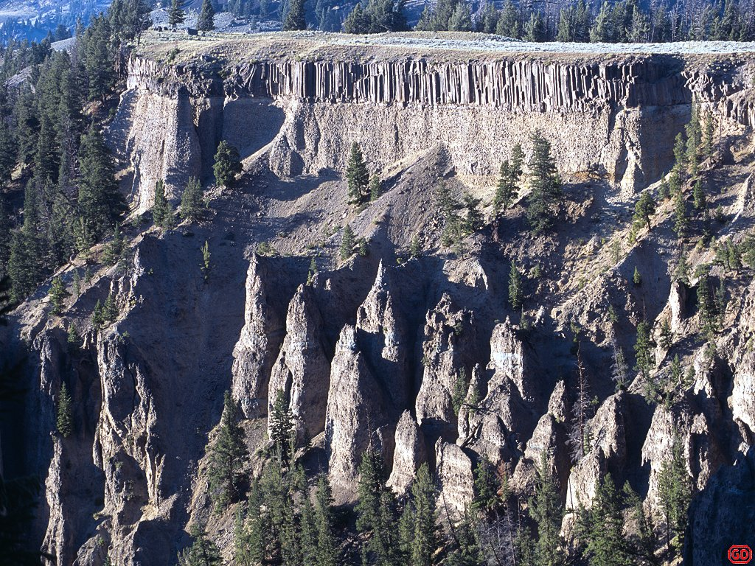
Overview
Large scale
Forensic geophysics
Geomorphology
Remote sensing
Forensic anthropology
Forensic seismology
Small scale
Forensic mineralogy
Geochemistry
Soil characterization

Slide 3
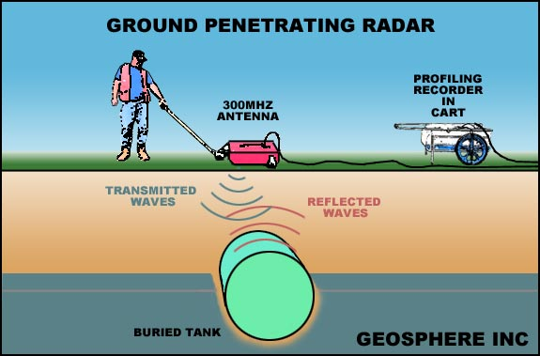
Large Scale Applications of Geology
Ground Penetrating Radar (GPR)
Notes:
Explain picture and how it works Main tool of forensic geophysicist
Has been used forensically in unearthing historic mass burials and very importantly in plastic landmine detection systems could also be potentially applicable to finding a body underwater, property in water or a 55 gallon drum 9in freshwater or soik only)

Slide 4
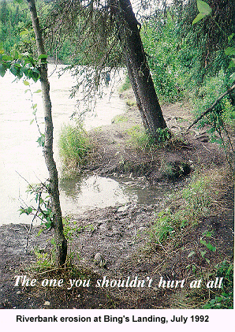
Geomorphology
Definition: The study of the arrangement and form of the Earth's crust and of the relationship between these physical features and the geologic structures beneath
Notes:
Definition: The study of the arrangement and form of the Earth's crust and of the relationship between these physical features and the geologic structures beneath
Examples of litigation related to river boundary disputes, causes of bank erosion, and the effect of diversions on channel morphology are provided by
Ask them, how do you think this could be used forensically?
Answer: Just looking at how the surface has been disturbed may lead an investigator to tell whether something might be buried or the location might have been the location of a crime scene

Slide 5
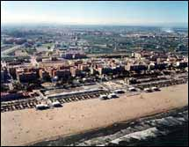
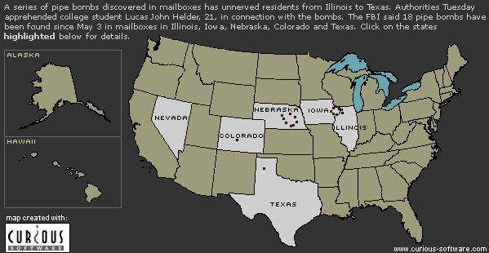
Remote sensing
Gives comprehensive overview of crime scene
Non-intrusive
Used to monitor covert release of industrial waste
Monitor water currents in order to predict where bodies, toxic waste, or munitions may be
Notes:
Explain figures
This is what you are doing in lab this week

Slide 6
Geographic Information Systems (GIS)
http://www.nlectc.org/videos/justnet.html
http://www.viddler.com/explore/esri/videos/44/
GIS and law enforcement video
Allows prediction of crime and thus better allocation of resources
Has even led to crime solving

Slide 7
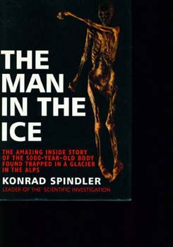
Forensic Anthropology
Study of buried or hidden animal or human remains
Man in the Ice discovered on the Austrian/ Italian border

Slide 8
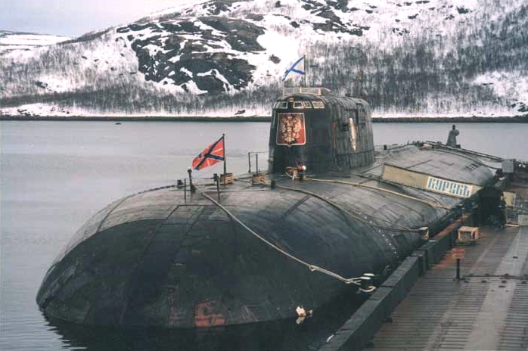
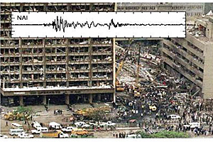
Forensic Seismology
The study of earthquakes and of the structure of the Earth by natural and artificial seismic waves
Notes:
Used primarily for remote monitoring of underground nuclear testing by China, the former Soviet Union, and the U.S. on each other
Also used to understand what happened in 2 recent events
August 10, 2000 the Russian submarine Kursk sunk in the Baltic. It was detected by seismology as two events, the first was smaller than the second. This proved that there was no collision or impact.
Underground shockwaves detected at the UK Government's seismic monitoring station, Blacknest, confirm the submarine was rocked by two explosions.
Experts believe the first, smaller blast may have been caused by the leak of hydrogen peroxide (HTP), a colourless, odourless liquid used to propel the Kursk's torpedoes.
A fireball spreading to the front compartment of the submarine could have detonated stacks of stored torpedoes, sparking the second, massive explosion that flooded the Kursk with water.
More recently, Wallace and Koper collaborated with Dirk Hollnack of the University of Nairobi in a seismic analysis of the Aug. 7, 1998, truck-bomb blast at the American Embassy in Nairobi, Kenya. The bomb seriously damaged a dozen buildings, injuring more than 4,000 people, 220 fatally. The Nairobi attack was recorded by a broadband seismometer operated by the geology department of the University of Nairobi at a site 3 kilometers (less than 2 miles) northwest of the blast. This seismic station was the only station that recorded the embassy attack, but Wallace, Koper and Hollnack used its high-quality data in an analysis that found precisely when the explosion occurred, at 10:39:19.8 local time -- plus or minus two-tenths of a second, and the size of the bomb. The Nairobi bomb was deadly but fairly small, equivalent to 3 metric tonnes of TNT.

Slide 9
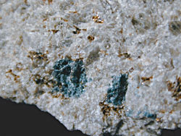
Forensic Mineralogy
Can be useful in forensic investigations
Case of Becky O’Connell in Sioux Falls, SD 1990
Discovery of gahnite at crime scene & suspect’s truck was key to conviction on 1st degree murder
Notes:
Forensic geologist saw truly unusual grains of a blue mineral The geologist thought they were either blue diamond or gahnite, diamond was excluded. Gahnite is a rare mineral and a search showed that it had never been reported in SD. Where did it come from? During the Ice Age perhaps glaciers carried a decomposing cobble, or fragment of a rock containing this mineral from Canada south to the spot where Becky’s body was found. Whatever its origin, the presence of gahnite in both samples tied the suspect to the spot where Becky’s body was found and strengthened the prosecutions case against him

Slide 10
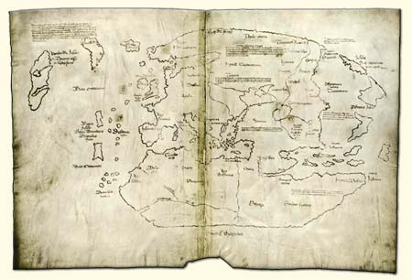
Forensic Geochemistry
The study of the chemical properties of rocks applied in forensic situations
Vinland Map
Notes:
The Vinland map is purportedly a 15th century Mappa Mundi, redrawn from a 13th century original. In addition to showing Africa, Asia and Europe, the map depicts a body of land across the Atlantic called Vinland; the map describes this region as having been visited in the 11th century. If authentic, such evidence is an important addition to archeological findings such as the L'Anse aux Meadows site, documenting pre-Columbian Norse travels to the Americas. To date it is unknown if the map is fake or authentic
Dating of parchment
There have been claims that the map is a forgery and examinations by a number of institutions, including the Smithsonian Institution, have returned conflicting results. Radiocarbon dating, performed by physicist Douglass Donahue and chemists Jacqueline Olin and Garman Harbottle, place the origin of the parchment somewhere between 1423 and 1445, although the entire map appears to have been coated with an unknown substance sometime in the 1950s. This could have been part of a previously undocumented attempt at preservation, or could have been done by a forger as part of the process of drawing a new map on a previously-used piece of 15th century parchment. It is unclear whether the ink on the map is on top of this more recent layer of material or not.[1]
[edit] Dating of ink (a Controversy)
Chemical analysis of the ink dated the map to after 1923 due to the presence of anatase (titanium dioxide) –a naturally rare compound that has been used as a synthetic pigment since the 1920s. Anatase was not manufactured before the 1920s, which suggests that the yellowing of ink on the map was faked. Although in 1992 Dr. Thomas Cahill of University of California, Davis found natural anatase in a variety of medieval manuscripts, the rounded crystals in the ink from the map were characteristic of synthetically created anatase. In July 2002, the authenticity of the map was again challenged. Using Raman spectroscopy, the drawings on the map are claimed to consist of simulated stains from the decay of an iron-based ink, although the ink itself is carbon-based and should have generated no decay stains. [2] All of the other pages of the Historia Tartorum and Speculum historiale were written using standard medieval iron-based ink. Nevertheless, chemist Jacqueline Olin, a retired researcher with the Smithsonian Institution, has concluded that the map's ink was made in medieval times.[3]

Slide 11
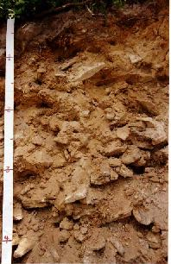
Soil Characterization
Horizons
Color, texture
Structure
Consistency
Free carbonates
pH, NPK
Bulk density
Notes:
All these things can give a composite picture of what the soil is like, both at a crime scene and on a suspect’s vehicle or person. Soil is very individualistic and will vary at locations even 10 meters apart from one another. Many cases have been solved this way for example in the murder of Lord Louis Mountbatten, a distinguished war hero, diplomat, and elder statesman of Britain’s royal family by the IRA

Slide 12
GIS Case Study
Tylenol murders
4 healthy young people dying in less than a week

Slide 13
Manner of death: natural
murder
Cause of death: poisoning by cyanide found in Tylenol
If you were the makers of Tylenol what would you do?

Slide 14
3 more deaths occurred at the beginning of October 1982 also in Chicago
Nationwide panic

Slide 15
McNeil Consumer Products/Johnson & Johnson
Inform public
Find the source of poisoning whether it had been introduced at factory or elsewhere
Someone had taken product off shelf where sold, filled with cyanide, and returned them at later time
What would you do if you were J&J?

Slide 16
Why these locations?
What clues would you follow up on for these locations?
Type of cyanide was KCN used in industries such as gold and silver plating, fertilizer production, steel plating, film processing, and chemical manufacturing

Slide 17
Suspects
48 year old amateur chemist & dockhand
James W. Lewis & wife LeAnn
Unsolved case; 1st case of terrorism in U.S.
Good: tamper resistant packaging

Slide 18
How did mapping the location of the tainted bottles help the investigation?
What other forensic techniques were used?
What else could have been helpful?

Slide 19
Forensic GIS
Tracing of DNA from a suspect back to his or her home region
A fraudulent claim for loss of income from retail stores could be checked using the geographically spread income over a wide area using GIS

Slide 20
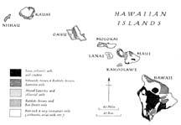

Slide 21
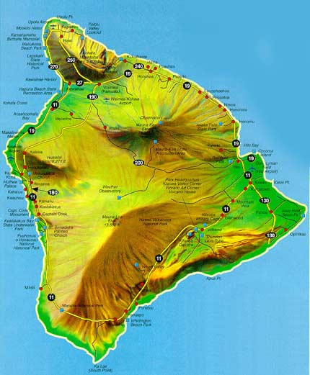
Northeastern coastal region near the city of Hilo features eroded soil abundant in microorganisms

Slide 22
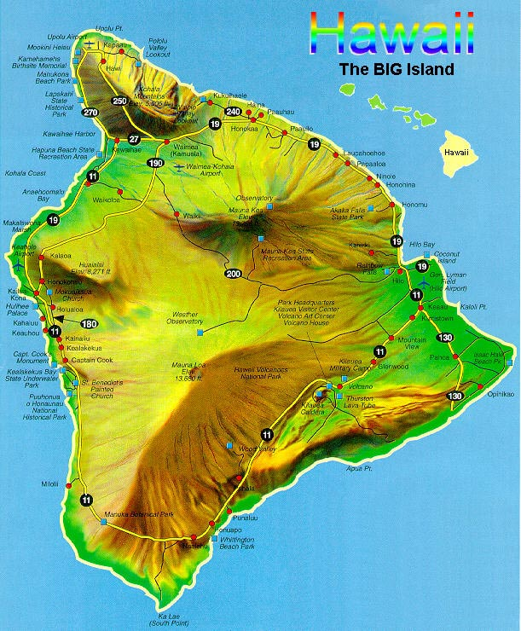
The central mountainous region where Mauna Loa resides has soil that is volcanic and free of coral and microorganisms

Slide 23
The far east coast near the city of Opinikao features soil abundant in microorganisms

Slide 24
Northeastern coastal region near the city of Hilo features eroded soil abundant in microorganisms
The central mountainous region where Mauna Loa resides has soil that is volcanic and free of coral and microorganisms
The far east coast near the city of Opinikao features coral soil abundant in microorganisms

Slide 25
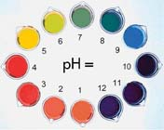
Record results from pH test demonstration on handout

Slide 26
Soil A: Found on body
Soil B: Found on body
Soil C: Found on suspect’s vehicle

