Slide 1
Gravimetric Analysis a. simple, very little equipment or training is required b. fast c. can be fairly specific
Example: A solution contains Hg²⁺. We can determine the amount of Hg²⁺ by precipitating it with a solution of Cl⁻. Assume there are no other insoluble chloride salts present. A 25.00mL solution containing Hg²⁺ was treated with excess NaCl and precipitated 0.4511g HgCl₂. What was the molarity of the Hg²⁺ originally?

Slide 2
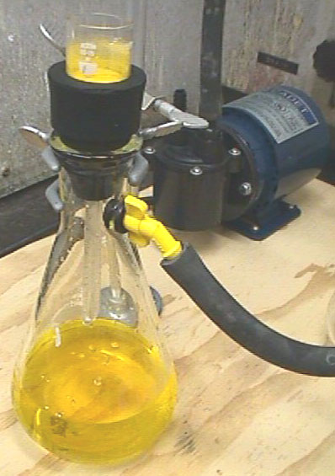
Limitations of Gravimetric Analysis
Any interferents must be removed prior to precipitation
Method is not very sensitive

Slide 3
Species analyzed | Precipitated form | Form weighed | Some interfering species
K⁺ | KB(C₆H₅)₄ |  | NH₄⁺, Ag⁺, Hg²⁺, Tl⁺, Rb⁺, Cs⁺
Mg²⁺ | Mg(NH₄)PO₄.6H₂O | Mg₂P₂O₇ | Many metals except Na⁺ and K⁺
Ca²⁺ | CaC₂O₄.H₂O | CaCO₃ or CaO | Many metals except Mg²⁺, Na⁺, or K⁺
Ba²⁺ | BaSO₄ | BaSO₄ | Na⁺, K⁺, Li⁺, Ca2+, Al3+, Cr³⁺, Fe³⁺, Sr²⁺, Pb²⁺, NO₃⁻
Ti⁴⁺ | TiO(5,7-dibromo-8-hydroxyquinoline)₂ | same | Fe³⁺, Zr⁴⁺, Cu²⁺, C₂O₄²⁻, citrate, HF
VO₄³⁻ | Hg₃VO₄ | V₂O₅ | Cl⁻, Br⁻, I⁻, SO₄²⁻, CrO₄²⁻, AsO₄³⁻, PO₄³⁻
Cr³⁺ | PbCrO₄ |  | Ag⁺, NH₄⁺
Mn²⁺ | Mn(NH₄)PO₄.H₂O | Mn₂P₂O₇ | Many metals
Fe³⁺ | Fe(HCO₂)₃ | Fe₂O₃ | Many metals
Ni²⁺ | Ni(dimethylglyoximate)₂ | same | Pd²⁺, Pt²⁺, Bi³⁺, Au³⁺

Slide 4
Example:
I have a solution of 100.0mL of a solution containing Li⁺, Pb²⁺, Na⁺, and K⁺. I want to determine the amount of Pb²⁺ is in the solution gravimetrically. The suggested procedure calls for precipitation with SO₄². Would I be able to use CO₃²⁻ instead? What potential disadvantages are associated with using Na₂CO₃ instead of Na₂SO₄?

Slide 5
Part 2 of example
The lowest reliable measurement possible with the electronic balance is 0.0010g. What is the detection limit for Pb²⁺ using SO₄²⁻ as the precipitating agent? CO₃²⁻ as the precipitating agent?

Slide 6
Characteristics of Good Gravimetric Techniques
Ideally Precipitates in a gravimetric analysis should be:
Insoluble, Ksp should be way below the amount expected in solution. Limiting factor for detection is usually the balance, not Ksp. (For larger samples, this may not be true.)
Easily filterable, make large crystals which separate from solution easily
Pure with known composition, that is, they do not make a whole bunch of insoluble complexes.

Slide 7
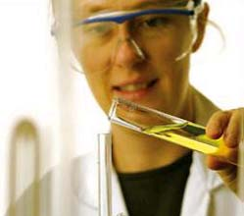
Tips for good Gravimetric Analyses
Things which can be done for best gravimetric results:
Cool solution after precipitation has started.
Add precipitating reagent slowly so crystals are larger
Keep the volume of solution large so concentration of analyte and precipitant is low.

Slide 8
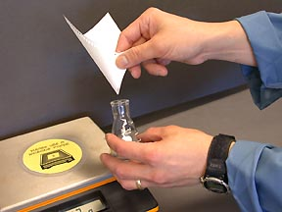
Laboratory procedures
Transfer of solids
Single chunk handle with tweezers
Powdered transfer washings with at least 3 times with solvent
Weighing bottles: tight fitting ground glass joints prevents contamination or loss of sample. When handling ground glass joints use either paper or tongs
Handling precipitates Solution is precipitated

Slide 9
Laboratory Technique Considerations
1. Filters
Paper is very hydroscopic, hard to get reliable tare weight
GFF made from glass fibers less hydroscopic but should still be kept in desicator. Very fine pores, different pore sizes available.
Sintered glass fibers cannot be heated to high temperatures
2. Transferring
decant: Pour majority of supernatant through without disturbing precipitate.
Wash precipitate: decant wash solution.
3. Control of moisture
Moisture is ubiquitous in the laboratory, in order to control for this a dry atmosphere will have to be maintained in a reproducibly dry atmosphere by storage in a desicator or evaporation or ignition

Slide 10
Laboratory Considerations continued
4. Drying: Occurs by putting an open weighing bottle (may be covered with a watch glass) at a temperature slightly above 100oC to get rid of water or waters of hydration.
5. Weighing to constant weight means with +0.1mg
Requires more than one weighing!!!
6. Desicators
Objects cannot be weighed when hot or warm. But if you were to take a sample out and wait for it to cool it would pick up moisture like that so put it in a desicator. Don’t seal descicator, creates a vacuum Desicant blue dry pink wet

Slide 11
Common Desiccants
Mechanism of Action
Hydration | ANHYDRONE® (Magnesium Perchlorate anhydrous), CaCl2, MgO, MgSO4, K2CO3, KOH, Drierite, Na2SO4 (anhydrous), H2SO4, ZnCl2
Absorption and/ or Adsorption | BaO, CaSO4, Molecular Sieve, H3PO4, NaOH Pellets
Chemisorption | CaO, P2O5

Slide 12
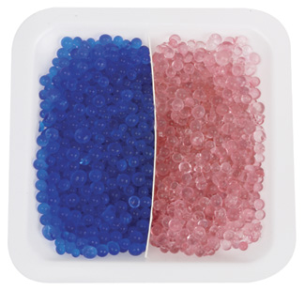
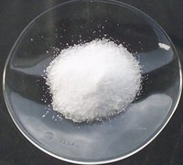
Silica gel goes from blue to pink as it absorbs moisture Can be regenerated in oven
Anhydrous sodium sulfate gets clumpy as it absorbs water
More Information about desiccants including common interferents and regeneration temperature can be found at:
http://www.jtbaker.com/techlib/documents/3045.html

Slide 13
Further laboratory considerations
7. Evaporating: Evaporating dishes allow rapid evaporation but also are easy to tip otherwise cause loss of analyte. Glass beads may be added to avoid bumping and loss of analyte.
8) Ignition: Hotter temperature for elimination of water or other reactant
Muffle furnaces that go up to 1100ºC are used primarily for this Need to use porcelain crucible.

Slide 14
Example
A raw sewage sample was brought in for total suspended solids and volatile solids analysis. A portion of the sample was poured into a tared evaporating dish and weighed. The sample was then heated at 105ºC for 4 hours, weighed, heated at 550ºC overnight, and weighed again. The data are as follows:
Tare wt. 42.9073g
Wet sample 104.4680g
105 wt. 45.4140g
550 wt. 43.3236g
What is the TSS in g/L? What percent of the solids are volatile?

Slide 15
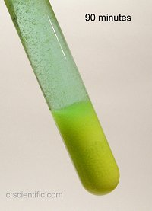
Why are we concerned about solubility considerations when doing gravimetric analysis?
Precipitate must be insoluble so that greater than 99.99% of analyte present in solution precipitates in order for gravimetric analysis to be considered quantitative
Solubility losses (to solution) can be minimized by carefully controlling the composition of the solution in which the precipitate forms. This requires understanding the relevant equilibrium reactions affecting the precipitates solubility.

Slide 16
Solubility can be affected by pH
Where is the solubility of CaCO3 expected to be the least?
Be quantitative

Slide 17
Example
For what pH range will PbCrO4 have its least solubility?

Slide 18
Application of Gravimetric Analysis
A 0.3516g sample of a commercial phosphate detergent was ignited at red heat to destroy the organic matter. The residue was then taken up in hot HCl, which converts the P to H₃PO₄. The PO₄ was precipitated out as MgNH₄PO₄.6H₂O by addition of Mg²⁺ followed by aqueous NH₃. After being filtered and washed, the ppt. was converted to MgP₂O₇ (MW = 222.57g/mol) by ignition at 1000ºC. The residue weighed 0.2161g. Calculate the % P in the sample.

Slide 19
Another example
Long ago a workman at a dye factory fell into a vat containing hot concentrated H₂SO₄ and HNO₃. He dissolved completely. Because no one witnessed the accident, it was necessary to prove that he fell in so his wife could collect the insurance money. The man weighed 70kg. A human body contains 6.3ppt(housand) P. The acid vat was analyzed for P to see if it contained a dissolved human.
A. The vat had 8.00 x 10³L of liquid and 100.0mL was analyzed. If the man fell into the vat, what is the expected quantity of P in the vat?
B. The 100.0mL was treated with a molybdate reagent that caused (NH₄)₂[P(Mo₁₂O₄₀)].12H₂O to precipitate. This substance was dried at 110ºC to remove water of hydration and heated to 400ºC until it reached a constant composition corresponding to the formula P₂O₅.24MoO₃ which weighed 0.3718g. The same acid without a person dissolved in it and treated in an identical manner had a weight of 0.00331g. How much P was present in the 100.0mL sample? Is this consistent with a dissolved man?

