Slide 1
Spectroscopy
Utilizes the various regions of the electromagnetic spectrum to detect signal

Slide 2
Different regions
UV results from changes in bonding e- UV spectroscopy
γ rays result from nuclear transitions Scintillation counting, γ ray emission, radioactive assays, and DNA fingerprinting
X-rays result from inner e- transitions x-ray powder diffraction
Visible also from bonding e- transitions visible spectroscopy
Visible also from bonding e- transitions visible spectroscopy

Slide 3
Different Regions
IR results from vibration and rotation of molecules IR and Raman spectroscopy
Radio results from spin of nuclei in magnetic field NMR
Microwave results from rotation of molecules microwave absorption and e- spin resonance

Slide 4
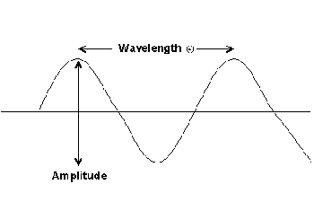
Frequency: # of oscillations to the field per second
Wavelength: Distance between any 2 equal points on wave
Wavenumber: 1/λ = n

Slide 5
Transmittance:
T = P/Po
Where: Po = initial power of beam
P = power of beam passing through sample
%T = P/Po x 100
A = -logT
A = εbc
The thicker the glass the darker the brew, the less the light that shines through

