Slide 1
Complex Equilibria

Slide 2
General Approach to solving complex equilibria
Write all the pertinent reactions
Write the charge balance
Write the mass balance
Write the equilibrium constants for each reaction
Count equations and unknowns
Solve

Slide 3
Charge Balance: sum of all the positive charges must equal all negative charges
Write a charge balance for a solution containing H⁺, OH⁻, Ca^{2+,} HCO₃⁻, CO₃²⁻, Ca(HCO₃)⁺, CaOH⁺, K⁺, ClO₄⁻

Slide 4
Mass balance: sum of the amount of all species in a solution containing a particular atom must equal the amount of that atom delivered to the solution
The mass balance for a solution containing 0.0250 moles of H₃PO₄ in 1.0 liter is:

Slide 5
Complex equilibria: Example 1
Determine the concentration of [H⁺] and [OH⁻] in pure water

Slide 6
Complex equilibria example 2
What would the Ca²⁺ in water be in a saturated solution of CaCO₃ at pH=4? Ignore the contribution of CO₂ from the atmosphere.
Relevant equilibria:
CaCO₃ ==== Ca²⁺ + CO₃²⁻
H₂O ==== H⁺ + OH⁻
CO₃²⁻ + H⁺ ==== HCO₃⁻
HCO₃⁻ + H⁺ ==== H₂CO₃

Slide 7
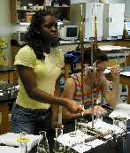
Titrations
Standard reagent is added to a solution containing analyte until the reaction between the analyte and the reagent is judged to be complete

Slide 8
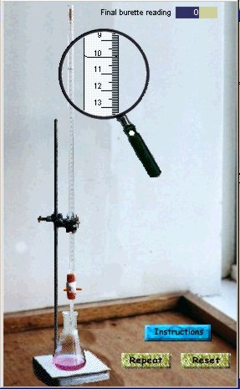
Types of Titrations
Volumetric: standard reagent is measured volumetrically
Gravimetric: mass of standard reagent is measured
Coloumetric: Quantity of charge in coloumbs to complete a reaction is measured

Slide 9
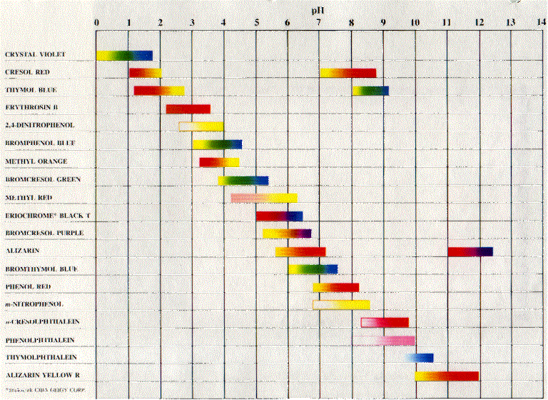
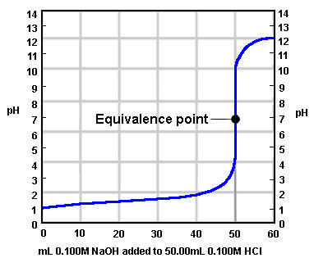
Endpoint detection: example of NaOH + HCl
Phenophalein
Indicator error

Slide 10
Methods of endpoint detection
1. Color change
2. Voltmeters including pH meters
3. Refractometers
4. turbidometers
5. even thermometers
Goal in a titration is to determine the amount of analyte

Slide 11
Primary Standards
Is a highly purified compound that serves as a reference material in all volumetric and titrimetric methods. It must be:
1) Highly pure, established methods for confirming purity should be available.
2) Stable toward air
3) Absence of hydrates of water so that the composition of the solid does not change with variations in relative humidity

Slide 12
Primary standards continued
4) Readily available at reasonable cost.
5) Reasonably soluble in titration medium.
6) Reasonably large molar mass so that the relative error associated with weighing the standard is minimized.
Examples?
KHP, AgNO3

Slide 13
Secondary standards
Hard to find primary standards therefore secondary standards are often used.
Secondary standard is a compound whose purity has been established by chemical analysis and serves as a reference material for titrimetric methods of analysis.
Examples?
NaOH, EDTA

Slide 14
Titrations
Advantages:
Disadvantages:

Slide 15
Redox titration example
How many grams of oxalic acid should be dissolved in 500.0mL of water to make a 0.100N solution for titration with MnO₄⁻?

Slide 16
Redox Review
LEO the Lion says GER

Slide 17
Redox titration example
How many grams of oxalic acid should be dissolved in 500.0mL of water to make a 0.100N solution for titration with MnO₄⁻?

Slide 18
Coloumetric Titration
Cyclohexene is titrated with Br₂ that has been electrolytically oxidized from Br⁻. If it requires 595.1 sec to complete the titration with a current of 4.825mA, how much cyclohexene was there in the sample?

