Slide 1
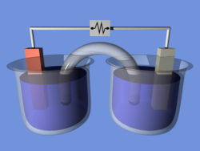
Electrochemistry Review
Predict the voltage that will be measured when activities are 1.0
Predict the voltage when [ZnSO₄] is 0.010M
What is the cathode and what is the anode?
Is this an electrolytic or galvanic cell?
Useful info:
Zn²⁺ + 2e⁻ →Zn(s) -0.763V
Cu²⁺ + 2e⁻ → Cu(s) +0.337V
Zn
Cu
0.2M CuSO₄
1M ZnSO₄
Represent the above electrochemical cell in standard notation
What species is being oxidized in each cell? Reduced?

Slide 2
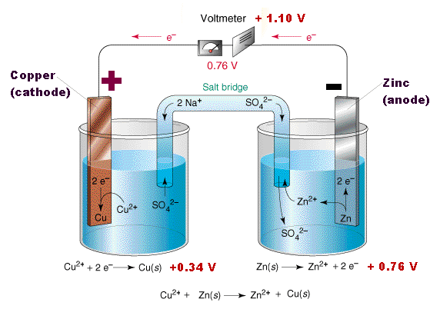
Demonstration The Human salt bridge
Zn(s) + Cu²⁺ → Zn²⁺ + Cu(s)
What is the purpose of a salt bridge?

Slide 3
Electrochemistry
H₂ electrode reference electrode
Defined as 0.00V at all temperatures
Solid calomel electrode also used as reference but its potential is 0.2444V relative to H₂
By convention: Electrode potentials are written as reduction potentials

Slide 4
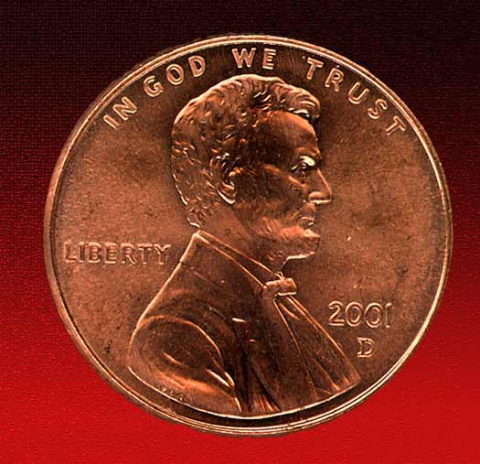
Example
A Cu penny can be dissolved in nitric acid but not in hydrochloric acid. Using reduction potentials from the book, show why this is so. What are the products or expected products of each reaction?

Slide 5
Ion Selective Electrodes
Notes:
Historically this was the method of choice in the late 1970s and 1980s today ISE still have many applications, the most famous of which is the pH meter
Pollution Monitoring: CN, F, S, Cl, NO3 etc., in effluents, and natural waters.
Agriculture: NO3, Cl, NH4, K, Ca, I, CN in soils, plant material, fertilisers and feedstuffs.
Food Processing: NO3, NO2 in meat preservatives.
Salt content of meat, fish, dairy products, fruit juices, brewing solutions.
F in drinking water and other drinks.
Ca in dairy products and beer.
K in fruit juices and wine making.
Corrosive effect of NO3 in canned foods.
Detergent Manufacture: Ca, Ba, F for studying effects on water quality.
Paper Manufacture: S and Cl in pulping and recovery-cycle liquors.
Explosives: F, Cl, NO3 in explosive materials and combustion products.
Electroplating: F and Cl in etching baths; S in anodising baths.
Biomedical Laboratories: Ca, K, Cl in body fluids (blood, plasma, serum, sweat).
F in skeletal and dental studies.
Education and Research: Wide range of applications.

Slide 6
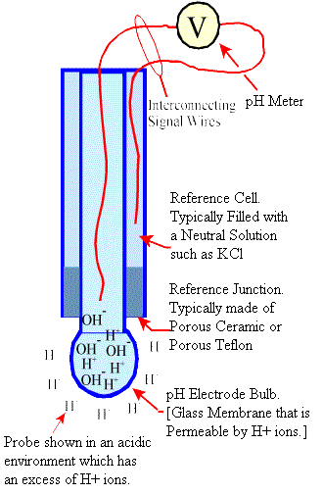
pH electrodes
In solution to be measured, external ions diffuse through membrane until equilbrium is achieved, creates a build up of charge proportional to #H+ in external solution
Millivolt meter measures this potential difference
Notes:
The most essential component of a pH electrode is a special, sensitive glass membrane which permits the passage of hydrogen ions, but no other ionic species. When the electrode is immersed in a test solution containing hydrogen ions the external ions diffuse through the membrane until an equilibrium is reached between the external and internal concentrations. Thus there is a build up of charge on the inside of the membrane which is proportional to the number of hydrogen ions in the external solution.

Slide 7
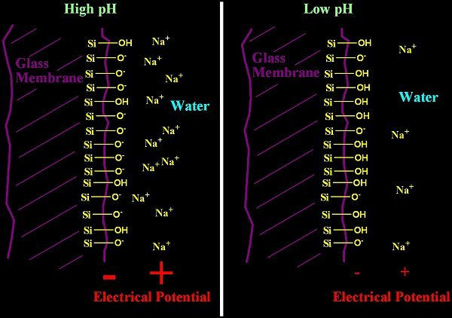

Slide 8
pH electrodes
Reference electrodes
Must be in contact with ISE
Allows balancing of charge
E = E⁰ + (2.303RT/ nF) x Log(A)
Notes:
In order to measure the electrode potential developed at the ion-selective membrane the ISE/pH electrode must be immersed in the test solution together with a separate reference system and the two must be connected via a millivolt measuring system. At equilibrium, the electrons added or removed from the solution by the ISE membrane (depending on whether it is cation or anion sensitive) are balanced by an equal and opposite charge at the reference interface. This causes a positive or negative deviation from the original stable reference voltage which is registered on the external measuring system.
Note that 2.303RT/nF is the Slope of the line (from the straight line plot of E versus log(A) which is the basis of ISE calibration graphs) and this is an important diagnostic characteristic of the electrode - generally the slope gets lower as the electrode gets old or contaminated, and the lower the slope the higher the errors on the sample measurements.

Slide 9
Differences between pH electrodes and other ISE
1.
2.
3.
4.
5.
6.
Notes:
CN, F, S, Cl, NO3 NH4, K, Ca, I,
b) Differences Between pH and Other Ion-Selective Electrodes
i) In contrast to the pH membrane, other ion-selective membranes are not entirely ion-specific and can permit the passage of some of the other ions which may be present in the test solution, thus causing the problem of ionic interference.
ii) Most ISEs have a much lower linear range and higher detection limit than the pH electrode. Many show a curved calibration line in the region 10-5 to 10-7 moles/l and very few can be used to determine concentrations below 1x10-7 moles/l. Thus, for low concentration samples, it may be necessary to construct a calibration graph with several points in order to define the slope more precisely in the non-linear range.
iii) The calculation of ionic concentration is far more dependent on a precise measurement of the potential difference than is the pH, because the pH depends on the order of magnitude of the concentration rather than the precise value. For example it would take an error of more than 5 millivolts to cause a change of 0.1 pH units, but only a 1 millivolt error will cause at least a 4% error in the calculated concentration of a mono-valent ion and more than 8% for a di-valent ion. This is because the theoretical value for the slope at 25°C is 59.2 for mono-valent ions and 29.6 for di-valent ions. In practical application, however these slopes can vary considerably because of variations in temperature, deviations from "ideal" behaviour, and minor impurities or contamination of the ion-selective membrane, or if samples are measured near the detection limit of the electrode, in the non-linear range. The critical factor is not so much the actual value of the slope but that this should be as high as possible and remain constant over the range of concentrations and the time period required for the analyses. Thus, when measuring other ion concentrations, it is essential to take extra precautions to minimise any errors in the measurement of the electrode potential.
iv) For ion concentration measurements, steps must be taken to minimise the effect of the Ionic Strength of the sample. This is because pH is defined as the log of the Activity of the ion (which is measured directly by any ISE) but most measurements of other ions require the actual concentration, which can differ significantly from activity in samples with complex matrices and high Ionic Strength.
v) It is more usual to plot a calibration graph using the ionic concentration with a logarithmic scale on the X-axis rather than the pX factor (analogous to pH) on a linear axis.
vi) Some ISEs will only work effectively over a narrow pH range.

Slide 10
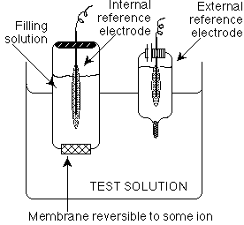
Schematic Diagram of ISE

Slide 11
Capillary Electrophoresis a.k.a. CE, CZE, HPCE
Separation is based on differences in solute mobilities when a strong electric field is applied across a buffer

Slide 12
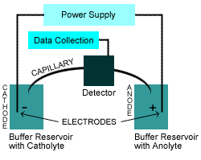

Slide 13
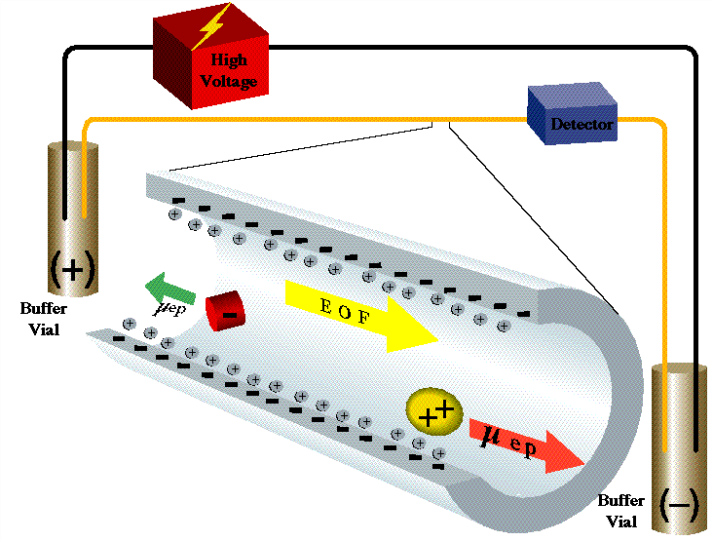
Advantages (Vs. HPLC)
1.
2.
3.
4.
5.
Notes:
Advantages:
Higher efficiency
2. Short analysis time
3. Simple apparatus
4. Small sample and separation buffer
5. Selectivity in CE is easily altered through different buffer additives
HOW IT WORKS: (Picture)
Electroosmotic flow (EOF): Movement of separation buffer through the capillary as a result of the potential at the solvent, silica interface Interface is negatively charged as a result of the deprotonation of the silanol groups therefore attracts cations from separation buffer to form an electric double layer. Upon application of an electric field cations in outer portion flow toward cathode they are highly solvated so they transport bulk liquids in same direction.

Slide 14
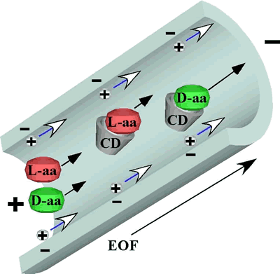
Velocity of Flow can be altered by:
1.
2.
3.
4.
Notes:
Velocity of analyte traveling can be altered by: 1) adding buffer to adjust the pH &/or solution viscosity
2) Adding a radial field
3) Adding anionic surfactants
4) Adding organic solvent to separation buffer
Flow is plug like rather than parabolic!

Slide 15
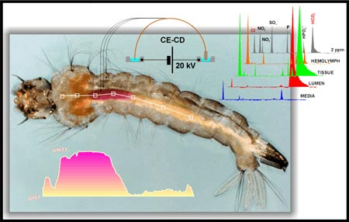
Applications
Can detect very small amounts of substances atamolar 10⁻¹⁸!
Detection of Alkylated Cellulose Derivatives in Several Archaeological Linen Textile Samples by CE/MS
Identification of Proteins in Single-Cell CE Fingerprints Based on Comigration with Standard Proteins
Postelectrophoresis Capillary Scanning Method for DNA Sequencing
Extraction of Rutin from Buckwheat (Fagopyrum esculentum Moench) Seeds and Determination by CE

