Slide 1
Radiation Chapter 21

Slide 2
Radiation
Background radiation: radiation we are exposed to all our lives
Most background radiation is naturally occurring arising from:
Sun & outer space Cosmic radiation
Cosmogenic radiation: comes from radioactive isotopes in atmosphere
Primordial radionucleotides: radioactive elements that have always been present in earth

Slide 3
Radioactivity
There are 114 or so elements & 340 isotopes of all the elements, only about 70 are radioactive
All isotopes with atomic numbers greater than 83 are radioactive
Most are not significant contributors to our overall radiation dose because of their low abundance

Slide 4
What makes something radioactive?
The nucleus of an atom contains protons and neutrons
They are packed together with a lot of repulsive charge
Opposites attract, same charges repel
If atom has too many neutrons, beta emission occurs
²³⁵₉₂U → ⁰₋₁e + ²³⁵₉₃Np
If atom has too few neutrons, positron emission occurs

Slide 5
Types of Radiation
Alpha particles: least penetrating, can be stopped by thin pieces of paper or 2.5-8.5cm of air
Beta particles: Will be stopped by 0.5cm of lead or skin
Gamma rays: Most penetrating: Can pass through 22cm of steel or 2.5cm of lead

Slide 6
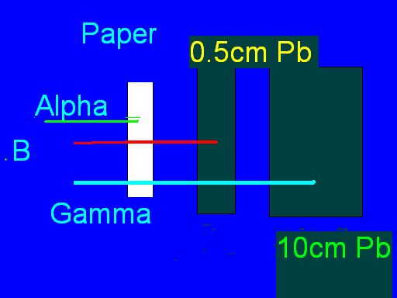
Radiation
Beta

Slide 7
Other types of radiation

Slide 8
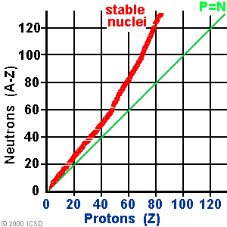
Band of Stability
Notice most elements are stable & elements possess a driving force to try to become stable

Slide 9
Radioactivity & Safety
Depends upon half life, amount of material involved, the nature of the released radiation, & total exposure to the radioactivity released.
Larger amount of material is obviously more dangerous

Slide 10
Radiation & Safety Continued
Half life → Shorter half life will emit more of its radiation over a given period of time
¹³¹I half life of 8 days
²³⁸U half life of 4.5 billion years
Type of radiation also important
α particles can be stopped by skin
β particles can be stopped by Al foil
γ rays are ultimately most dangerous, dominant problem in nuclear waste storage

Slide 11
Half lives
If you had 750 g of ¹⁴C how many grams would be remaining after 22,920 years? T_{1/2} = 5715 years

