Slide 1
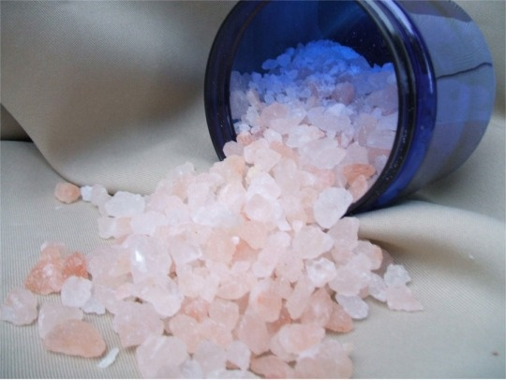
Salts
Def: Ionic compound whose cation comes from a base and whose anion comes from an acid
Ex. 1 NaCl
Ex. 2 K2CO3
Ex. 3 NH4Br

Slide 2
Reactions of salts with water - hydrolysis
Conjugate base of a weak acid (strong or weak?) will react with water to give considerable amounts of OH⁻
Conjugate acid of a weak base will react with water to give considerable amounts of H3O⁺
Examples:
KHCO₃
NH₄Cl

Slide 3
More salts
Salts made from conjugate base of weak acid will be basic
Salts made from conjugate acid of a weak base will be acidic
Salts made from cations & anions from strong acids & bases will be neutral
Salts made from cations & anions of weak acids & bases wll be acidic or basic depending upon relative Ka, Kb values

Slide 4
Structure and Acidity
For binary acids H-X
1. bond strength affects acid strength
MOST IMPORTANT
- stronger bonds are less easily dissociated than weaker bonds and will thus make weaker acids
- Example: halogens
H-F very strong bond, weak acid
Which would be stronger? HBr, HCl, or HI?

Slide 5
Binary Acids
2. Polarity of bond affects acid strength
- Polar bond where H tends to be positive will make H a proton donor
- Polar bond where H tends to be negative will make H a proton acceptor
- Non-polar bonds such as C-H produce solutions that are neither acidic nor basic

Slide 6
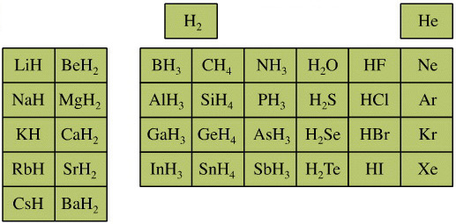
Acid strength depends on:
3. Stability of the conjugate base
- The more stable the conjugate base the stronger the acid

Slide 7
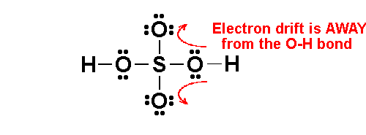
Oxyacids Structure & Acidity

Slide 8
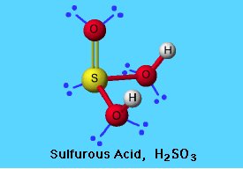
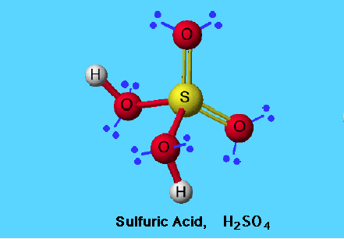
Which acid will be more acidic? Why?

Slide 9
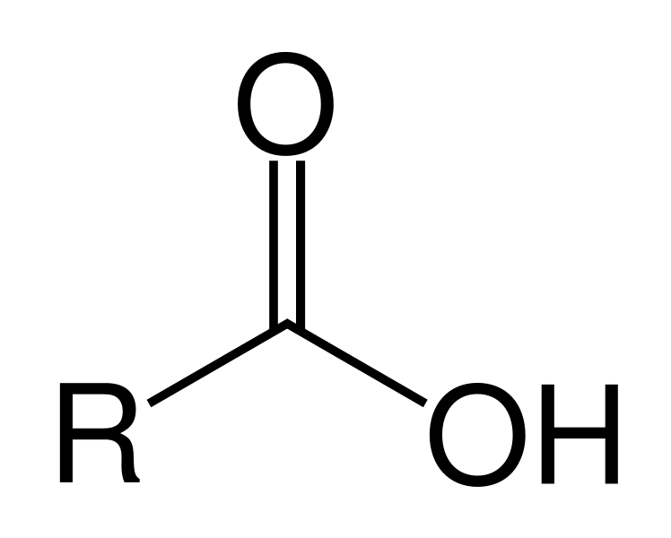
Carboxylic Acids

Slide 10
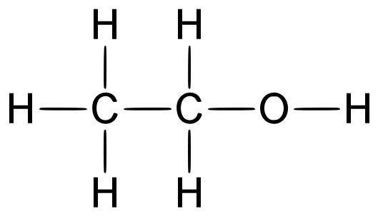
Demonstration: Structure & Acidity
Ethanol
Phenol
Based upon the structure of ethanol and phenol predict which one will be more acidic. (Which one will make the indicator turn more red?)
Notes:
Phenol red is an acid base indicator, it is red in acidic solutions and changes to yellow in more basic solutions
Thymol blue is also an acid base indicator, changing from yellow to blue with increasing pH

Slide 11
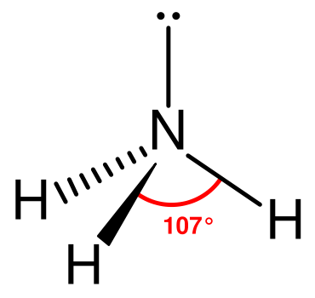
More structure & acidity
aniline
ammonia
Based upon the structure of these two molecules, which would you predict to be a stronger base? (Which one will give a deeper blue?)

