Slide 1
Cell potentials under non-standard conditions
(standard conditions 1M, 1 atm pressure)
If we have the reaction:
Cu²⁺ + Fe → Fe²⁺ + Cu Eº = 0.78V
If we increase [Cu²⁺] which direction would reaction go?
Products
Increasing Cu²⁺ increases the driving force of the reaction and will increase the cell potential
E = Eº - RTlnQ Nernst Equation
nF
Or at 298K E = Eº - .0592logQ
n

Slide 2
Example
Calculate E_{cell} for the cell diagrammed below:
Cu Cu²⁺ (0.50M) Fe³⁺ (0.20M), Fe²⁺ (0.10M) Pt

Slide 3
Ag Ag⁺ (0.0010M) Ag⁺ (0.010M) Ag
Calculate the cell potential of the concentration cell above.

Slide 4
A lead battery like that used in cars operates under non-standard conditions. Calculate the potential for the battery when the concentration of H₂SO₄ is 6.00M at 25ºC.
Pb (s) + PbO₂ (s) + H₂SO₄ → 2PbSO₄ (s) + 2H₂O

Slide 5
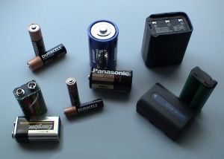
Batteries
Ideal battery should be
1) Inexpensive
2) Portable
3) Environmentally benign when discarded
4) Have long life (maintain its potential for a long period of time)

Slide 6
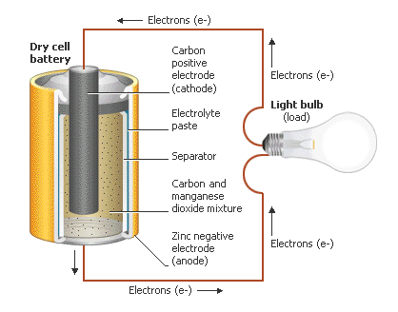
Types of Batteries Dry Cell
Strengths:
low cost
made of non-toxic materials
Weaknesses
difficult to recycle
prone to leaking
short shelf life
unstable potential and current

Slide 7
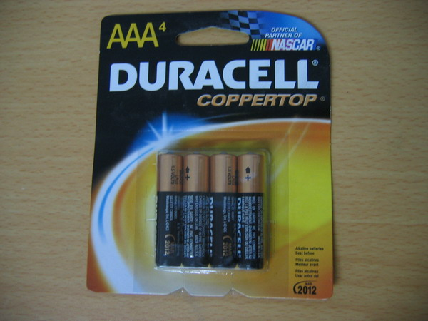
Types of Batteries Alkaline Cell
Similar to dry cell but uses basic electrolyte so it does not react with Zn when not in use
Cannot be recycled
Longer shelf life than dry cell
More $ than dry cell

Slide 8
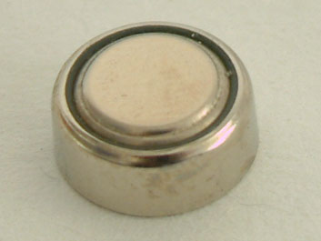
Types of Batteries Ag Cell
Cathode is made of Ag2O
1.6V
Can be very small
Great reliability over long periods of time
Good for pacemakers, hearing aids, cameras

Slide 9
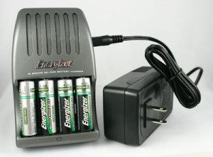
Types of Batteries Rechargeable Batteries
An external source of electricity reverses the spontaneous cell reaction, after charging the species they revert to the original concentrations allowing the battery to give off electricity again
Car batteries, NiCd (laptops, cell phones), NiMH (hybrid cars) batteries Li (cell phones, laptops)
Strengths: inexpensive, high power density, long shelf life, have 1/32 the impact on environment vs. non-rechargeable
Weaknesses: may release toxic metals to environment, some can generate H₂ @ cathode making them potentially explosive

Slide 10
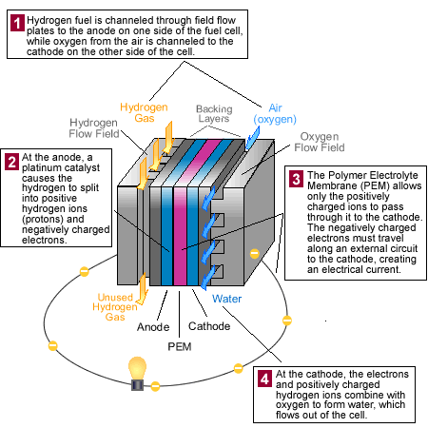
Fuel Cells
Not batteries, fuel must be continually supplied

Slide 11
Electrolysis
Recall
Galvanic cells: change chemical energy into electrical energy
Electrolytic cells: change electrical energy into chemical energy
Electrolytic cells can be used to recharge batteries, plate chrome, make Al
Because electrolytic cells require electrical energy, it is possible to figure out exactly how much electricity it takes to produce a given amount of metal electroanalytically with stoichiometry
Current and time
Quantity of charge in C
Moles of e⁻
Moles of metal
Grams of metal

Slide 12
Electrolysis example
What current is required to produce 4.0g of chromium metal from Cr(IV)oxide in 24 hours?
Current = amps = C/sec

Slide 13
2nd electrolysis example
Ultra-pure Cu and Ag can be made by electrolyzing a solution of CuCl₂ and AgCl. Which metal is cheaper to produce this way? CuCl₂ costs $27.80/ 250 grams
AgCl₂ costs $79.10/ 250 grams

