Slide 1
Introduction
Chemistry in the Environment
(Where we live)

Slide 2
Origins of the Atmosphere - Hypothesis
The Earth's primitive atmosphere was probably formed by the accretion of extraterrestrial volatile materials and by outgassing of the Earth's interior. As accretion diminished and the Earth evolved, the steamy atmosphere condensed to form oceans, leaving an atmosphere dominated by CO₂ (1 to 10 bar), CO and N₂ (1 bar). Despite a faint young Sun, the initially high concentration of CO₂ maintained surface temperatures on Earth above 0ºC by means of the greenhouse effect. The weakly reducing primitive atmosphere was favorable for the emergence of biota. Photosynthesis then increased oxygen concentrations, which, in turn, allowed ozone formation in the upper atmosphere by photochemical reactions. The shielding of the Earth's surface from dangerous solar UV radiation by ozone in the upper atmosphere permitted life to evolve onto land. At the same time, the concentrations of CO₂ (and other greenhouse gases) declined, thereby compensating for an increasingly bright Sun. The relatively stable climate of the Earth over the past 3.5 Ga, during which time the mean surface temperature has remained in the range of -5 to 50°C, is probably due to the negative feed­back between surface temperature, atmospheric CO₂, and the weathering rates of rocks.
Notes:
1 bar = 10⁵ Pa
1 atm = 1.01x105 Pa = 760 torr = 760 mmHg

Slide 3
Where is the atmosphere?

Slide 4
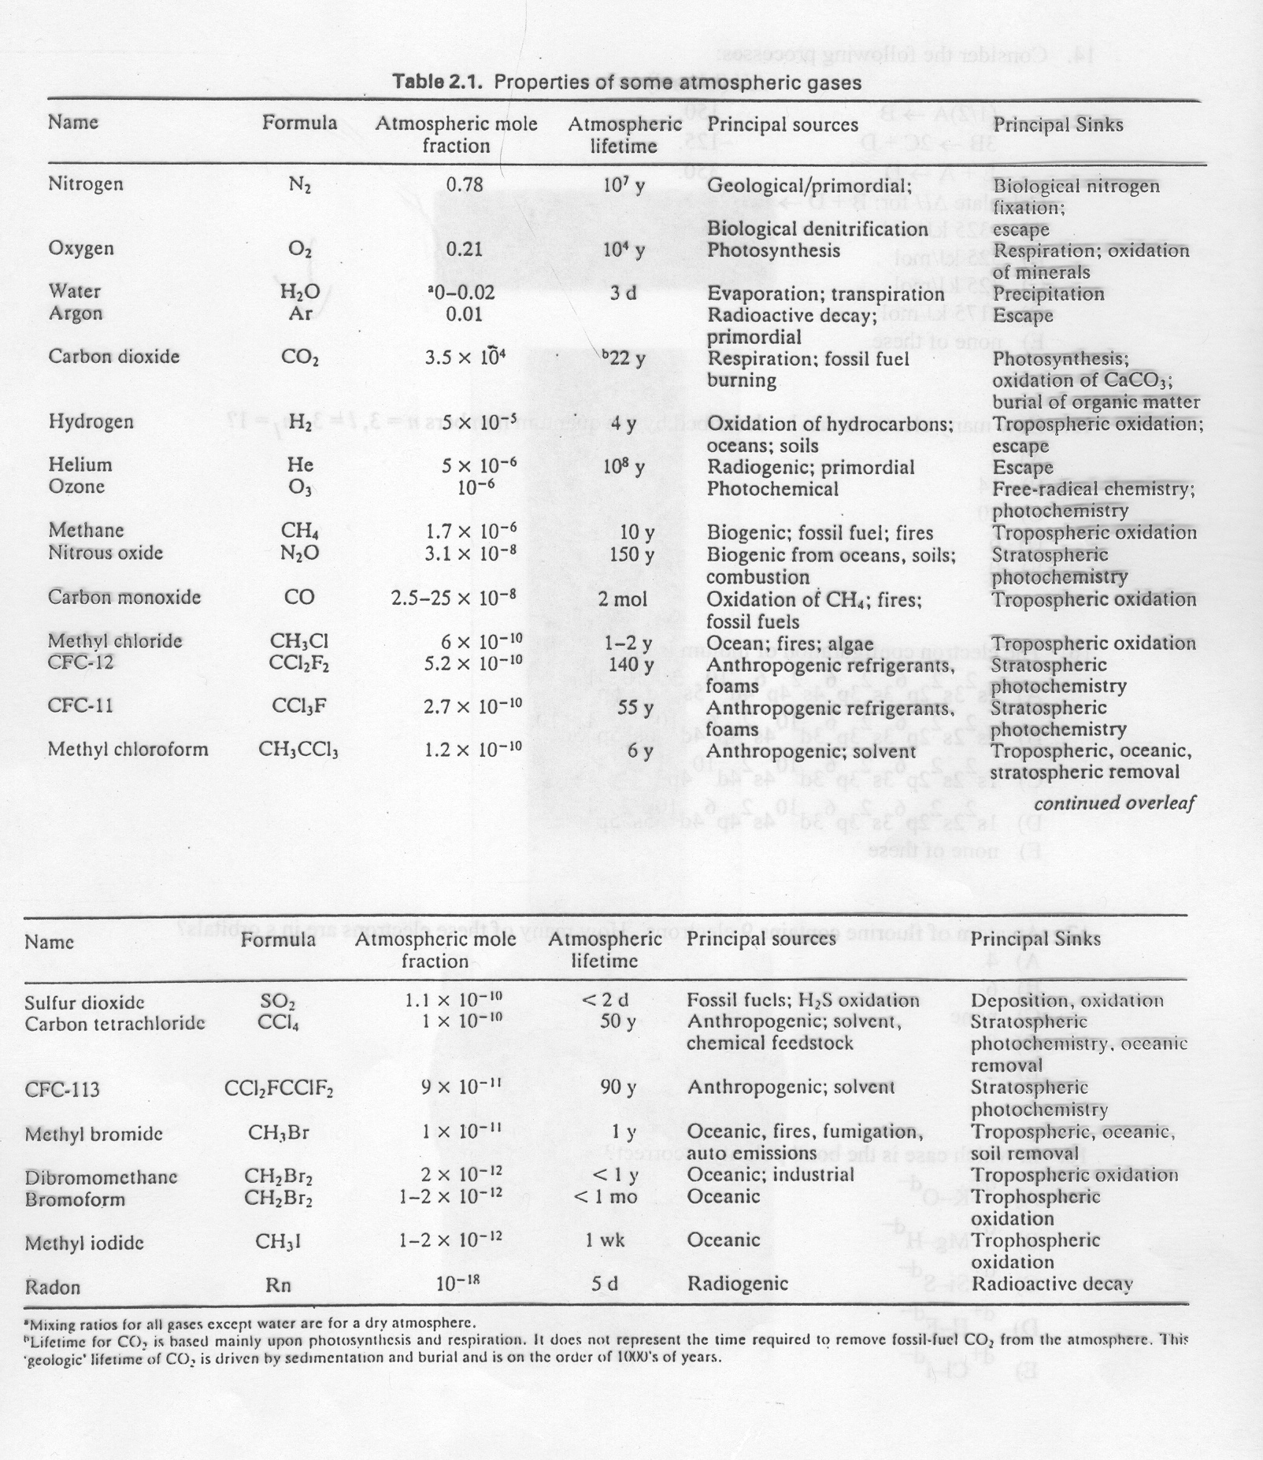
What is in the atmosphere?
Notes:
Average molar mass of atmosphere = 28.96 g/mol
P_{x} = Χ_{x}P_{atm}

Slide 5
Ozone
How did it get there and why is it still there.
Notes:
Early atm dominated by carbon dioxide
Photosynthetic process bring oxygen

Slide 6
Chemistry of the Stratosphere
The Ozone Layer

Slide 7
Notes:
High frequency (UV-C and UV-B) radiation absorbed in the upper atmosphere.
E=hv, νλ=c

Slide 8
Notes:
Pressure drops off logarithmically.
Temperature changes define atmospheric regions.

Slide 9
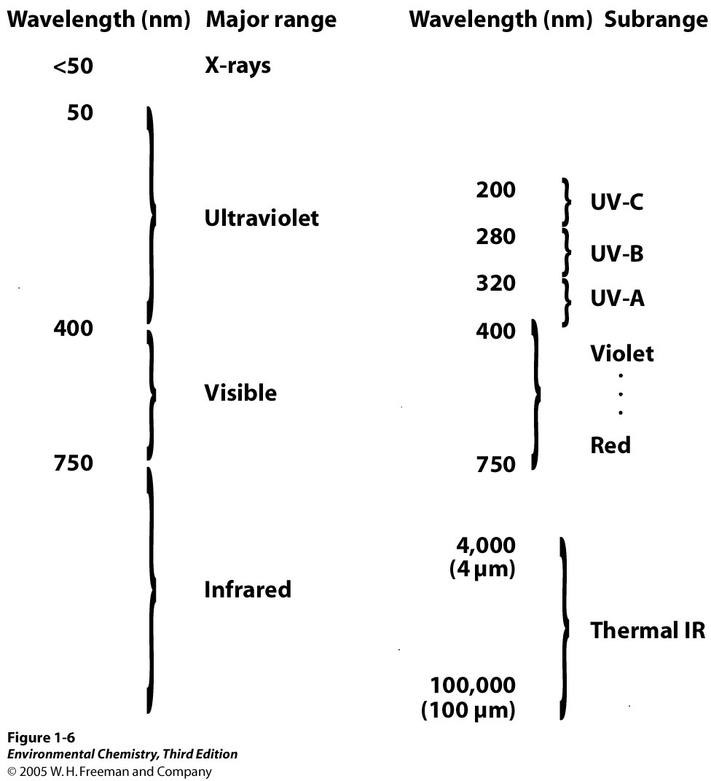
Notes:
Do problem 1-1

Slide 10
Absorption Spectrum for Oxygen
Notes:
Absorption due to electronic transition. Molecules excited to higher energy state.
Do problem 1-2

Slide 11
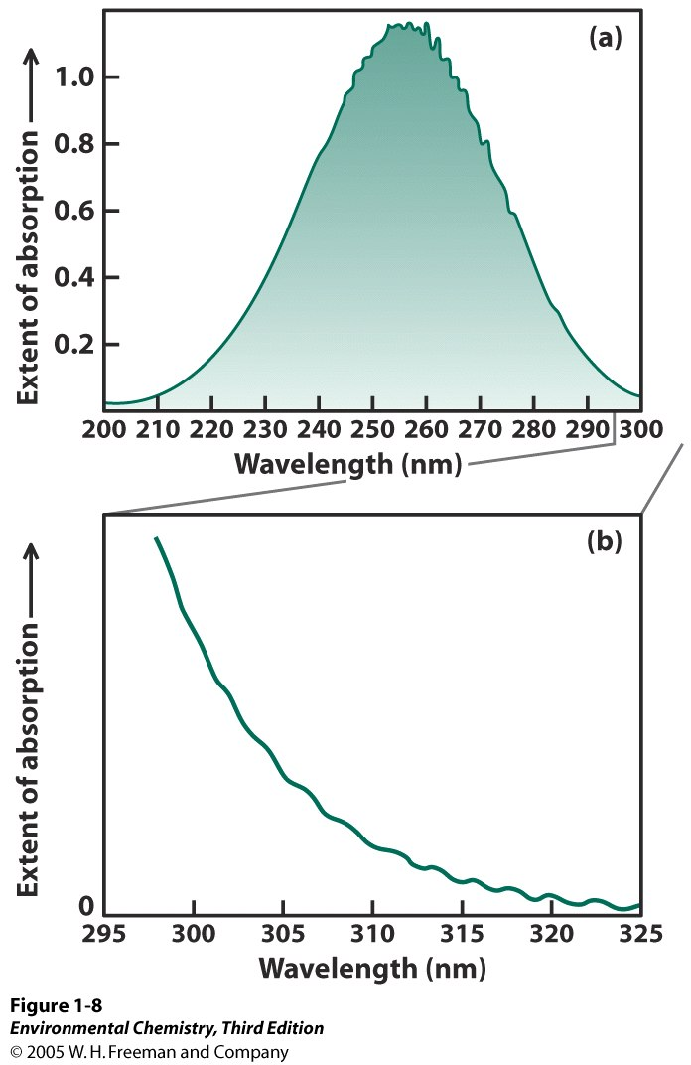
Absorption Spectrum for Ozone

Slide 12
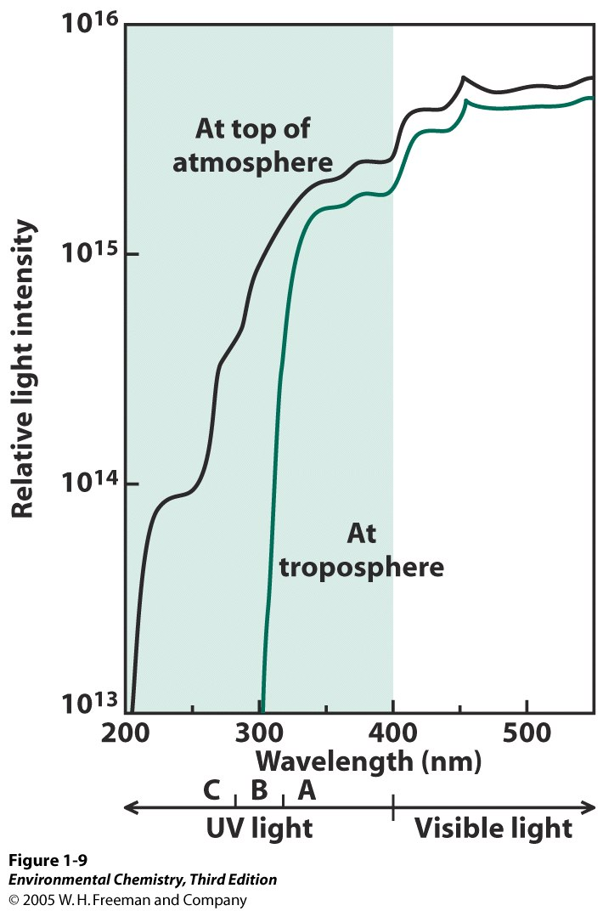

Slide 13
What is the longest wavelength of light that could dissociate ozone by this mechanism?
Does ozone absorb light of sufficient energy?
Notes:
What is the longest wavelength of light that could dissociate ozone by this mechanism? Does ozo

Slide 17
Chapter 1 – Additional Problem

Slide 18
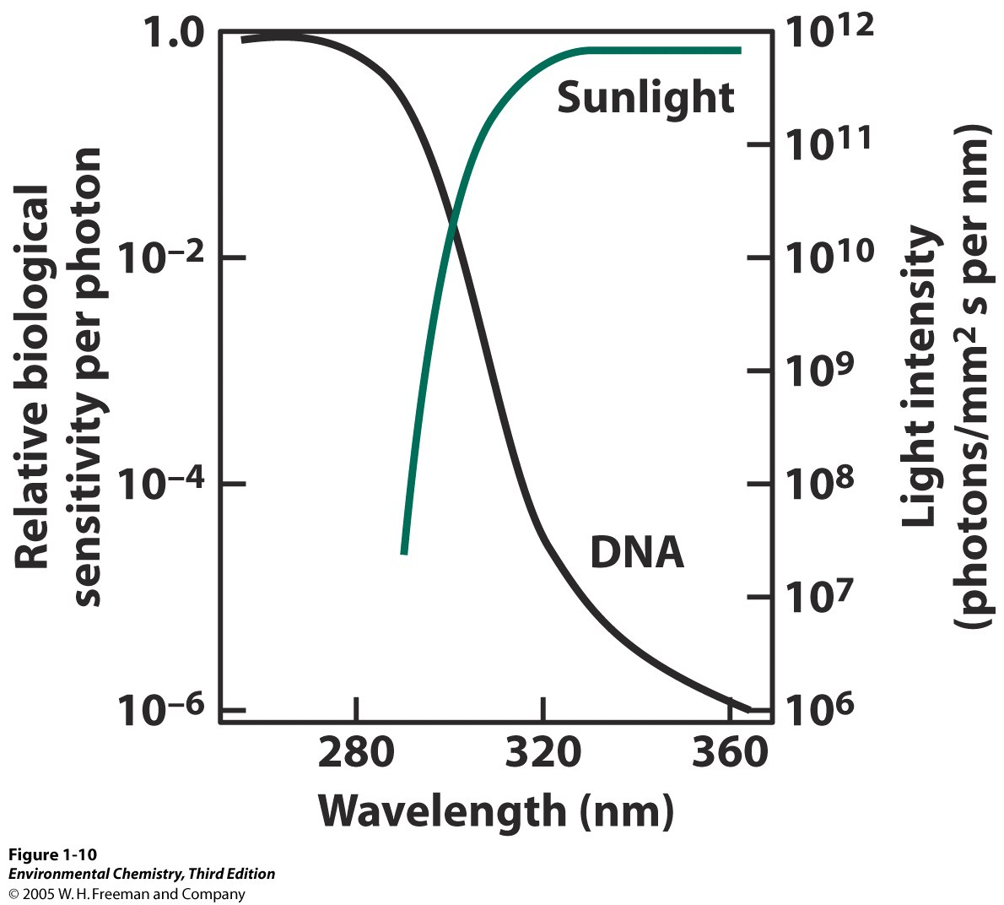

Slide 19
Skin Cancer Rates vs. UV Flux

Slide 21
Creation and Noncatalytic Destruction of Ozone

Slide 22
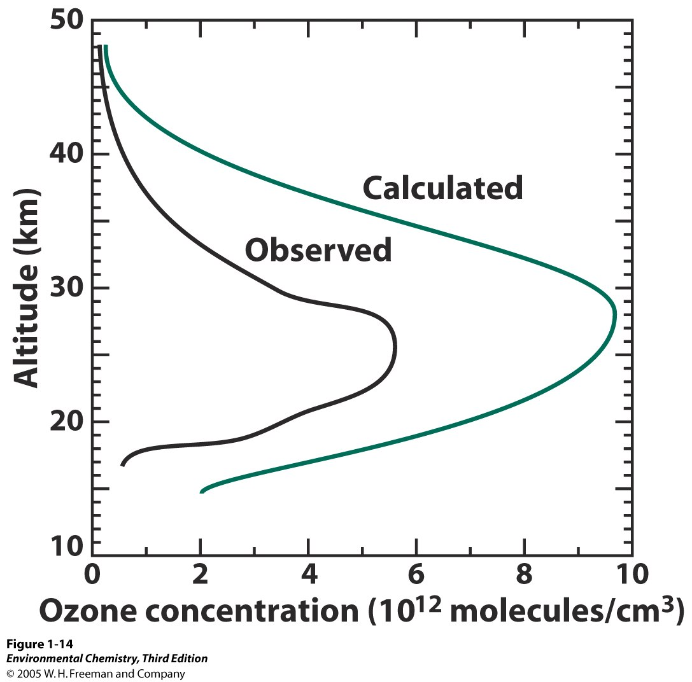

Slide 23
Calculate mole fraction of ozone at 25 km

Slide 24
Chapter 1

Slide 25
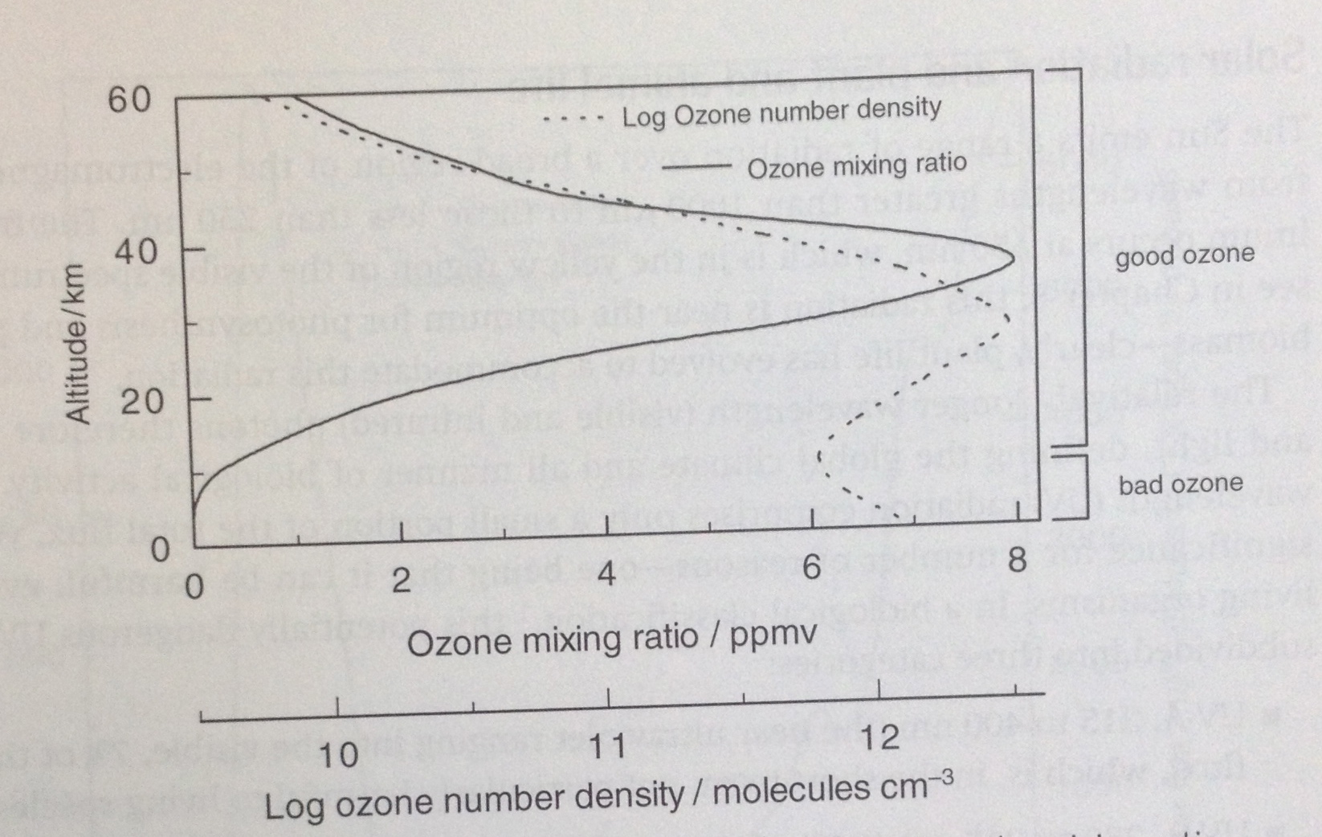

Slide 26
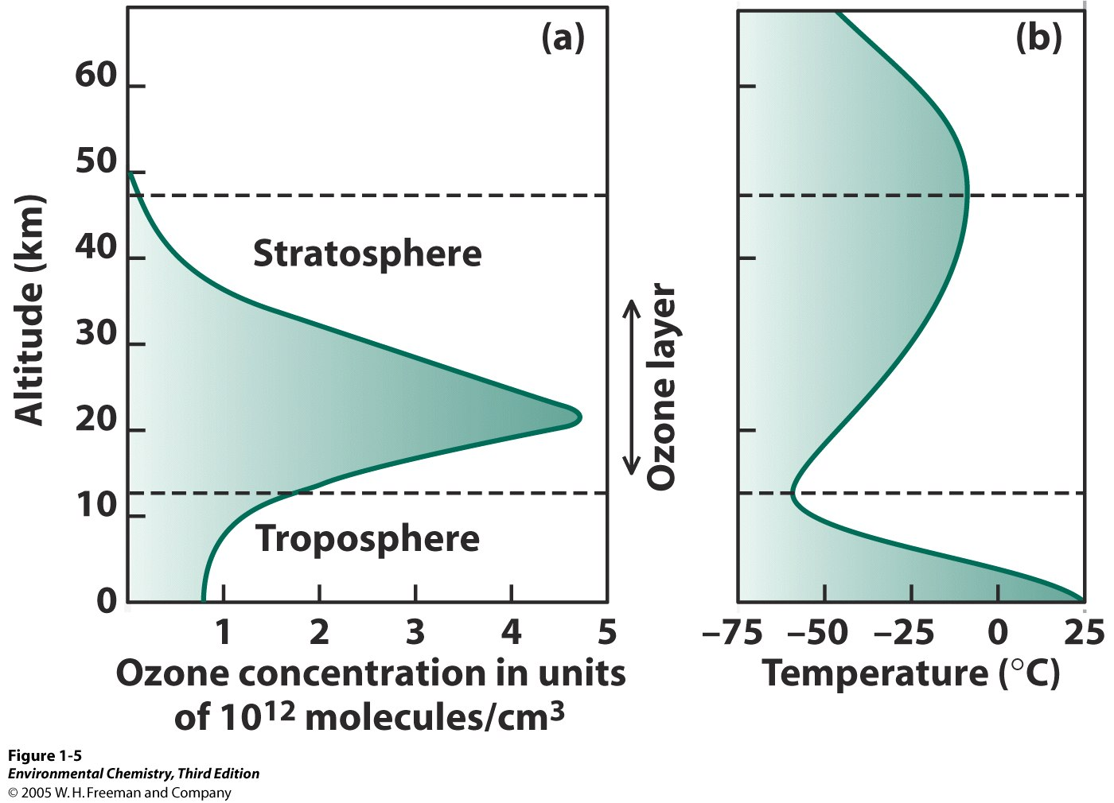

Slide 27
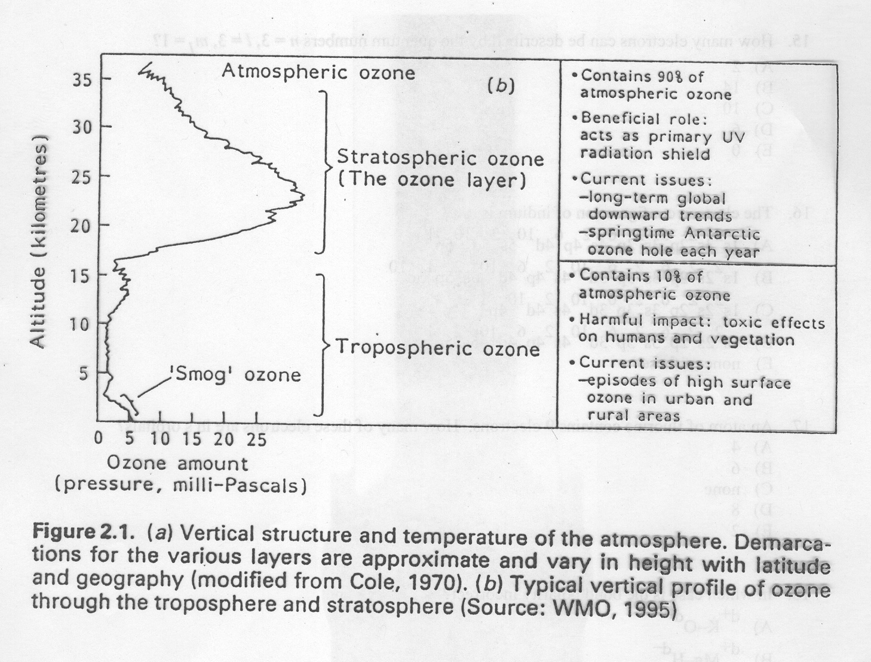

Slide 28
Ozone Levels by Latitude

Slide 29
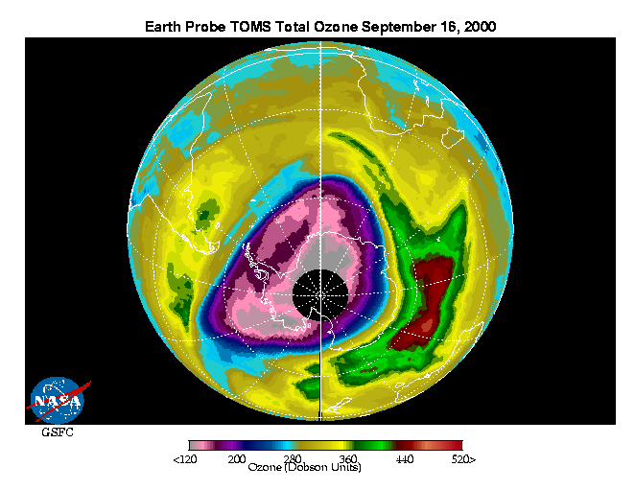

Slide 30
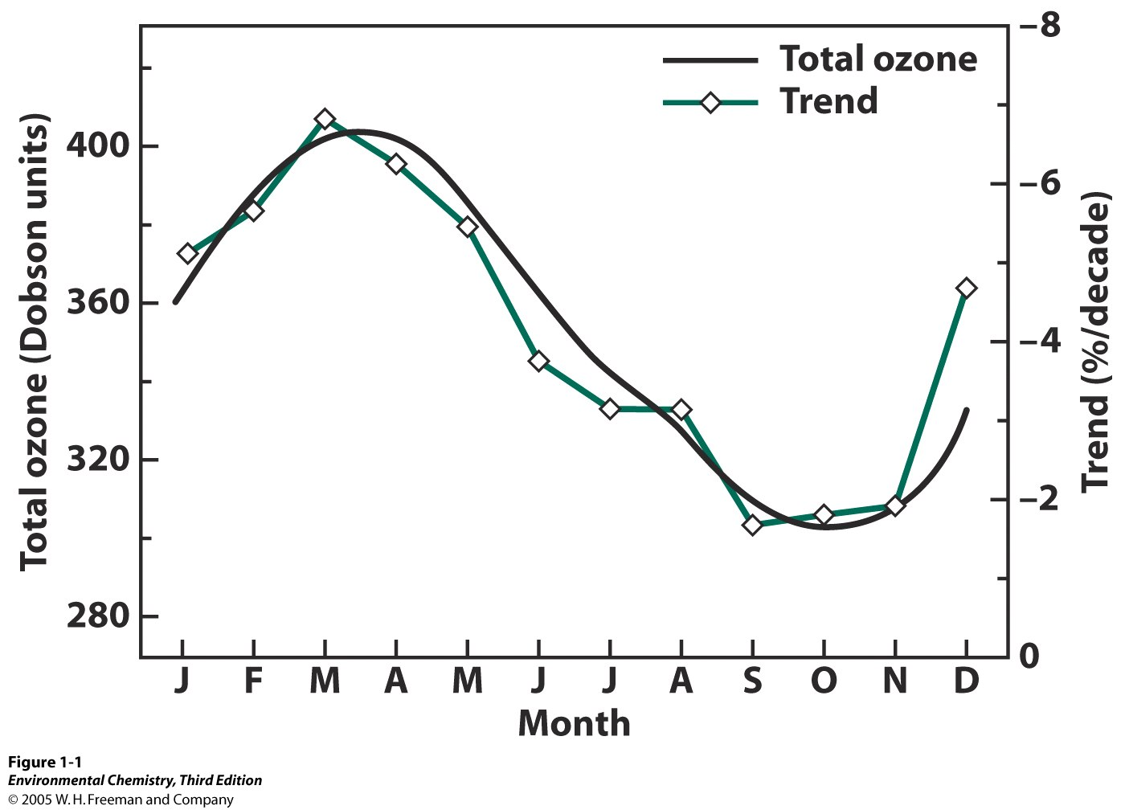
Annual Variation in Ozone Levels

Slide 31
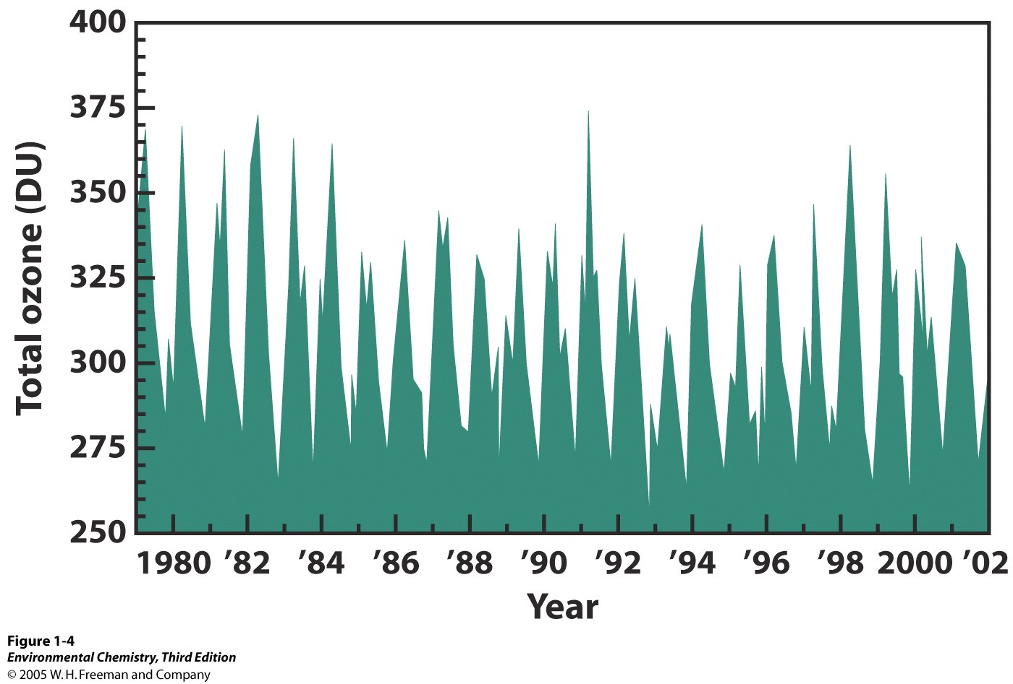

Slide 32
Catalytic Destruction of Ozone

Slide 33
CHAPTER 01: Figure 1.9
© 2012 W. H. Freeman & Co.

Slide 34
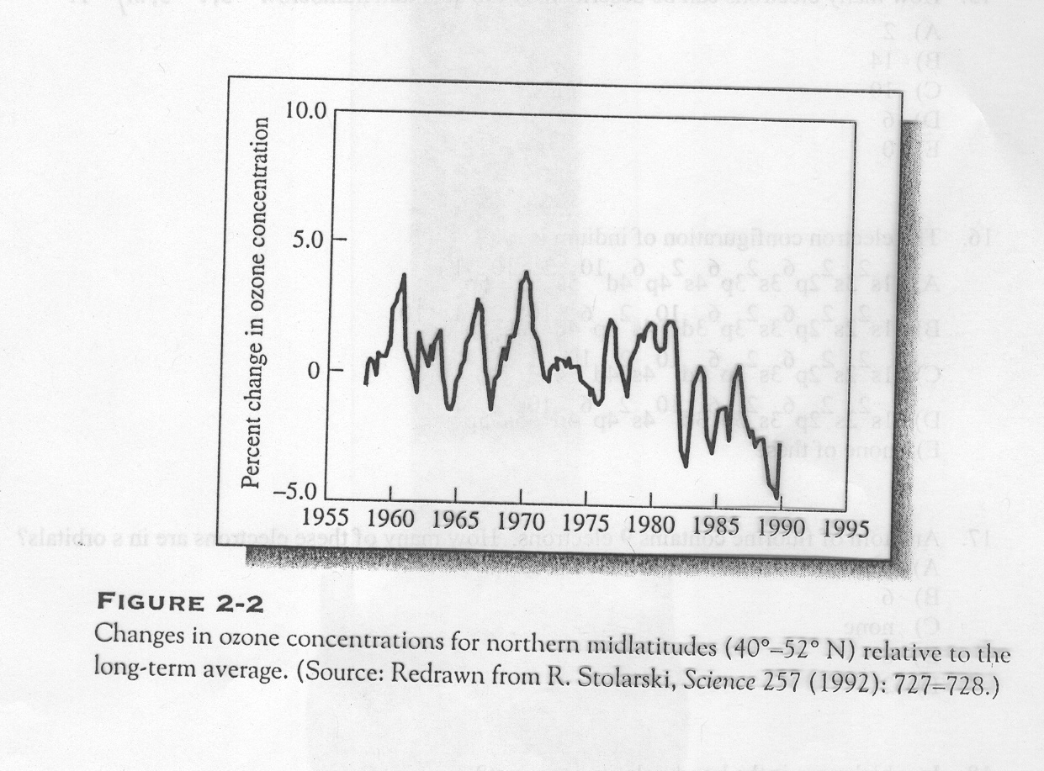
Decrease in overall ozone levels primarily due to increases in X catalysts

Slide 35
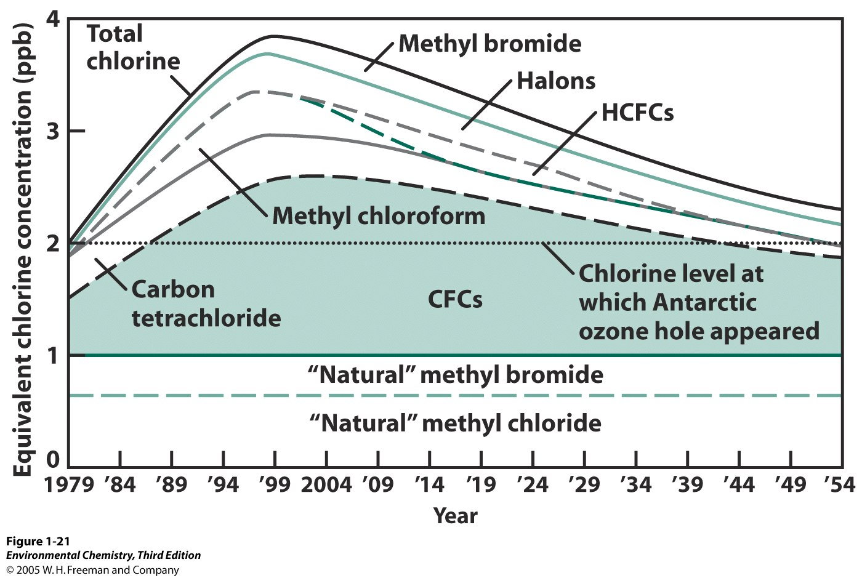

Slide 36
NOAA-CMDL

Slide 37
NOAA-CMDL

Slide 38
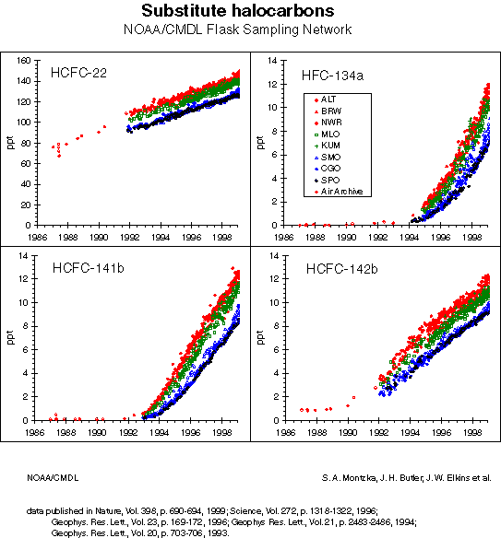

Slide 40
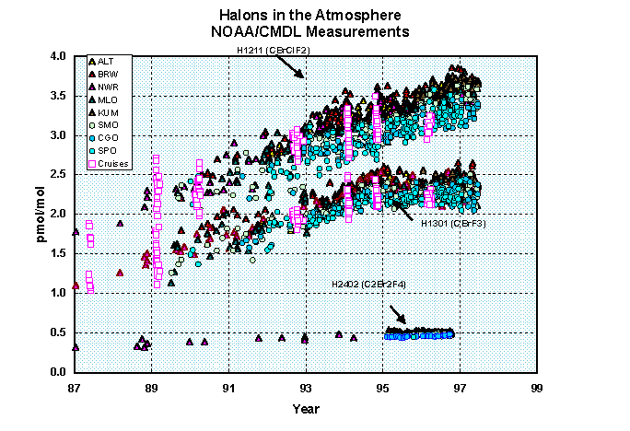

Slide 41
NOAA-CMDL

Slide 43
NOAA’s ER-2 Flying Lab

Slide 44
Chapter 1 – Additional Problem

Slide 45
Chapter 1 – Additional Problem

Slide 46
Chapter 1 – Additional Problem

Slide 47
END

