Slide 1
The Stratosphere
The Ozone Holes

Slide 2
Antarctic Ozone Hole - 1996

Slide 3
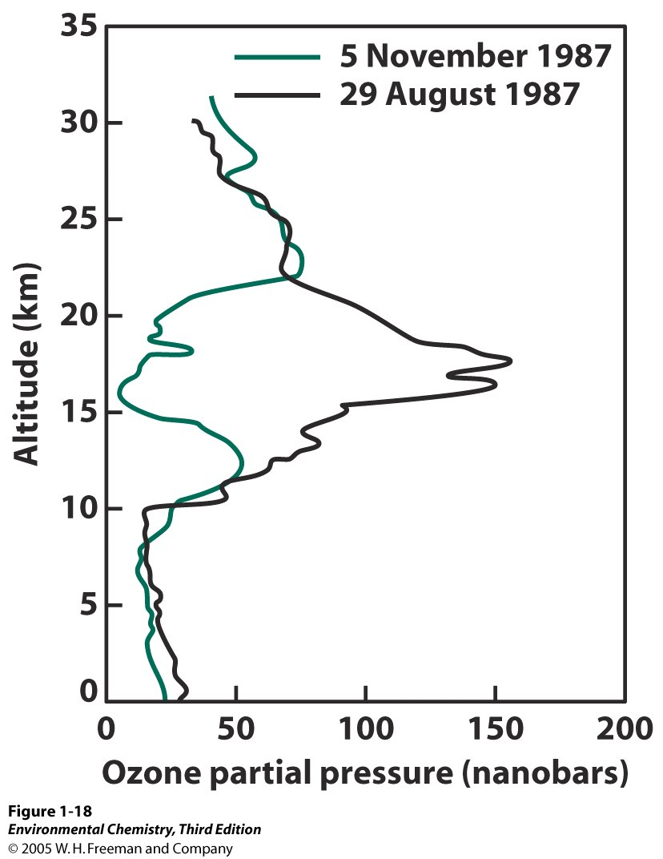

Slide 4
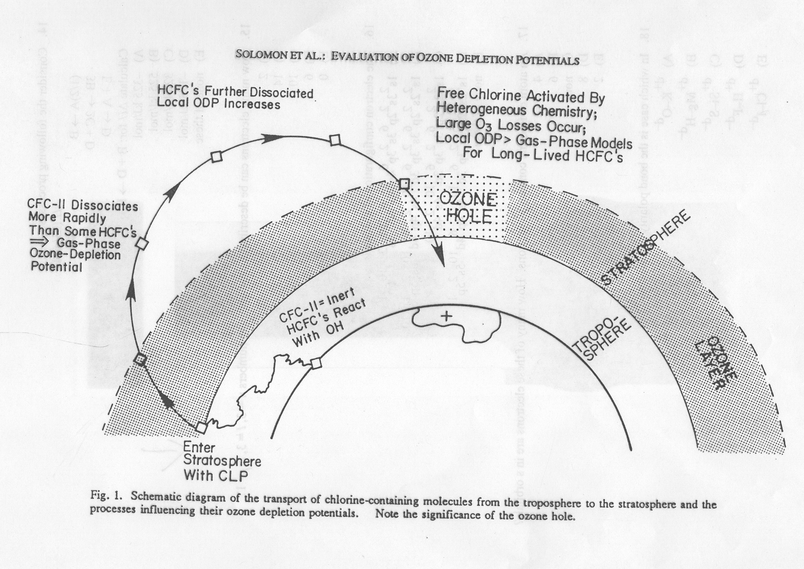

Slide 5
Polar Vortex

Slide 6
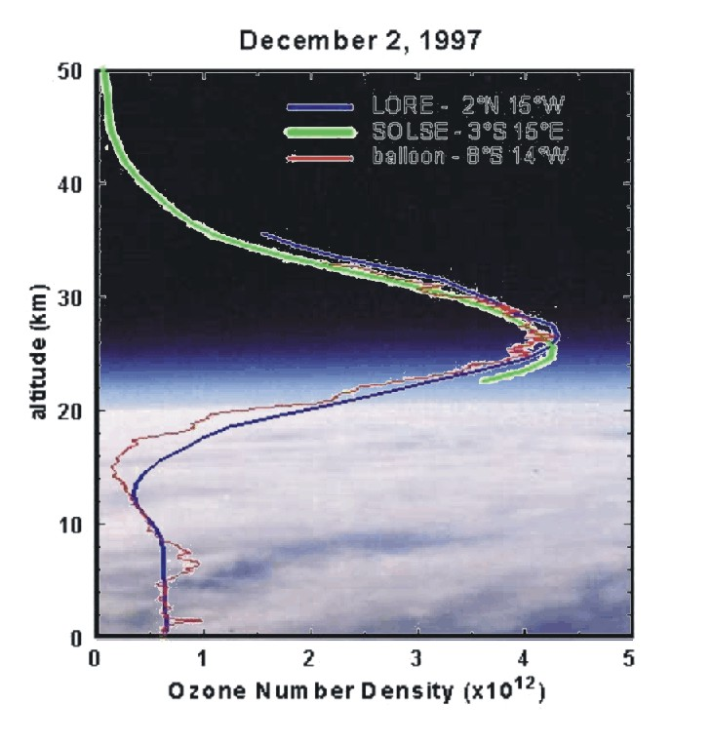

Slide 7
Antarctic Ozone Hole

Slide 8
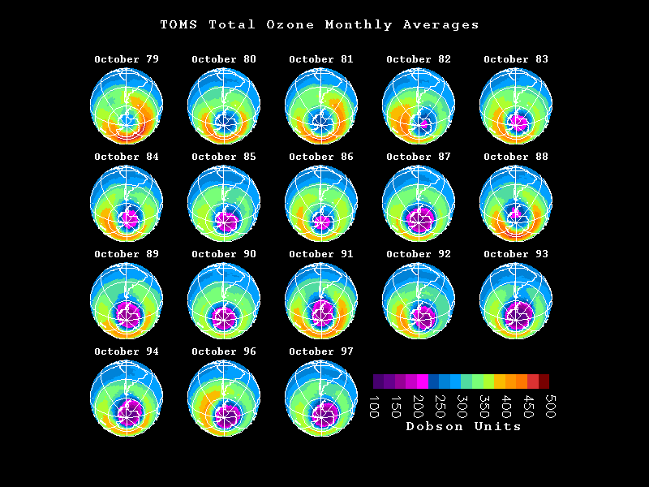

Slide 9
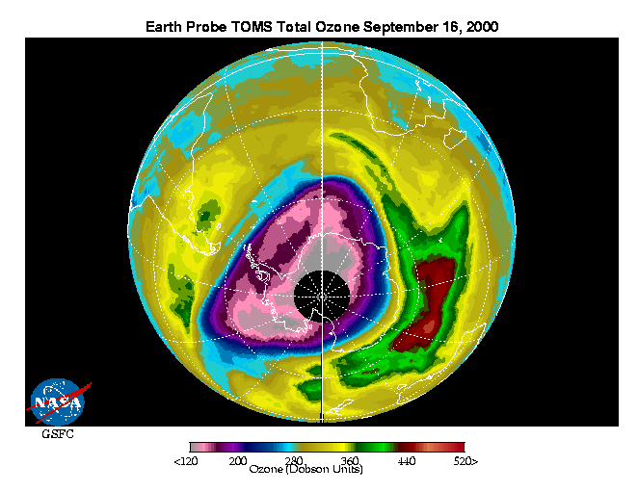

Slide 10
The Polar Vortex

Slide 11
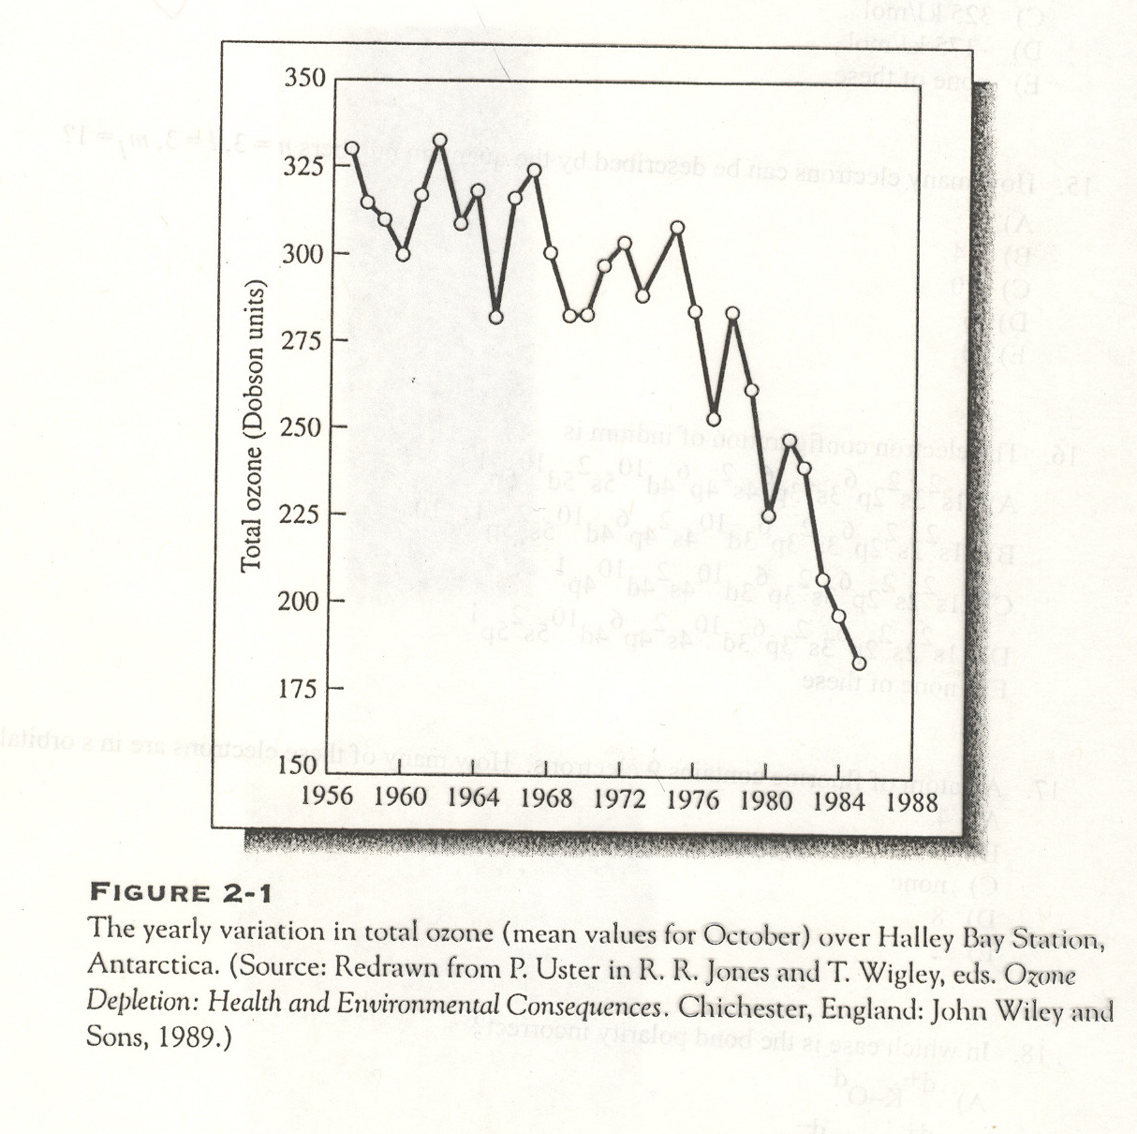

Slide 12
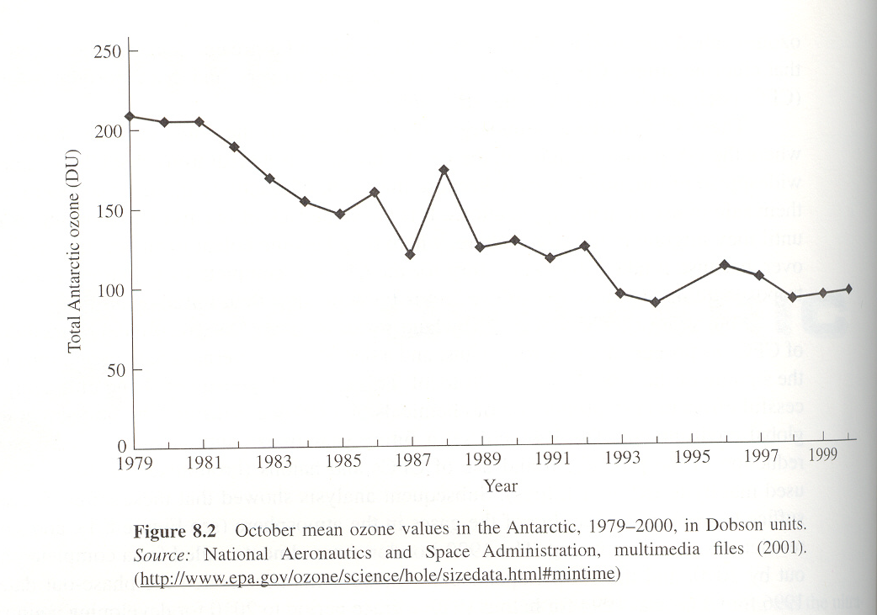

Slide 13
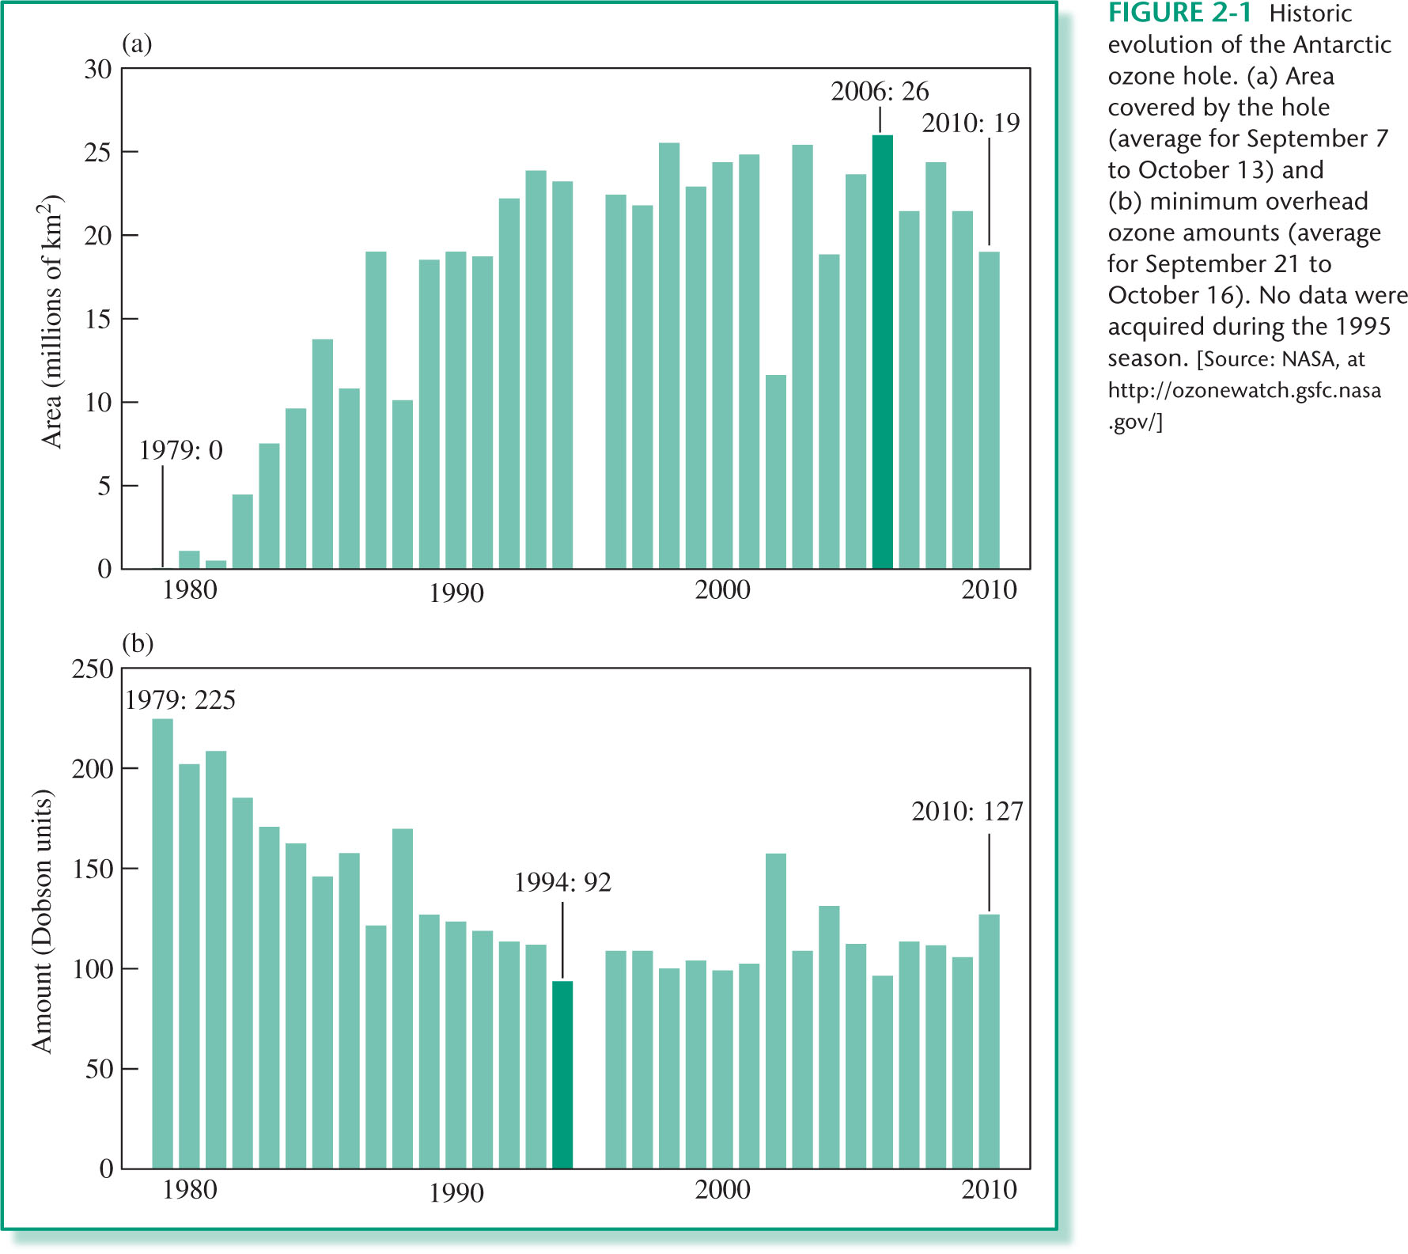
CHAPTER 02: Figure 2.1
© 2012 W. H. Freeman & Co.

Slide 15
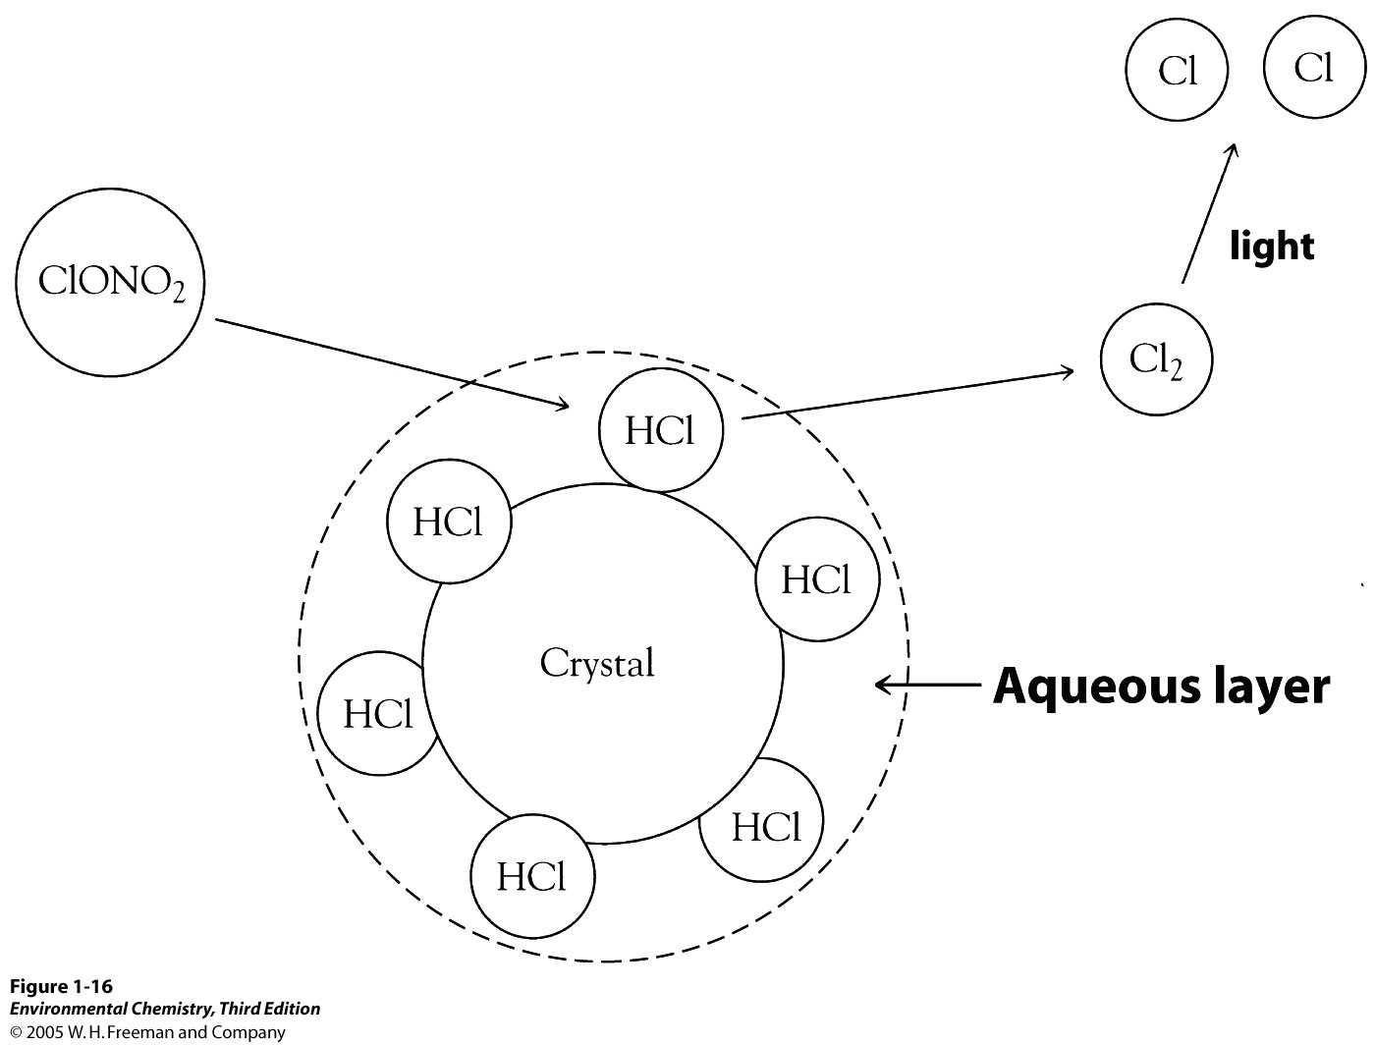

Slide 16
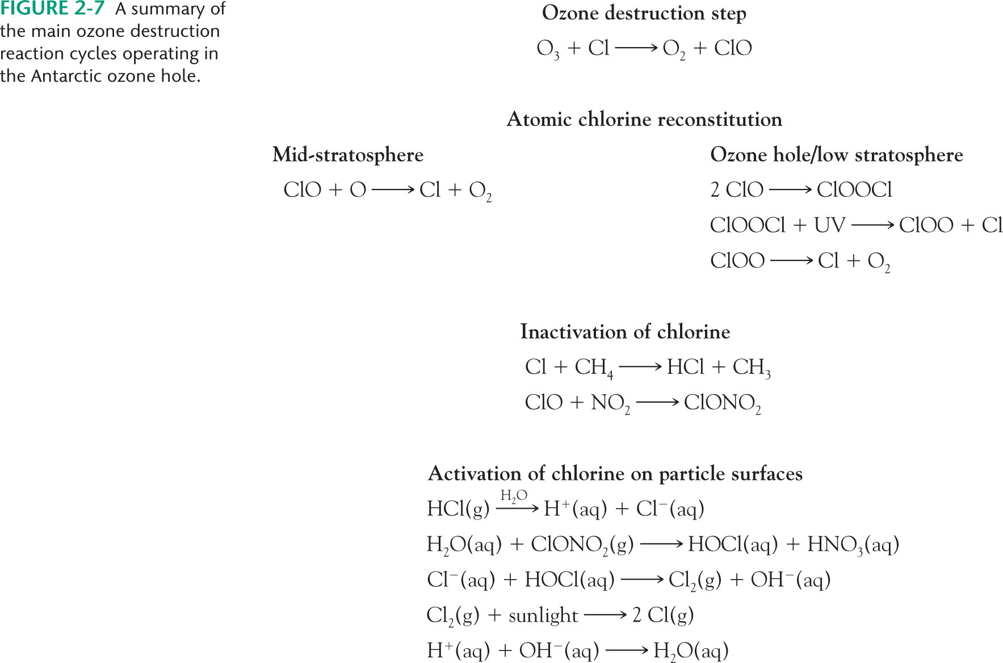
CHAPTER 02: Figure 2.7
© 2012 W. H. Freeman & Co.

Slide 17
Time Dependence of Ozone Hole

Slide 18
Chlorine Chemistry in the Polar Stratosphere

Slide 19
Modeling of Stratospheric Chemistry

Slide 20
Modeling vs. Satellite Data

Slide 22
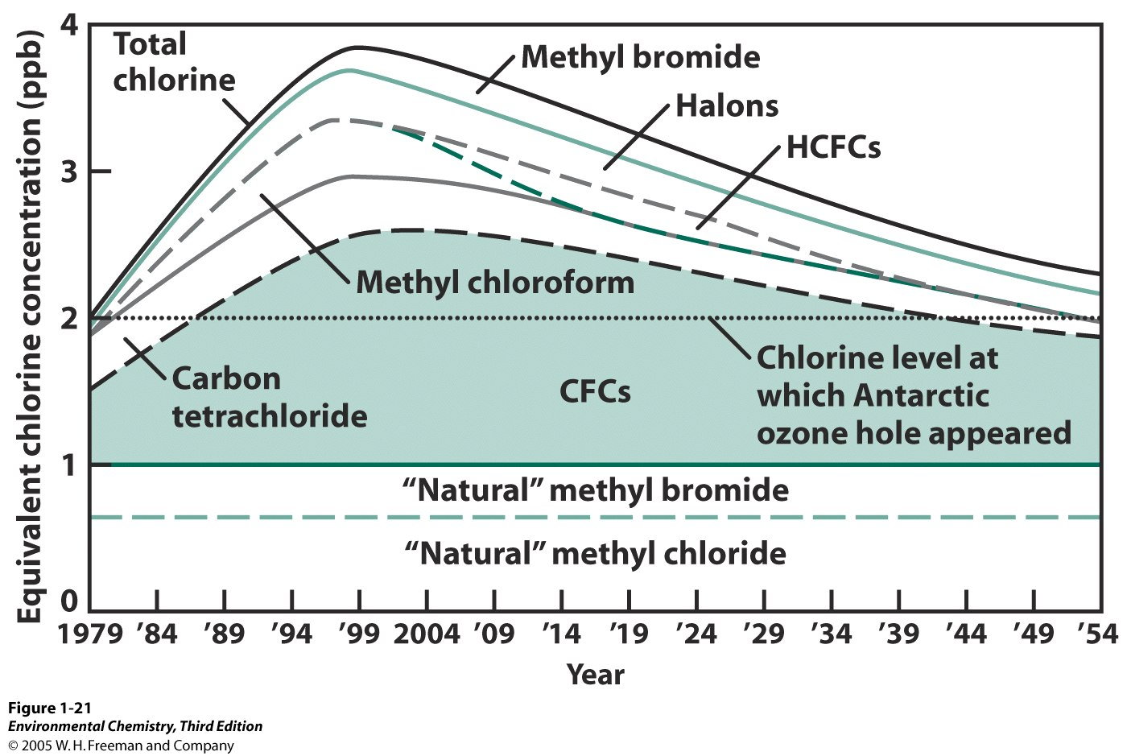
Dissipation of the Antarctic Ozone Hole

Slide 23
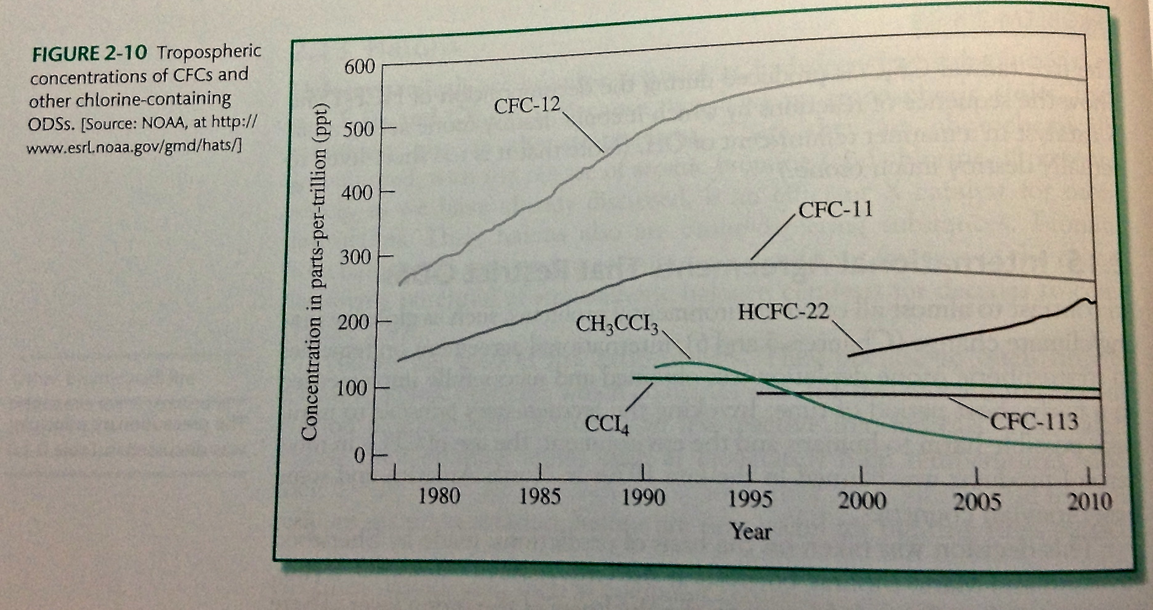
What are these compounds?

Slide 24
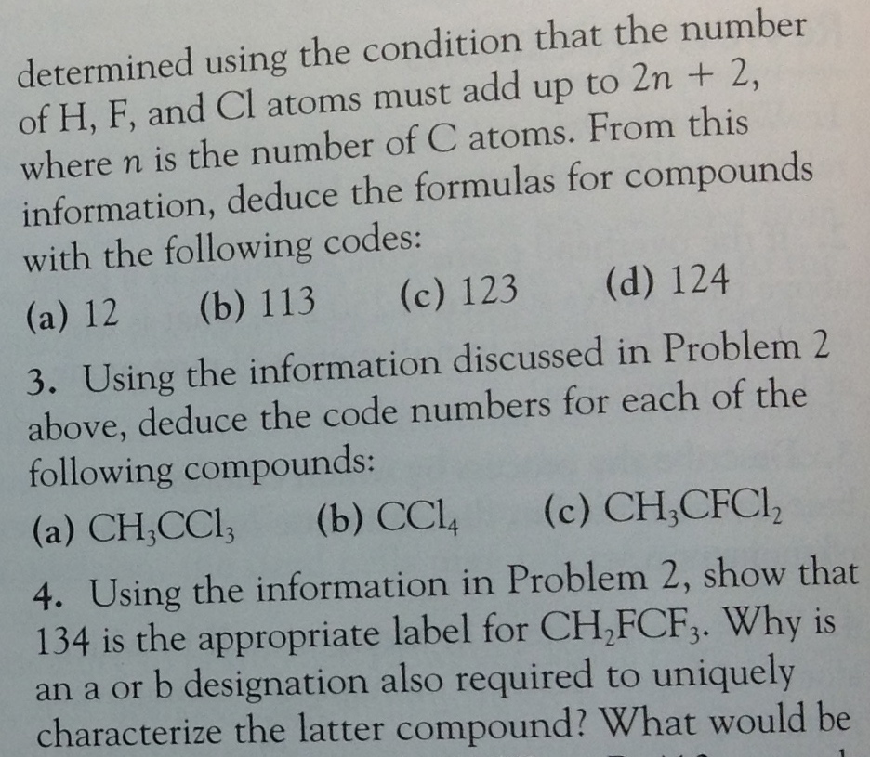

Slide 25
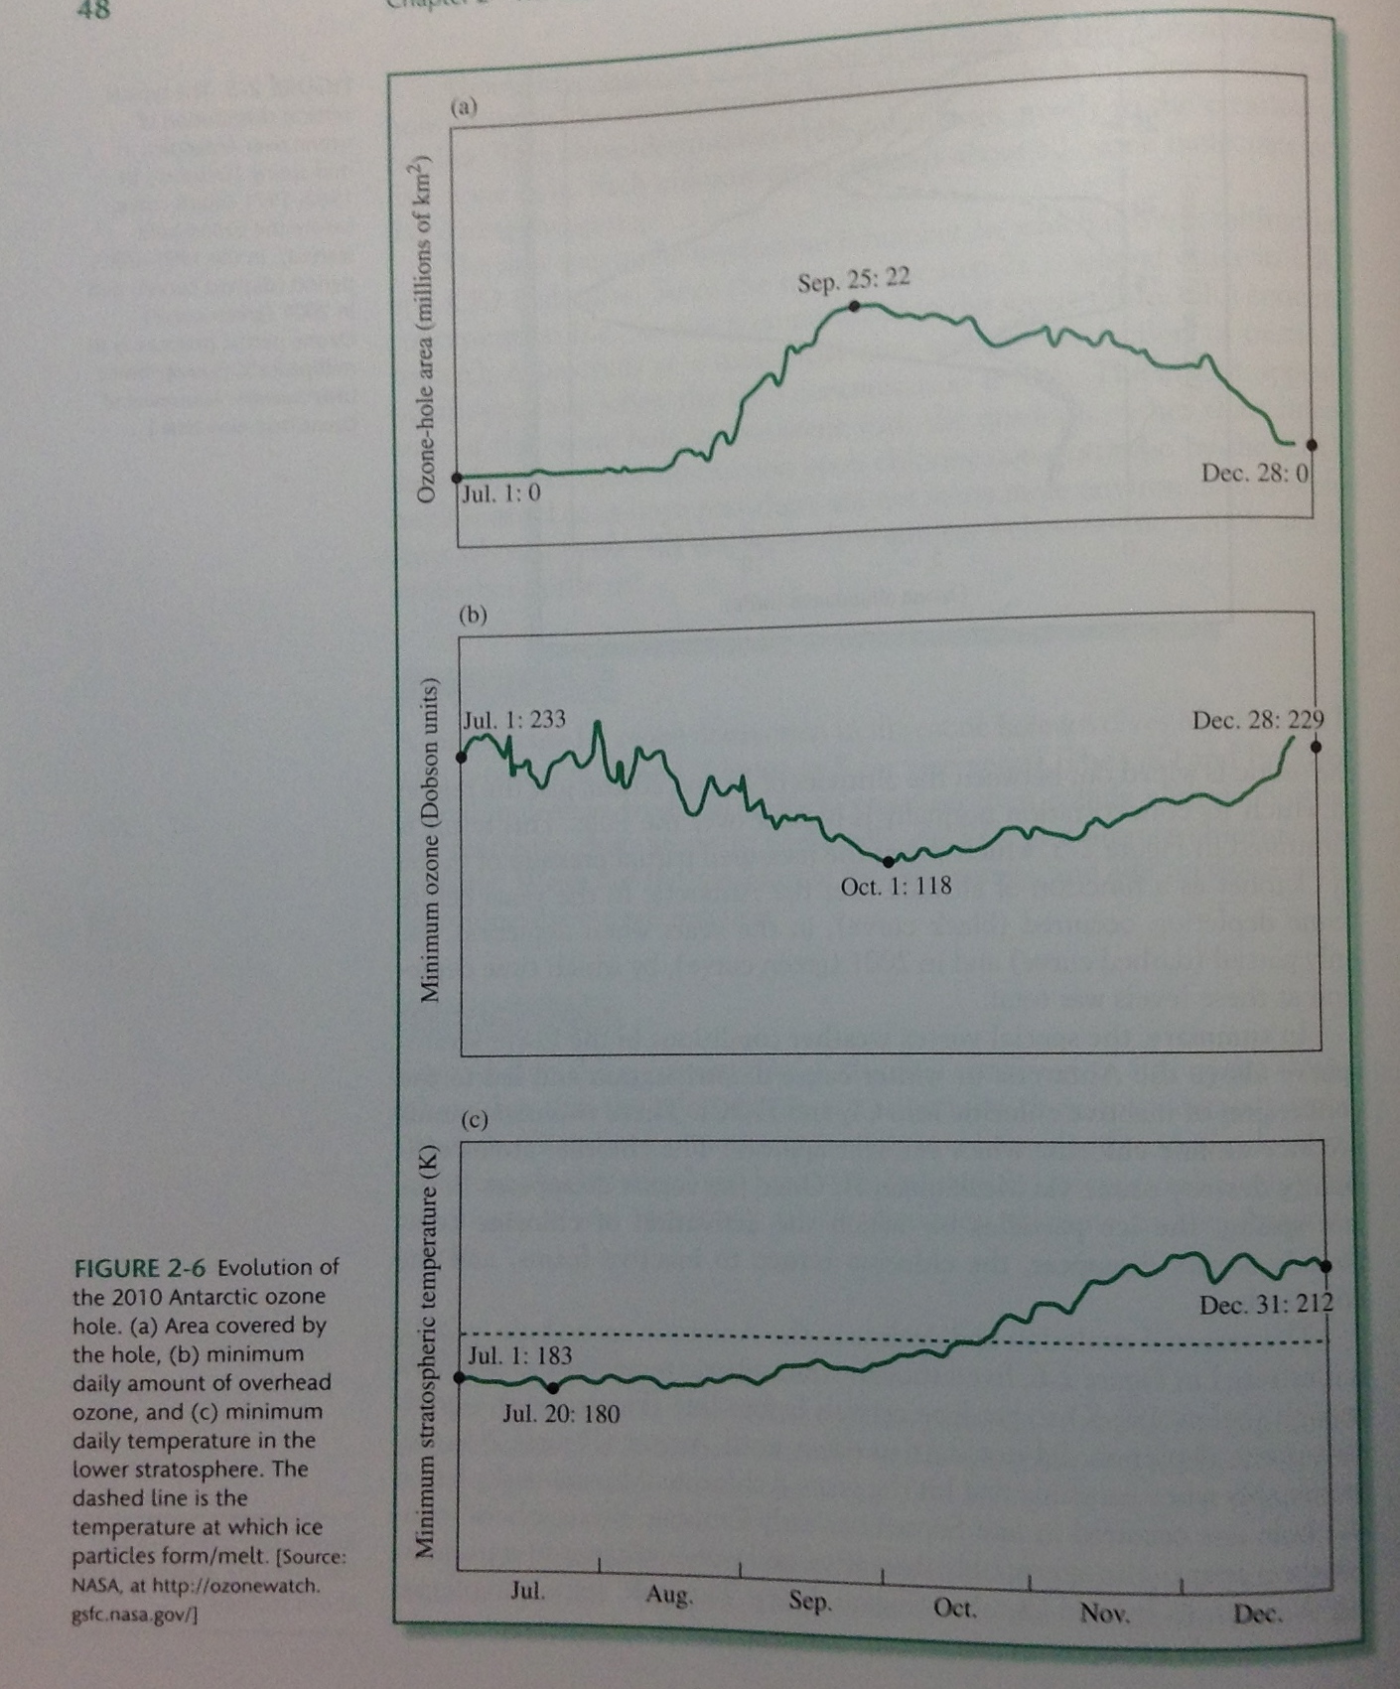
Annual changes in ozone distribution at the south pole.
How does temperature and season play a role?

Slide 26
CHAPTER 02: Figure 2.1
© 2012 W. H. Freeman & Co.

Slide 27
Antarctic Ozone Minimum thru 2002

Slide 28
Average Area of Ozone Hole thru 2002

Slide 29
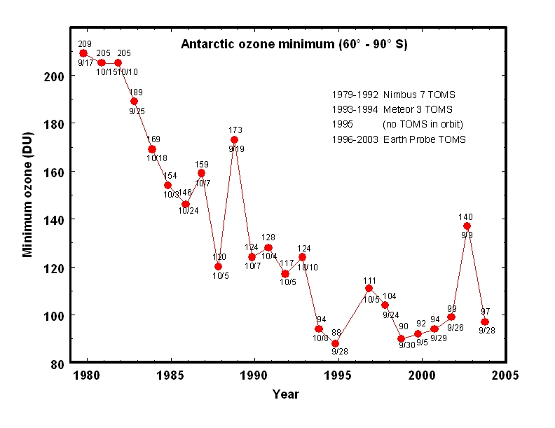
Antarctic Ozone Minimum thru 2003

Slide 30
Average Area of Ozone Hole thru 2003

Slide 31
Northern Hemisphere

Slide 32
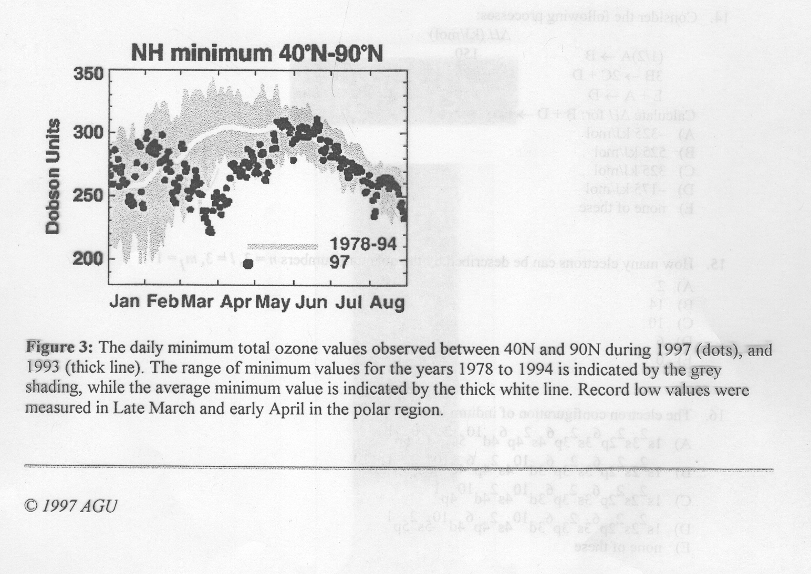

Slide 33
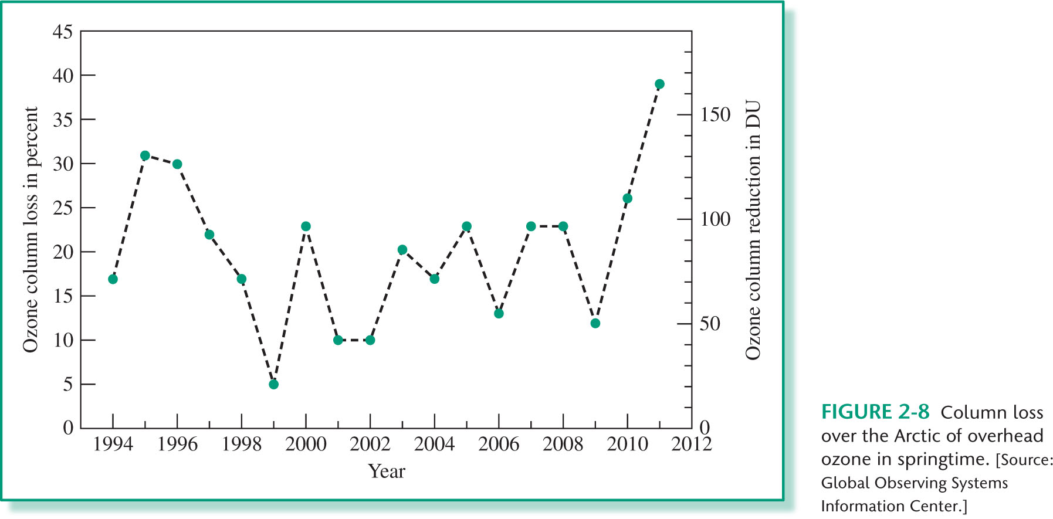
CHAPTER 02: Figure 2.8
© 2012 W. H. Freeman & Co.

Slide 35
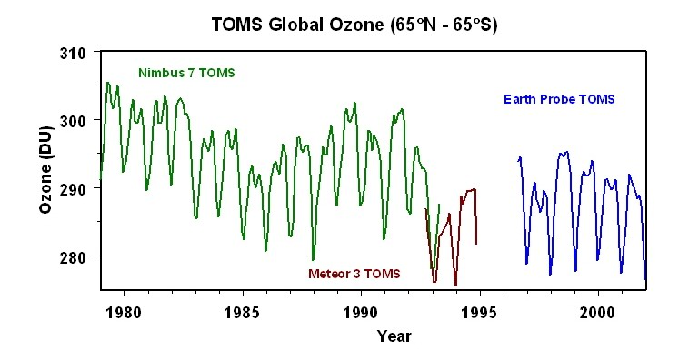
Total Average Global Ozone

Slide 36
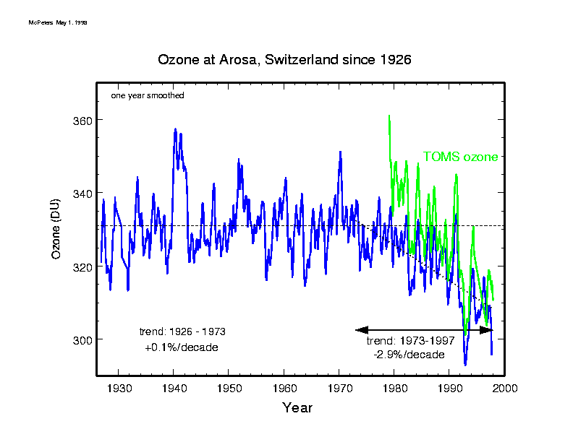

Slide 37
Effect of Increased Concentration of Greenhouse Gases on Stratospheric Temperature

Slide 38
END

