Slide 1
Troposphere
Tropospheric Chemistry and Atmospheric Pollutants
Chapters 3 and 4

Slide 5
Chapter 3 – Problem 1

Slide 6
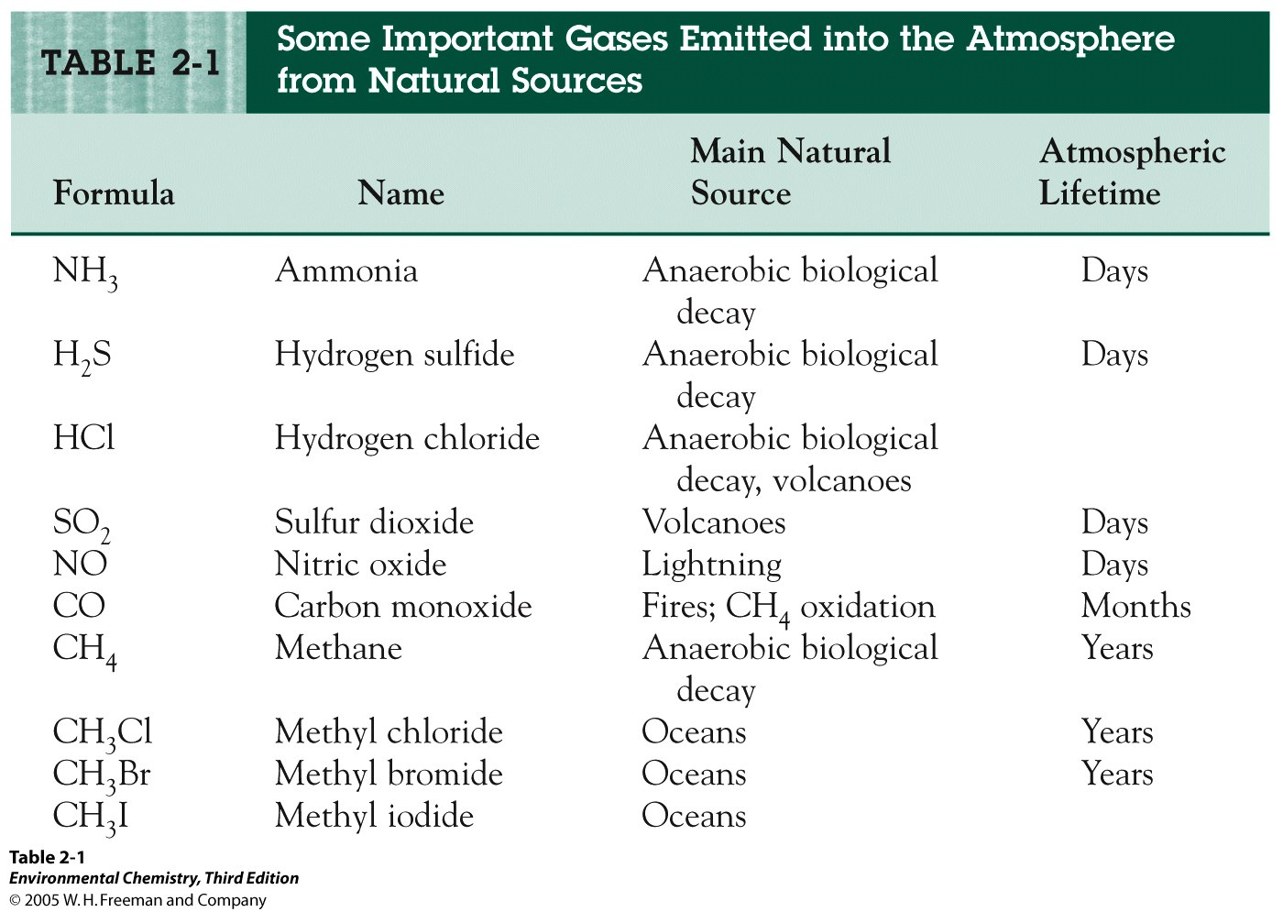

Slide 7
Ozone and the Production of OH.

Slide 8
CHAPTER 03: Unnumbered Figure 3.1
© 2012 W. H. Freeman & Co.

Slide 9
OH. Reactive with most Gases from Natural Sources – Why?

Slide 10
Principles of Reactivity
OH. Will add to multiple bonds where the product is more stable than the reactant
OH. Will abstract a H from a molecule to form H₂O
Photolysis of H₂CO
Radical rxn’s with O₂ – peroxy radicals
Peroxy radicals - rxn with NO_{x} radicals
Non peroxy rad. – rxn with O₂ to produce an additional bond or for no H available for abstraction O₂ will add

Slide 11
Formation of NO_{x} Radicals

Slide 12
CHAPTER 03: Unnumbered Figure 3.3
© 2012 W. H. Freeman & Co.

Slide 13
NO_{x} Cycle

Slide 14
Additional Problem 3-2

Slide 15
Atmospheric Oxidation of Methane

Slide 16
Atmospheric Oxidation of Methane

Slide 18
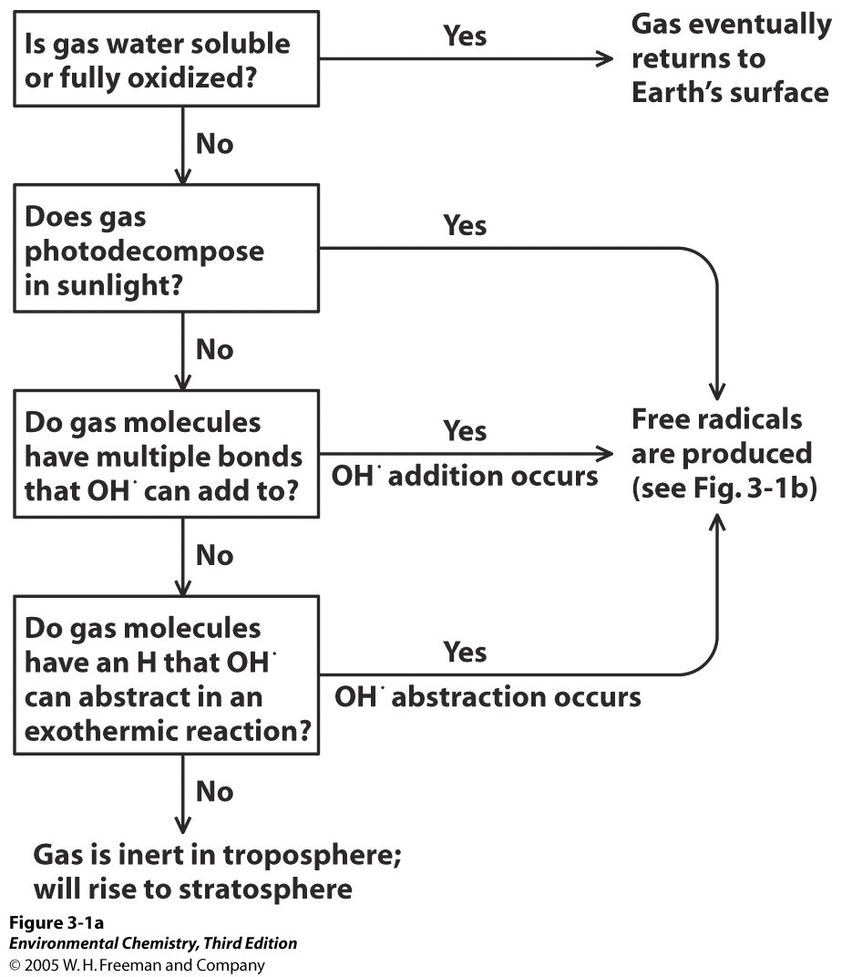

Slide 19
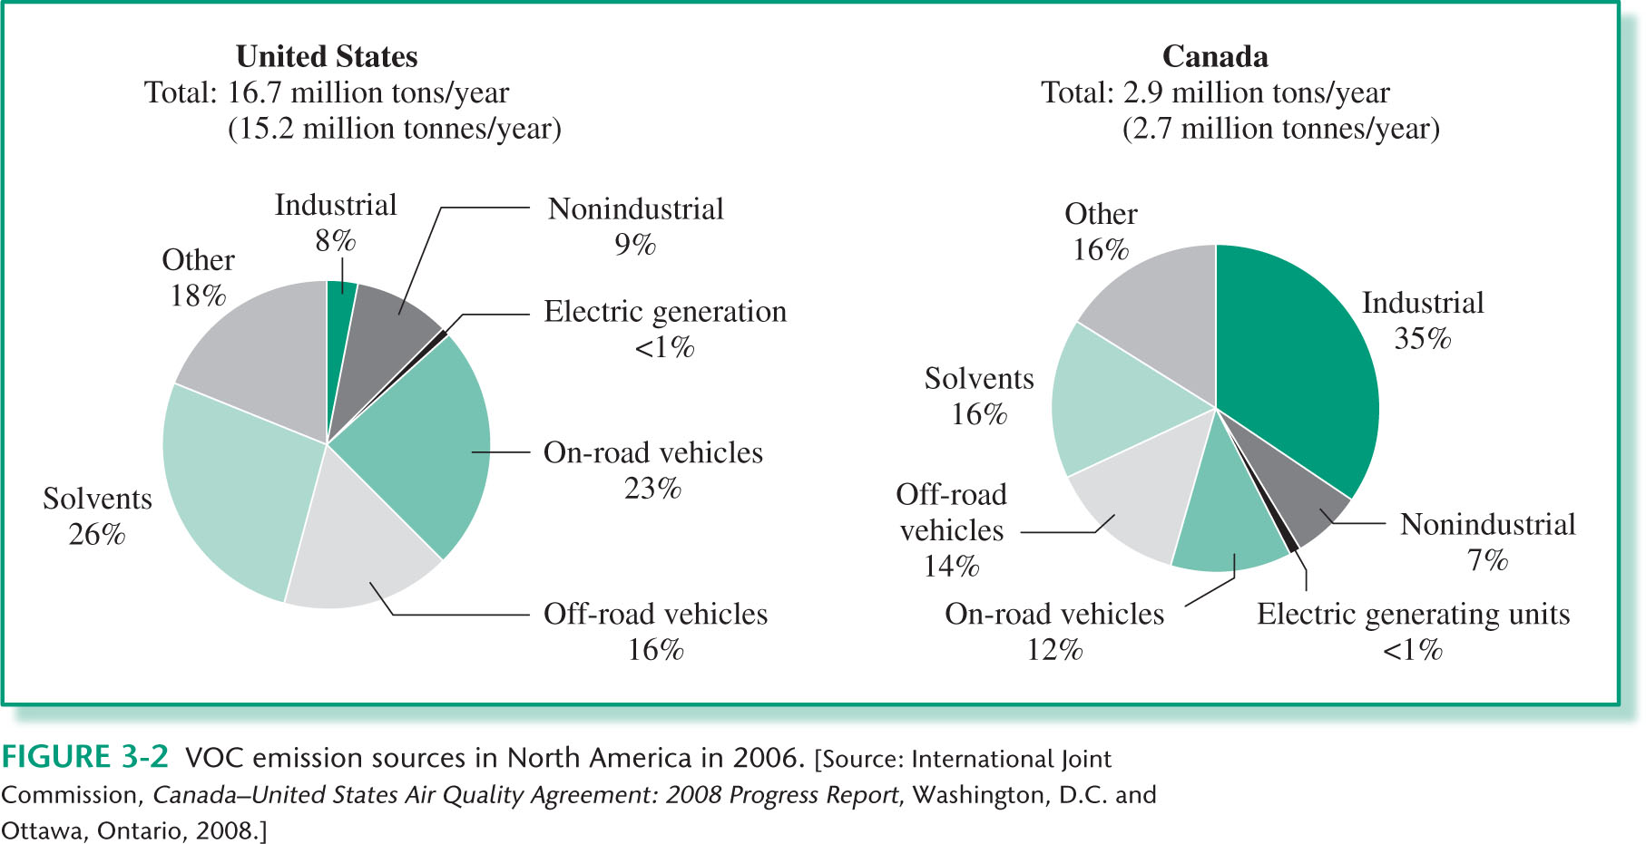
CHAPTER 03: Figure 3.2
© 2012 W. H. Freeman & Co.

Slide 20
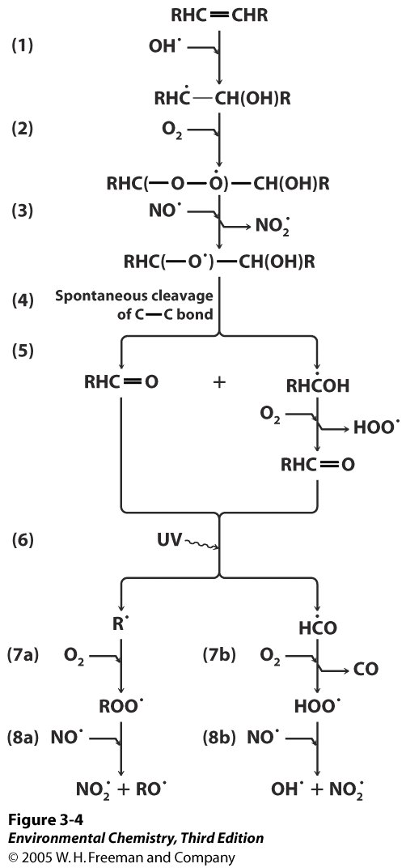

Slide 21
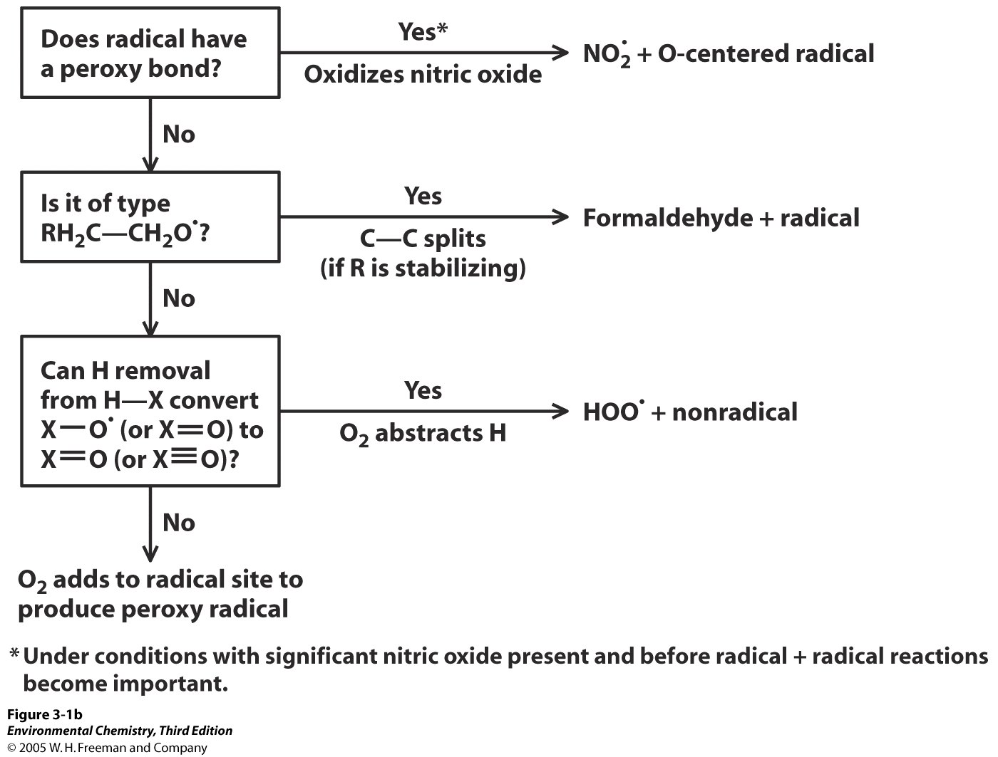

Slide 22
END

Slide 23
Troposphere
Photochemical Smog

Slide 24
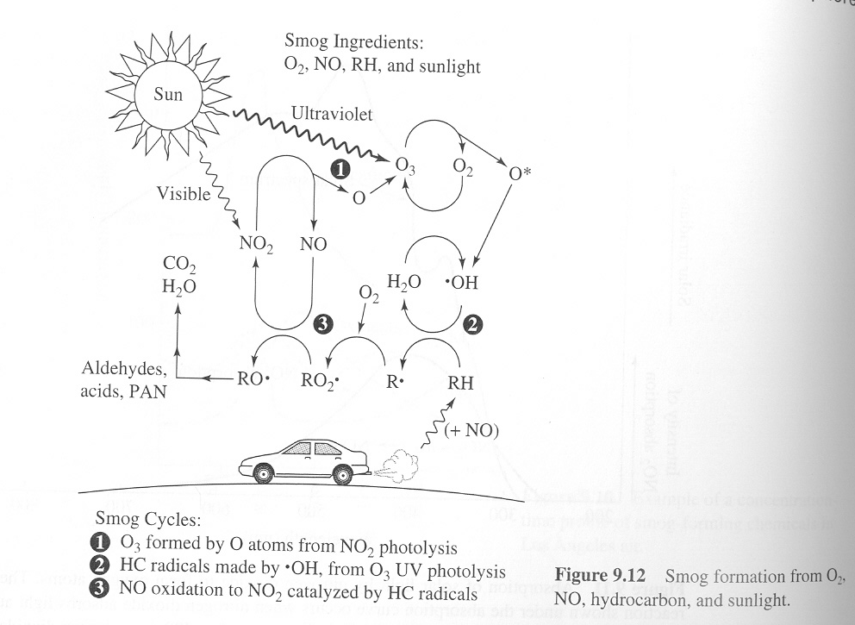
The Ingredients of Smog

Slide 25
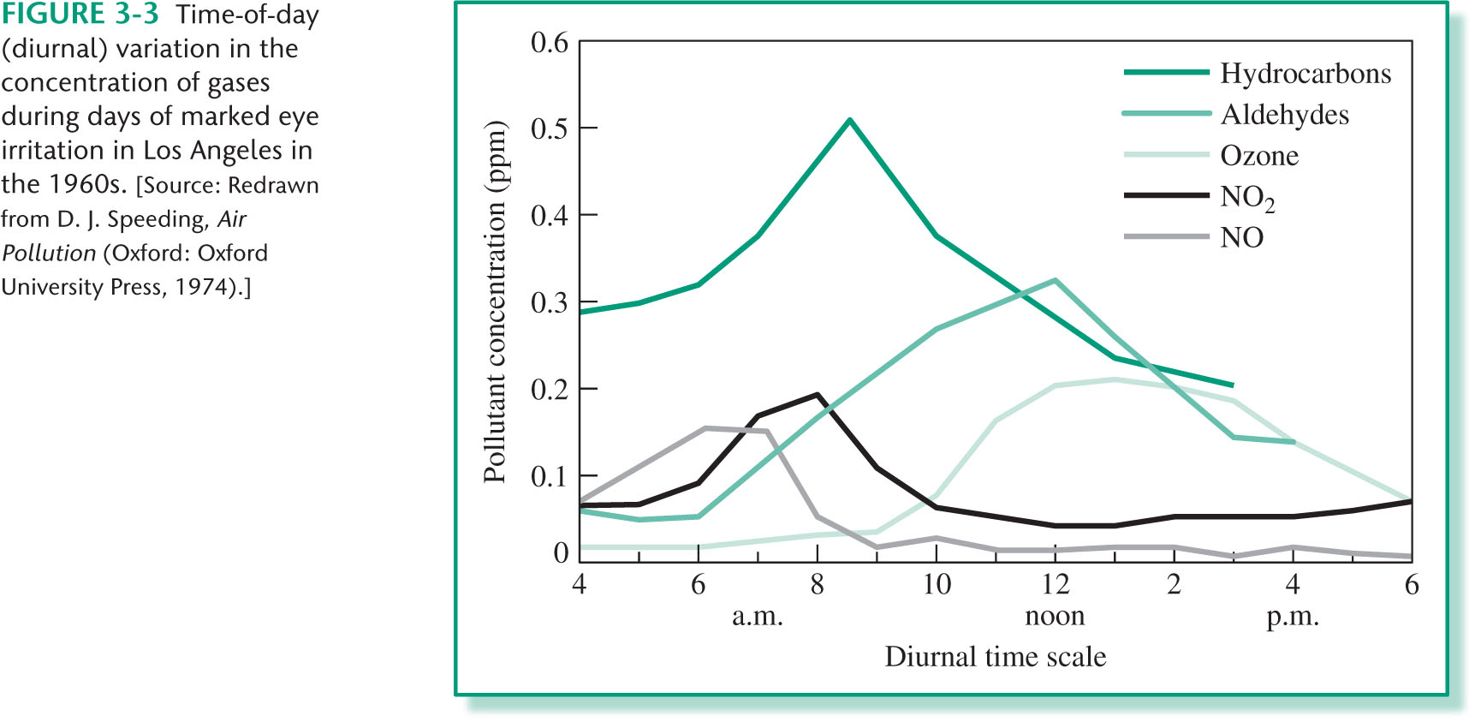
CHAPTER 03: Figure 3.3
© 2012 W. H. Freeman & Co.

Slide 26
Additional Problem 3-4

Slide 27
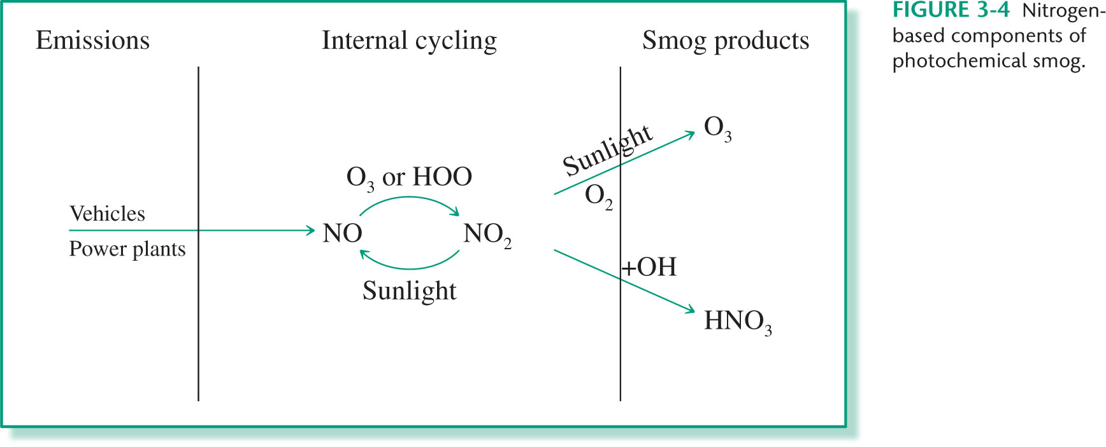
CHAPTER 03: Figure 3.4
© 2012 W. H. Freeman & Co.

Slide 28
CHAPTER 03: Figure 3.2
© 2012 W. H. Freeman & Co.

Slide 29
Volatile Organic Compound Emissions (VOC’s)

Slide 30
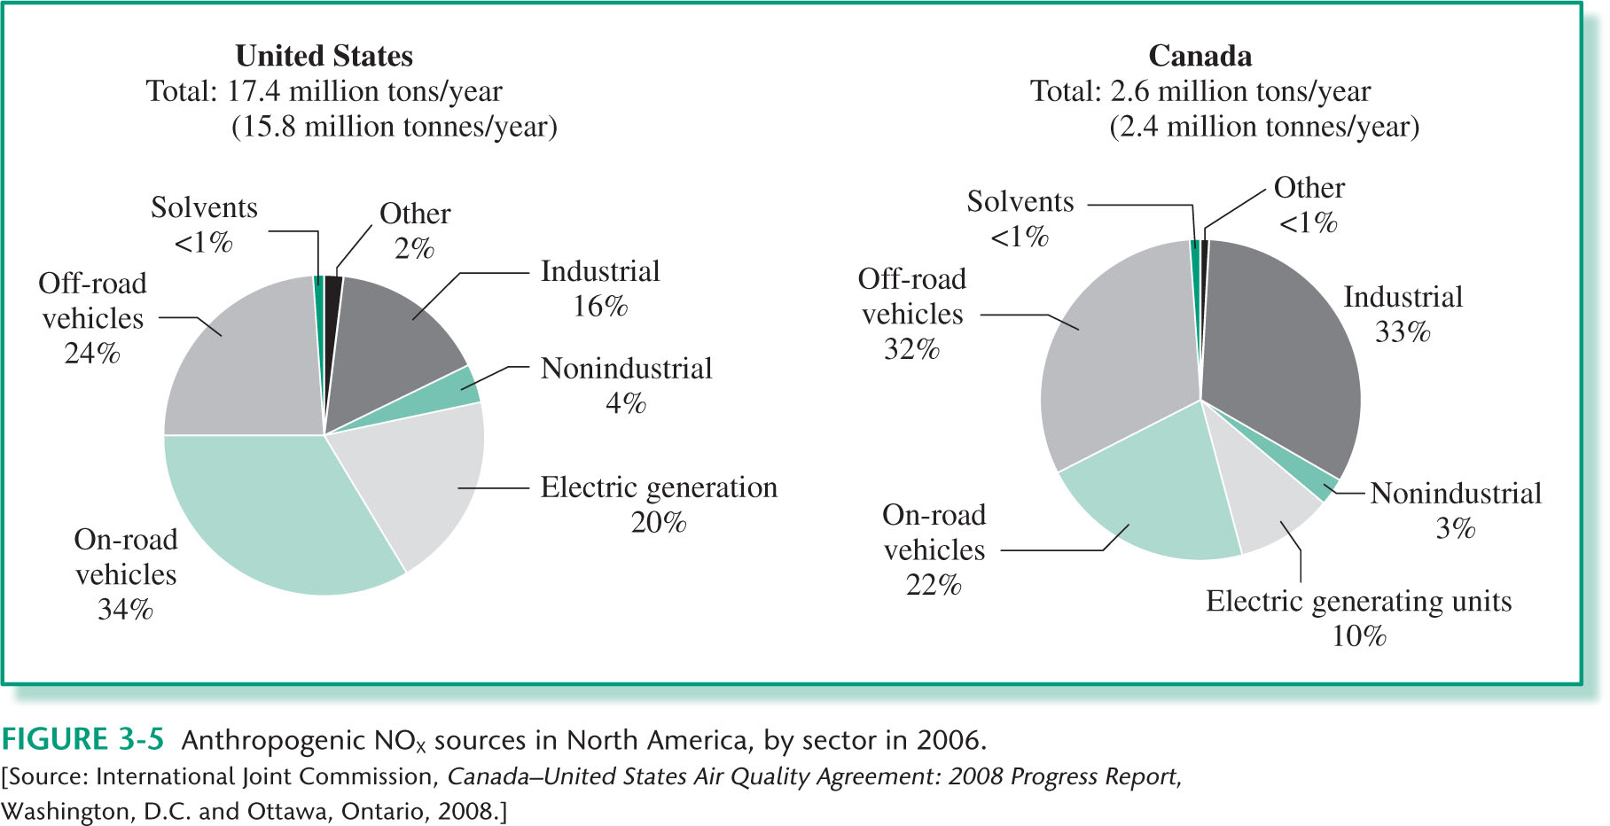
CHAPTER 03: Figure 3.5
© 2012 W. H. Freeman & Co.

Slide 31
Nitrogen Oxide Emissions (NO_{x})

Slide 32
Possible reaction pathways for chemical emissions

Slide 33
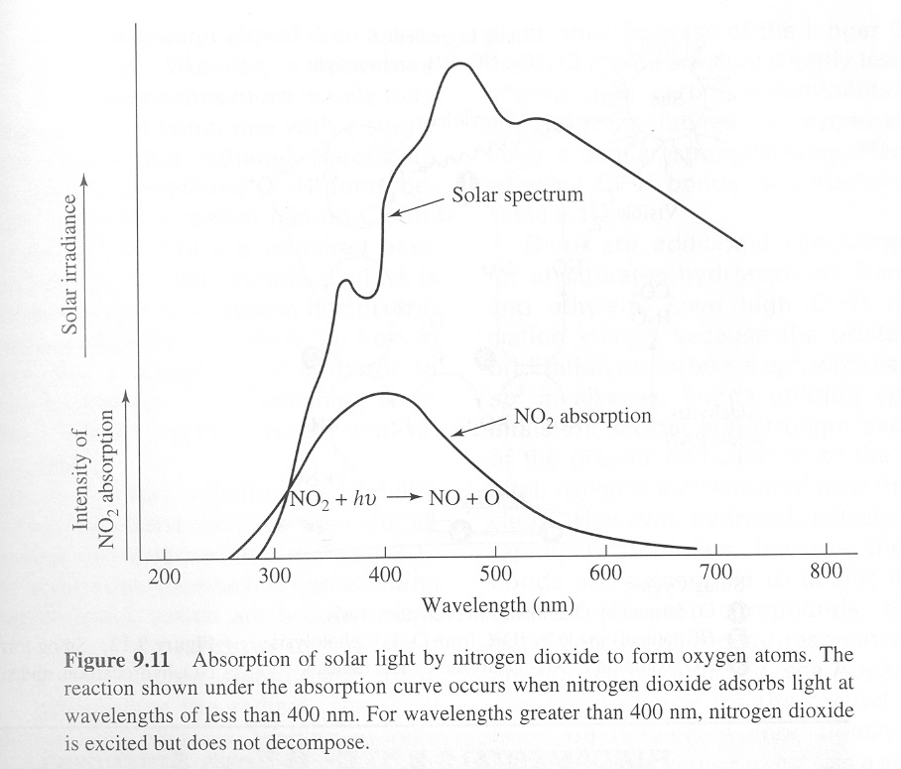
NO₂. Absorption Spectra
For λ < 400 nm

Slide 34
Decomposition of VOC’s

Slide 35
Radical Reactions

Slide 36
The Ingredients of Smog

Slide 37
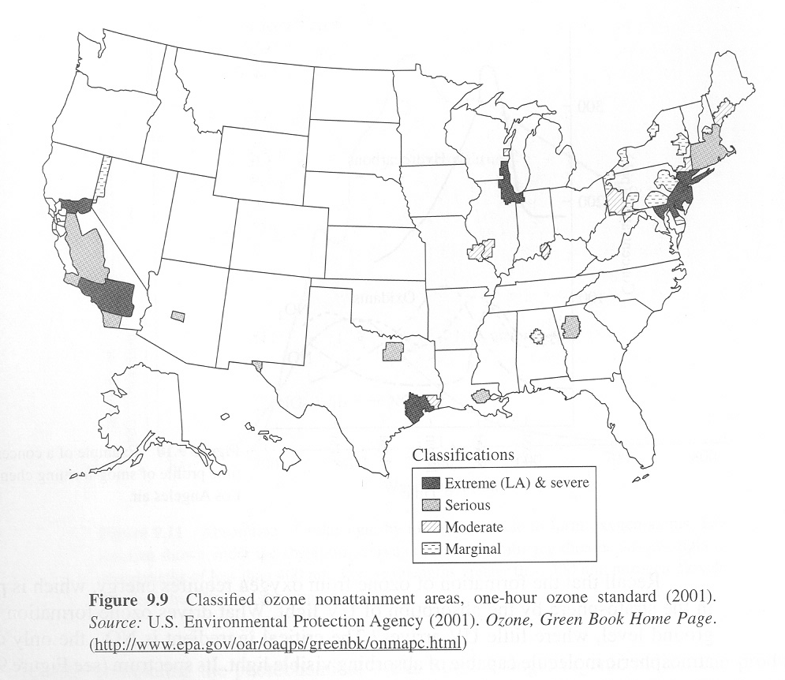
Ozone Nonattainment Areas

Slide 38
Surface Ozone Levels

Slide 39
Time profile of smog forming chemicals in Los Angeles

Slide 40
Composition of auto exhaust as air-fuel ratio varies

Slide 41
Additional Problem 3-3

Slide 42
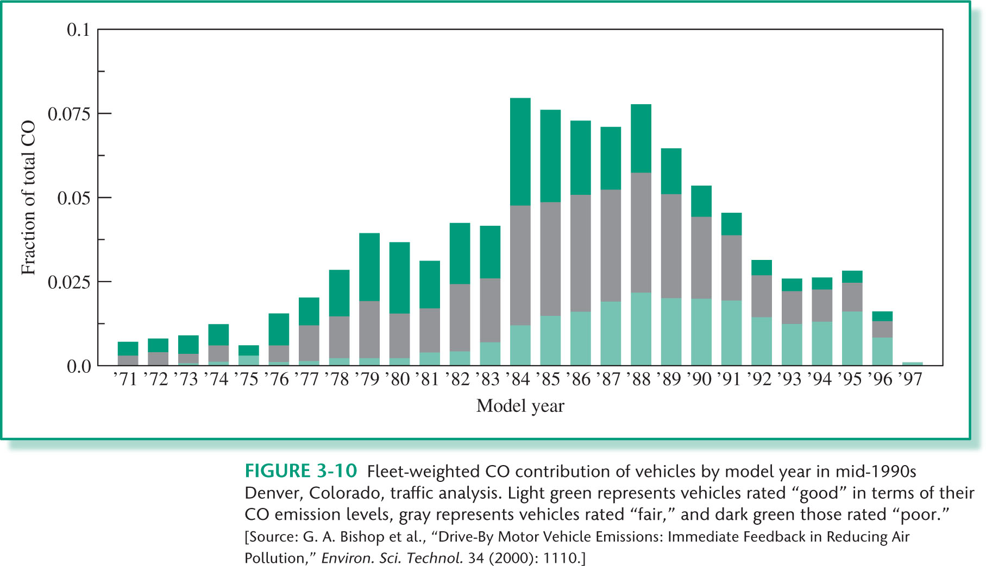
CHAPTER 03: Figure 3.10
© 2012 W. H. Freeman & Co.

Slide 43
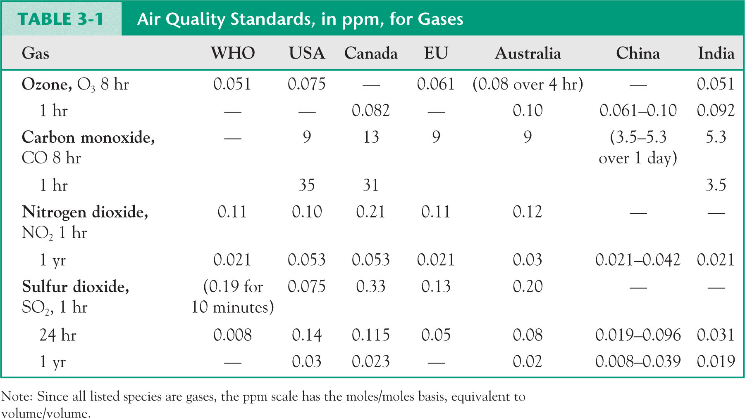
CHAPTER 03: Table 3.1
© 2012 W. H. Freeman & Co.

Slide 44
Time profile of smog forming chemicals in Los Angeles

Slide 45
Troposphere
Acid Rain

Slide 47
Chapter 3 – Problem 15

Slide 49
Possible reaction pathways for chemical emissions

Slide 50
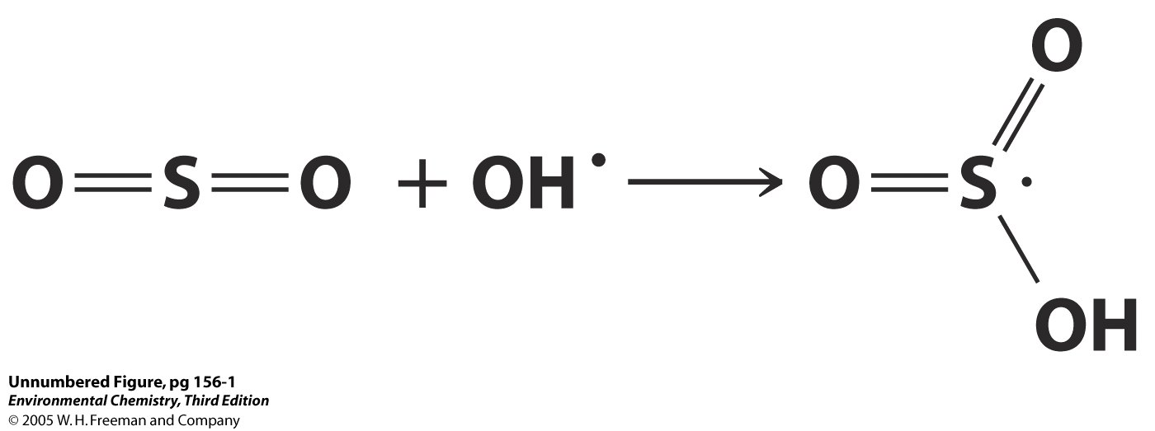

Slide 51
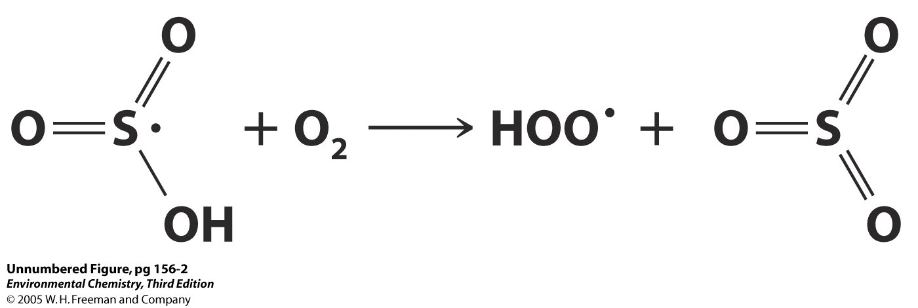

Slide 52
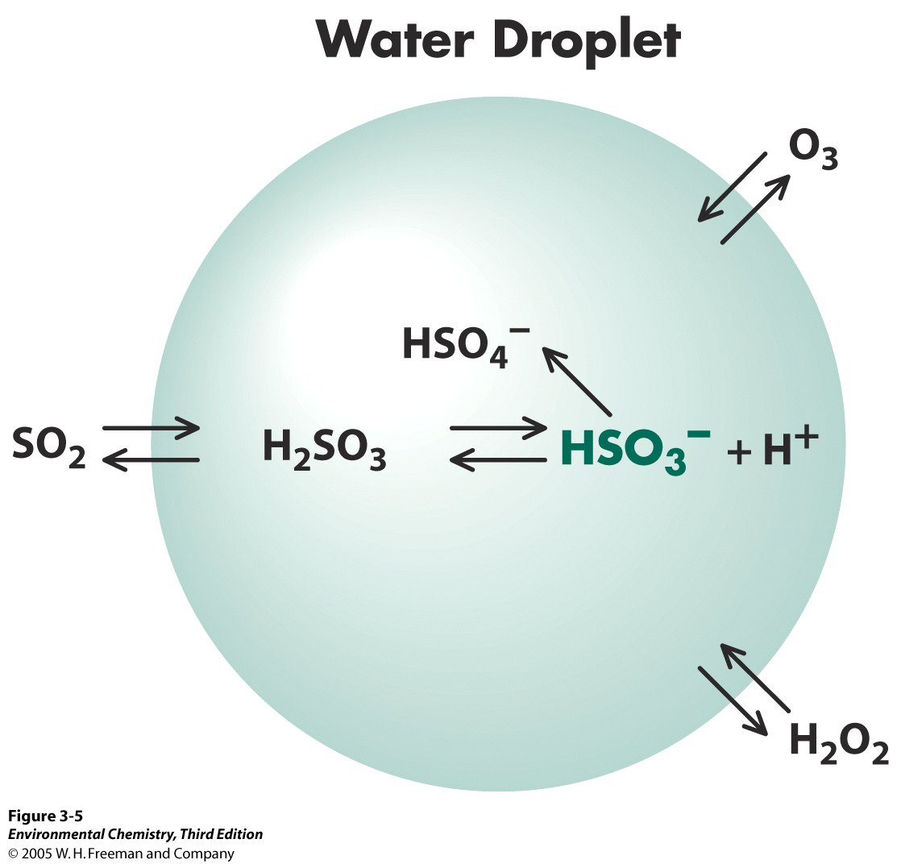

Slide 53
Chapter 3 – Problem 13

Slide 54
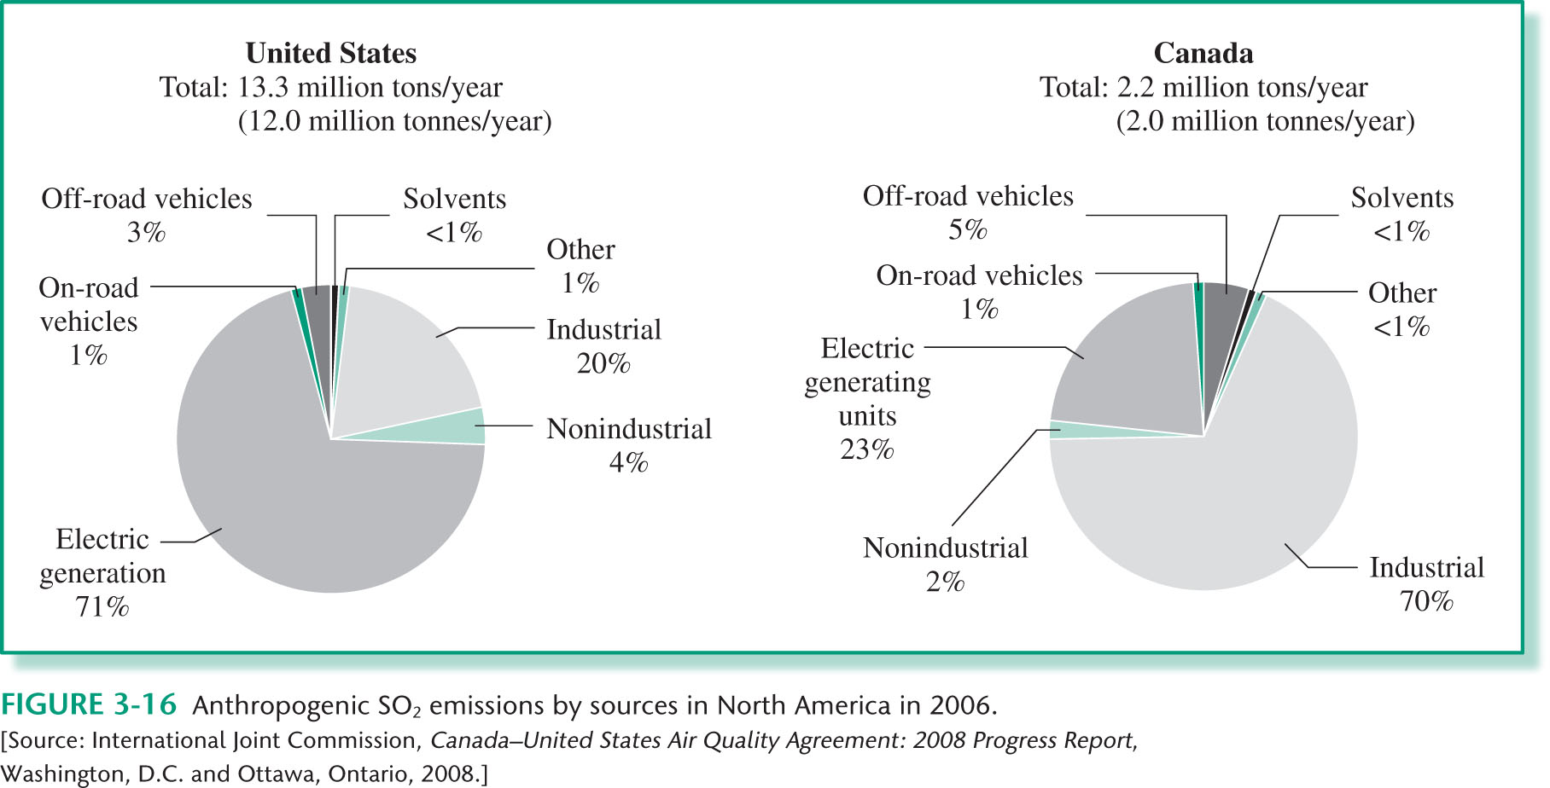
CHAPTER 03: Figure 3.16
© 2012 W. H. Freeman & Co.

Slide 55
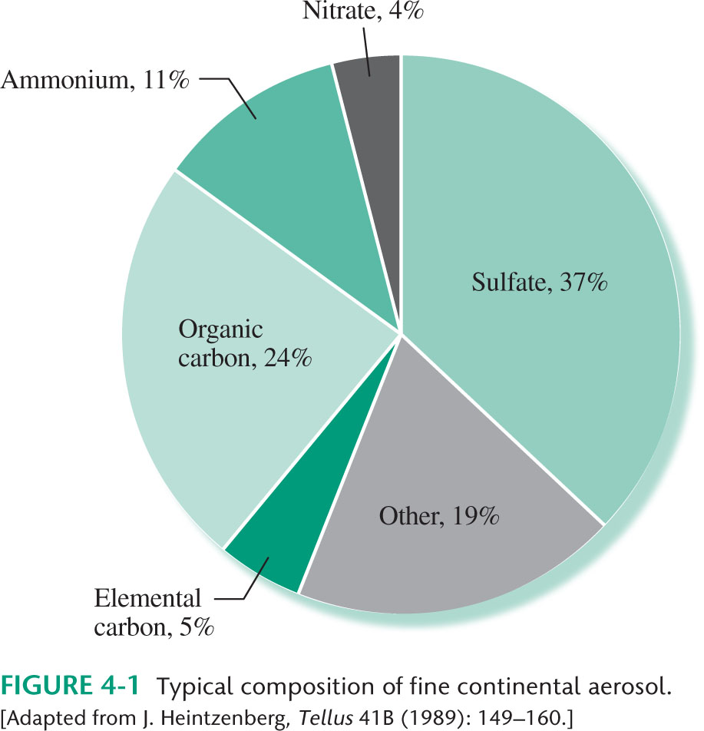
CHAPTER 04: Figure 4.1
© 2012 W. H. Freeman & Co.

Slide 56
Chapter 4 – Problem 1

Slide 57
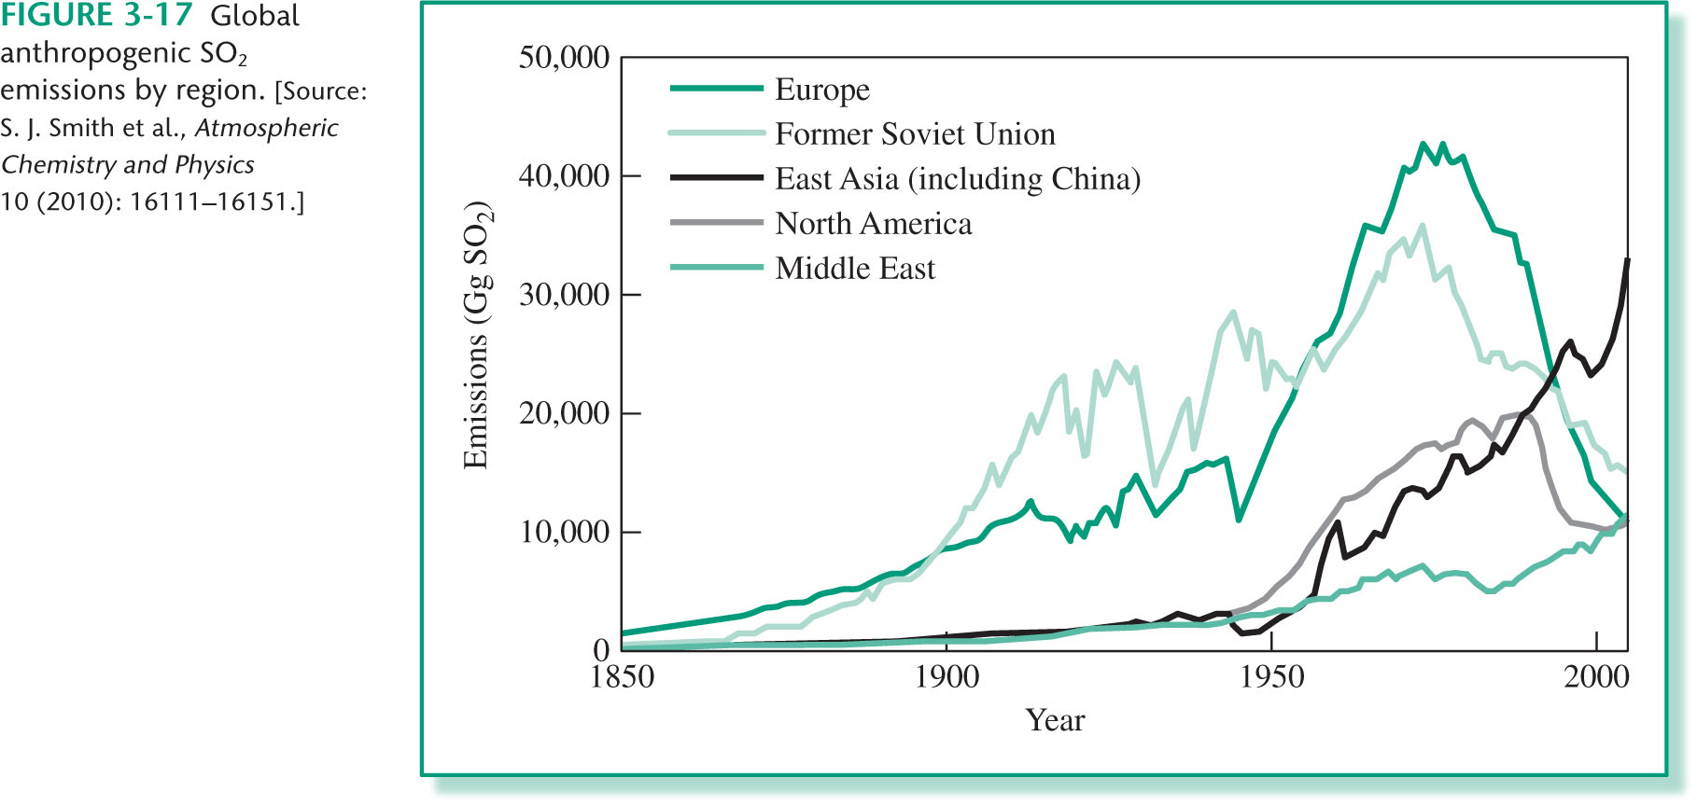
CHAPTER 03: Figure 3.17
© 2012 W. H. Freeman & Co.

Slide 58
Chapter 3 – Additional Problem 7

Slide 59
Long term, volume weighted averages of pH in precipitation – Europe 1978-1982

Slide 60
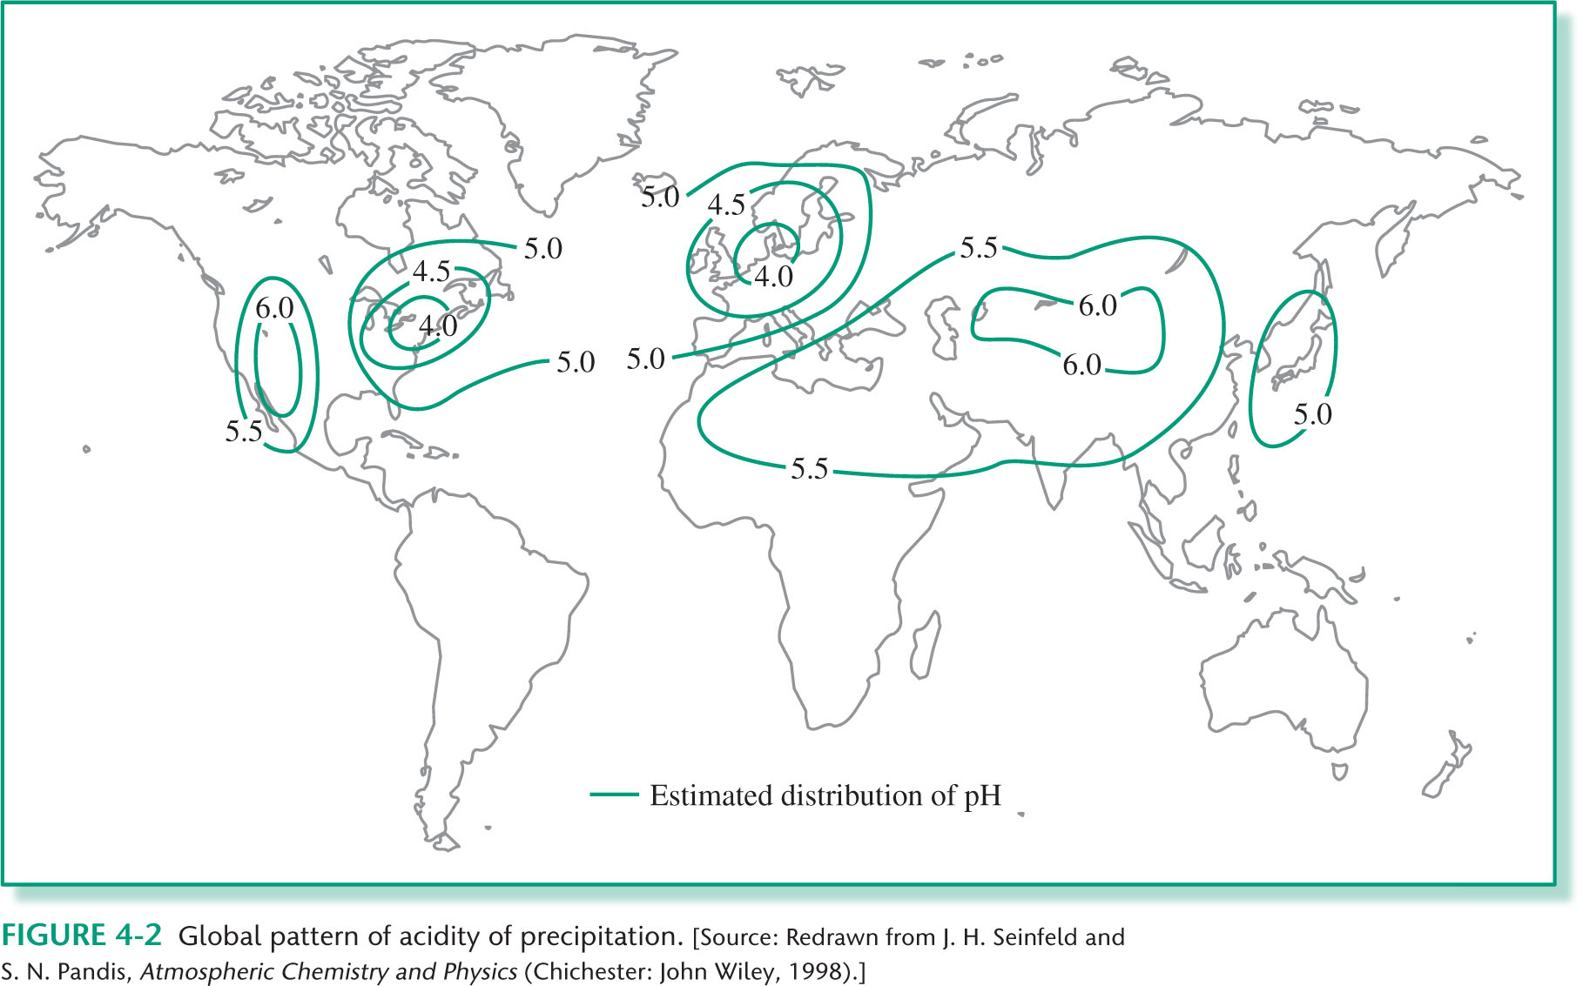
CHAPTER 04: Figure 4.2
© 2012 W. H. Freeman & Co.

Slide 61
Northeastern U.S. 1980-1984

Slide 62
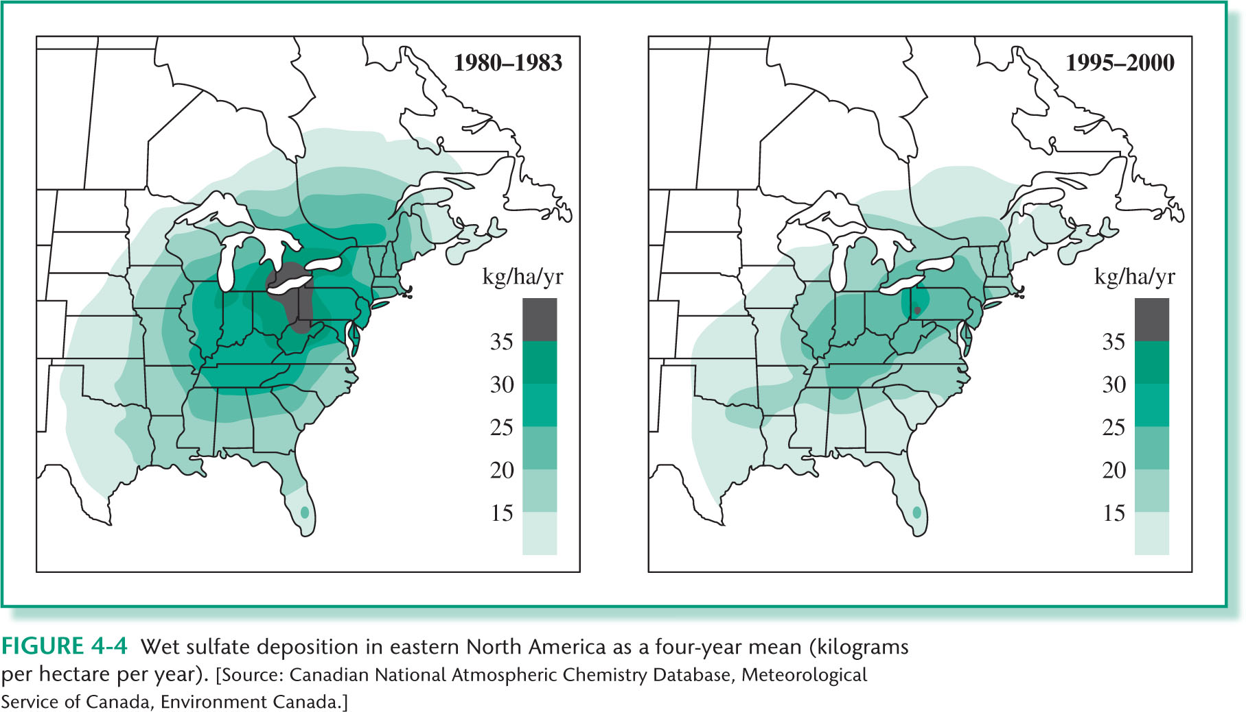
CHAPTER 04: Figure 4.4
© 2012 W. H. Freeman & Co.

Slide 63
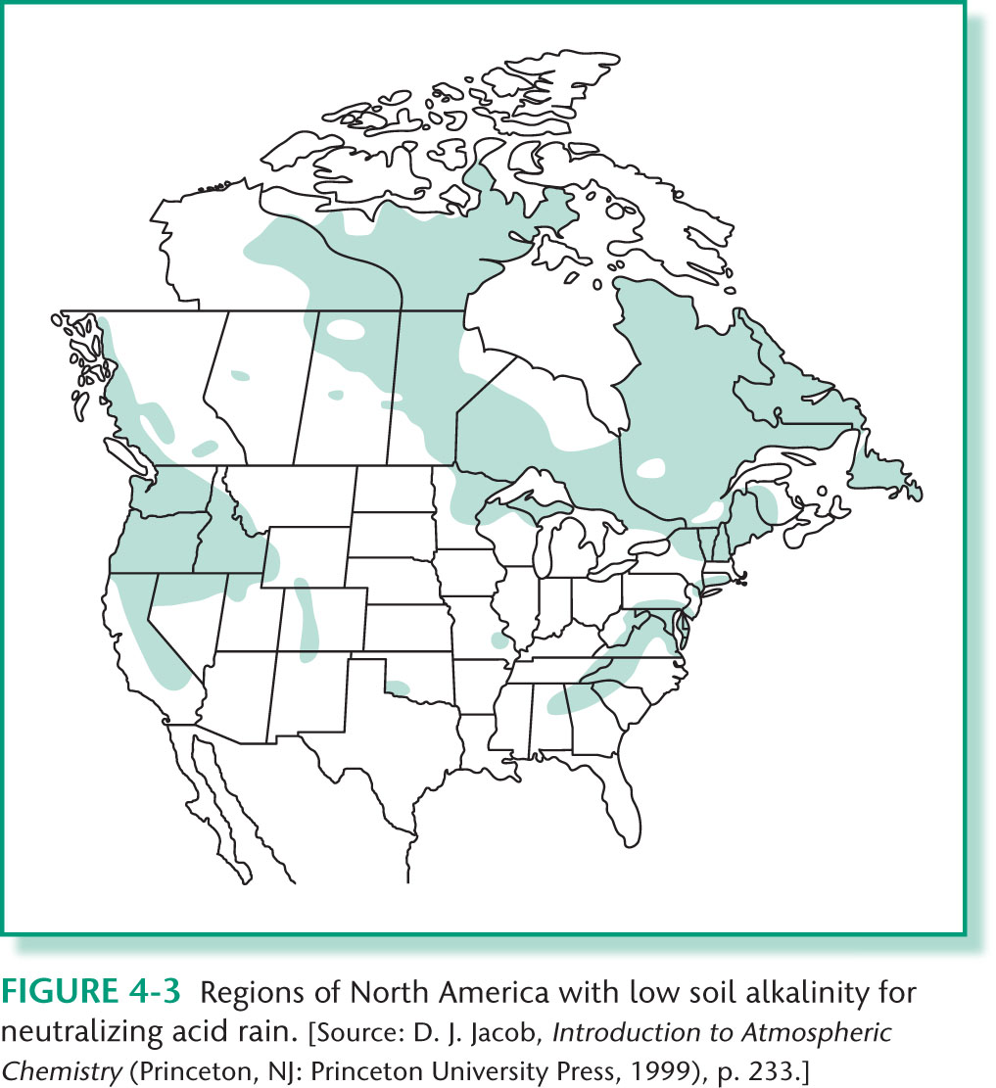
CHAPTER 04: Figure 4.3
© 2012 W. H. Freeman & Co.

Slide 64
End

