Slide 1
Hydrosphere
Acid Rain

Slide 2
Hydrologic Cycle

Slide 3
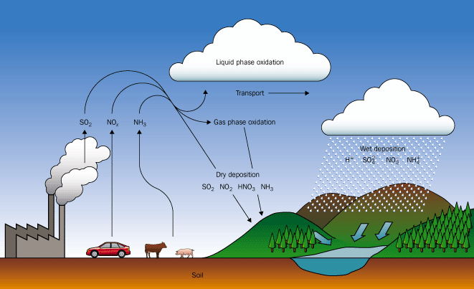

Slide 4
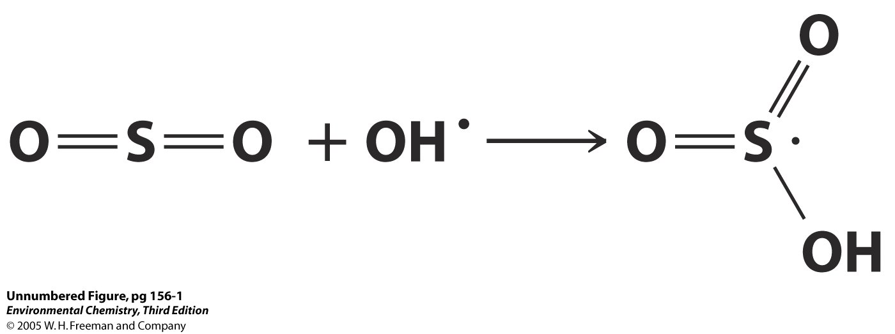

Slide 5
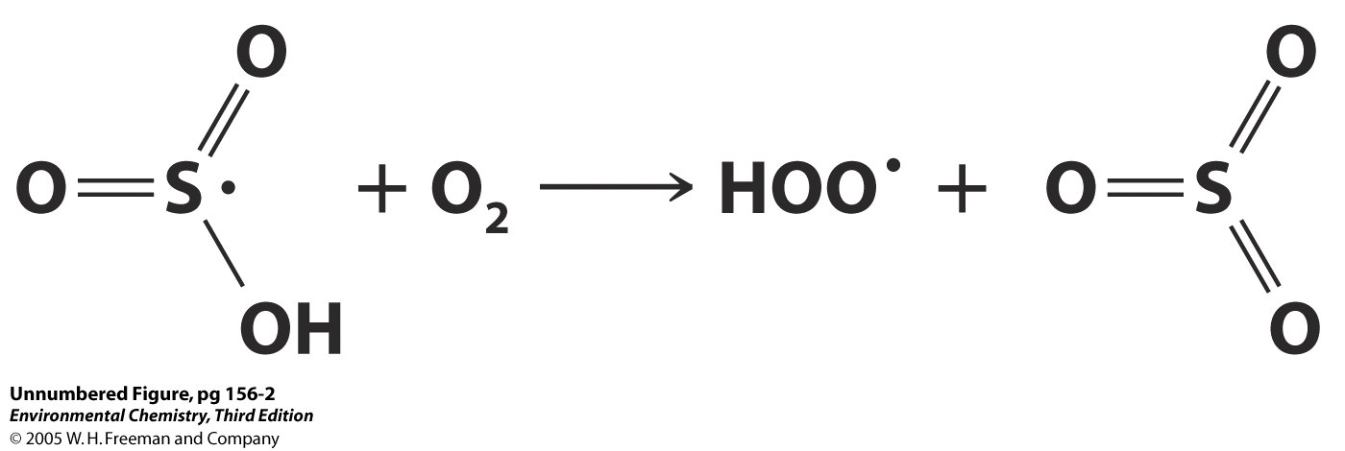

Slide 6
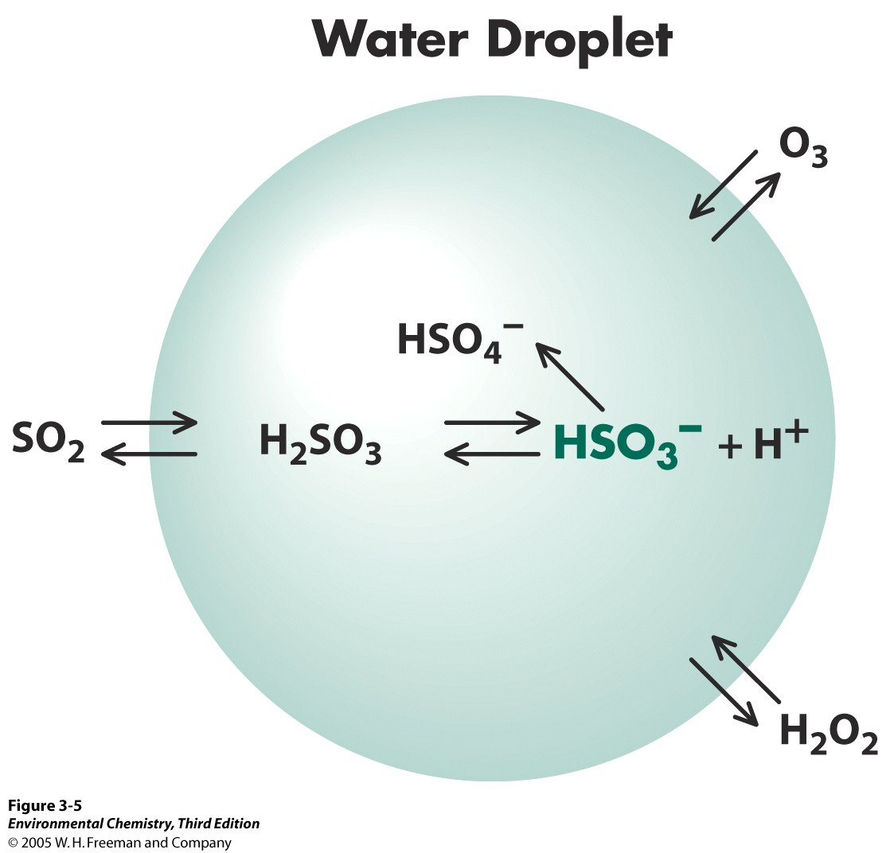

Slide 7
Sulfur Cycle

Slide 8
Long term, volume weighted averages of pH in precipitation – Europe 1978-1982

Slide 9
Northeastern U.S. 1980-1984

Slide 10
Lake Water pH vs. SO₂ Emissions

Slide 11
The fish have been dying off in a lake down wind of a coal fired power plant. Based on the following information, calculate the pH of rain relative to the SO₂(g) emitted from the power plant. Based on the the calculated pH of the rain is this a possible explanation for the fish kill?
[SO₂] = 0.11 ppbv
At 25 ºC K_{h} for SO₂= 1.0 mol/(L atm)
At 25 ºC, K_{a} for H₂SO₃ = 1.7 x 10⁻²

Slide 12
End

