Slide 1
Water and its Chemistry
Dissolved Oxygen and its role in Oxidation / Reduction Chemistry

Slide 2
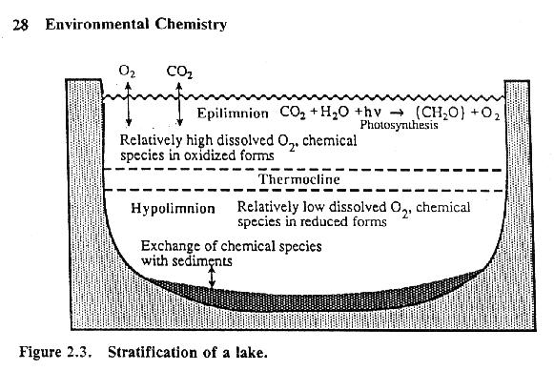

Slide 3
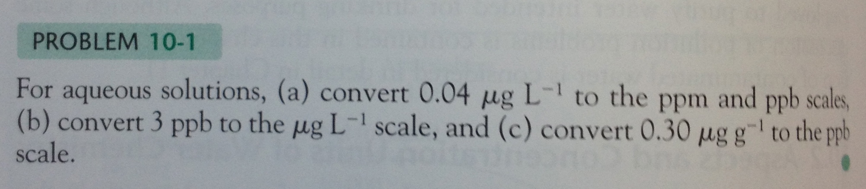

Slide 4
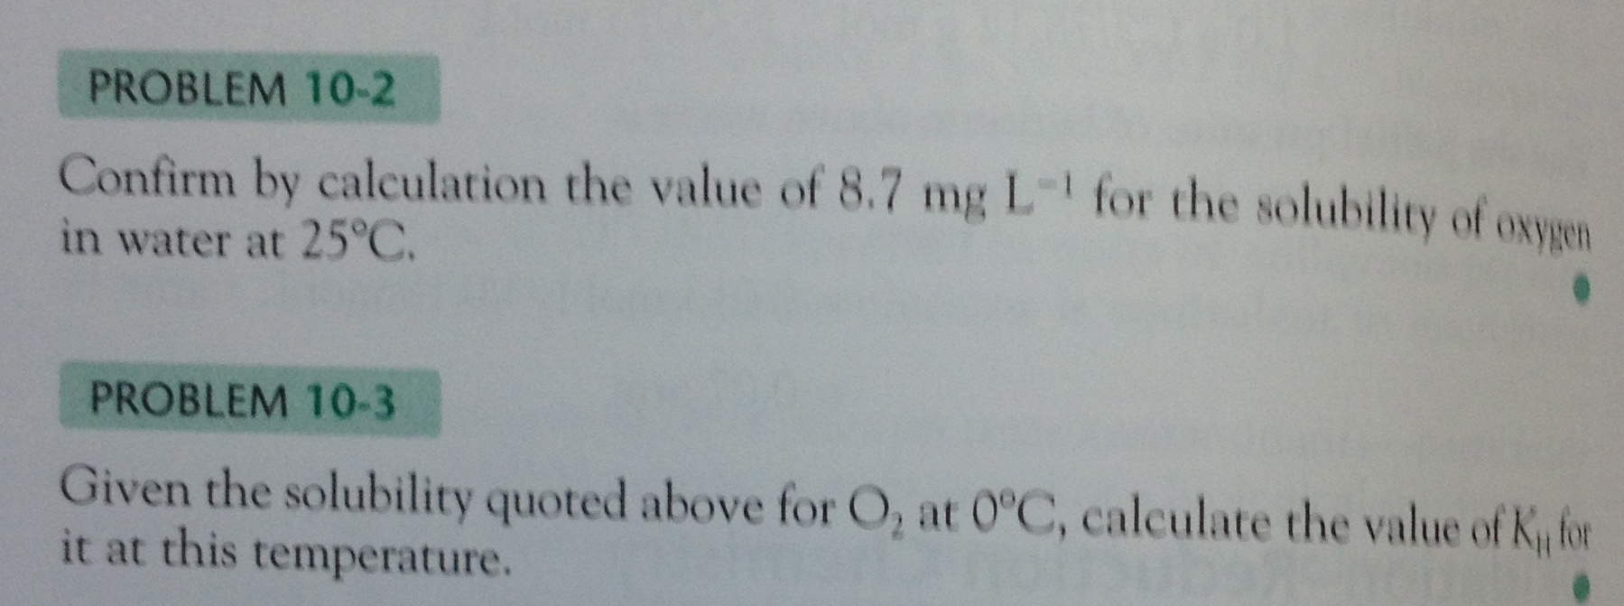

Slide 5
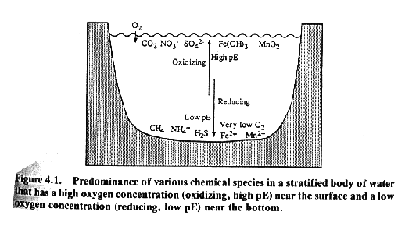

Slide 6
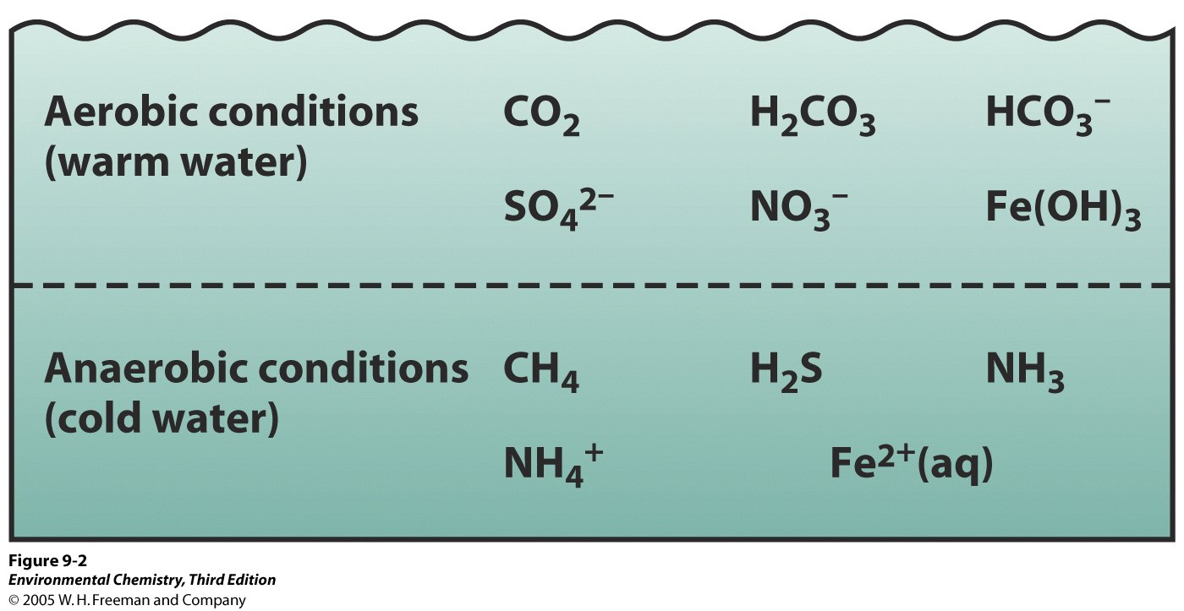
Stratification – low oxygen conditions in deep waters

Slide 7
Review of Terms
oxidation-reduction (redox) reaction: involves a transfer of electrons from the reducing agent to the oxidizing agent.
oxidation: loss of electrons
reduction: gain of electrons

Slide 8
Rules for Assigning
Oxidation States
1. Oxidation state of an atom in an element = 0
2. Oxidation state of monatomic element = charge
3. Oxygen = −2 in covalent compounds (except in peroxides where it = −1)
4. H = +1 in covalent compounds
5. Fluorine = −1 in compounds
6. Sum of oxidation states = 0 in compounds Sum of oxidation states = charge of the ion

Slide 9
Balancing by Half-Reaction Method
1. Write separate reduction, oxidation reactions.
2. For each half-reaction:
- Balance elements (except H, O)
- Balance O using H₂O
- Balance H using H⁺
- Balance charge using electrons

Slide 10
Balancing by Half-Reaction Method (continued)
3. If necessary, multiply by integer to equalize electron count.
4. Add half-reactions.
5. Check that elements and charges are balanced.

Slide 11
Half-Reaction Method - Balancing in Base
1. Balance as in acid.
2. Add OH⁻ that equals H⁺ ions (both sides!)
3. Form water by combining H⁺, OH⁻.
4. Check elements and charges for balance.

Slide 12
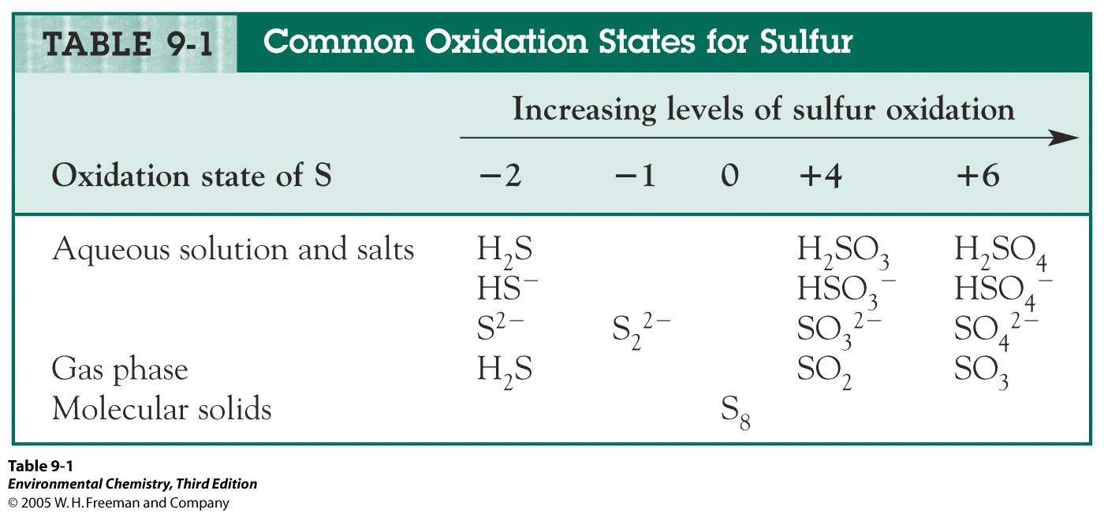

Slide 13
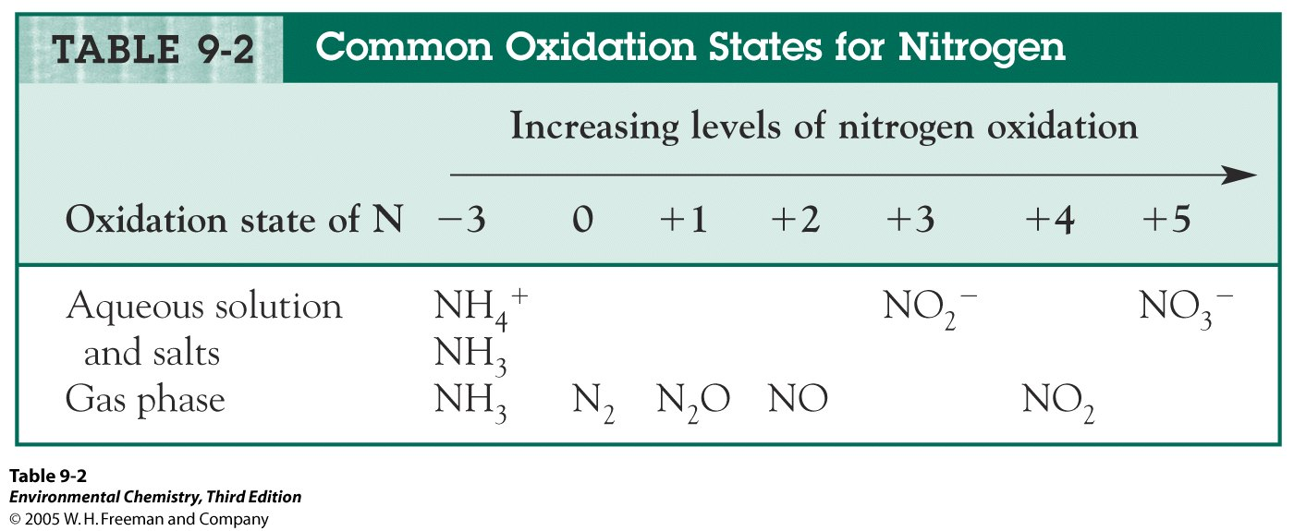

Slide 14
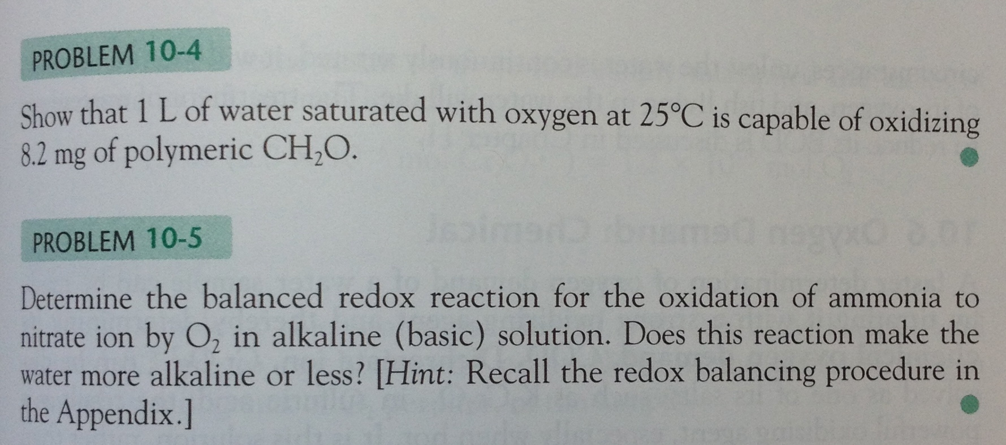

Slide 15
Electrochemistry
The study of the interchange of chemical and electrical energy.

Slide 16
Galvanic Cell
A device in which chemical energy is changed to electrical energy.

Slide 17
Anode and Cathode
OXIDATION occurs at the ANODE.
REDUCTION occurs at the CATHODE.

Slide 18
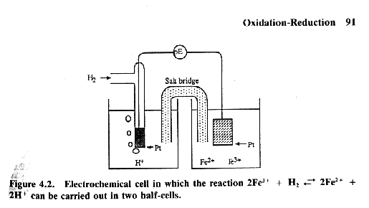

Slide 20
The pE Scale
pE = (E*F)/(2.303*R*T)=E/0.0592
Low pE means e⁻ are available (reducing)
High pE means e⁻ not available (oxidizing)

Slide 21
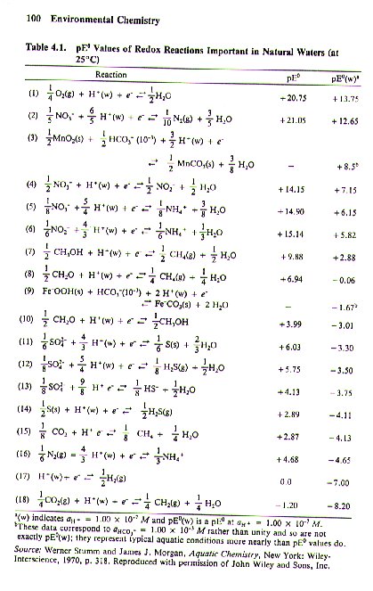
pE at
Standard
Conditions for Rxn’s in Natural
Waters

Slide 22
The Nernst Equation
We can calculate the potential of a cell in which some or all of the components are not in their standard states.

Slide 23
Free Energy and Cell Potential
ΔG° = −nFE°
n = number of moles of electrons
F = Faraday = 96,485 coulombs per mole of electrons

Slide 24
Calculation of Equilibrium Constants for Redox Reactions
At equilibrium, E_{cell} = 0 and Q = K.

Slide 25
From the Nernst Equation
pE = pEº - log(Q)
Q is the reaction quotient

Slide 26
pE and Free Energy
ΔG = -2.303nRT(pE)
n = moles of e-
R = gas constant
T = absolute temperature
pE for the reaction

Slide 27
pE and Equilibrium
Log K = n(pEº)
Gives insight into which species will be dominate.

Slide 28
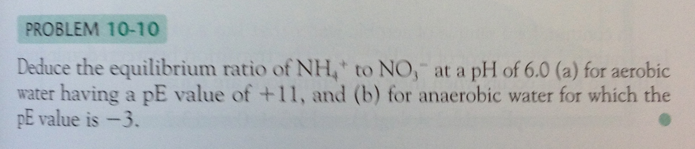

Slide 29
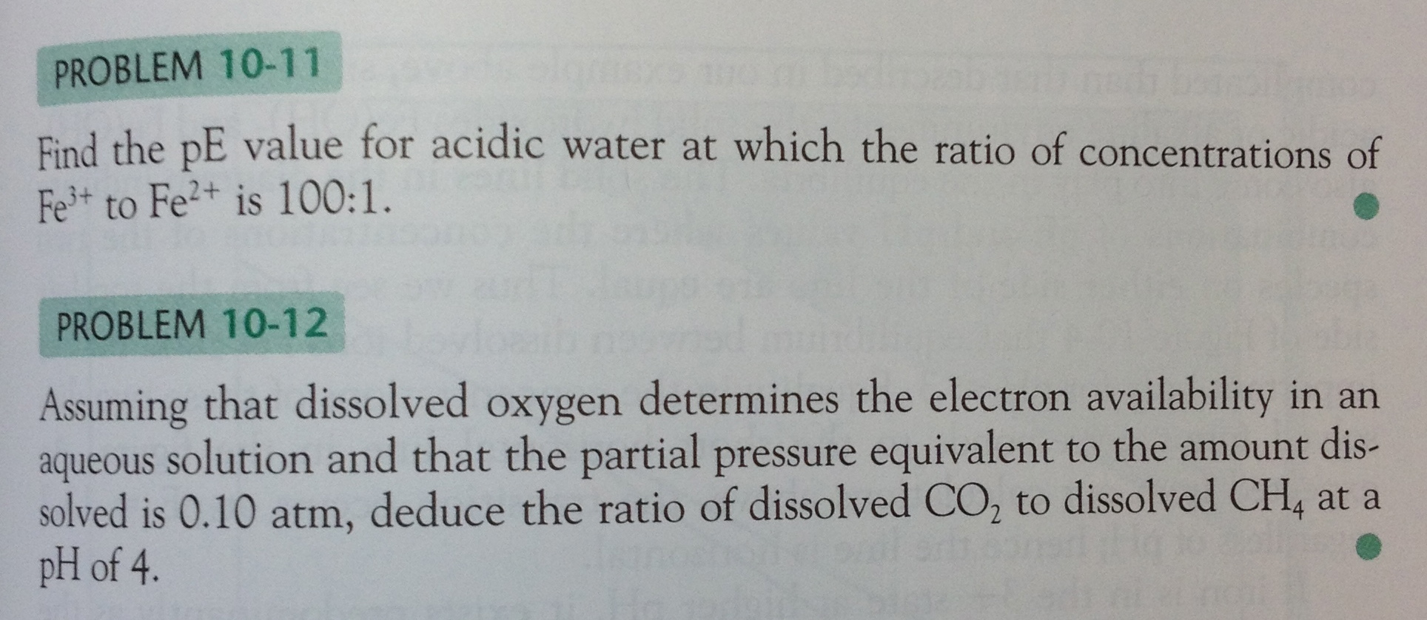

Slide 30
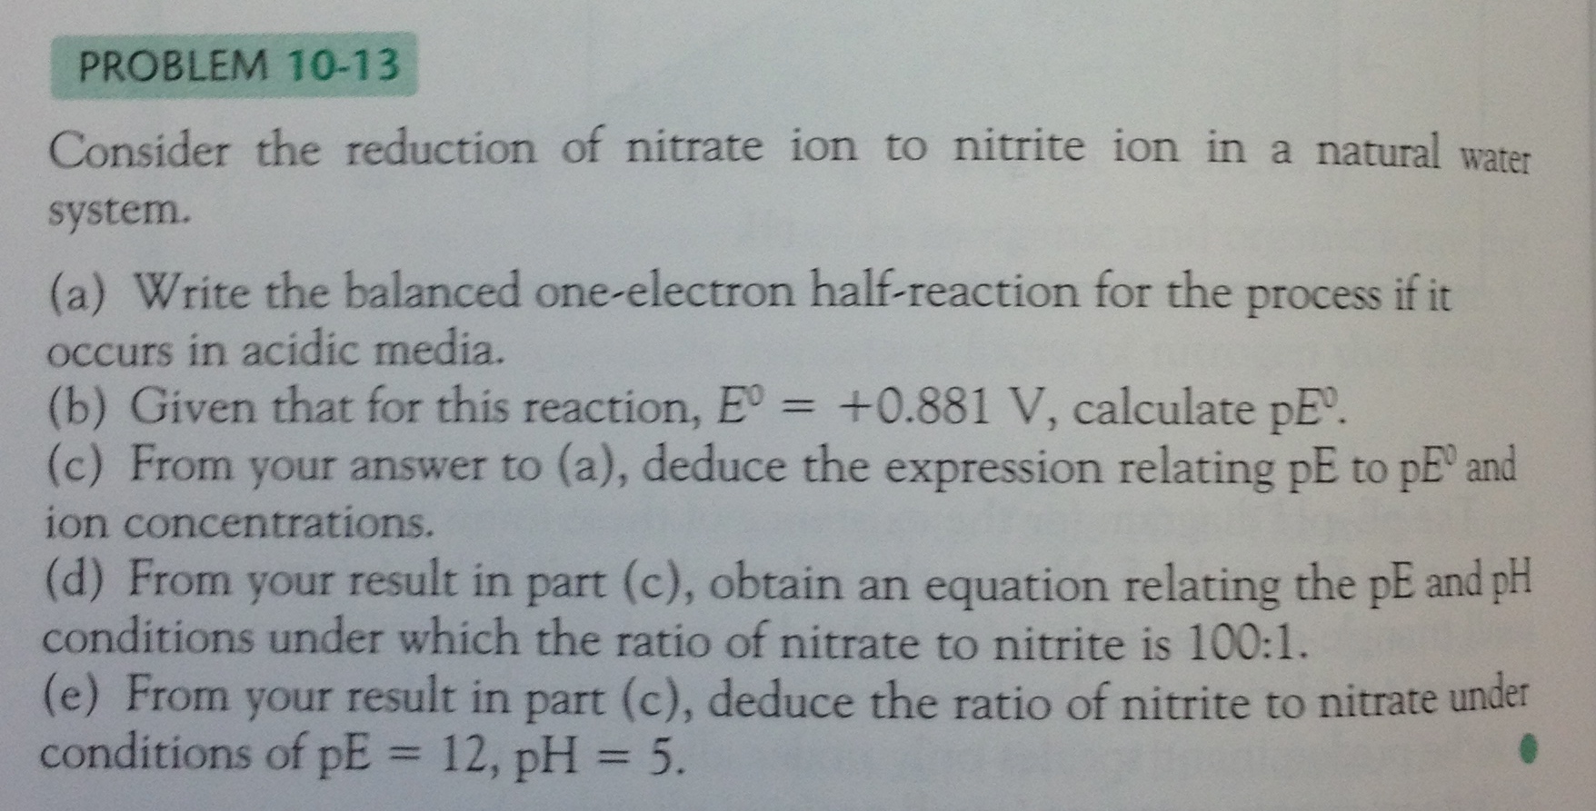

Slide 31
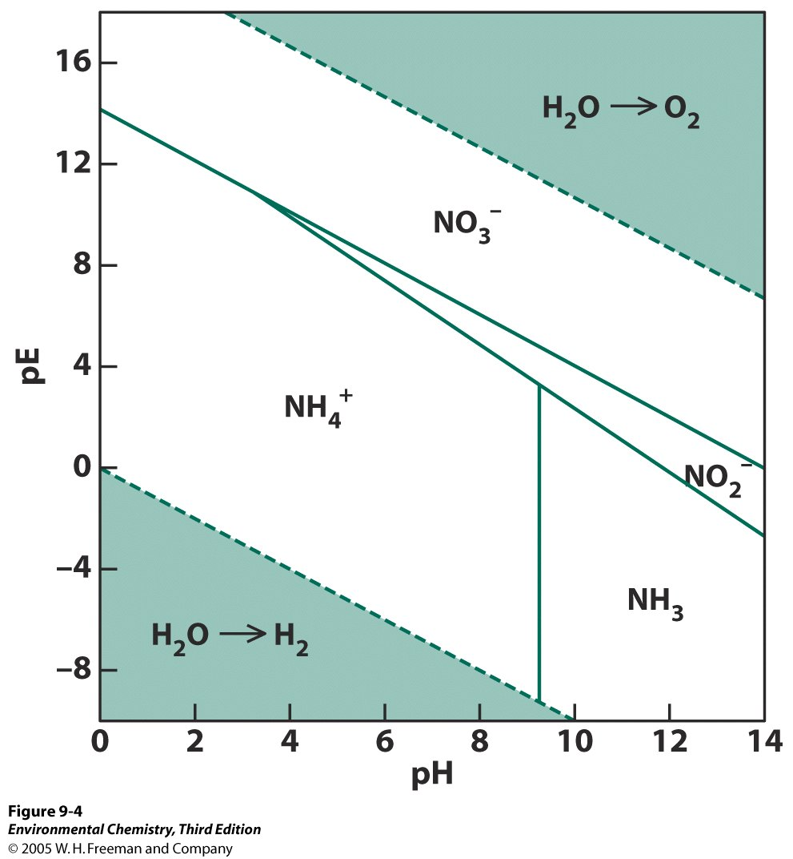

Slide 32
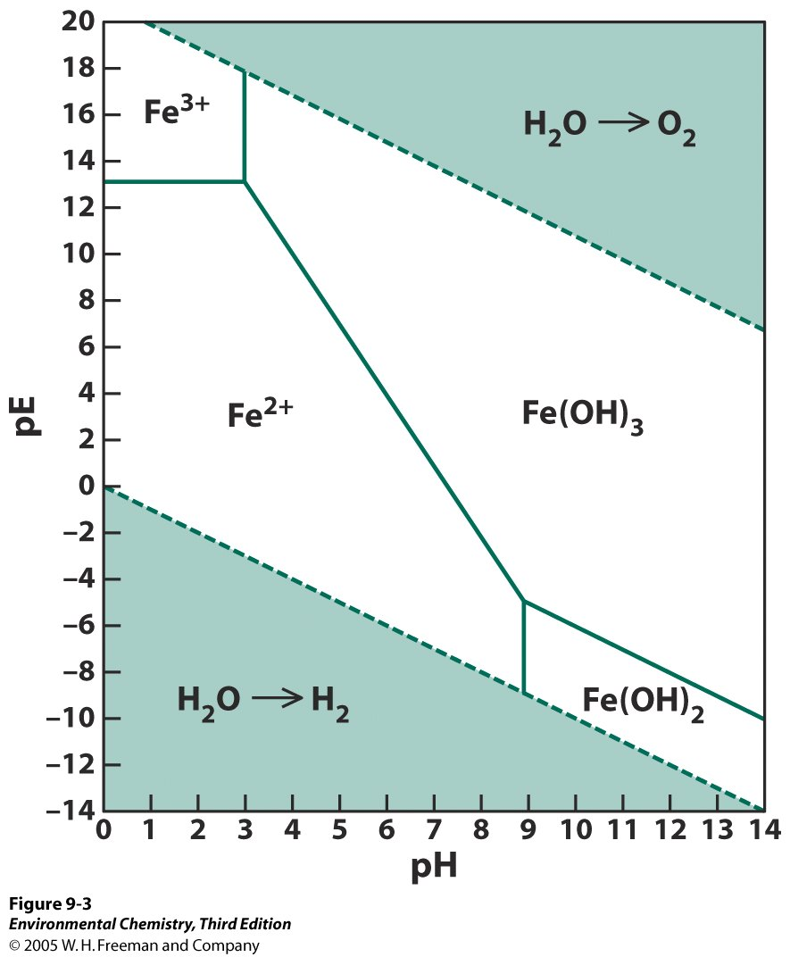

Slide 33
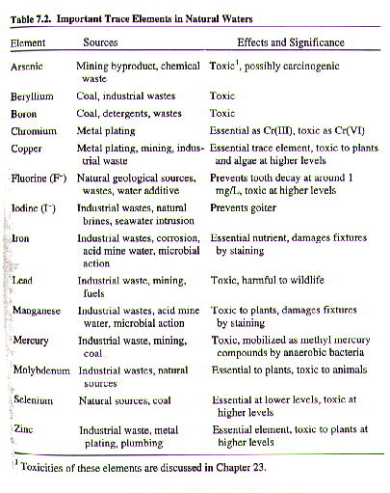

Slide 34
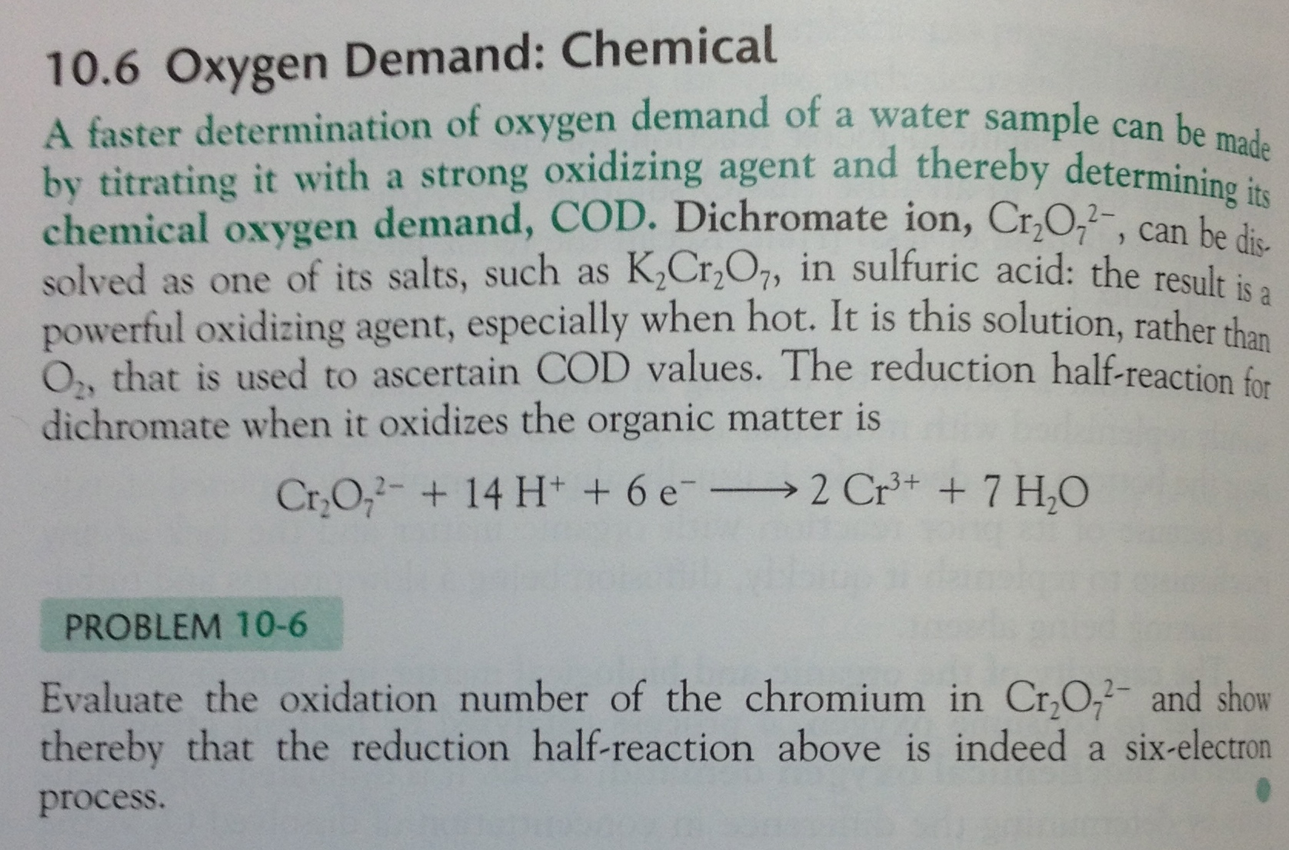

Slide 35
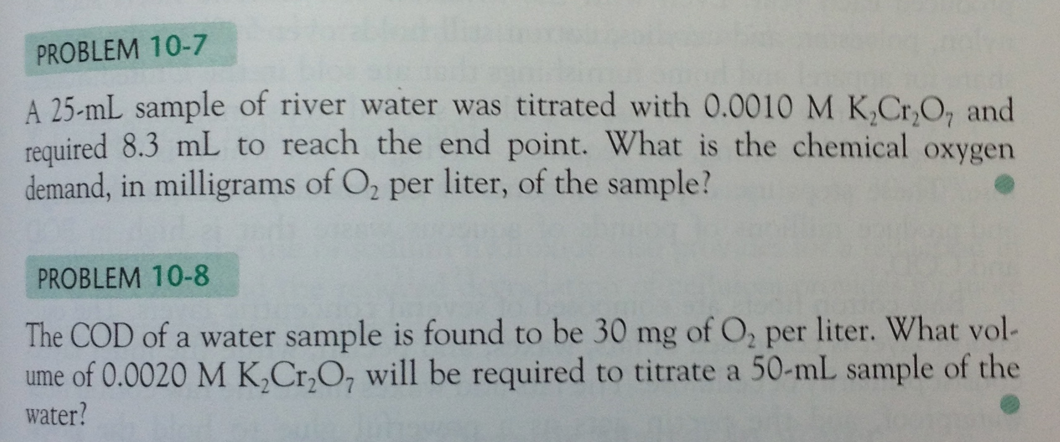

Slide 36
