Slide 1
Hydrosphere
Acid/Base Chemistry and the Carbon Dioxide – Carbonate Cycle

Slide 2
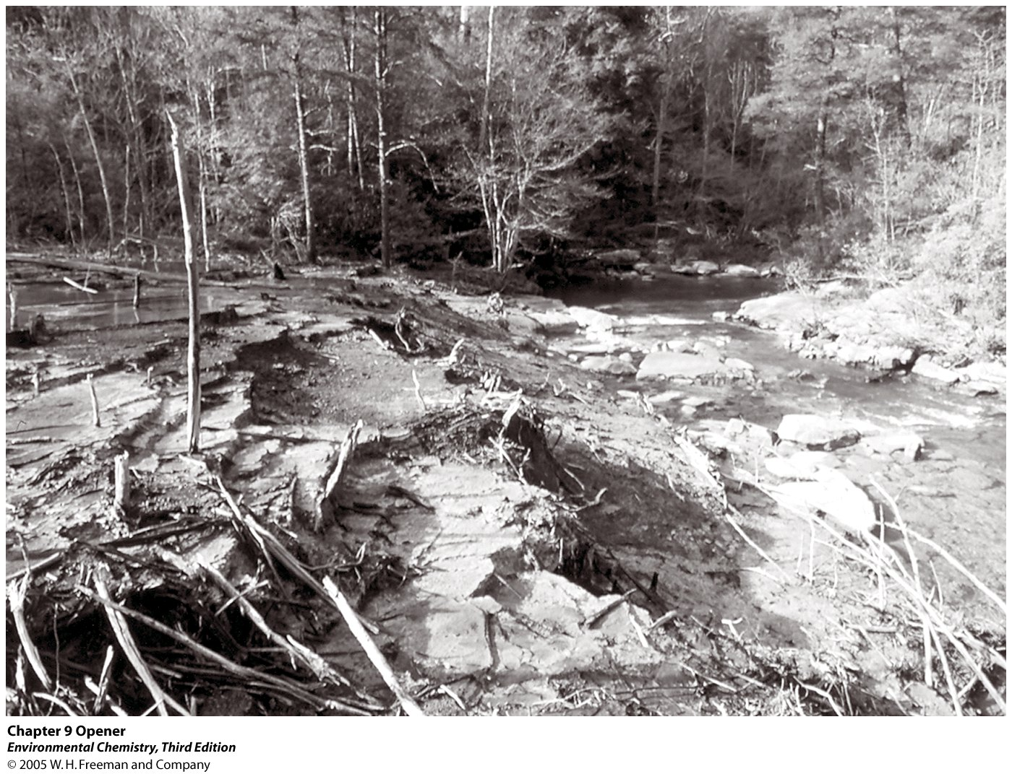

Slide 3
Hydrologic Cycle

Slide 4
Stratification of a Lake

Slide 5
Reservoirs and Annual Flows of Carbon (in 10¹⁵ g)

Slide 6
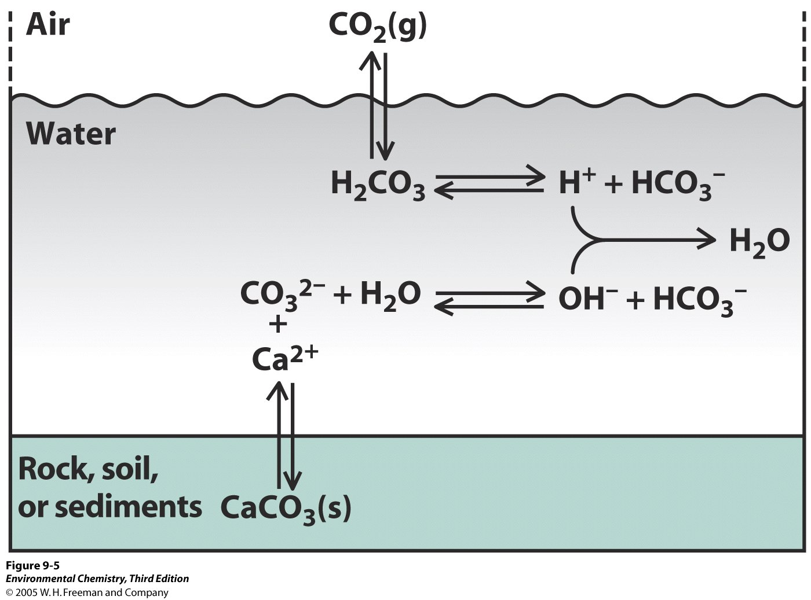

Slide 7
Equilibrium Constants

Slide 8
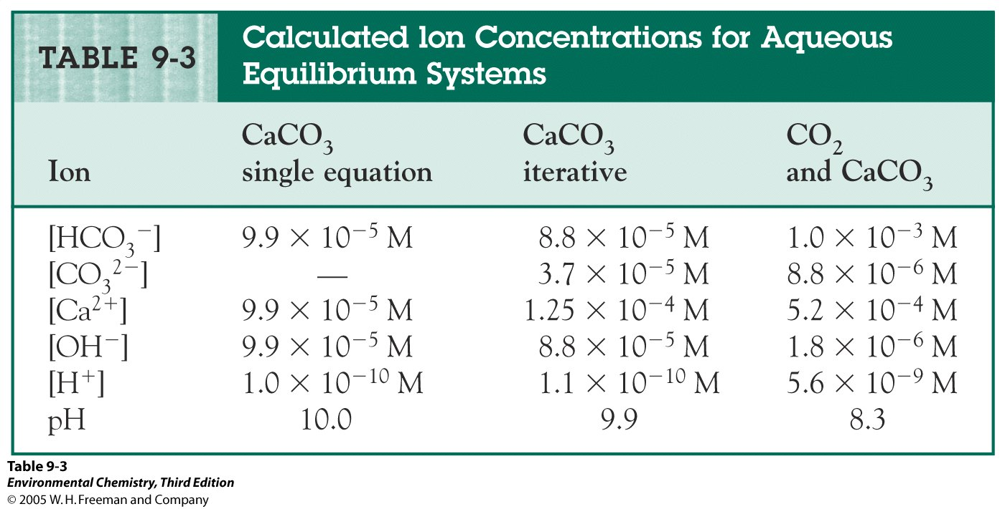

Slide 11
Distribution of Species in Water

Slide 12
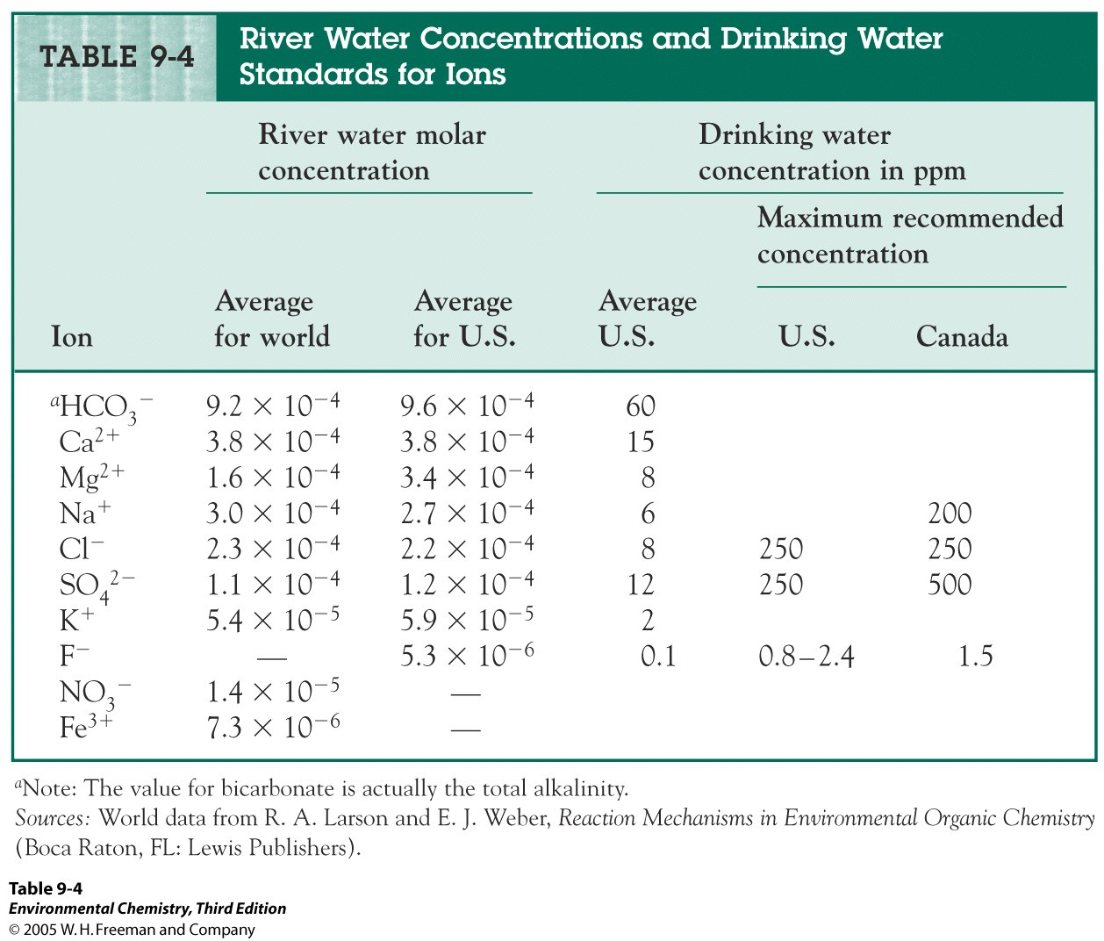

Slide 20
End

