Slide 1
Amphibians

Slide 2
Amphibians

Slide 3
Amphibians
First vertebrates adapted to land environment
Preceded onto land by plants, insects, snails
~350 million years ago

Slide 4
Amphibians
Not completely land adapted
Structurally between fish & reptiles
Most cannot be far removed from water

Slide 5
Amphibians
Things to be considered in water to land movement:
1) O₂ content of air greater than water (less effort to take up O₂ from air)
2) air less dense (lack of body support)

Slide 6
Amphibians
3) greater temperature fluctuations (unpredictable temperature extremes)
4) greater habitat variety (cover, shelter, breeding areas)

Slide 7
Earliest Amphibians
Appeared to have arisen from lobe-finned fishes
Were abundant during period when amphibians first appeared
Possessed characteristics that benefited first amphibians

Slide 8
Earliest Amphibians
Strong, mobile fins - used as stabilizers during swimming
Used as paddles to pull themselves across land in search of water

Slide 9
Earliest Amphibians
Lungs - lived in freshwater lakes & streams during periods of alternating floods, droughts
Gills useless in low dissolved O₂ areas or dry areas
Surviving fishes of this period developed simple lung

Slide 10
Earliest Amphibians
Salamander-like
Retained many characteristics of fish
Skull, tooth structure similar - snout more elongated
Fish tail with fin rays
Opercular bones present

Slide 11
Earliest Amphibians
Several differences
Jointed limbs with 5 digits (pentadactyl)
Ears for picking up airborne sounds (replace lateral line)
Improved olfactory powers - for airborne odors

Slide 12
Amphibian Diversity
Wet, warm conditions followed alternating dry-wet
Perfect conditions for amphibians - radiated off into many lines
Little pressure to become better land-adapted because of water everywhere

Slide 13
Amphibian Diversity
Became better adapted to water
Bodies became more flattened
Some developed webbed feet
Some developed weaker legs & stronger tails for more efficient swimming

Slide 14
Amphibian Diversity
Produced 3 basic groups of amphibians present today
Order Anura (without tail) - frogs, toads
Order Caudata (with tail, Urodela) - salamanders & newts
Order Gymnophiona (naked snake) - caecilians

Slide 15
Lungs & Circulation
Improved on efficiency of simple lung
Supplied it with capillary network to improve O₂ uptake
Double circulation
Systemic
Pulmonary

Slide 16
Jointed Limbs
Strengthening of limbs - 5 digits, joints
Improvements in pelvic, pectoral girdles
Developed for continued survival in aquatic environments, but pre-adapted others for life on land

Slide 17
Amphibian Characteristics
Aquatic ectotherms - body temperature varies with the environment
Difficult to withstand temperature extremes of terrestrial environment

Slide 18
Amphibian Characteristics
Skin must be kept moist - obtain much of their O₂ through the skin
Thin, unprotected from desiccation

Slide 19
Amphibian Characteristics
Mode of reproduction requires water or moisture
Eggs fertilized externally
Larvae must pass through an aquatic tadpole stage

Slide 20
Amphibian Characteristics
Skelton mostly bony
Varying number of vertebrae
Some may have ribs
Notochord does not persist

Slide 21
Amphibian Characteristics
Great variety of body forms
Elongated trunk with distinct head, neck, tail, 4 legs (tetrapods)
Frogs with compact depressed body, fused head & trunk, no neck

Slide 22
Amphibian Characteristics
Some legless forms without distinct body regions (caecilians)

Slide 23
Amphibian Characteristics
Webbed feet common
No “true” claws or nails on digits

Slide 24
Amphibian Characteristics
Skin smooth and moist
No ectodermal scales (some have concealed dermal scales)
Many glands - some poisonous

Slide 25
Amphibian Characteristics
Two nostrils open into mouth cavity
Breathe with mouth closed

Slide 26
Amphibian Characteristics
Respiration via lungs, skin, gills
Some salamanders lack lungs
Skin well vascularized
External gills in larvae may persist throughout life in some

Slide 27
Order Gymnophiona
Caecilians
Body long, slender, wormlike
Limbs and limb girdles absent
Many vertebrae, long ribs
Tail short or absent

Slide 28
Order Gymnophiona
Burrowers, tropical forests of S. Amer., Africa, SE Asia
Small, mostly degenerate eyes (mostly blind as adults)
Sensory tentacles on snout
Tail short or absent, terminal anus

Slide 29
Order Gymnophiona
Feed on worms, small invertebrates
Fertilization internal, eggs deposited in moist soil near water
Some species guard eggs (body folds)

Slide 30
Order Gymnophiona
May or may not have aquatic larval stage
Complete larval development may occur in egg
Viviparity common in more advanced forms
Embryos eat oviduct wall

Slide 31
Order Caudata
Salamanders and newts
Least specialized amphibians
Found in almost all tropical and northern temperate regions of world
Most species in N. America

Slide 32
Order Caudata
Typically small, most <15 cm long
Aquatic species may be much larger
Carnivorous Japanese giant salamander may be >1.5 m long

Slide 33
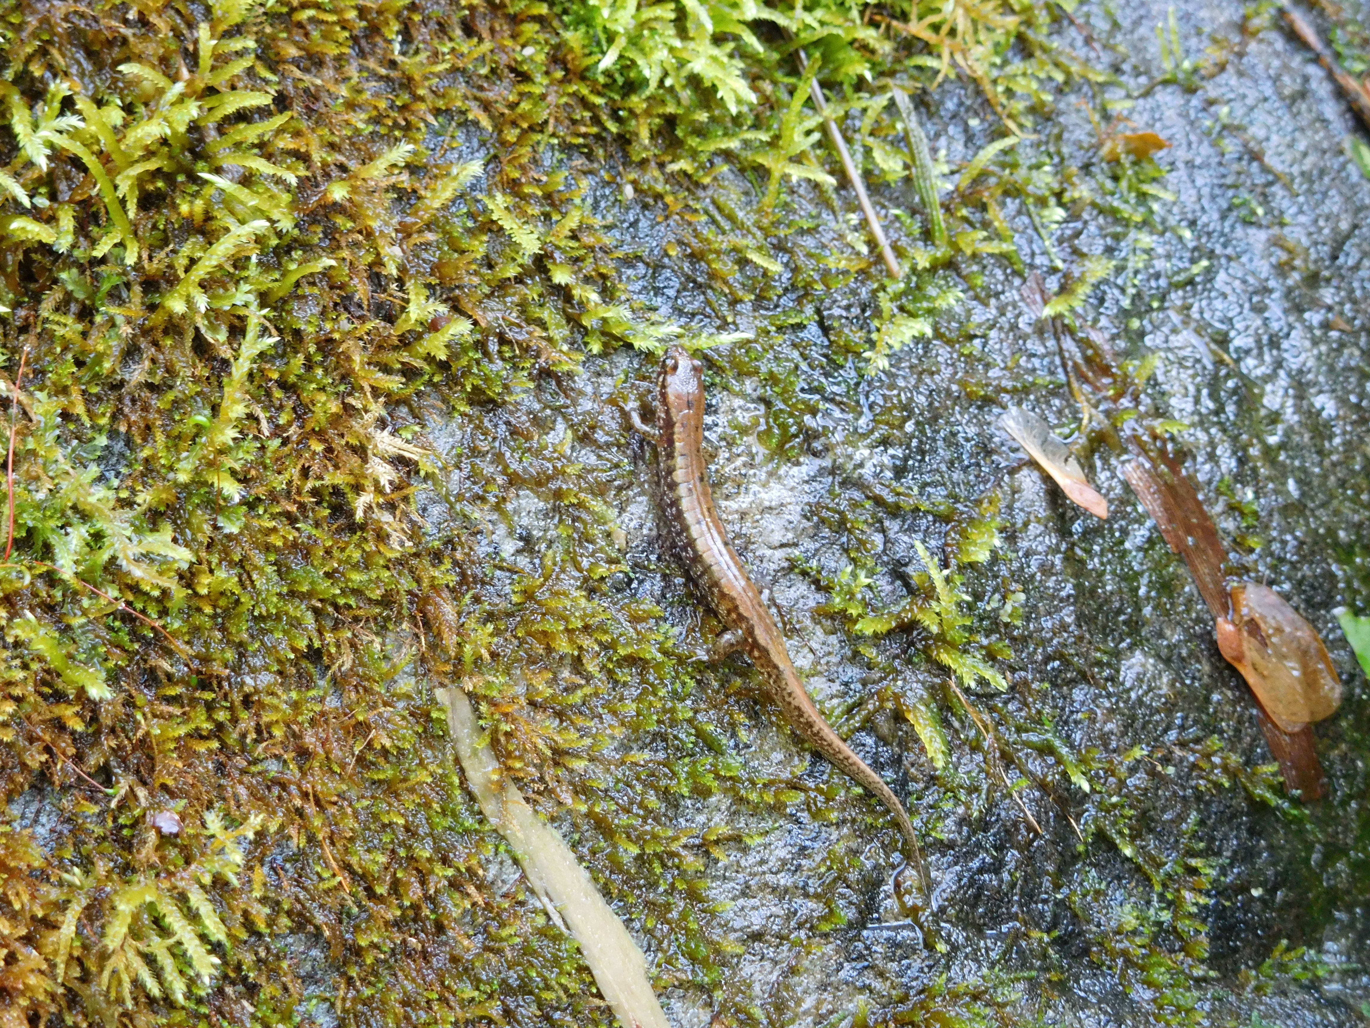
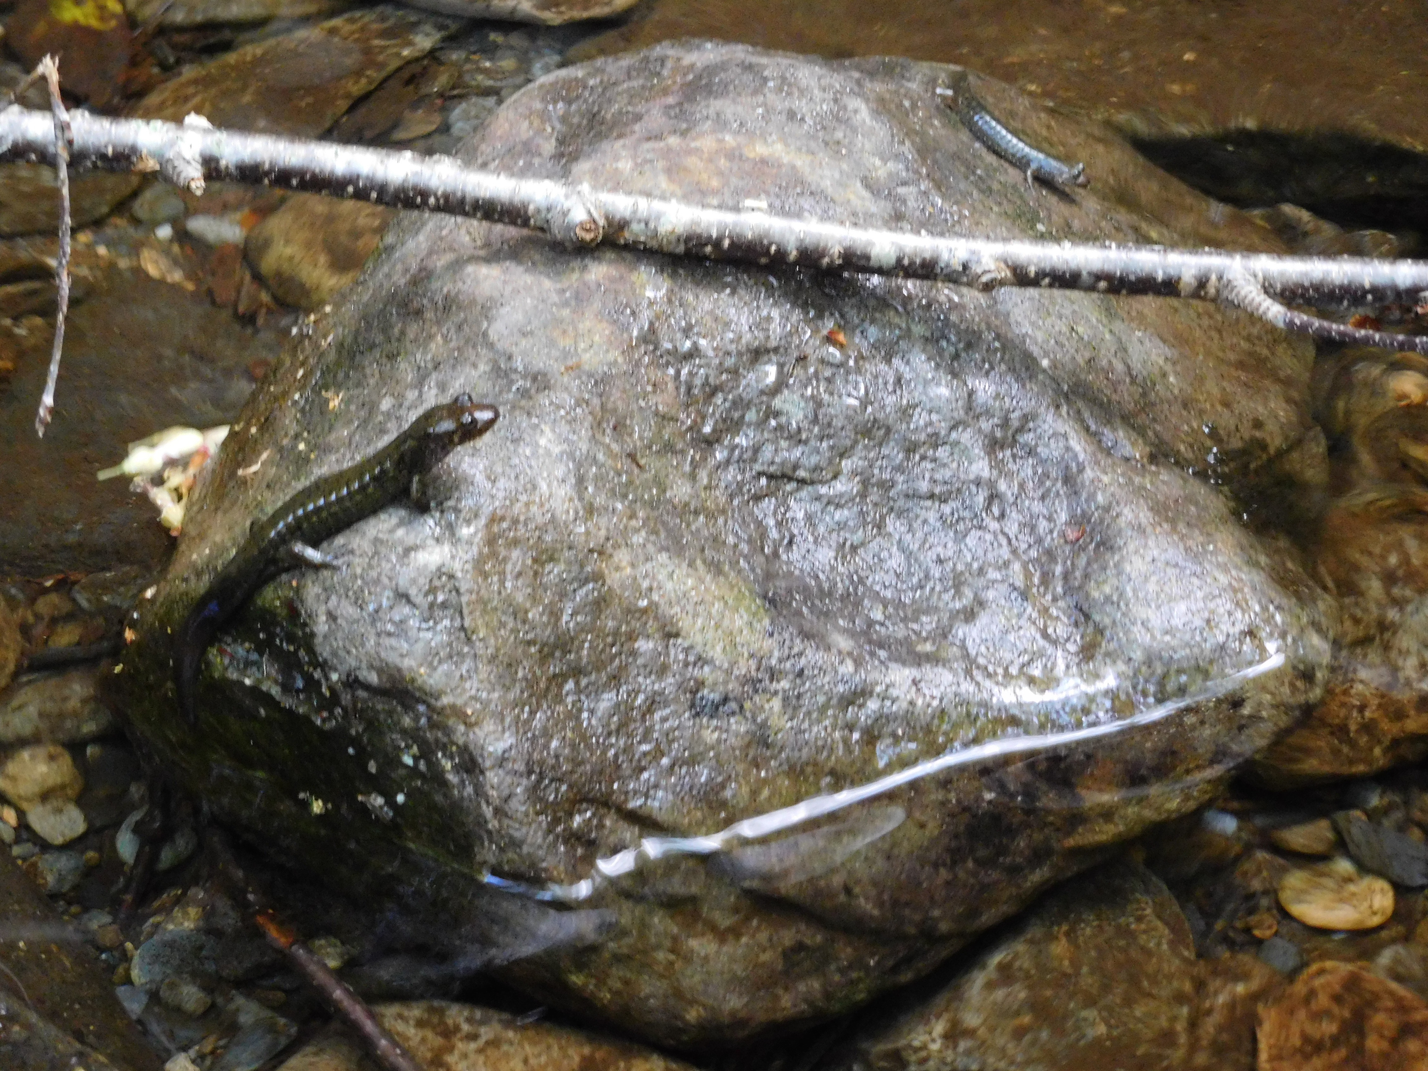

Slide 34
Order Caudata
No scales
2 pairs of equal-sized limbs
Primitive limbs set at right angles to body

Slide 35
Order Caudata
Some species have rudimentary limbs
Amphiuma has tiny limbs
Sirens have minute forelimbs, no hindlimbs
Different enough for separate order?

Slide 36
Order Caudata
Amphiuma
Siren

Slide 37
Order Caudata
Carnivorous - prey on worms, small arthropods, small molluscs
Most eat only things that are moving

Slide 38
Order Caudata
Food is protein-rich - do not store great quantities of fat or glycogen
Ectotherms, low metabolic rate - low food demand

Slide 39
Order Caudata
Most salamanders are terrestrial
Live in moist places under stones, rotten logs
Seldom far from water

Slide 40
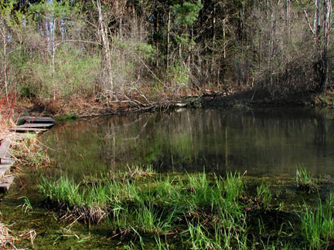
Order Caudata
Some salamanders wholly aquatic throughout life cycle

Slide 41
Order Caudata - reproduction
Little diversity of breeding habits
Eggs of most salamanders fertilized internally
Female picks up packet of sperm (spermatophore) previously deposited by male onto some substrate

Slide 42
Order Caudata - reproduction
Ritualistic behaviors help ensure female receptivity
Additional behaviors ensure recovery of sperm mass by female

Slide 43
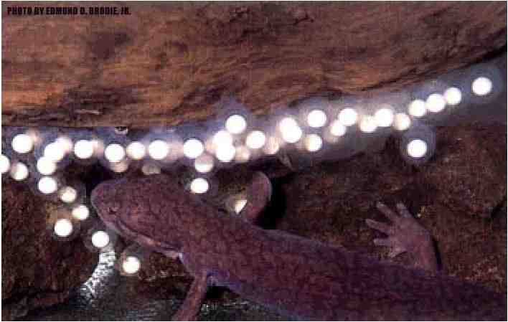
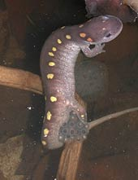
Order Caudata - reproduction
Aquatic species lay eggs in clusters or stringy masses in water
Often attached to submerged objects

Slide 44
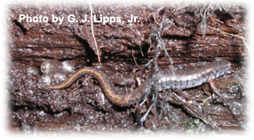
Order Caudata - reproduction
Terrestrial species lay eggs in tiny, grape-like clusters under logs, in vegetation, or in excavations in soft earth

Slide 45
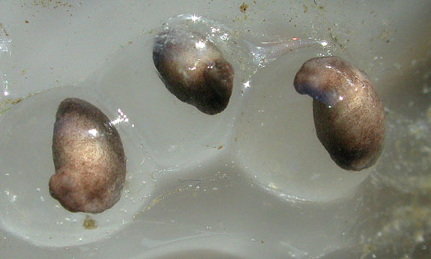
Order Caudata - development
Some species remain (female) and guard eggs until hatching

Slide 46
Order Caudata - development
Larvae which hatch are not tadpole-like
Resemble parents

Slide 47
Order Caudata - development
Still must undergo metamorphosis to attain adult form
Gills generally lost and fin-like tail modified during metamorphosis

Slide 48
Order Caudata - development
Size and type of gills dependent on larval habitat
Larger in lake, pond, smaller in stream habitat
Lungs usually replace gills in adults (except in aquatic forms)

Slide 49
Order Caudata - development
Development variation: American newts
Have a terrestrial stage between aquatic larva and aquatic breeding adult
Red-spotted newt - red eft stage - 1-3 years

Slide 50
Order Caudata - no lungs
Some salamanders don’t bother developing lungs when they lose gills
Family Plethodontidae - lungless salamanders - most of familiar N. Amer. salamanders

Slide 51
Order Caudata - no lungs
Only adult vertebrates with neither lungs nor gills
Skin highly vascularized - vascular net
Extension of capillaries into epidermis OR thinning of epidermis over dermal capillaries

Slide 52
Order Caudata - no lungs
Provides 90-95% of gas exchange
Other 5-10% from capillaries inside mouth
Buccopharyngeal breathing

Slide 53
Order Caudata - no lungs
Originated in swift, cool, highly oxygenated streams in Appalachia
Cutaneous respiration could provide enough O₂
Lungs would provide too much buoyancy in this environment

Slide 54
Order Caudata - metamorphosis
Most salamanders undergo metamorphosis, but some retain gills or other larval characteristics after becoming sexually mature
Neoteny (young, to extend)

Slide 55
Order Caudata - metamorphosis
Some retain characters for entire lifetime - permanent larvae
Obligatory neoteny
Necturus - mudpuppy
Live on bottom of ponds, lakes, large rivers

Slide 56
Order Caudata - metamorphosis
Either developing tissues fail to respond to thyroxin (metamorphosis hormone) OR pituitary gland doesn’t develop fully to produce thyrotropin that stimulates thyroid gland to produce thyroxin

Slide 57
Order Caudata - metamorphosis
Others retain characteristics, but can change if conditions are favorable
Facultative neoteny
Achieved by delaying somatic development, but not sexual maturation

Slide 58
Order Caudata - metamorphosis
Example of facultative neoteny: Ambystoma species
Tiger salamander subspecies called American axolotl
Mexico and SW US

Slide 59
Order Caudata - metamorphosis
Remains aquatic, gill-breathing, fully reproductive larval form unless water begins to dry up
Metamorphoses to adult, loses gills, develops lungs, assumes appearance of ordinary salamander

Slide 60
Order Caudata - metamorphosis
Can be artificially induced to metamorphose by treating them with thyroxin
Essential for normal metamorphosis in all amphibians

Slide 61
Order Caudata - territoriality
Some salamanders display territorial behavior
Use scent to mark territories - Plethodontidae
Males of some species defend territories against conspecifics

Slide 62
Order Caudata - territoriality
Attack intruders with foreign scent, but not neighbors with familiar scent
Nasolabial grooves - chemosensory system

Slide 63
Order Caudata - territoriality
Territory defended against intruders at expense of reduced energy intake
Attack nose of intruders - ruin chemosensory system?
Less able to feed, smaller

Slide 64
Order Caudata - toxicity
Many newts contain mucous glands in skin that secrete irritating or toxic materials
E.g., red eft (terrestrial red-spotted newt) produces a potent neurotoxin

Slide 65
Order Caudata - toxicity
Produces unpleasant numbness or tingling sensation in animals touching it
Secretions have been known to kill animals that ingested them (including humans)

Slide 66
Order Caudata - toxicity
Species may advertise their toxicity with conspicuous aposematic, or warning, colors and behaviors
Red eft is brilliant red-orange

Slide 67
Order Caudata - toxicity
Other species that are more plainly colored often flip when attacked to display brightly colored bellies

Slide 68
Order Caudata - toxicity
Some species have adapted to mimic toxic forms
E.g., red-backed salamander has a red color morph (normally only red on back) that resembles red eft
Studies: red morph suffers less bird predation than normal color morph

Slide 69
Order Anura
Frogs & toads
>3400 species
Most familiar, successful amphibians
Obvious, common characteristic - lack of tail in adult
All pass through tailed larval stage

Slide 70
Order Anura
Specialized for jumping mode of locomotion

Slide 71
Order Anura
Further distinguished from Caudata by:
Larvae - tadpole or polliwog stage
Metamorphosis during development

Slide 72
Order Anura
Tadpole
Long, finned tail
Both internal, external gills
No legs
Specialized mouthparts for herbivory (salamander larvae are carnivorous)
Highly specialized internal anatomy

Slide 73
Order Anura
Striking metamorphosis from tadpole to adult
Neoteny never exhibited in frogs or toads

Slide 74
Order Anura
Represent specialized side branch of amphibian evolution
Not good representatives of vertebrate body plan

Slide 75
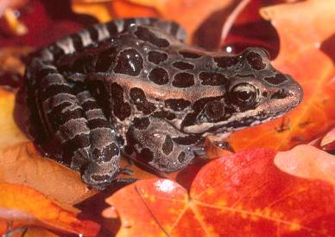
Order Anura
No visible neck
Caudal vertebrae fused (to form urostyle)
Ribs generally absent
Hindlegs much enlarged

Slide 76
Order Anura
21 different families
Common North American frogs
Ranidae - grass frogs
Hylidae - tree frogs

Slide 77
Order Anura
Bufonidae - true toads
Short legs, stout bodies, and thick skins, usually with prominent warts
“toad” often used to refer to more terrestrial members of many families

Slide 78
Order Anura
Largest anuran - West African goliath frog
>30 cm from nose to anus, ~1 m with outstretched legs
3 kg+ (up to 15 lbs.)
Eats animals as large as rats, ducks

Slide 79
Order Anura
Smallest anuran - Cuban leafclimber frog
~1 cm - covered by a dime

Slide 80
Order Anura
Bullfrog - up to 20 cm long

Slide 81
Order Anura
Most abundant, successful frogs belong to genus Rana
260 species
Temperate, tropical regions (not New Zealand, oceanic islands, southern S. Amer.)
Most often near water

Slide 82
Order Anura
Most larger frogs are solitary except during breeding season
Males call noisily for females

Slide 83
Order Anura
Winter - hibernate in soft mud at bottom of pools, streams
Low energy demand
Glycogen, fat stored during spring, summer to provide energy during winter

Slide 84
Order Anura
Tree frogs winter under humus on forest floor
Tolerant of low temperatures

Slide 85
Order Anura
May survive prolonged freezing of all extracellular fluid (35% of body water)
Accumulate glucose, glycerol in body fluids to protect tissue from damage from ice crystals

Slide 86
Order Anura - enemies
Natural enemies - snakes, aquatic birds, turtles, racoons, humans
Usually defenseless

Slide 87
Order Anura - enemies
Some tropical, subtropical forms are aggressive, jump at and bite attackers
Others play dead

Slide 88
Order Anura - enemies
Others blow up lungs - difficult to swallow
Jumping is best defense
Some species have poison glands

Slide 89
Order Anura - skin
Thin and moist
Attached loosely to body only at certain points

Slide 90
Order Anura - skin
Stratified epidermis, inner dermis
Outer layer of epidermis shed periodically
Deposits of soft keratin - protection against water loss, some abrasion

Slide 91
Order Anura - skin
Dermis, lower epidermis have two types of glands
Mucous - secrete protective waterproofing mucous
Serous - secrete whitish, watery poison

Slide 92
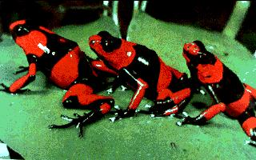
Order Anura - skin
Poisons of dendrobatid frogs (small, S. Amer. frogs) are most lethal animal secretions known
More poisonous than venoms of sea snakes, any arachnids

Slide 93
Order Anura - skin
Dermis also contains several types of pigment cells - chromatophores
Many can adjust color to blend in with background

Slide 94
Order Anura
Entire musculoskeletal system is specialized for jumping and swimming, via thrusts of the hindlimbs

Slide 95
Order Anura - skeleton
Vertebral column - rigid structure - lost much of flexibility found in fishes
Transmits forces from limbs to body

Slide 96
Order Anura - skeleton
Body much shorter - only 9 trunk vertebrae, several fused caudal vertebrae
Caecilians have 285 vertebrae

Slide 97
Order Anura - skeleton
Skull much lighter than in fishes
Changed for improved special senses, feeding, breathing

Slide 98
Order Anura - muscles
Limb muscles - probably derived from radial muscles that move fish fins up and down
Arranged in antagonistic groups (actions of one oppose another)

Slide 99
Order Anura - muscles
Abductor - away from median axis
Adductor - toward median axis
Flexor - bend part
Extensor - straighten part
Rotators - rotate

Slide 100
Order Anura - muscles
Myotome muscles modified to provide support to various portions of body (head, belly)

Slide 101
Order Anura - lungs
Frogs and toads are more highly dependent on lung breathing than are the salamanders
Several disadvantages of cutaneous respiration

Slide 102
Order Anura - lungs
1) skin must be kept thin, moist - too delicate for wholly terrestrial life
2) gas exchange rate across skin nearly constant - cannot vary with increased activity

Slide 103
Order Anura - lungs
Cutaneous respiration important to anurans during winter hibernation
Also, under normal conditions most CO₂ is lost across skin surface,most O₂ taken up by lungs

Slide 104
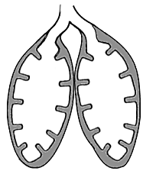
Order Anura - lungs
Lungs are elastic sacs with inner areas subdivided into many chambers
Not as much internal surface area relative to higher vertebrates

Slide 105
Order Anura - lungs
Frogs are positive-pressure breathers
Breathe by swallowing air - forcing it into their lungs
All higher vertebrates use negative-pressure system
Expansion of lungs to pull air inward

Slide 106
Order Anura - lungs
Both male and female anurans have vocal cords
Males are better developed
Located in larynx - voicebox

Slide 107
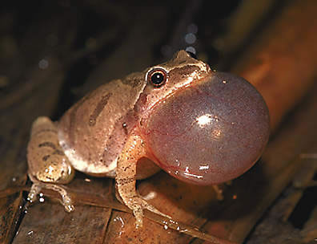
Order Anura - lungs
Sound produced by passing air back and forth between lungs and large pair of air sacs (vocal pouches) in floor of mouth
Pouches also serve as resonators in males
Function to attract mates

Slide 108
Order Anura - circulation
Shift from gill to lung breathing solved some circulatory problems, but caused others
Eliminated major obstacle to arterial blood flow - gills

Slide 109
Order Anura - circulation
Needed to develop new circuitry to serve lungs - pulmonary circulation
6th aortic arch developed into pulmonary artery
New pulmonary veins developed for return

Slide 110
Order Anura - circulation
More difficult evolutionary problem - separate oxygenated from deoxygenated blood
Amphibians have made it halfway
Two atria, but single ventricle - potential mixing

Slide 111
Order Anura - circulation
Actually little mixing of oxygenated, deoxygenated blood
Spiral valve in conus arteriosus (leading from ventricle) may help maintain selective distribution
Controversial - defied complete analysis

Slide 112
Order Anura - feeding
Adult frogs are carnivorous
Feed on insects, spiders, worms, slugs, snails, millipedes, anything moving and small enough to eat

Slide 113
Order Anura - feeding
Snap at prey with protrusible tongue
Attached at front, free behind
Free end very glandular, produces sticky secretion, adheres to prey

Slide 114
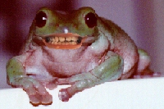
Order Anura - feeding
Teeth on premaxillae, maxillae, vomers
Not biting or chewing
Used to prevent prey escape

Slide 115
Order Anura - digestion
Digestive tract relatively short in adults, longer in tadpoles
Carnivore adaptation vs. herbivore adaptation
Variety of enzymes produced

Slide 116
Order Anura - nervous system
Dramatic changes occurred in nervous system as vertebrates moved onto land
Increased cephalization to cope with increased need for information processing

Slide 117
Order Anura - nervous system
Increased senses of smell, vision, hearing, increased demand for balance
Has resulted in loss of independence of the spinal ganglia

Slide 118
Order Anura - nervous system
Spinal ganglia can serve as “mini brains” in lower vertebrates
Coordinate actions without involving brains
But even with some loss of independence……

Slide 119
Order Anura - nervous system
Headless frog with only spinal cord intact still maintains high degree of purposeful, highly coordinated behavior
Normal posture, raise leg to remove disturbing object (other if one is restrained)

Slide 120
Order Anura - nervous system
Two senses highly advanced from fishes and most other amphibians
Hearing and sight

Slide 121
Order Anura - hearing
Lateral line system remains in aquatic larvae, but not most adults
Role is replaced by ear in most adult frogs
Obvious structure - tympanum - serves as eardrum

Slide 122
Order Anura - hearing
Picks up vibrations of airborne sounds and transmits them through middle ear to inner ear

Slide 123
Order Anura - hearing
Contains semicircular canals and structures similar, but simpler, than mammalian cochlea

Slide 124
Order Anura - hearing
Hearing of species is most sensitive to frequency range of their mating calls
Peeper - higher frequency
Bullfrog - lower frequency

Slide 125
Order Anura - sight
Eye is dominant special sense in most amphibians
Especially good in frogs
Fish eye had to be modified for land use

Slide 126
Order Anura - sight
Lachrymal glands, eyelids evolved to keep eye moist, dust-free, shielded from injury

Slide 127
Order Anura - sight
Upper and lower eyelids
Upper fixed
Lower with folded nictitating membrane that moves across eye surface

Slide 128
Order Anura - sight
Cornea exposed to air became an important refractive surface
Removed some of light bending and focusing burden from lens

Slide 129
Order Anura - sight
Lens normally focused on distant objects
Moved to focus on nearby objects
Opposite of arrangement in fishes

Slide 130
Order Anura - reproduction
Breeding is first desire after coming out of hibernation
Males migrate to water first - olfactory cues
Croak, call to attract females

Slide 131
Order Anura - reproduction
Females enter water when eggs mature and are clasped by males - amplexus
Females lay eggs and males fertilize them

Slide 132
Order Anura - reproduction
Eggs laid in large masses, anchored to vegetation
Jelly layer absorbs water and swells after fertilization
Development occurs quickly

Slide 133
Order Anura - reproduction
Tadpole hatches from protective jelly coat within 6-9 days (temperature-dependent)
Head and body, tail, ventral mouth with horny jaws, ventral adhesive disc, gills, etc.

Slide 134
Order Anura - reproduction
Length of tadpole stage is species-dependent
Leopard frog completes metamorphosis within 3 months
Bullfrog takes 2-3 years to complete process

