Slide 1
House Sparrow
Male
Female

Slide 2
Northern Cardinal
Female

Slide 3
House Finch
Male
Female

Slide 4
Mallard
Male
Female

Slide 5
American Goldfinch
Summer male
Winter male and female

Slide 6
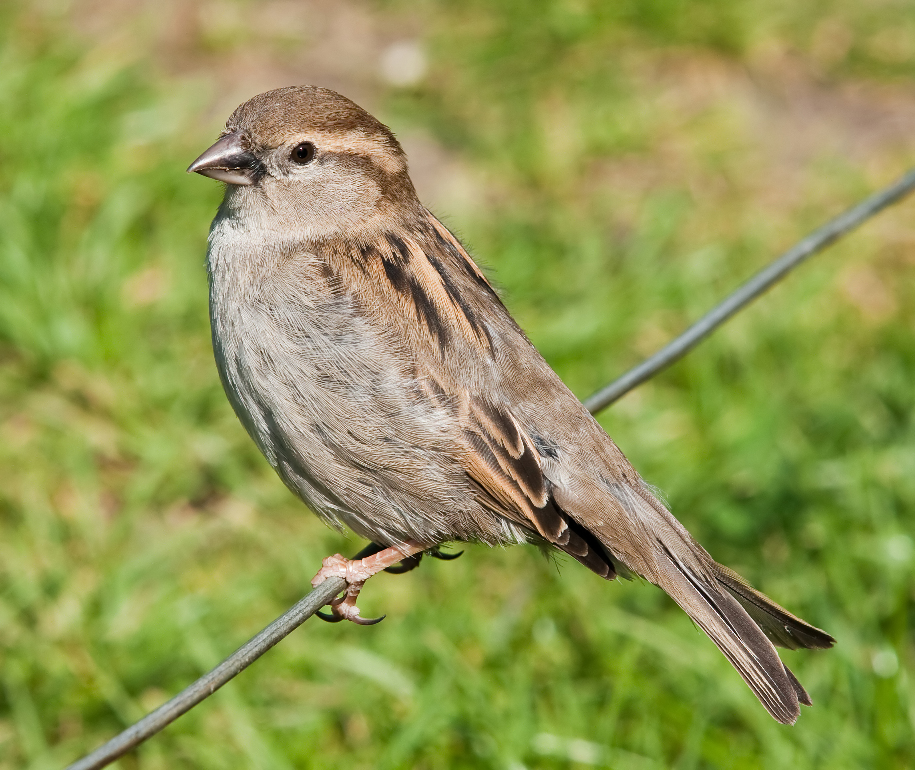
Females: House Sparrow vs. House Finch
House Sparrow
House Finch

Slide 7
Nuthatch vs. Chickadee
White-breasted Nuthatch
Black-capped Chickadee

Slide 8
Woodpeckers: Male vs. Female

Slide 9
Hairy vs. Downy Woodpecker
Hairy Woodpecker
Downy Woodpecker

Slide 10
Starling or Grackle?
European Starling
Common Grackle

Slide 11
Blue Jay & American Crow
Blue Jay
American Crow

Slide 12
Pigeons

Slide 13
Pigeon or Dove?
Pigeon
Mourning Dove

Slide 14
Dark-eyed Junco
Male
Female

