Slide 1
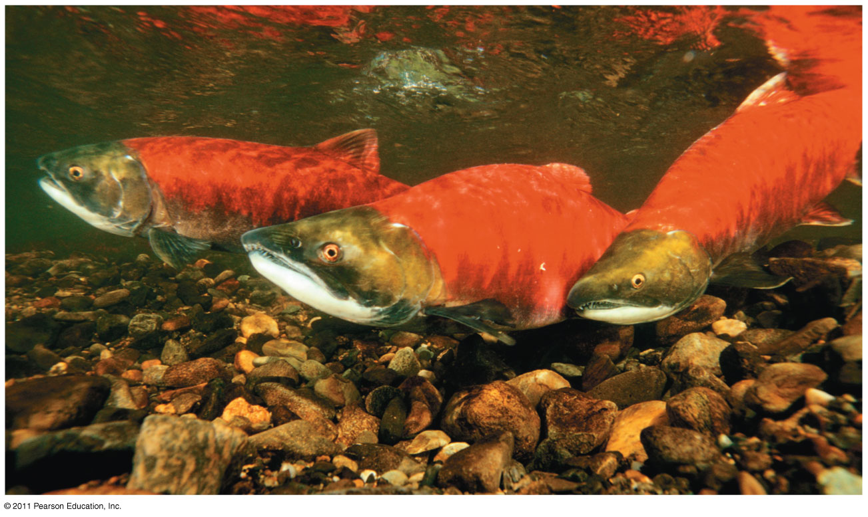
Osmoregulation & Excretion

Slide 2
A Balancing Act
Physiological systems of fishes operate in an internal fluid environment that may not match their external fluid environment
Relative concentrations of water and solutes internally must be maintained within fairly narrow limits
Internal environment influenced by external environment

Slide 3
Osmoregulation & Excretion
Osmoregulation
Regulates solute concentrations and balances the gain and loss of water
Excretion
Gets rid of nitrogenous metabolites and other waste products

Slide 4
Osmoregulation & Excretion
Freshwater fishes in different environments show adaptations that regulate uptake and conservation of both water and solutes

Slide 5
Osmoregulation & Excretion
Osmoregulation is based largely on controlled movement of solutes between internal fluids and the external environment

Slide 6
Osmosis and Osmolarity
Cells require a balance between uptake and loss of water
Osmolarity, the solute concentration of a solution, determines the movement of water across a selectively permeable membrane
If two solutions are isoosmotic, the movement of water is equal in both directions
If two solutions differ in osmolarity, the net flow of water is from the hypoosmotic to the hyperosmotic solution

Slide 7
Osmotic Challenges
Osmoconformers, consisting only of some marine animals, are isoosmotic with their surroundings and do not regulate their osmolarity
Osmoregulators expend energy to control water uptake and loss in a hyperosmotic or hypoosmotic environment

Slide 8
Hagfishes
Osmoconformers
Only vertebrate that is isotonic to seawater - much like marine invertebrates

Slide 9
Osmoregulators
Aquatic vertebrates - gills are chief organs of excretion/osmoregulation
Kidneys first evolved as osmoregulatory organs in fishes to remove water (freshwater) or conserve water (marine)

Slide 10
Marine Animals
Most marine vertebrates are osmoregulators
Marine bony fishes are hypoosmotic to sea water
They lose water by osmosis and gain salt by diffusion and from food
They balance water loss by drinking seawater and excreting salts

Slide 11
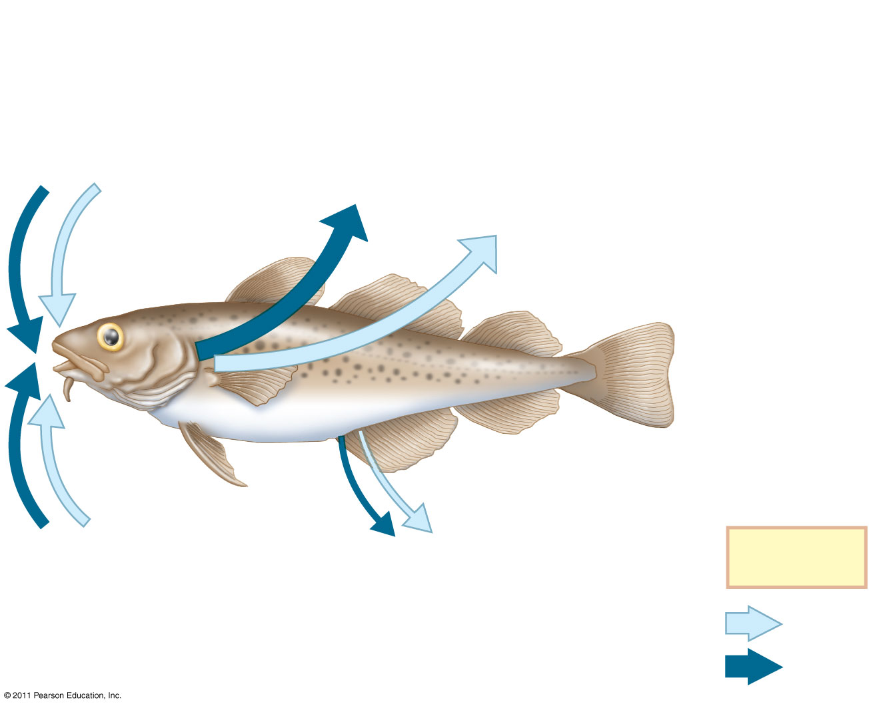
(a) Osmoregulation in a marine fish
Gain of water and salt ions from food
Excretion of salt ions from gills
Osmotic water loss through gills and other parts of body surface
Gain of water and salt ions from drinking seawater
Excretion of salt ions and small amounts of water in scanty urine from kidneys
Key
Water
Salt
Notes:
Figure 44.3 Osmoregulation in marine and freshwater bony fishes: a comparison.

Slide 12
Freshwater Animals
A different form of osmoregulator
Freshwater animals constantly take in water by osmosis from their hypoosmotic environment
They lose salts by diffusion and maintain water balance by excreting large amounts of dilute urine
Salts lost by diffusion are replaced in foods and by uptake across the gills

Slide 13
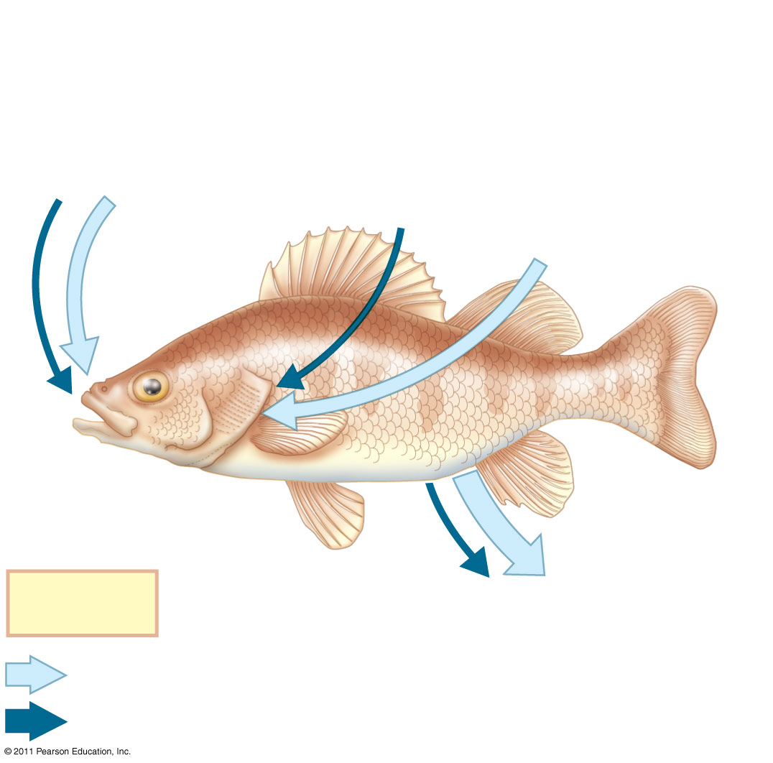
(b) Osmoregulation in a freshwater fish
Gain of water and some ions in food
Uptake of salt ions by gills
Osmotic water gain through gills and other parts of body surface
Key
Excretion of salt ions and large amounts of water in dilute urine from kidneys
Water
Salt
Notes:
Figure 44.3 Osmoregulation in marine and freshwater bony fishes: a comparison.

Slide 14
Kidneys-Fish nitrogenous wastes
The type and quantity of an animal’s waste products may greatly affect its water balance
Among the most significant wastes are nitrogenous breakdown products of proteins and nucleic acids
Fish typically produce toxic ammonia (NH₃) rather then less toxic compounds
Abundance of water to dilute toxic materials

Slide 15
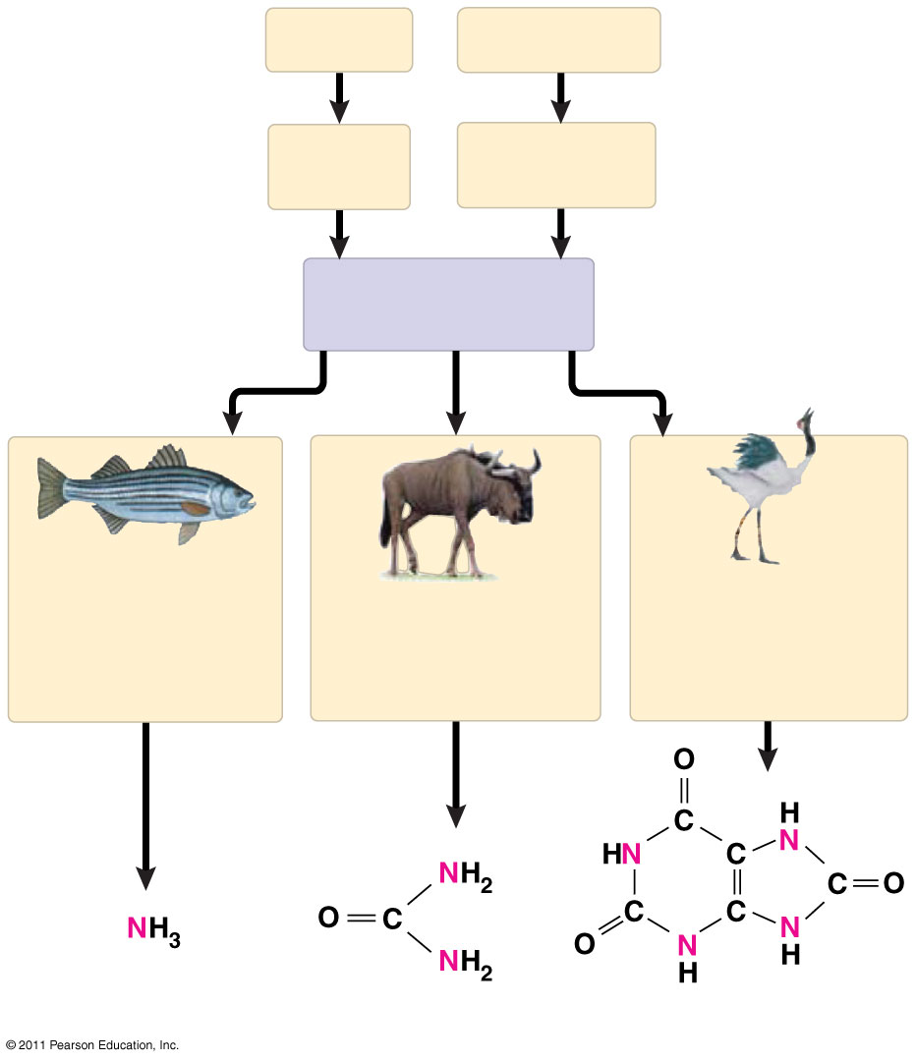
Proteins
Nucleic acids
Amino acids
Nitrogenous bases
—NH₂ Amino groups
Most aquatic animals, including most bony fishes
Mammals, most amphibians, sharks, some bony fishes
Many reptiles (including birds), insects, land snails
Ammonia
Urea
Uric acid
Notes:
Figure 44.8 Forms of nitrogenous waste.

Slide 16
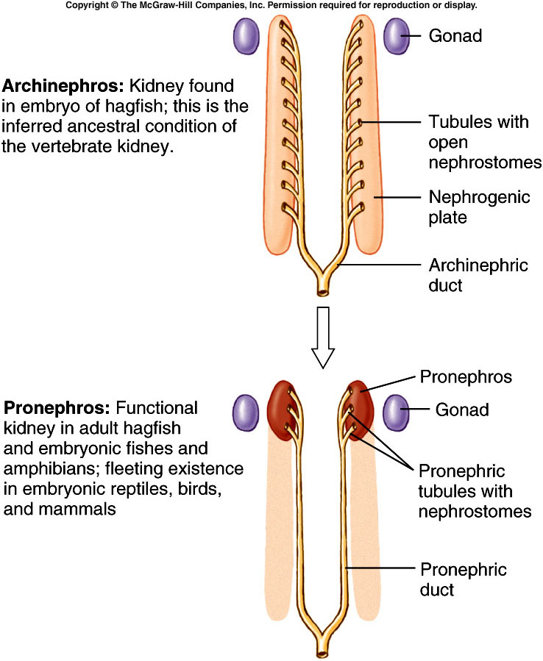
Fig. 30.9a

Slide 17
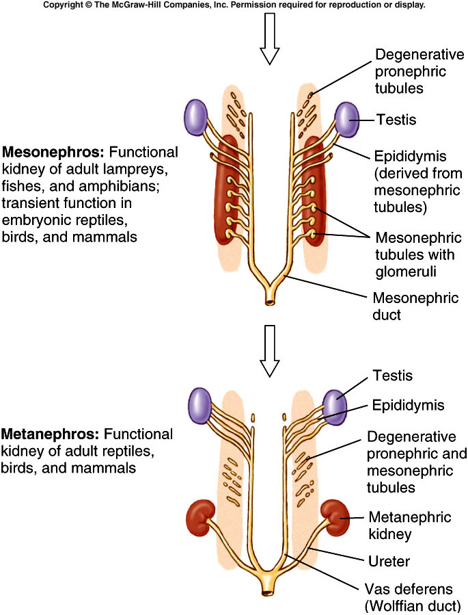
Fig. 30.9b

Slide 18
Excretory Processes-Kidneys
Excretory systems produce urine by refining a filtrate derived from body fluids
Key functions of most excretory systems
Filtration: Filtering of body fluids
Reabsorption: Reclaiming valuable solutes
Secretion: Adding nonessential solutes and wastes from the body fluids to the filtrate
Excretion: Processed filtrate containing nitrogenous wastes, released from the body

Slide 19
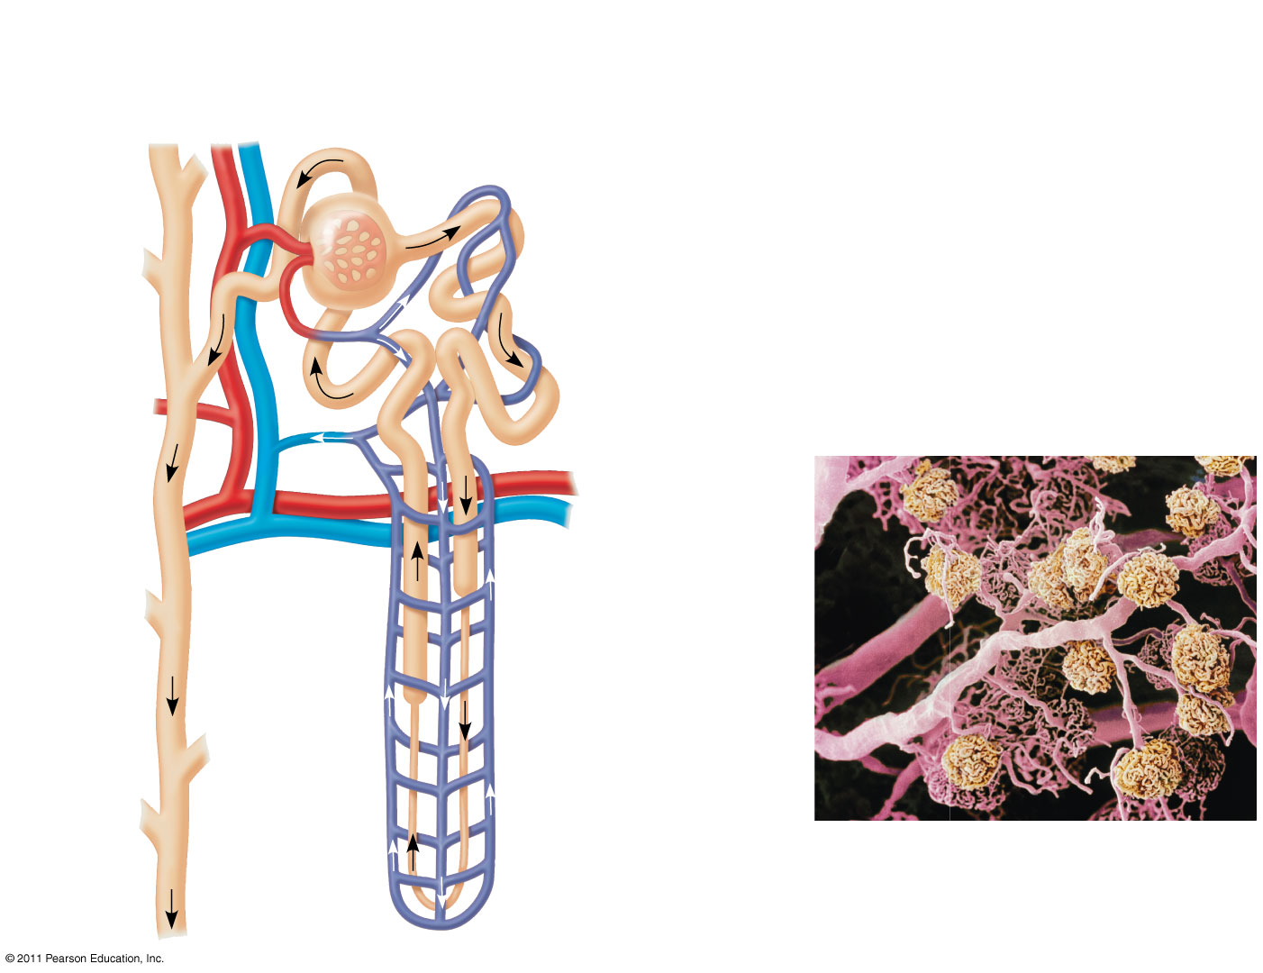
Nephron Organization
Afferent arteriole from renal artery
Glomerulus
Bowman’s capsule
Proximal tubule
Distal tubule
Peritubular capillaries
Efferent arteriole from glomerulus
Branch of renal vein
Descending limb
Vasa recta
Loop of Henle
Collecting duct
200 μm
Ascending limb
Blood vessels from a kidney. Arterioles and peritubular capillaries appear pink; glomeruli appear yellow.
Notes:
Figure 44.14 Exploring: the Mammalian Excretory System

Slide 20
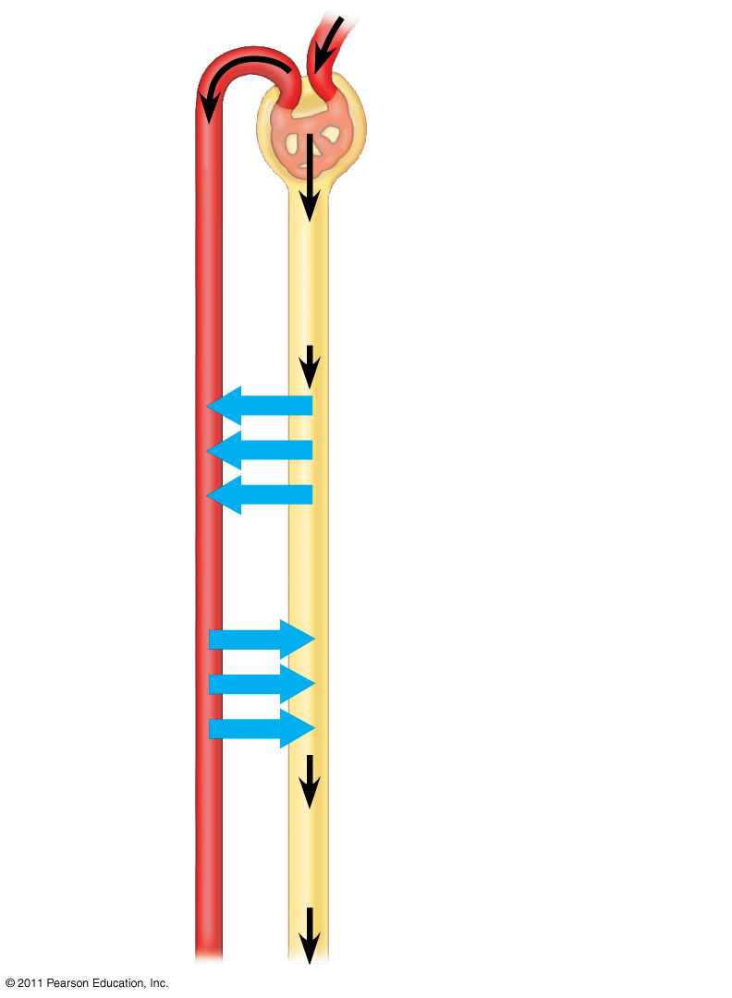
1
Filtration
Capillary
Filtrate
Excretory tubule
2
Reabsorption
3
Secretion
Urine
4
Excretion
Notes:
Figure 44.10 Key steps of excretory system function: an overview.

Slide 21
Bony Fishes
Freshwater fishes conserve salt in their distal tubules and excrete large volumes of dilute urine
Marine bony fishes are hypoosmotic compared with their environment
Their kidneys have small glomeruli and some lack glomeruli entirely
Filtration rates are low, and very little urine is excreted

Slide 22
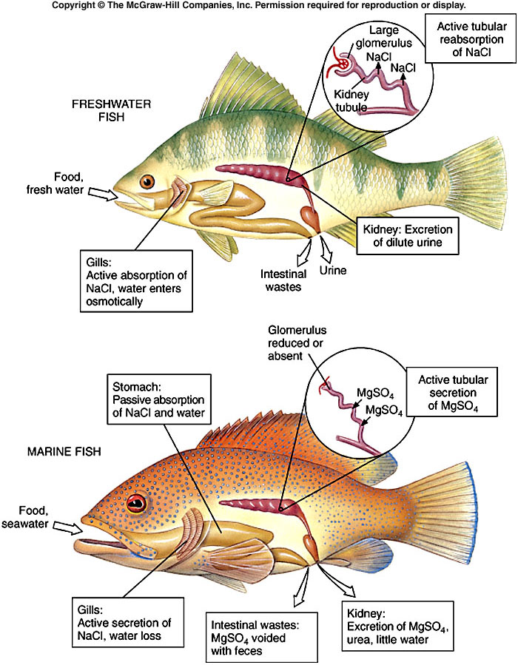
Fig. 30.3

Slide 23
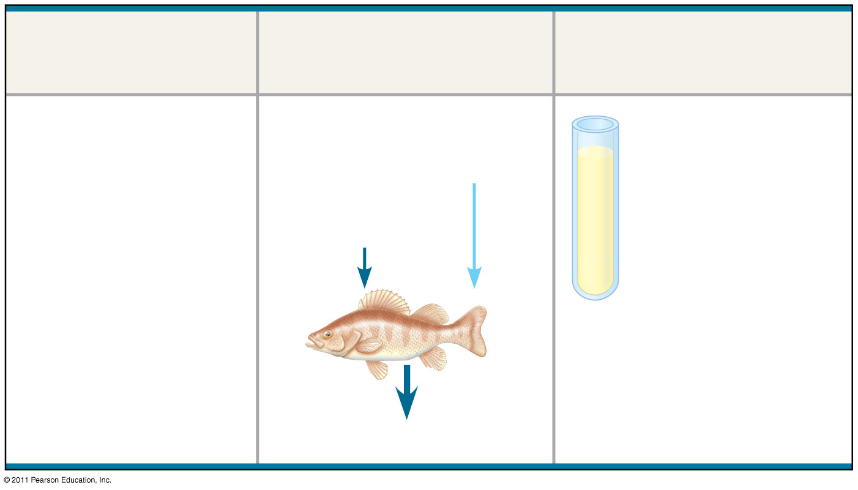
Animal
Inflow/Outflow
Urine
Freshwater fish. Lives in water less concentrated than body fluids; fish tends to gain water, lose salt
Does not drink water
Large volume of urine
Salt in (active trans- port by gills)
H₂O in
Urine is less concentrated than body fluids
Salt out
Notes:
Figure 44.UN01 Summary figure, Concept 44.1

Slide 24
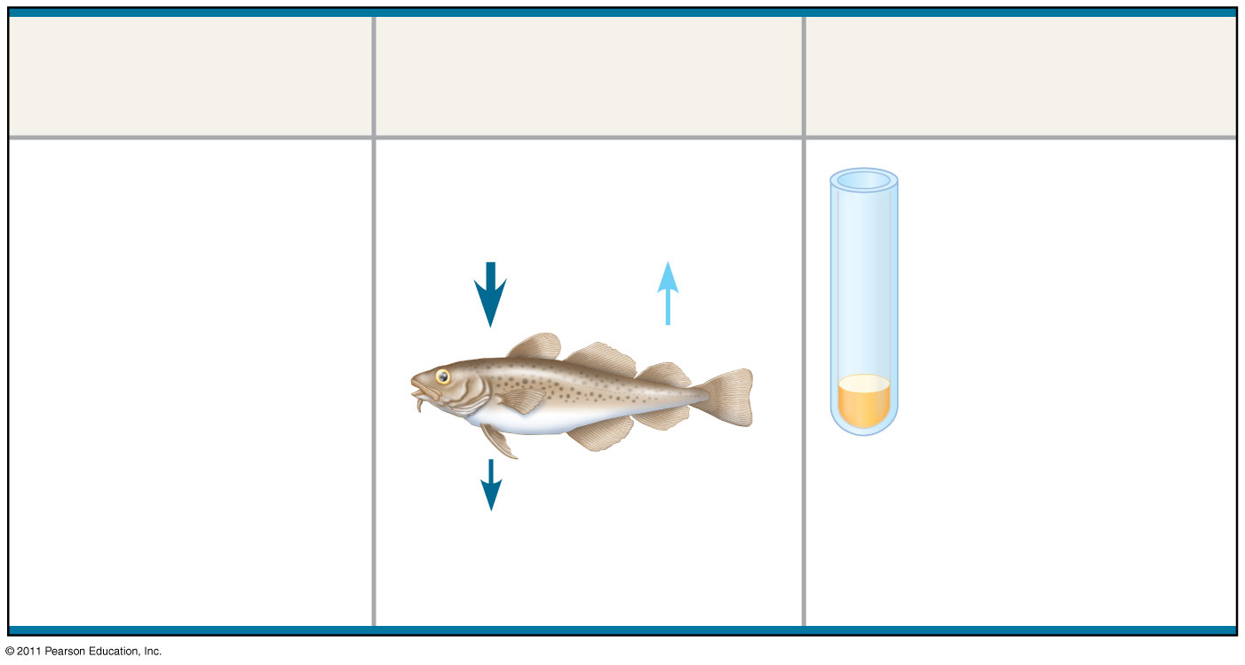
Animal
Inflow/Outflow
Urine
Marine bony fish. Lives in water more concentrated than body fluids; fish tends to lose water, gain salt
Drinks water
Small volume of urine
Salt in
H₂O out
Urine is slightly less concentrated than body fluids
Salt out (active transport by gills)
Notes:
Figure 44.UN01 Summary figure, Concept 44.1

Slide 25
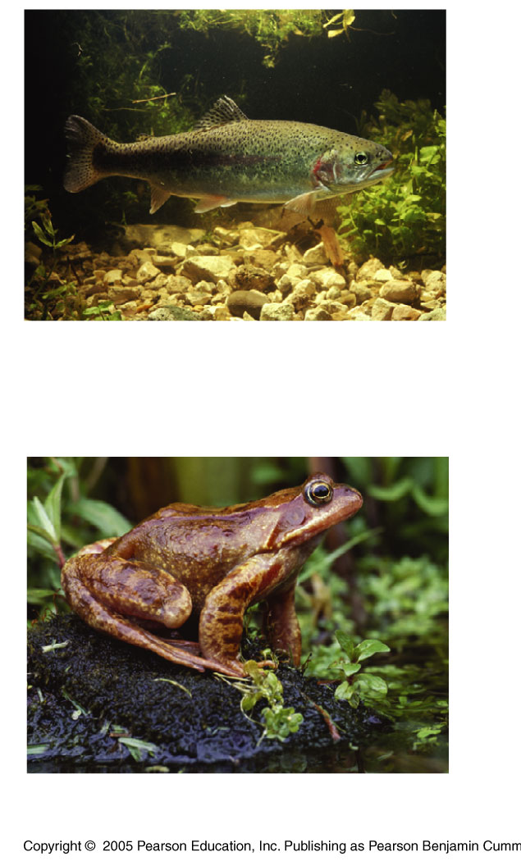
Freshwater fishes
Large volume of urine, salts are reabsorbed in the distal tubules
Rainbow trout
(Oncorrhynchus mykiss)
Frog (Rana)

Slide 26
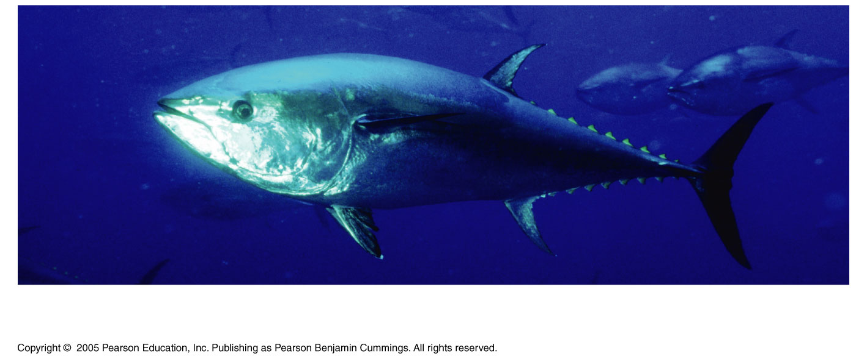
Marine bony fishes
Problem: gain salts from environment and tend to lose water
Lack distal tubule, smaller glomerulus, can adjust amount of urine
Northern bluefin tuna (Thunnus thynnus)

Slide 27
Marine cartilaginous fishes:
Shark tissue contains a high concentration of urea
To prevent urea from damaging other organic molecules in the tissues, they have trimethyl amine oxide (TMAO)
Because of high solute concentration in tissue, water enters the cells (sharks don’t drink)
Produce concentrated urine

Slide 28
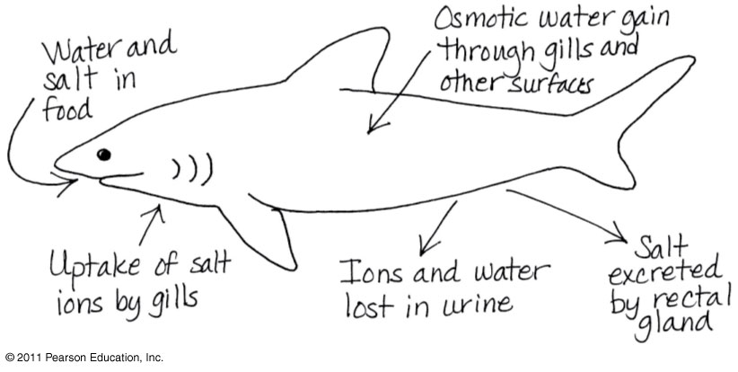

Slide 29
Euryhaline organisms like salmon:
In sea, they drink sea water and discharge salt through their gills
In freshwater, they stop drinking and produce large volumes of dilute urine, gills take up salt

