Slide 1
Fish Conservation
Woundfin, Virgin River, Utah

Slide 2
Changing Fauna
Extinction of endemic species
Fisheries are collapsing
Heavier reliance on aquaculture

Slide 3
Changing Fauna
Expanding human population
Exploiting fish at unsustainable rates
Competing for water, space, food

Slide 4
Original Fish Diversity
31,500 species worldwide
58% marine
41% freshwater
~1% diadromous

Slide 5
Imperiled Species
5% of marine species
20-40% of freshwater species
Humans confiscate water
Pollute water we do not use

Slide 6
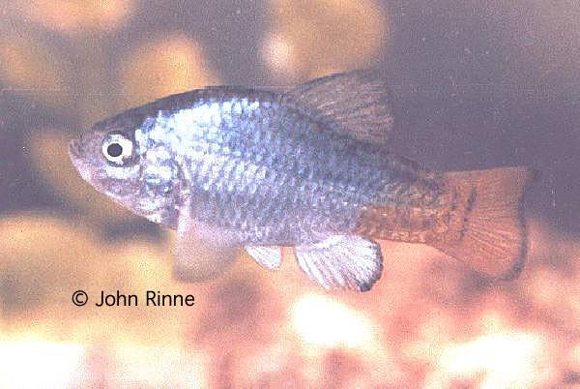
Imperiled Species
Fish most likely to be endangered in regions with:
Highly developed economies
Small, isolated bodies of water
High endemism
Arid or Mediterranean climates
Big rivers
Big lakes

Slide 7
Southwestern U.S.
Colorado River + isolated springs, small creeks
Arid climate
Many endemic pupfishes, minnows, suckers
Las Vegas with possibly world’s highest per-capita water consumption rate

Slide 8
North America
1/3 of region’s fish taxa either extinct or in need of protection
Most species in danger in southern, southwestern areas

Slide 9
Historical Abundance
Captain John Smith describing tributaries of the Chesapeake in 1608:
“… in diverse places that abundance of fish lying so thicke with their heads above the water, as for want of nets we attempted to catch them with a frying pan, but we found it a bad instrument to catch fish with. Neither better fish more plenty or variety had any of us ever seene, in any place swimming in the water than in the Bay of the Chesapeack, but there not to be caught with frying pans.”

Slide 10
Historical Abundance
Captain John Smith again: Having grounded on an oyster bed in the Potomac as the tide was going out “…we spied many fishes lurking amongst the weeds on the sands, our captaine sporting himself to catch them by nailing them to the ground with his sword, set us all a fishing in that manner, by this devise, we tooke more in an houre than we all could eat.”

Slide 11
Historical Abundance
Clearly, a different level of fish abundance than we encounter today.
Similarly abundant numbers of fish were described in the waters off New England and eastern Canada.

Slide 12
The Grand Banks Fishery
John Cabot 1497:
“… the sea there is swarming with fish, which can be taken not only with the net, but in baskets let down with a stone, so that it sinks in the water.”

Slide 13
Grand Banks/Georges Bank

Slide 14
The Grand Banks Fishery
The rich fishing grounds off the northeastern U.S. and eastern Canada result from a combination of factors:
The various banks are deposits of moraine left there by glaciers.
The water above them is relatively shallow (60-300 feet in most places).
They occur at the confluence of the cold nutrient rich northern Labrador current and the warm southern Gulf Stream.
The mixing of these currents combines warmth and nutrients to produce massive blooms of plankton that supported huge schools of mackerel and herring that in turn support cod and other predators.

Slide 15
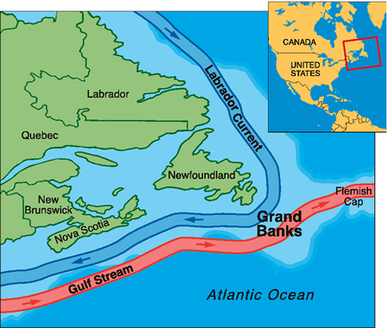
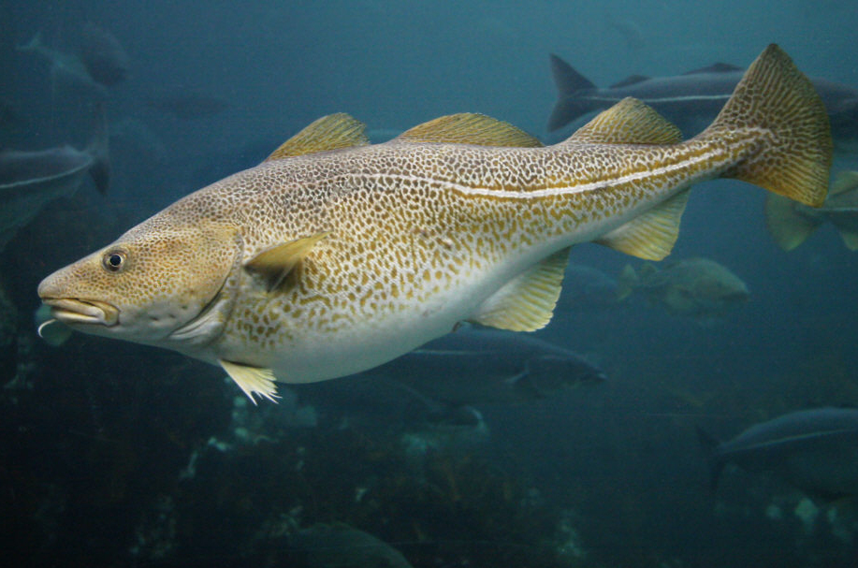
Atlantic cod!!

Slide 16
The Grand Banks Fishery
In 1992, the Canadian Government placed a two-year moratorium on cod fishing, which was extended indefinitely and remains in place today. In 2003, the two main populations of Atlantic cod were added to Canada’s endangered species list.
In U.S. waters, cod populations have similarly plummeted.
What happened? Industrial fishing happened.

Slide 17
The Grand Banks Fishery
From fishing almost exclusively by schooners from a few countries….

Slide 18
The Grand Banks Fishery
To factory ships from many nations

Slide 19
The Grand Banks Fishery

Slide 20
The Grand Banks Fishery
Estimates of the size of the original population suggest that there were about 7 million metric tons of cod off the Atlantic coast of Canada in 1505.
By 1992 the estimate was 22,000 metric tons (<1/3 of 1% of the original population.).

Slide 21
The Grand Banks Fishery
Cod stocks are showing signs of recovery. In 2010 cod stocks in the Grand Banks were estimated to have increased 69% since 2007.
However, that level is still only about 10% of 1960’s levels.

Slide 22
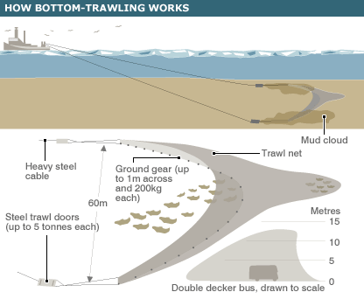
The Grand Banks Fishery
Why is fish stock recovery so slow?
Habitat transformation almost certainly has played a major role.

Slide 23
The Grand Banks Habitat
Before trawling, the sea bottom on the banks was not a layer of mud. Rocks outcrops, boulders and stones provided structure, places for young fish to hide and rich communities of sponges, crabs, mussels, anemones, tube worms and other invertebrates flourished.

Slide 24
The Grand Banks Habitat
A bottom trawler’s net is held open by large metal doors weighing thousands of pounds and the bottom of the bag is kept on the seabed by a weighted metal cable. Each pass of a net drags boulders and rocks, buries and crushes invertebrates and leaves behind a virtual moonscape.
Bottom trawling is the ecological equivalent of clear-cutting, but carried out on a much more massive scale and out of view.

Slide 25
Bycatch
Under-sized or non-target portion of catch
Can be up to 90% of total catch in some fisheries
Averages 1/3 of all fisheries
All dies

Slide 26
Bycatch
Under-sized fish (juveniles) of target species represent failure to recruit
Additional non-natural mortality factor that further suppresses population growth

Slide 27
Changed Communities
Cod, haddock, flounders harvested from Grand Banks replaced by sharks, skates
Also changes in zooplankton, benthos, other unexploited species

Slide 28
Alien Species Threats
Predation
Competition
Disease/Parasites
Hybridization

Slide 29
Predation
Nile perch devoured ~200 species of cichlids into extinction in Africa’s Lake Victoria

Slide 30
Competition
Alewife competed with Great Lakes whitefishes (Coregonus spp.) for limited plankton resources

Slide 31
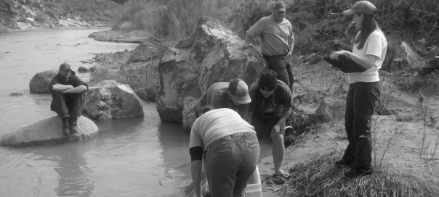
Disease/Parasites
Red shiner invasion in Utah’s Virgin River brought tapeworm that decimated native woundfin
Woundfin stocking, 2011

Slide 32
Hybridization
Rainbow trout X cutthroat trout
Cutbow
Hybrid vigor (rapid growth, large size), but loss of genetics

Slide 33
Biotic Homogenization
Both regional and worldwide scales
Losing natural distinctiveness

Slide 34
Minnesota Lakes
Warmwater, coolwater, coldwater
Walleye everywhere

Slide 35
Worldwide Homogenization
Temperate lakes and reservoirs:
Common carp
Largemouth bass
Sunfish
Mosquitofish
Northern pike
Catfish

Slide 36
Worldwide Homogenization
Coldwater streams:
Rainbow trout
Brown trout

Slide 37
Aquaculture
Meet demands of growing human population
Take pressure off wild fish populations
Problems: food requirements, escapements, more

Slide 38
Aquaculture
Atlantic salmon: pen-reared in bays, estuaries
Food of fish meal, fish oil (3 lbs. ocean fish = 1 lb. salmon)
Wastes, antibiotics
Escapements in the millions
Transport

Slide 39
Public Sentiment

Slide 40
Conservation Strategies
Ecosystem-based management
Protecting biotic diversity (including genetic)
Creating large-scale marine reserves
Eliminate alien invasions
Eliminate government subsidies of non-sustainable practices (logging, mining, etc.)

