Slide 1
Fish Ecology
Biological
factors
Physical factors
Temperature, pH, oxygen, light, salinity, etc.
Predation, competition, disease
Diversity and Abundance
Human
factors
Fishing, land use, dams, pollution, introduced species, etc.

Slide 2
Ecology & Filters
Local assemblages are the result of multiple filters applied through time
Present group not a random occurrence

Slide 3
Ecology & Filters
Pleistocene events
Zoogeographic barriers
Physiological factors
Biological interactions
Natural disturbances
Human disturbances

Slide 4
Ecology & Filters
Zoogeography plus physiological tolerances lead to fundamental niche
Biotic interactions produce the realized niche
Potential community

Slide 5
Ecology & Filters
Potential community
Natural disturbances
Floods, droughts
Natural community
Human disturbances
Dams, pollutants, introductions or extinctions
Observed community

Slide 6
Fish Ecology
Biological
factors
Physical factors
Temperature, pH, oxygen, light, salinity, etc.
Predation, competition, disease
Diversity and Abundance
Human
factors
Fishing, land use, dams, pollution, introduced species, etc.

Slide 7
Predictable Patterns
Balance of nature vs. constancy of change
Underlying, predictable structure, but a moving target, constantly changing through time

Slide 8
Predation
Most fish species are simultaneously predator and prey
Very few strict herbivores, detritivores (and young usually are invertivores)

Slide 9
Predation
Coevolution of feeding and defense mechanisms
Better predator, more elusive prey

Slide 10
Porcupinefishes
Predator
Strong beak/teeth
Prey
Spiny covering, toxins

Slide 11
Barracudas
Predator
Sharp teeth
Prey
Sleek bodies

Slide 12
Minnows
Predator
Pharyngeal teeth
Prey
Fear scents

Slide 13
Herrings
Predator
Fine gill rakers
Prey
Schooling behavior

Slide 14
Predators control prey
Typical situation
E.g., largemouth bass control bluegill - regulate population abundance, size structure

Slide 15
Prey control predators
Atypical situation
E.g., bluegill in Lake Winona eat bowfin eggs, young

Slide 16
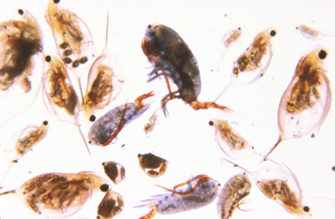
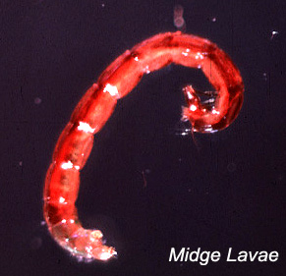
Prey switching behavior Optimal foraging theory
Alternate prey present- switch as needed to maximize energy intake vs. energy expenditure
E.g., bluegill - zooplankton, benthos

Slide 17
Intraspecific Predation
Cannabalism - bluegill males may consume eggs, young of nest neighbors
Females may “fake” courtship to gain nest access and consume eggs already present

Slide 18
Competition
…the demand of more than one organism for the same limited resource
Food, habitat, mates, whatever

Slide 19
Competition
Resource partitioning via some approach
Behavioral, morphological
E.g., feed in different habitats, or at different times
Character displacement
Alewife invasion of Lake Michigan shifted ciscoes from planktonic to benthic feeding (and reduced # of gill rakers)

Slide 20
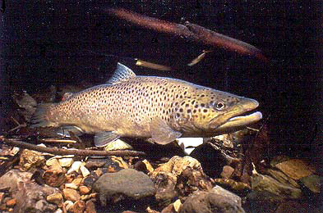
Competition
Difficult to demonstrate in action in natural situations
Ephemeral phenomenon
Observational and experimental evidence

Slide 21
Competition
Example: Arctic charr and brown trout in Swedish lakes
Feed offshore and inshore on zooplankton and benthos when alone

Slide 22
Competition
When together, charr offshore on zooplankton, trout inshore on benthos
Trout dominate in lab environment (aggression)
Trout exclude charr from most productive inshore habitats?

Slide 23
Competition
When alone, charr prefer zooplankton, trout prefer benthos
Charr have more, longer gill rakers
Brown trout more efficient benthos feeders

Slide 24
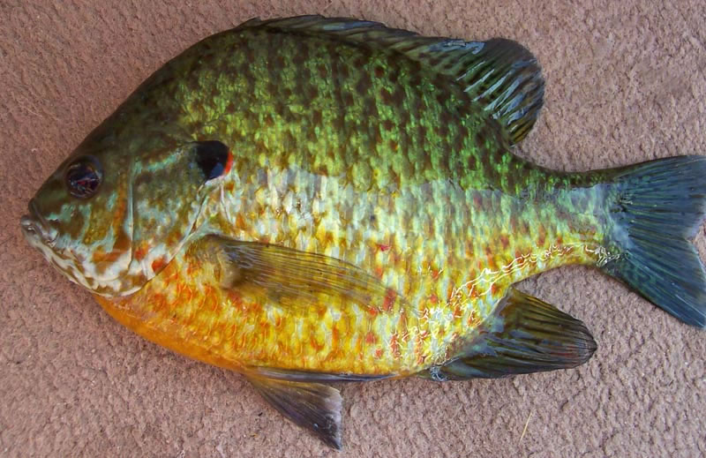
Competition
Differential exploitation
One species more efficient than another at using a resource
Brown bullhead and pumpkinseed both prefer benthos, but bullhead more efficient
Forces pumpkinseed to switch to zooplankton

Slide 25
Competition
Predation can both decrease and increase competition among fishes
Decrease by reducing numbers so that resources no longer are limiting
Increase by forcing fish together into restricted habitats

Slide 26
Competition
Habitat imprinting may be be an evolved behavior to minimize interactions, allowing greater coexistence among species or subspecies

Slide 27
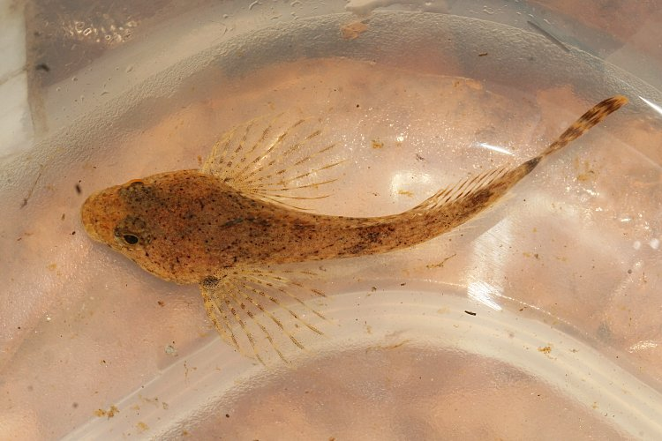
Intraspecific Competition
One of the main mechanisms regulating population size
Territoriality - limited space for feeding, reproduction
Dominance hierarchy, age class segregation

Slide 28
Intraspecific Competition
E.g., Mottled sculpin
Size segregation - large adults in different habitats than small adults, juveniles
Large adults occupy habitats with highest benthos densities

Slide 29
Symbiosis
Living together
Mutualism, commensalism, parasitism

Slide 30
Symbiosis
Mutualism - both parties benefit
Commensalism - one benefits, the other receives no benefit or harm
Parasitism - one benefits, the other is harmed

Slide 31
Mutualism
Minnows shoaling together in streams, lakes of eastern North America
Many advantages

Slide 32
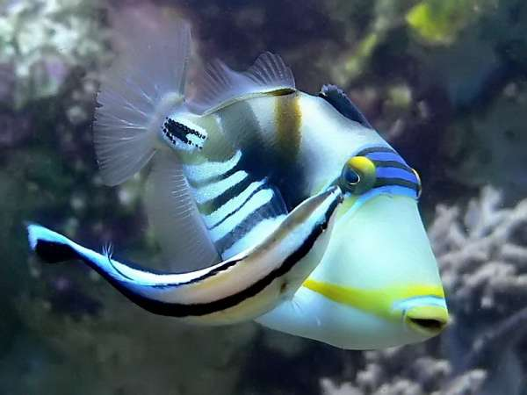
Mutualism
Cleaning behavior
Cleaner wrasses

Slide 33
Mutualism
Removal of dead tissues, parasites
Food
Living tissue removed? Just tactile stimulation?

Slide 34
Commensalism
Remoras - commensal on large sharks
Sucker attachment carries remora to new food source
No overall effect on shark

Slide 35
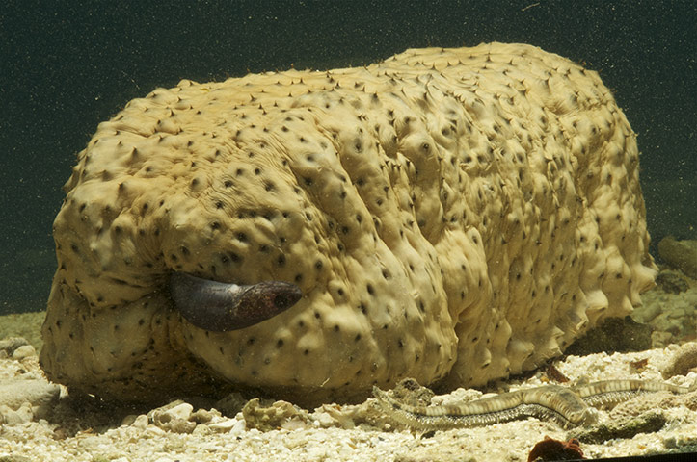
Parasitism
Pearlfishes - live in sea cucumbers
Enter body cavity through anus - feed on gonads
One host per lifetime - stays alive

Slide 36
Parasitism
Bitterling - lay eggs into freshwater mussels
Embryos develop from nutrients within gill cavities

Slide 37
Parasites & Pathogens
Effects of parasites, pathogens on fish is one of least understood areas of fish ecology
All fish carry parasites and pathogens, and effects can be costly

Slide 38
Parasites & Pathogens
Disease presumed to be a major source of mortality among fish, especially young
Minimizing effects via biochemical or behavioral means increases fitness

Slide 39
Parasites & Pathogens
Major outbreaks and fish die-offs are regular occurrences
Parasites and pathogens most “evolved” if they do not kill their host

Slide 40
Parasites & Pathogens
Mass kills considered a natural mechanism for population regulation of superabundant fishes
High density = easier disease transmission
Frequency of kills may be increased by organic pollution

Slide 41
Tapeworms

Slide 42
Parasite Generalities
Pelagic fishes tend to have fewer parasites than benthic, nearshore species (snails, copepods)
Bigger fish have more parasites (numbers and types)

