Slide 1
Genetics of Fishes

Slide 2
Basic Genetics
Most fish are diploid (2N)
Normal for most vertebrates
~50 chromosomes typical (range 16-446)
Produce haploid (1N) gametes

Slide 3
Basic Genetics
Constant chromosome number usually characteristic of a species
Some species may display variation
Rainbow trout - 58-64 chromosomes
Variation results when chromosome arms rearrange

Slide 4
Mendelian Inheritance
Alleles, homozygous, heterozygous
Dominant, recessive
Normal pigmentation dominant (AA or Aa)
Albinism recessive (aa)

Slide 5
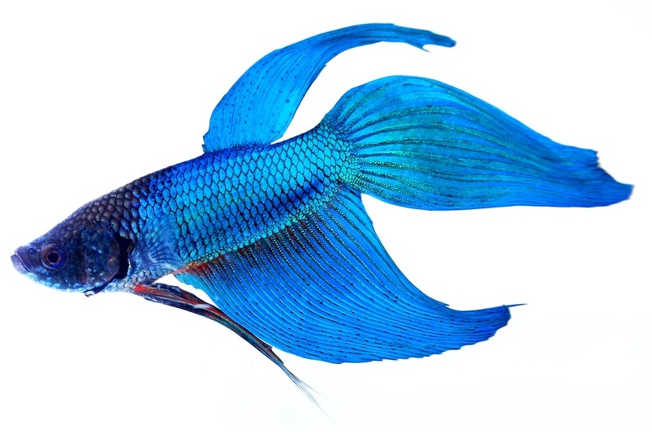
Partial Dominance
Siamese fighting fish color
Heterozygotes distinguishable from homozygotes
One homozygote is steel blue
Heterozygote is blue
Other homozygote is green

Slide 6
Polyploidy
Duplication of entire chromosome set
Possibly from failure in one cell cycle of cell division in early embryo
Triploid
Tetraploid

Slide 7
Polyploidy
Autopolyploidy - embryo from parents of the same species
Allopolyploidy - embryo from parents of different species

Slide 8
Polyploidy
Species in Salmonidae probably descended from autotetraploid ancestor
Species in Catostomidae probably descended from an allotetraploid ancestor

Slide 9
Oriental (weather) loach Misgurnus anguillicaudatus
Naturally occurring:
Diploids (50 chromosomes)
Triploids (75 chromosomes)
Tetraploids (100 chromosomes)

Slide 10
Induced Polyploidy
Can use various “processes” to induce polyploidy in some species
Heat shock
Cold shock
Pressure shock
Some chemical, antibiotic treatments

Slide 11
Induced Polyploidy
Disrupt end stages of meiosis just after fertilization by sperm
2N from egg + 1N from sperm = 3N triploid
2N from female
1N from male

Slide 12
Induced Polyploidy
Disrupt one of early cleavage divisions after normal fertilization
2N + 2N = 4N tetraploid
2N from female
2N from male

Slide 13
Typical Applications
To produce sterile fish (odd ploidy messes with normal meiosis) for a variety of uses
Grass carp to control unwanted vegetation in lakes and ponds

Slide 15
Typical Applications
Aquaculture - pen-reared Atlantic salmon may have inefficient feed transfer if energy is devoted to egg/sperm production
Polyploid salmon may not mature - all feed into growth

Slide 16
Typical Applications
Trophy fishery
Experimental releases of triploid Chinook salmon into Great Lakes to produce non-maturing, trophy-sized fish that won’t disrupt wild gene pools

Slide 17
Problems
“Nature finds a way”
Despite expected sterility of polyploid fishes, some fish may produce viable haploid gametes and reproduce
May result in a diploid population

Slide 18
Hybridization
Can occur naturally
Congeneric species in sympatry
Either natural, or because of introductions
Shiners often hybridize

Slide 19
Hybridization
Sunfishes
The genus Lepomis
Many different combinations

Slide 20
Hybridization
Crappies

Slide 21
Hybridization
Black basses
The genus Micropterus
Spotted bass X smallmouth bass

Slide 22
Hybridization
Cutthroat trout X rainbow trout
Losing genetic integrity of cutthroat populations
Introgression

Slide 23
Hybridization
Brook trout X brown trout
Tiger trout

Slide 24
Hybridization
Artificial manipulation for fast growth
Saugeye
Sauger X walleye

Slide 25
Hybridization
White bass X striped bass
Freshwater species and anadromous species
New fishery for large reservoirs

Slide 26
Hybridization
Tiger muskie
Northern pike X muskellunge
Sport fishery and forage management in lakes lacking pike

Slide 27
Hybridization
Hybrids typically sterile - problem with chromosome alignment during meiosis
Not always the case
Hybrids may show better vigor, faster growth

Slide 28
Sex Determination
10 sex-determining systems in fishes
Most fish (e.g., salmonids) are like humans
Male is heterogametic - XY
Female is homogametic - XX

Slide 29
Sex Determination
Some fishes have an alternative sex-determining system more like that of birds (e.g., some platies and some Tilapia spp.)
Female is heterogametic - WZ
Male is homogametic - ZZ

Slide 30
Sex Determination
Southern platy
Gender determined by combination of X, Y, and Z chromosomes

Slide 31
Environmental Sex Determination
Sex determined solely by sex chromosomes in most fishes
Produces sex ratio of 1:1
Some species may have additional autosomal chromosomes involved in sex determination

Slide 32
Environmental Sex Determination
The sex of the Atlantic silverside is controlled by both genotype and water temperature
Temperatures experienced by larvae 30-45 days after hatching strongly influence gender
Cold temps. - females
Warm temps. - males

Slide 33
Transgenic Fish
Inserting genes from other organisms into fish to improve “performance”
http://abcnews.go.com/WNT/video/abc-news-samples-dna-altered-salmon-17879830

