Slide 1
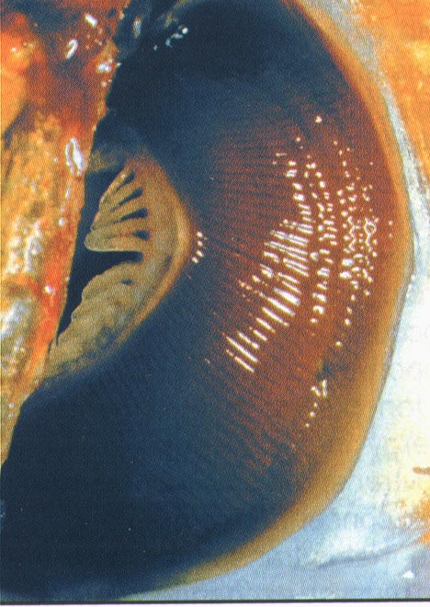
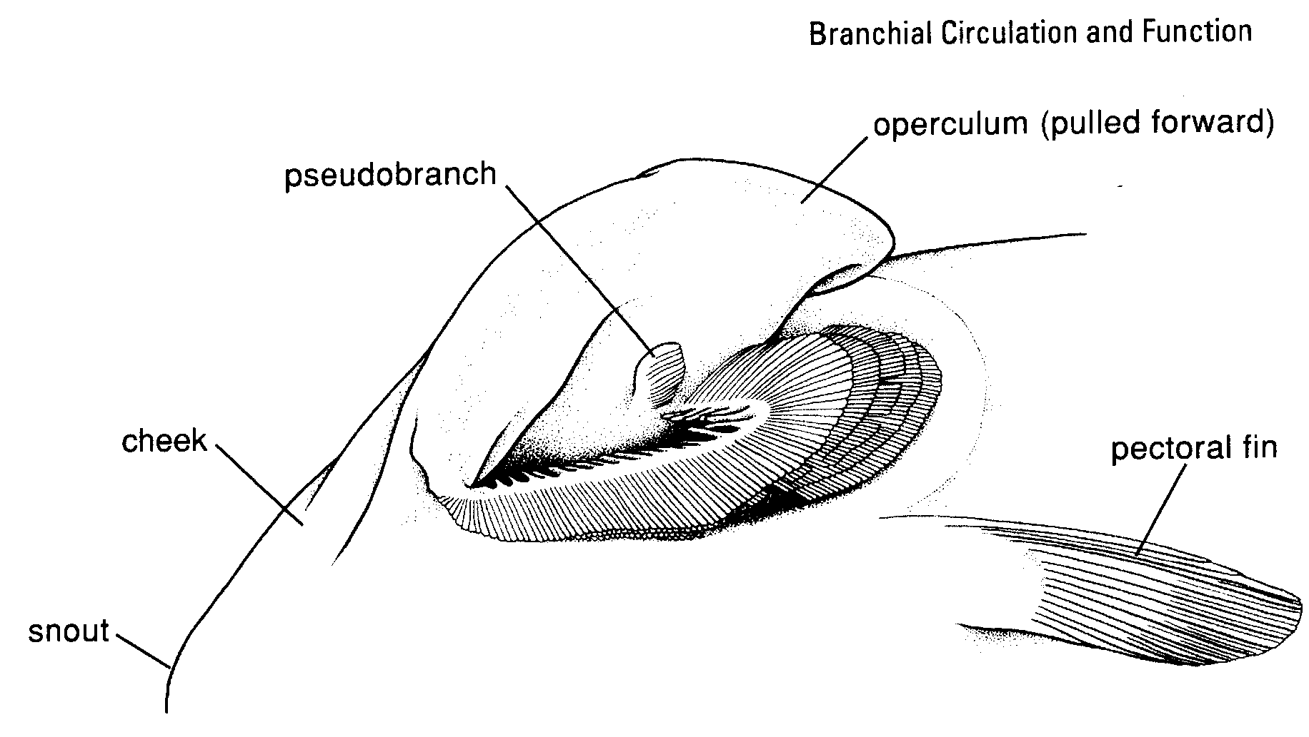
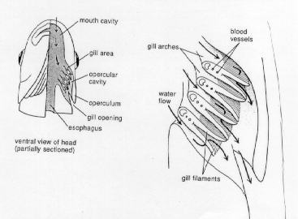
Respiration Updated Audio starts with Slide 9

Slide 2
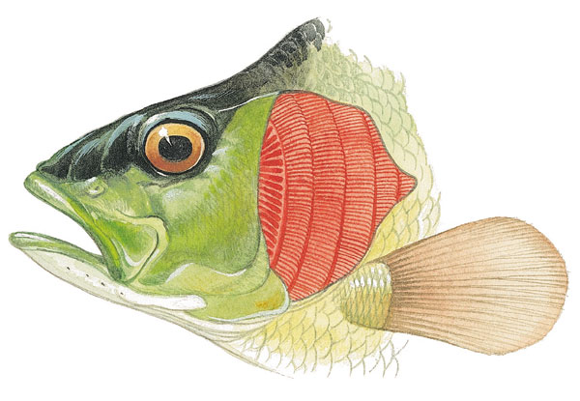
Respiration
Respiration via 4 pairs of gills
No individual openings to outside
Gills on each side covered by single, flap-like operculum

Slide 3
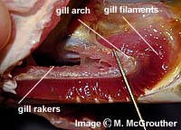
Gill Structure

Slide 4
The Gill as a Respiratory Structure
Buccal cavity can be opened and closed by opening and closing the mouth.
Opercular cavity can be opened and closed by movements of the operculum.
Ram ventilation
    blood flows in an opposite direction to the flow of water, thus maximizing oxygenation of blood
      gill arches
        countercurrent flow

Slide 5
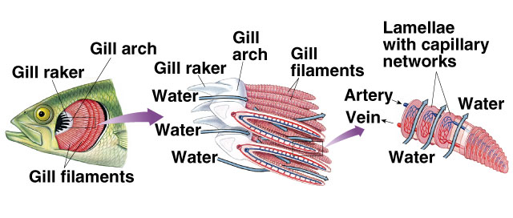
Structure of a Fish Gill

Slide 6
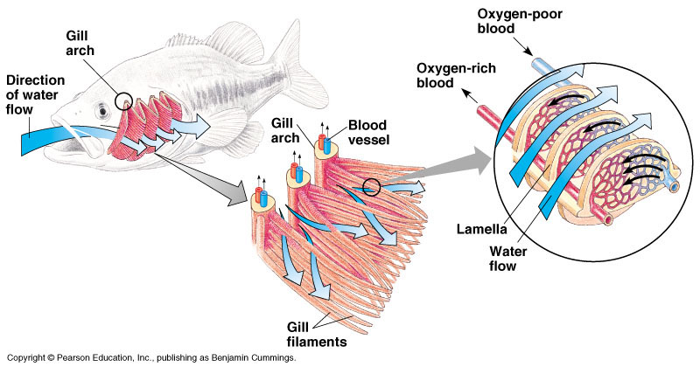
Fish
Because the gills are so VASCULAR and have a large surface area, gas exchange can happen adequately

Slide 7
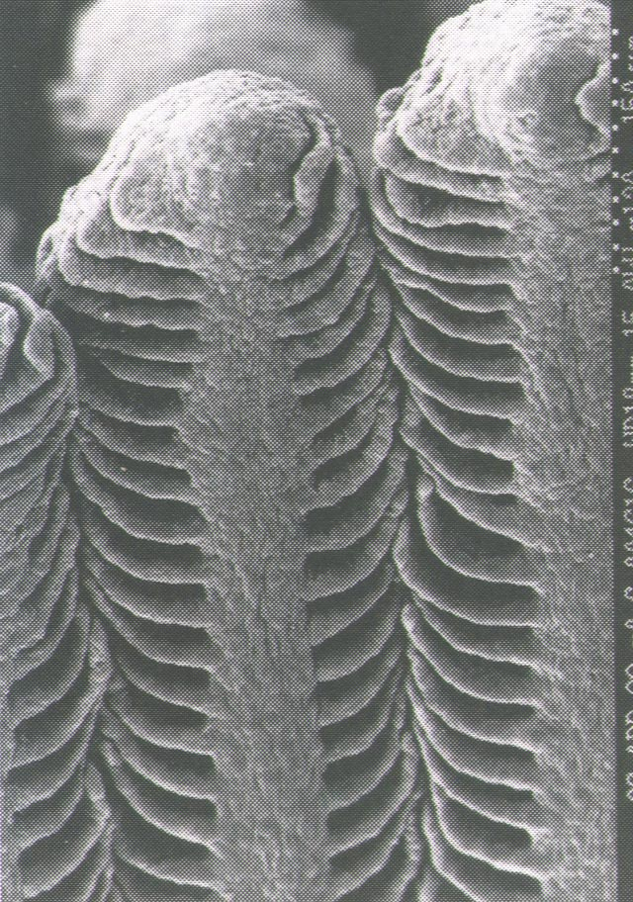
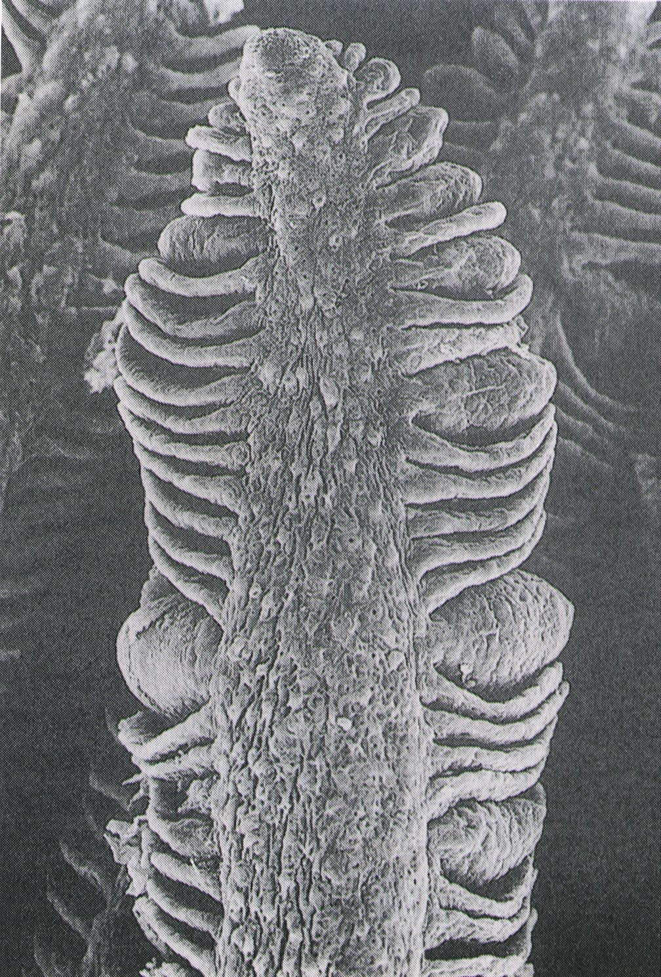
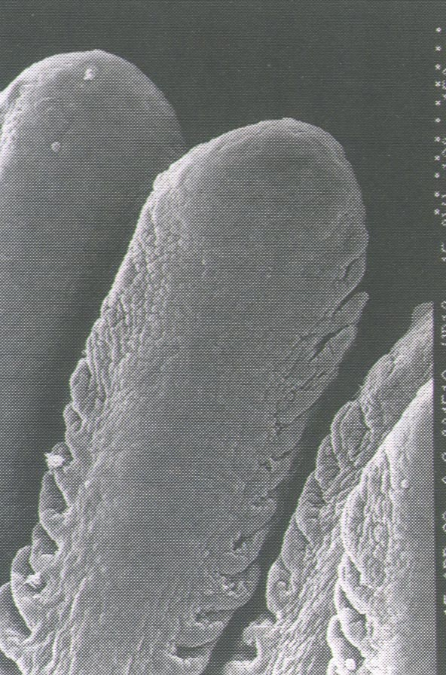
  Healthy gills 2 layers of epithelial cells
  Irritated gills - hyperplasia (reduction in exchange efficiency)

Slide 8
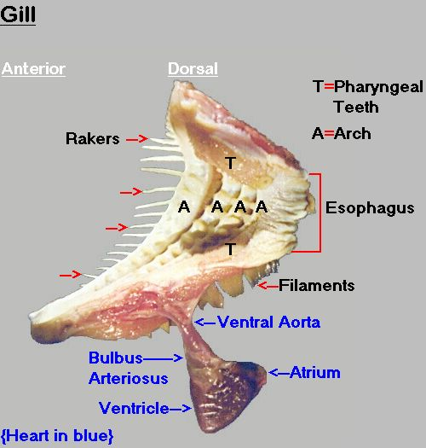
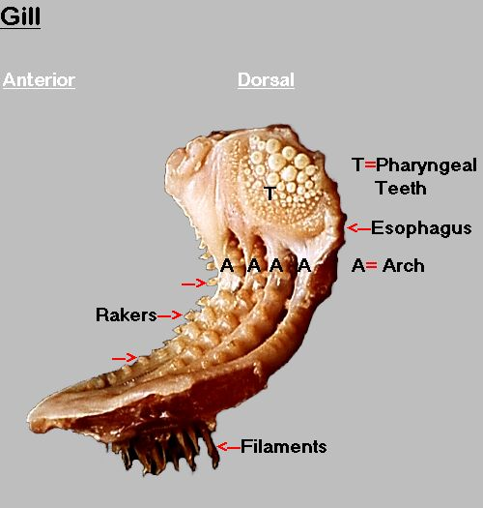
Teleost gill structure

Slide 9

Respiratory Pump in Fish
Fish need a more efficient method than terrestrial animals
  Unidirectional system, water always moves one way across gills and out operculum
  No mixing of fresh and respired water, maintaining highest possible P_{O2} at gill surface

Slide 10
Fish
They breathe by pumping water through the mouth, over gill filaments and out through slits in the sides of the pharynx
Double Pump System: by decreasing pressure in mouth, water is forced in; by increasing pressure in mouth, water is forced out through the opercula

Slide 11
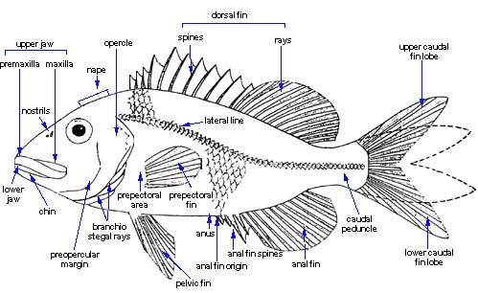
Respiration
Single, moveable operculum has allowed a pumping mechanism to develop
Continually forces water across gills even when fish is stationary

Slide 12
Respiration
With mouth open, opercles flare outward but remain in contact with body

Slide 13
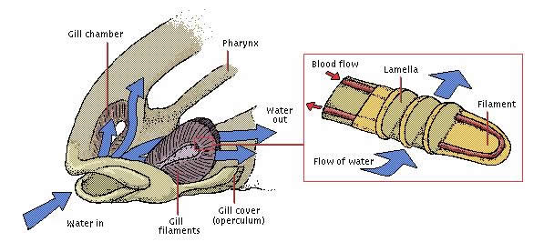
Respiration
Water drawn into mouth
Mouth closes and opercula open
Opercula pulled in, forcing water over gills and out opercular openings

Slide 14
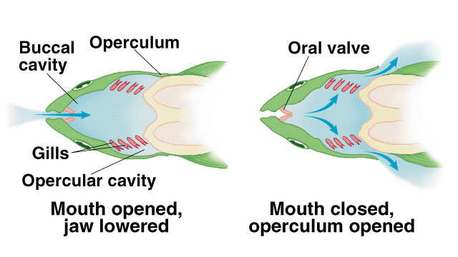
Bony Fish Respiration

Slide 15
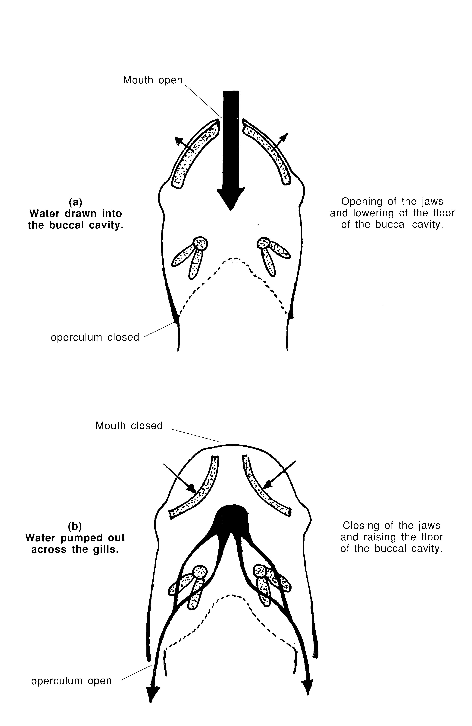
Respiratory Pump in Fish
Dual Pump
Phase I
Expansion of buccal and opercular cavities while opercula are closed
Phase II
Mouth closes, opercula open, forcing water across gills
Buccal cavity
Opercular cavity

Slide 16
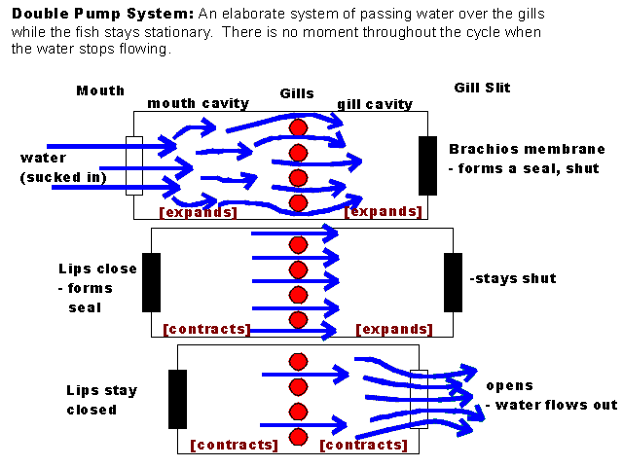

Slide 17
Respiration
Gill filaments finely divided into small lamellae to increase surface area
Blood flow through lamellae in direction opposite that of water flow

Slide 18
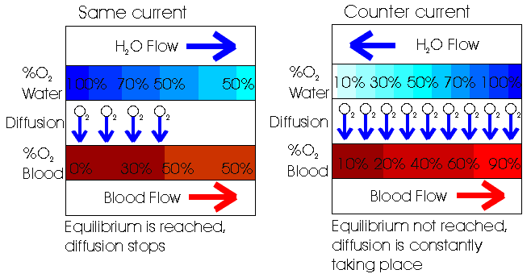
Respiration
Countercurrent flow
Allows for most efficient extraction of O₂ from water

Slide 19
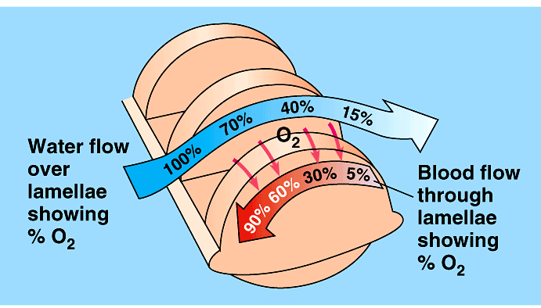
Countercurrent blood flow increases the efficiency of obtaining O₂ from water

Slide 20
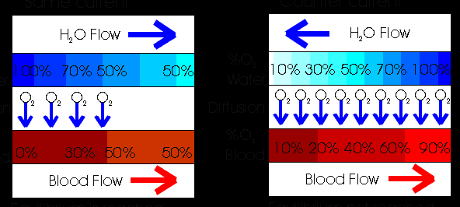
Counter Current Exchange
Blood flows through gill tissue in the opposite direction of water
If blood flow were in same direction, then blood would only be able to get half of available oxygen
With blood flow opposite…the gradient is always such that oxygen will pass to the blood
This gives fish 80 – 90% efficiency in acquiring oxygen

Slide 21
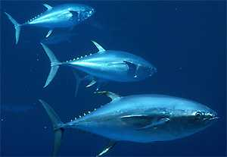
Respiration
Active fish like tuna must keep moving continually to move water across gills
Lack the pumping mechanism

Slide 22
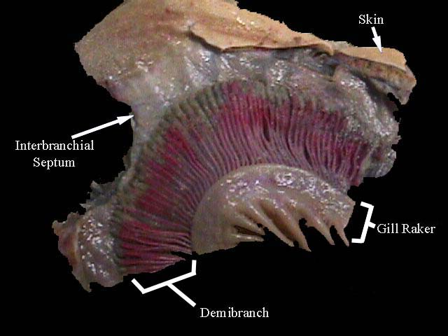
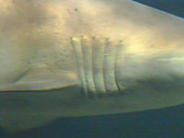
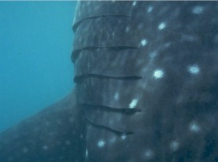
Shark gill structure

Slide 23
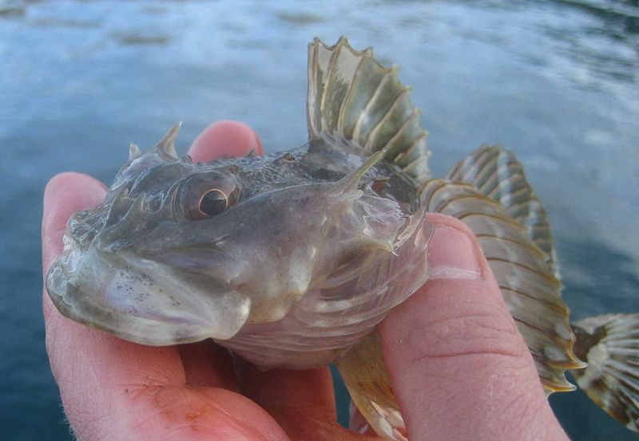
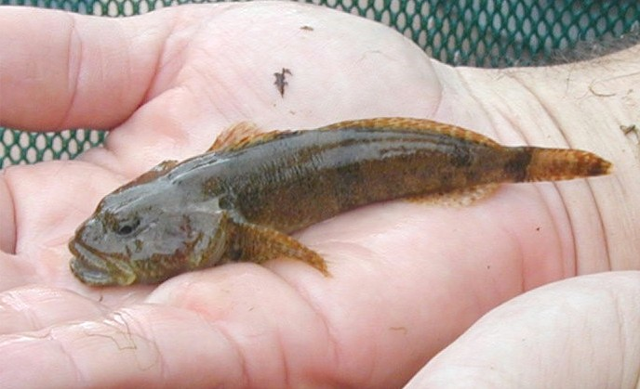
When fish are taken out of the water they suffocate, not because they can’t breathe the oxygen available in the air
Their gill arches collapse and there is not enough surface area for diffusion to take place
Some fish are designed to be exposed to the air for brief periods

Slide 24
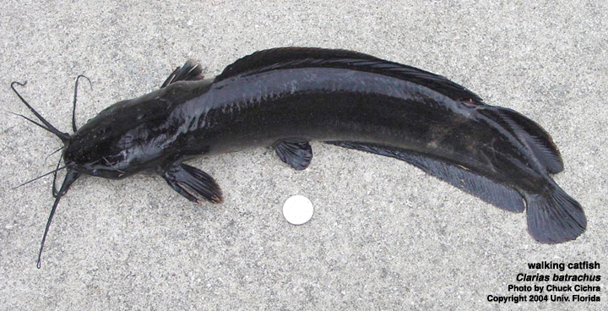
Air Breathing Fish!?
The walking catfish can go from pond to pond as long as their gills stay wet

Slide 25

Lungs
Some fish use lungs to breath
Pouches branching off esophagus
Breathe air at surface or remain out of water

Slide 26
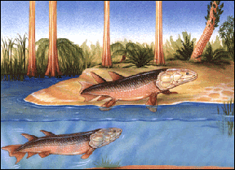
Lungs

Slide 27
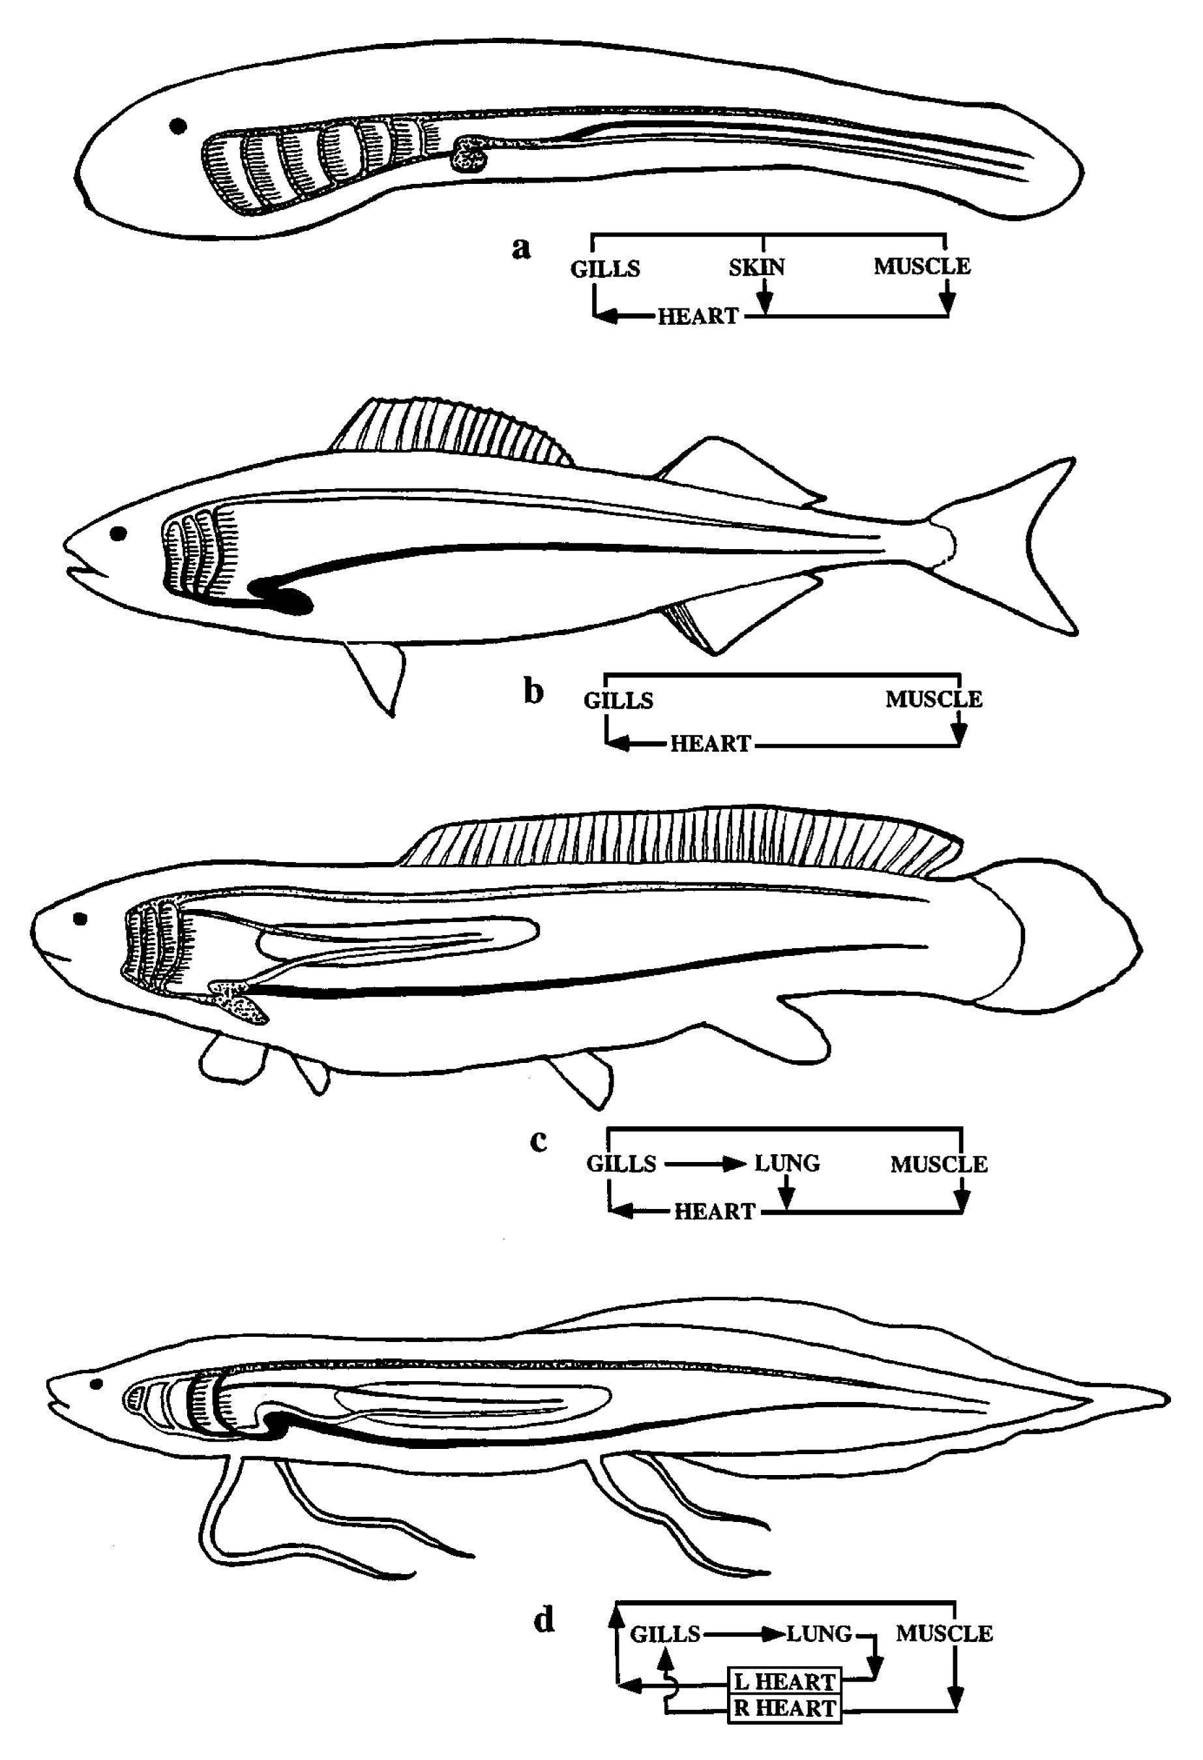
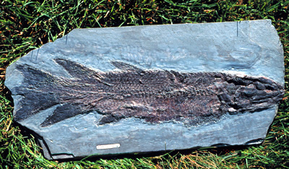
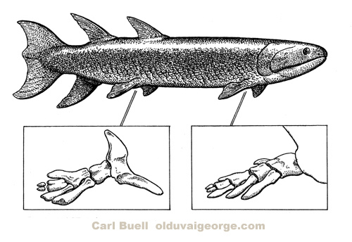

Slide 28
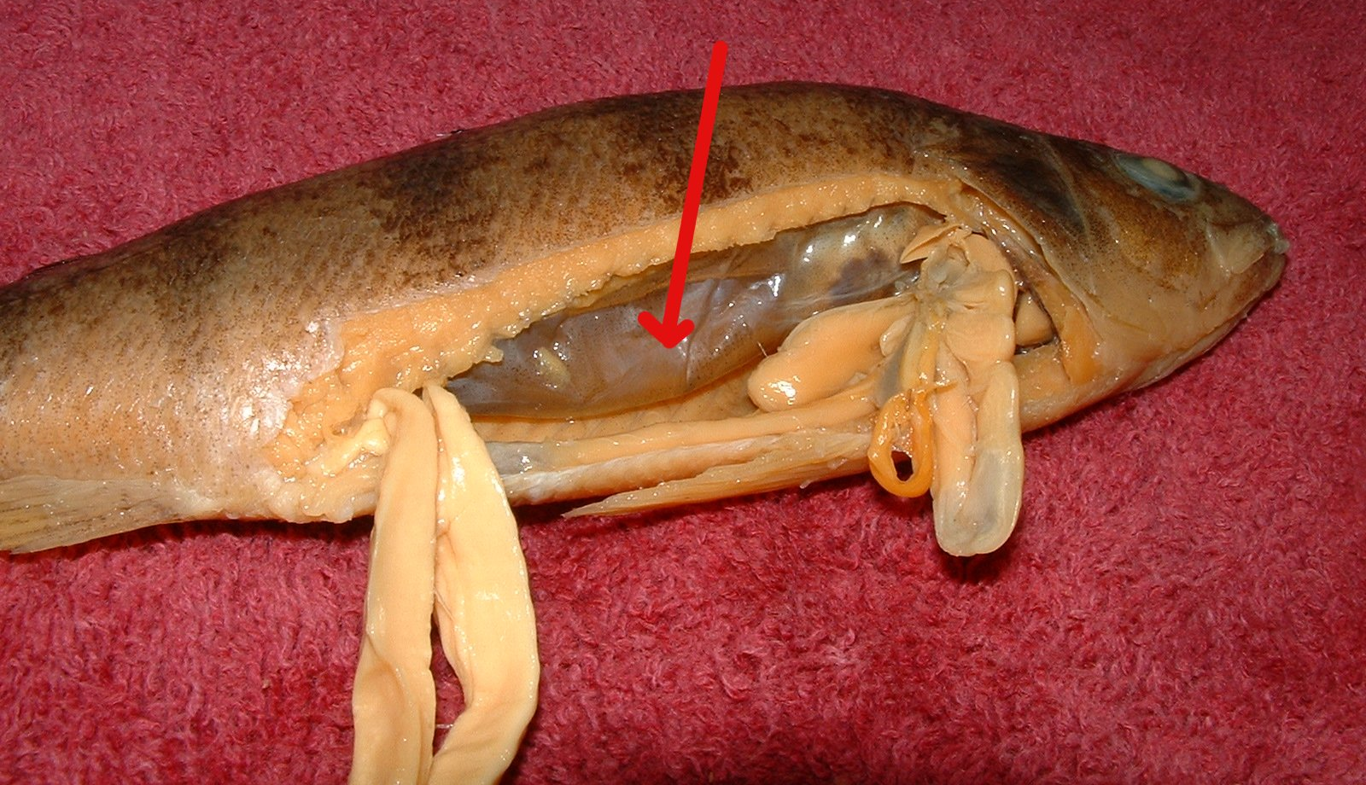
SWIM BLADDER controls buoyancy
Image by Riedell/Vanderwal©2005

Slide 29
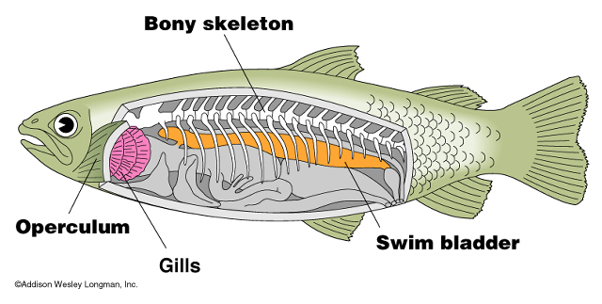
Swim Bladder
Many fish possess a swim bladder (Actinopterygii)
Creates neutral buoyancy so fish can remain motionless in water column

Slide 30
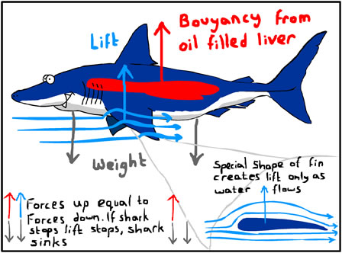
Swim Bladder
Not in sharks
Depend on constant movement and fat deposits

Slide 31
Swim Bladder
Swim bladder probably arose from paired lungs of primitive fish
Lungs were present before swim bladder

Slide 32
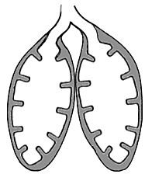
Swim Bladder
Paired lungs probably necessary because of alternating wet and dry periods
Supplemented gills

Slide 33
Swim Bladder
Swim bladder present in pelagic bony fish
Usually absent in benthic fish

Slide 34
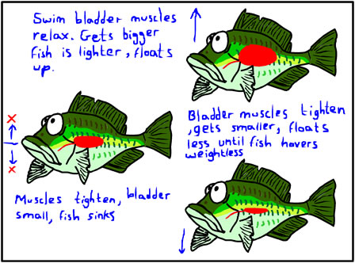
Swim Bladder

Slide 35
Swim Bladder
Gas adjustments can be complicated physiologically and anatomically

Slide 36
Swim Bladder
Less specialized fish have swim bladder connected to esophagus
Can gulp air at surface to fill bladder, or burp out excess

Slide 37
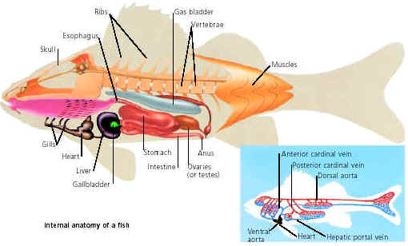
Swim Bladder
More specialized fish have swim bladder not connected to esophagus
Gas secreted into bladder by gas gland

Slide 38
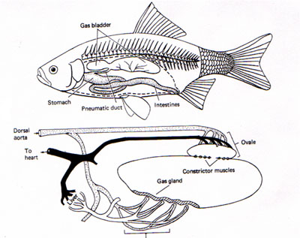
Swim Bladder
Rete mirabile - complex of blood vessels - increases gas concentration in bladder
Ovale - removes gas from bladder - slowly

Slide 39
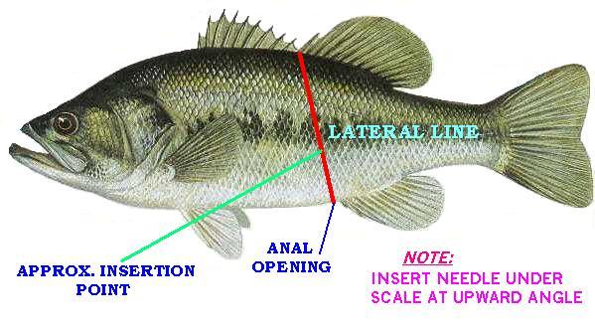
Swim Bladder
Slow deflation causes problems with fish angled from depths
Instructions on bladder deflation

Slide 40
Swim Bladder
Some fish have posterior connection between bladder and intestine
Allows for rapid venting of gas (rapid surfacing)

