Slide 1
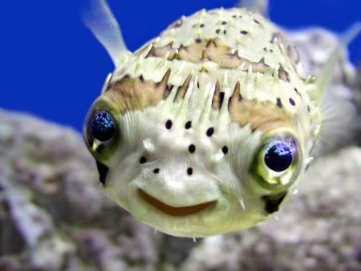
Fish Senses

Slide 2

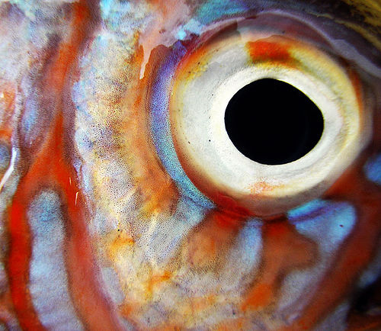
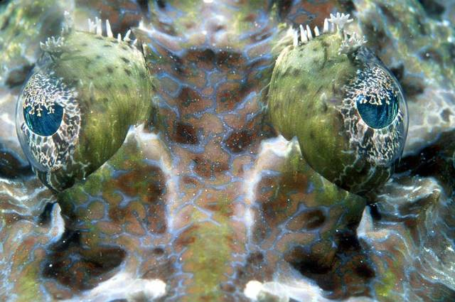
Vision

Slide 3
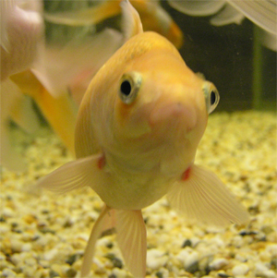
Eye position
Lateral to forward
Allows vision to side as well as forward
Monocular to side, some degree of binocular to front

Slide 4
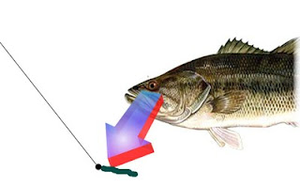
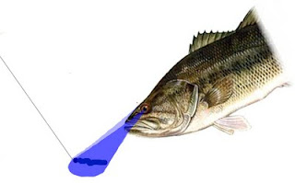
Top-Down View of Fish Eye Structure
Fish perceive both visual fields independently.

Slide 5
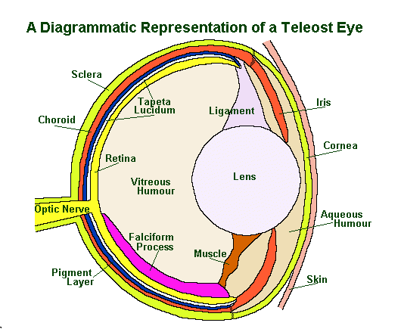
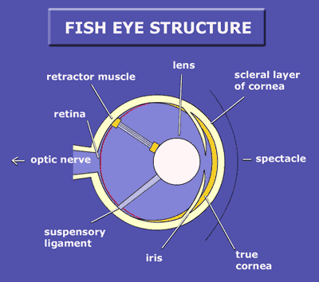
Typical Fish Eye
Large, round lens (can’t change shape) - refracts light better underwater
Focused by moving lens anterior/posterior
Pupil/iris change little - low light environs - lens may actually move through iris

Slide 6
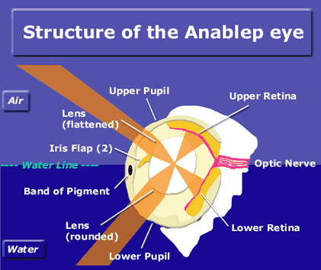
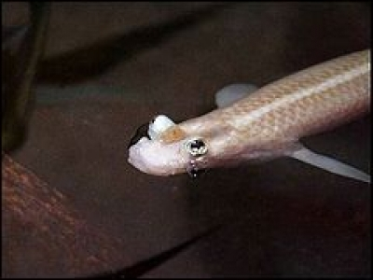
Four-eyed Fish
Each eye has two pupils
One for above-water vision, one for below-water vision
Single lens in each varies in thickness top to bottom to compensate for refractive differences between air and water

Slide 7
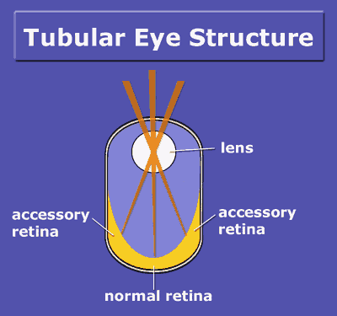
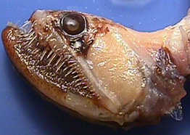
Deep-sea Fishes
Eyes tend to be tubular to gather more light
Eyes also tend to be proportionally larger relative to head size

Slide 8
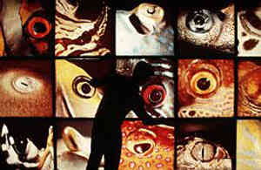
Colored Corneas
Colored corneas function as light filters
Absorb specific wavelengths of light
Yellow corneas absorb blue and green light
Increase contrast at low light levels

Slide 9
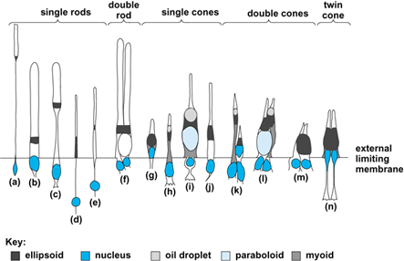
Rods in retina
Rods are physically retracted when light levels are high (cones are static)
Higher proportion of rods to cones than in humans
Rods can be retracted in some fish and covered with a black melanin tissue

Slide 10
Cones and Pigments
Cones distinguish between various colors (wavelengths)
Each cone has a pigment which absorbs light of a given wavelength
Different fish may have different pigment make-ups based on environment
Some fish have pigments that absorb at UV-range wavelengths

Slide 11
Fish and UV Light
Most teleost fish possess a type of cone which is sensitive to UV light (~360 nm)
UV vision may have been co-opted by evolution for other purposes (i.e., mating)
Aquatic UV vision is most likely short-range

Slide 12
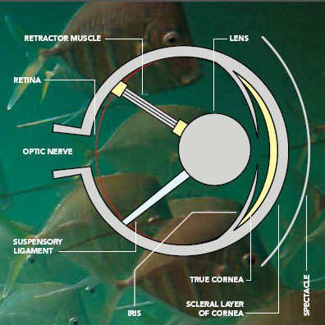
Perceiving Light is Difficult Underwater
Changing water conditions drastically affect a fish’s ability to see
Contrast is chief detector of objects such as other fish, plants
At different depths, color perception is very different

Slide 13
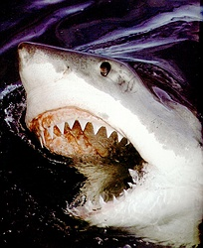
Sharks
Sharks have few retinal cones, relying mostly on rods for photoreception
Sharks are extremely sensitive to light
Rods are much larger and less numerous than in humans, making vision less acute

Slide 14
Sharks
Eyes still good, can see well in dim light, can see colors

Slide 15
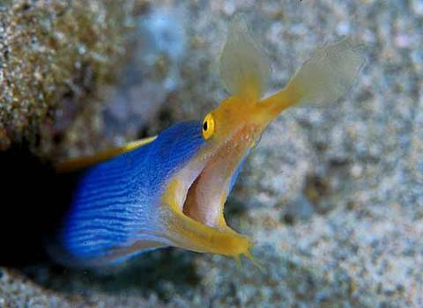
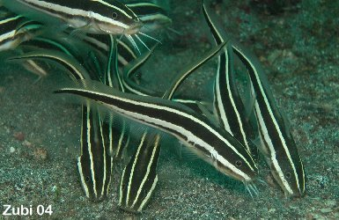
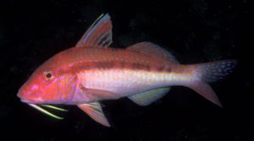
Olfaction
Taste

Slide 16
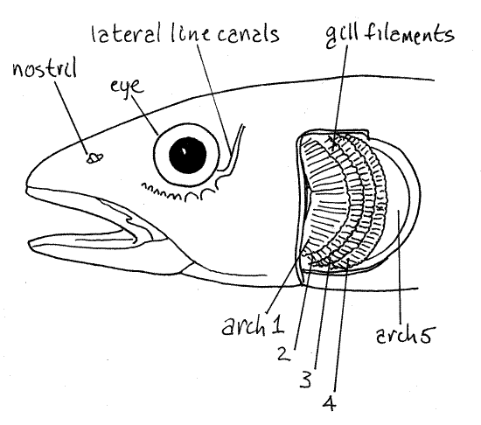
Sense of Smell

Slide 17
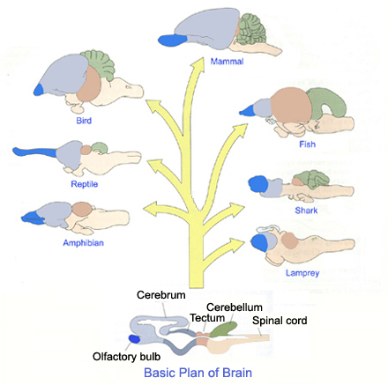
Most Fishes
Large olfactory bulb reflects importance of smell

Slide 18
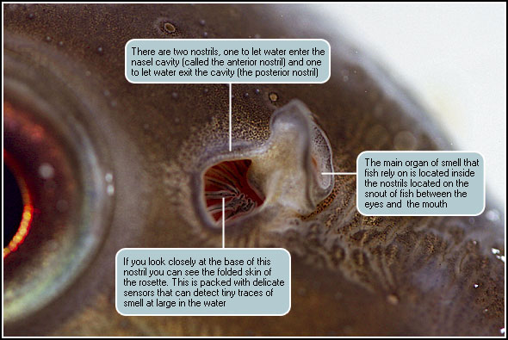
Nostrils

Slide 19
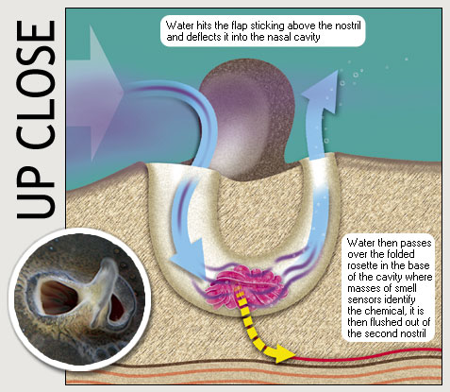
Nostrils

Slide 20
Use of Smell
Recognize places in their environment (migration)
Recognize each other as individuals
To communicate danger (alarm pheromone into the water if their skin is damaged)
In reproduction (pheromones released by females can trigger courting behavior in males)
To find food

Slide 21
Sharks
Excellent sense of smell
Use to locate potential prey (blood)

Slide 22
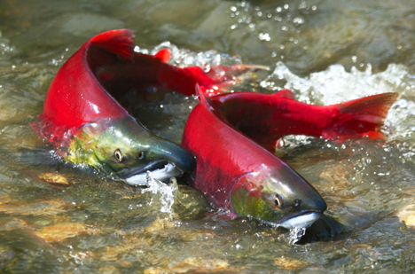
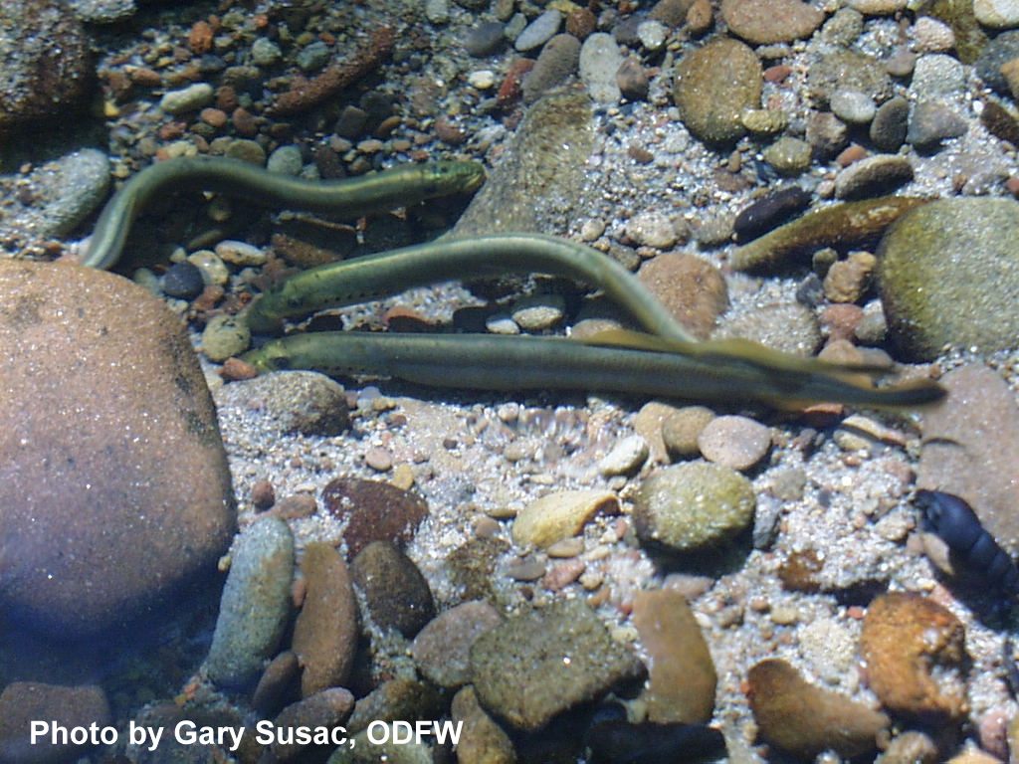
Salmon and Lamprey
Salmon use olfaction to detect proper stream (chemical signature) to enter for spawning
Lamprey use smell to locate juveniles in streams (to enter for spawning)

Slide 23
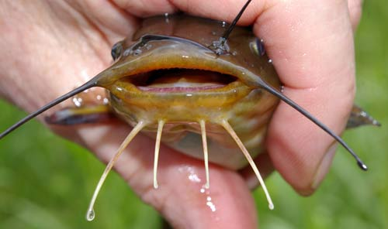
Sense of taste
Taste buds – used to detect food
Tongues, barbels, lips, face, entire body

Slide 24
Sense of taste
Catfishes have taste buds on barbels, entire body to locate food in murky waters

Slide 25
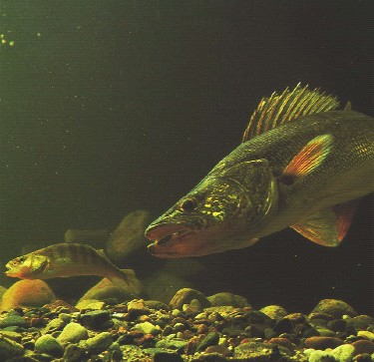
Sense of taste
Walleye have taste buds on lips, face
Can “taste” bait by “bumping” it without biting it

Slide 26
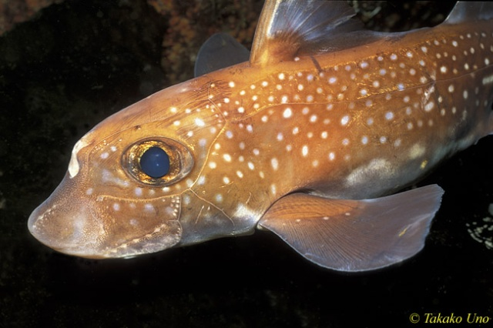
Lateral Line

Slide 27
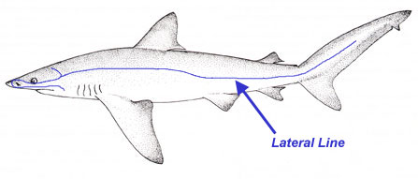
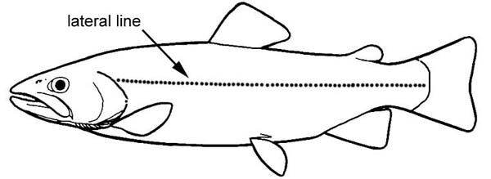
Lateral Line

Slide 28
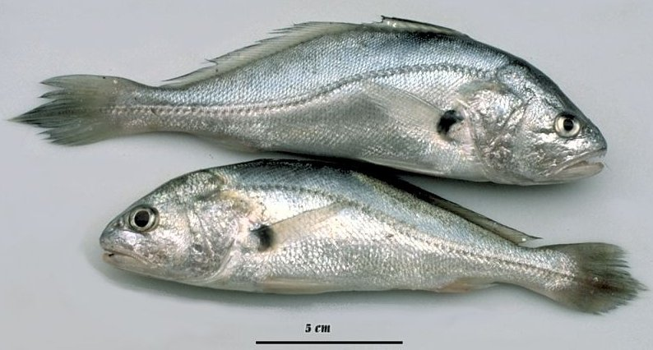
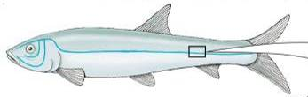
Lateral Line

Slide 29
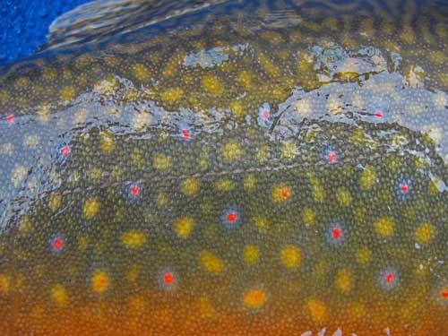
Lateral Line
Connects scales to sensory cells and nerve fibers
Very important sensory organ

Slide 30
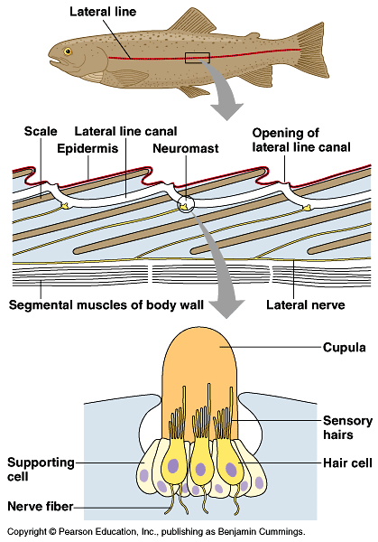
Contains mechanoreceptors that function similarly to mammalian inner ear
Provides a fish with information concerning its movement through water or the direction and velocity of water flowing over its body

Slide 31
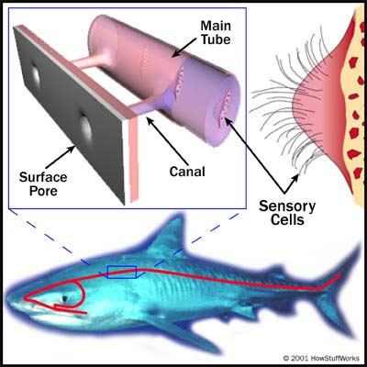
Same in Sharks
Canal system extending along sides and over head
Openings to surface, special sensory cells inside
Sensitive to vibrations, currents
Detect objects, moving animals

Slide 32
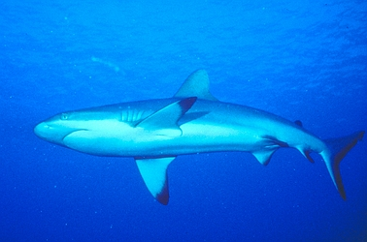
Other senses
Sharks also can detect electricity, which is emitted in small amounts by every living animal
May be more sensitive to electric fields than any other animal

Slide 33
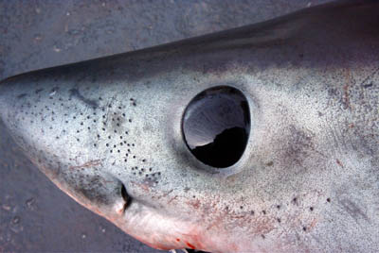
Electroreception
Have special network of jelly-filled pits near snout called ampullae of Lorenzini to detect electric fields
Can pick up weak electrical stimuli from muscle contractions of animals

Slide 34
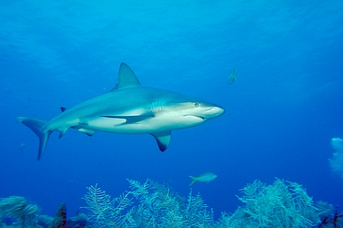
Ampullae of Lorenzini
May also serve to detect magnetic fields, which some sharks may use in navigation

