Slide 1
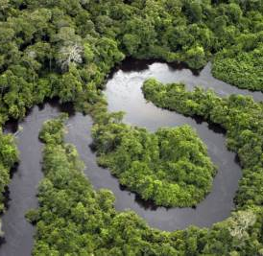
Ecology of Large Rivers
Chemical & Physical
Environment

Slide 2
River and Streamwater Chemistry
River water chemistry reflects chemical composition of rainwater and watershed soils and rocks, plus human activities
Both inorganic and organic
Ca²⁺, Na⁺, Mg²⁺, K⁺, HCO₃⁻, SO₄²⁻, Cl⁻
Nutrients N, P, Si
Gases N₂, CO₂, O₂
Dissolved organic matter
Dissolved metals Pb, Hg, Zn, Cu

Slide 3
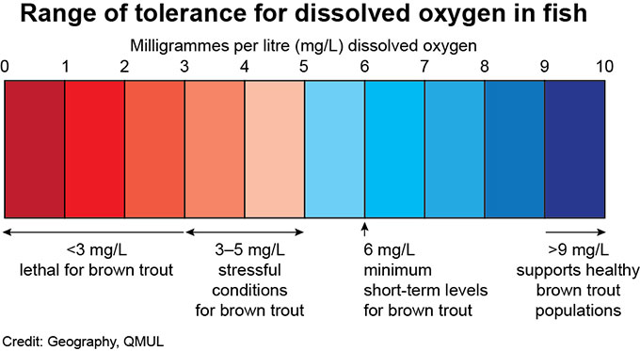
Dissolved Gases
Oxygen and carbon dioxide most important gases in moving waters
Concentrations maintained at equilibrium with atmosphere (temperature, pressure) by water turbulence/movement
O₂ up, CO₂ down by photosynthesis
Opposite for respiration (also decomposition)
Groundwater flows have low O₂, high CO₂

Slide 4
Major Ions
Ca²⁺, Na⁺, Mg²⁺, K⁺, HCO₃⁻, SO₄²⁻, Cl⁻
World average concentration of 120 mg/L
Highly variable (low in igneous basins, high in arid regions)
Concentrations twice as high in rivers draining sedimentary basins than in igneous basins

Slide 5
Major Ions
Rivers draining wetter regions (high precipitation, high surface water runoff) have lower ionic concentrations than rivers in arid climates (dilution, less evaporation)
Precipitation less important than geology in affecting river chemistry, except in basins where rocks are resistant to dissolving

Slide 6
Seasonal Changes
River chemistry can change seasonally due to:
Discharge regime
Precipitation inputs
Biological activity
Some ions unchanged by discharge variation, others decline with increased flows (likely dilution; e.g. Ca, Mg, total conductivity)

Slide 7
Chemical Classification of Rivers - Gibbs
Three major mechanisms control river water chemistry
Rock dominance: rocks and soils are major source of dissolved materials (intermediate ion concentrations)
Precipitation dominance: tropical rivers with precipitation as major ion source (low ion concentrations)
Evaporation dominance: arid region rivers (high ion concentrations)
Most world rivers are in middle; low in Na⁺, dominated by Ca²⁺, HCO₃⁻ ions (weathering of sedimentary rocks)

Slide 8
Bicarbonate Buffer System
Inorganic carbon takes multiple forms in rivers
Different forms exist with each other in chemical equilibrium
Dominant form present is pH-dependent
High concentrations of inorganic carbon serve as a buffer against rapid and large pH changes

Slide 9
Buffer Mechanism
Weathering of carbonate-rich sedimentary rock contributes bicarbonate ions
Additions of these ordinarily would shift pH toward higher values
Presence of buffer system counteracts carbonate additions by increasing concentration of carbonic acid
Same buffer can counter biological changes in concentrations of inorganic carbon (photosynthesis, respiration)

Slide 10
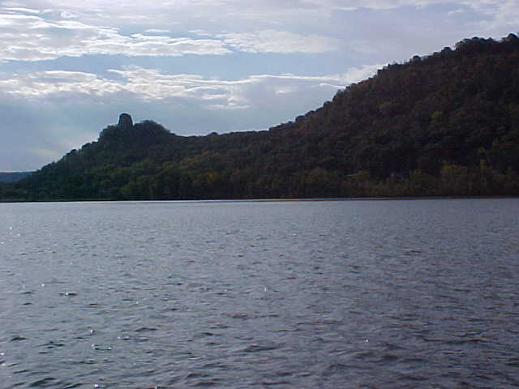
Alkalinity
Measure of buffering capacity of water
Carbonates and bicarbonates of alkali metals
Lake Winona occupies part of an old side channel of the Mississippi River.

Slide 11
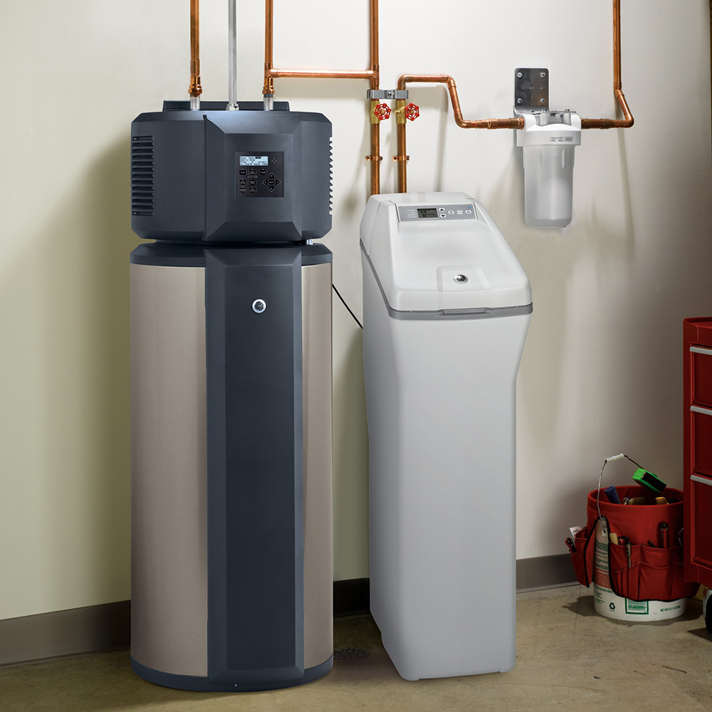
Hardness
Calcium and magnesium salt content
Temporary hardness - carbonates and bicarbonates, can be removed by boiling
Precipitation of CaCO₃
Ca(HCO₃)₂ = CaCO₃ + H₂O + CO₂
Permanent hardness - sulfates, chlorides, other anions
Hardwater versus softwater rivers and streams

Slide 12
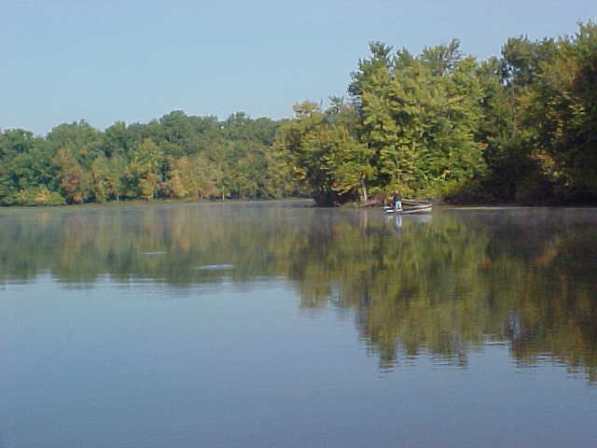
Salinity
Concentrations of Ca²⁺ Mg²⁺ Na⁺ K⁺ and HCO₃⁻ CO₃²⁻ SO₄²⁻ Cl⁻
Plus other ionized components of other elements
Sam Gordy Slough is a backwater lake of the Mississippi River.

Slide 13
Changing Chemistry – Human Influence
Chemical changes of many types ongoing for decades
Different changes in different river systems
Dependent upon climate, basin geology, land use, other human activities

Slide 14
Freshwater Salinization Syndrome
Increased weathering (human-accelerated)
Increased human inputs (road deicer, ag lime, others)
Increased biological alkalinization
Increased salinization
Increased alkalinization

Slide 15
Chloride
Road salt use in colder climates
Often correlated to % impervious land surface
Aquatic chronic toxicity at 230 mg/L, acute at 860 mg/L

Slide 16
Acid Rain and Rivers?
Major problems 20+ years ago
Toxic metals (Al) mobilized at low pH (<5.5)
Conditions currently improving

Slide 17
Emerging Contaminants (CECs)

Slide 18
Emerging Contaminants
Pharmaceuticals and personal care products (PPCPs)
Estrogen mimics, caffeine, antidepressants, beta-blockers, psychoanaleptics, antihistamines
Ag pesticides, herbicides, fungicides
Can be highly toxic in streams and rivers
Fracking wastewaters
Mercury plus proprietary chemicals
Microplastics

Slide 19
River Physical Environment
Current, habitat, temperature are most important physical variables in rivers/streams
Organisms must have adaptations to all these to survive in specific locality
Simple or extreme environments generally support few species, complex environments support more

Slide 20
Current/Flow Characteristics
Several hydraulic variables important for organisms
Types of flows: laminar, turbulent, transitional
Turbulent flows most common in natural channels
Mean velocity, depth, surface roughness useful in defining flows

Slide 21
Turbulence
Surface roughness increases turbulence
Roughness due to rocks, wood, plants
Complex patterns of turbulence, velocity downstream from roughness elements
Calm water immediately downstream, turbulence further downstream

Slide 22
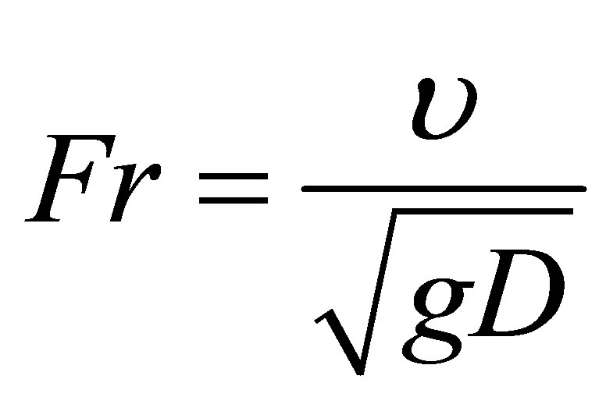
Hydraulic Flow Models
Different models attempt to use simple number scale to describe the types of flows and forces experienced by a river-dwelling organism
E.g., Reynolds number (velocity, depth, viscosity) (roughness Reynolds number when applied to substrate)
Froude number (incorporates gravitational forces)

Slide 23
Flow Effects on Organisms
Many hydraulic parameters affect distribution of aquatic invertebrates
Channel measures:
Mean velocity
Froude number
Reynolds number
Near-bed measures:
Velocity
Turbulence
Shear stress

Slide 24
Reynolds Roughness and Invert Abundance
More taxa found in less turbulent areas of riffles, fewer taxa located in the most turbulent areas
Same pattern for overall invertebrate abundance: higher in less turbulent, lower in more turbulent areas
Shear stress – force applied by moving water on an organism (or substrate particle)

Slide 25
Living on the Riverbed
Most organisms live attached to, within, or associated with the substrate
Flows turbulent and difficult to measure at such small scales
Living a balance between physical drag forces trying to dislodge them, and benefits of delivery of food, nutrients, gases, removal of wastes

Slide 26
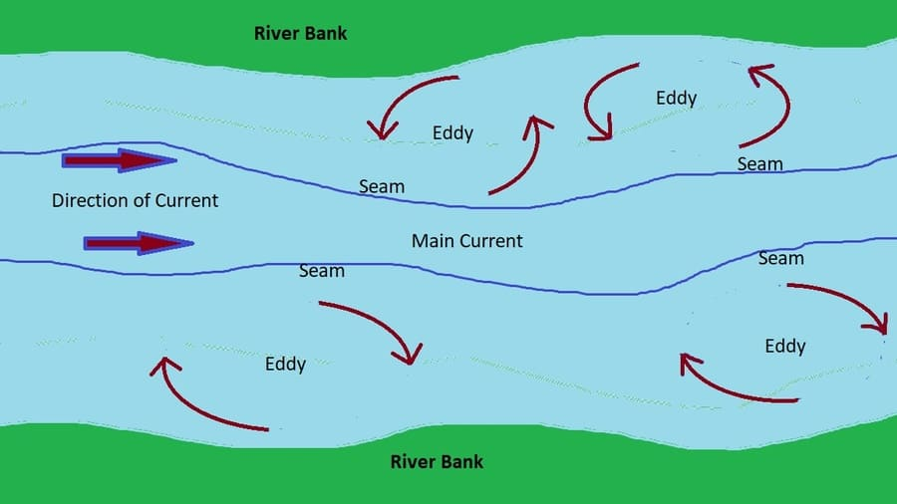
Living in the Water Column
Fish remain out of main current, or turbulent areas
Hold positions in low-velocity water behind current obstructions (rocks, logs)
Optimize tradeoff between energy supply (drifting food organisms) and energetic costs of swimming
Also may take advantage of current vortices (eddies) when making upstream movements against main current

Slide 27
What about floods?
What happens to benthic invertebrates and fishes during river flooding?
Fates depend on magnitude of flooding
Organisms respond differently to “normal” floods than they do to rare extreme flows

Slide 28
Responses to Modest Floods
As velocities and shear forces increase with flooding, inverts and fish seek shelter in low-flow areas or substrate crevices (if available)
Allow organisms to wait out modest flooding and return again to normal conditions quickly

Slide 29
Extreme Floods
Extreme flood events leave few, if any, refuges available to inverts and fishes
Flows capable of moving houses produce massive shear forces capable of mobilizing ALL bottom substrates
High flows can scour channels and virtually eliminate biota

Slide 30
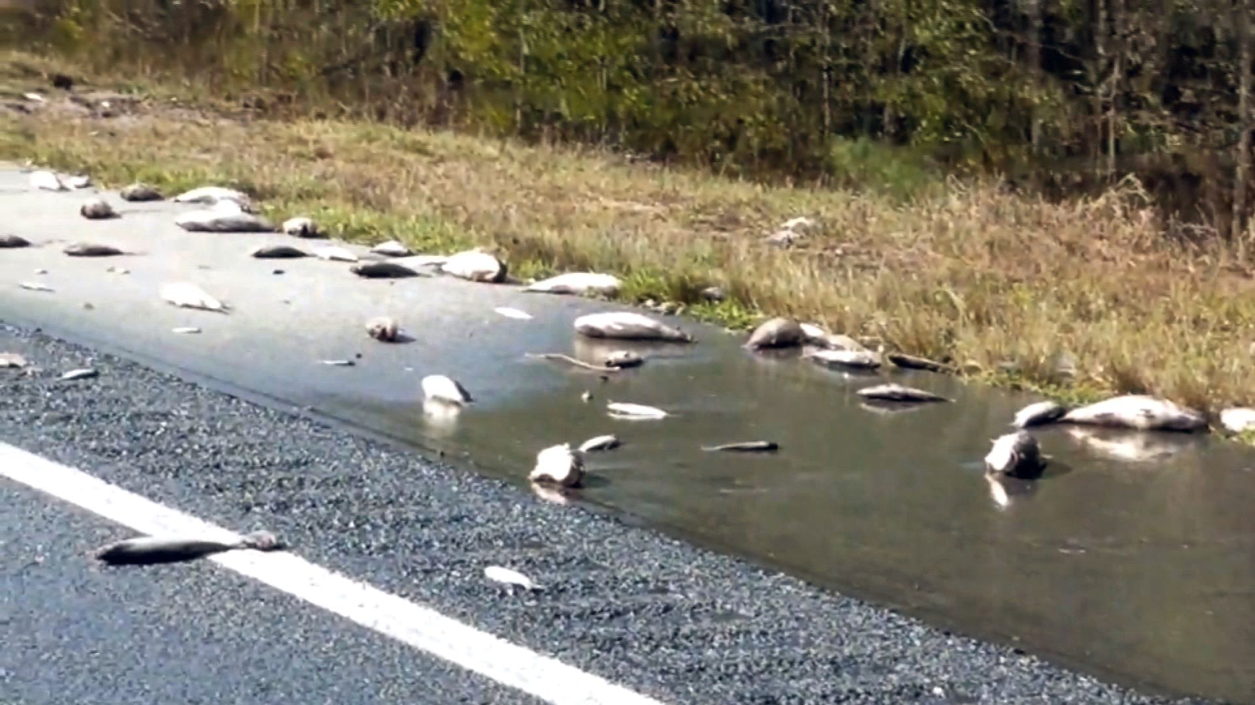
Aftermath of Extreme Flooding
Flooding leaves behind scoured landscapes devoid of most life
Invertebrates killed or displaced far downstream (except deep hyporheic habitats)
Juvenile fish eliminated
Some adult fish may survive, but mortalities could exceed 60%
Requires extended time period to recover (e.g., 2 years for small streams in Whitewater River system after 2008 flood)

Slide 31
Applying Flow Environment Knowledge
By understanding the flow needs/preferences of river biota, we can make better decisions when managing river flows
flow restorations?
E.g., By knowing the preferred flow environments of benthic invertebrates, we can better regulate dam releases (especially minimum flows) to meet those needs

Slide 32
Applying Flow Environment Knowledge
Fishways to provide passage of migrating fish around dams, weirs, or natural barriers
Do the fishway hydraulics match the abilities of the fish species for which they were designed?
Many do not

Slide 33
Applying Flow Environment Knowledge
Mississippi River lock and dams have no specific fishways
Fish can ”lock through” with barge traffic
Fish can pass through roller gates
Studies have found that standard operations can restrict fish migration
Can modify operations to alter hydraulics → better suited to fish passage

Slide 34
Applying Flow Environment Knowledge
Spawning salmonids have specific but predictable flow needs
Flows can be “adjusted” in regulated rivers to maximize available spawning habitat
Especially important when setting minimum flow requirements for hydropower dams on rivers

Slide 35
Applying Flow Environment Knowledge
Example: Prickett Dam and Hydropower Station on Sturgeon River in Michigan
Sturgeon River hosts spawning migrations of Lake Sturgeon, Rainbow Trout, Pink Salmon
Operating license (on:off daytime power generation) requires minimum releases when NOT generating power to provide useable spawning habitat

Slide 36
Physical Habitat in Rivers and Streams
Physical habitat structure
Inorganic and organic substrates of varying size
Channel units (pools, riffles, bends)
Heterogenous and structurally complex habitats → greater range of niches →
More coexisting species
More effective refuges
Greater range, abundance of food resources

Slide 37
Inorganic Substrates
Boulders, rubble, gravel, sand, silt, clay
Coarser materials often more stable, influence channel structure, provide habitat/refuges for inverts and juvenile fishes, feeding and oviposition sites for inverts
Finer materials provide burrowing habitat for many invert larvae (Hexagenia mayflies), larval lamprey

Slide 38
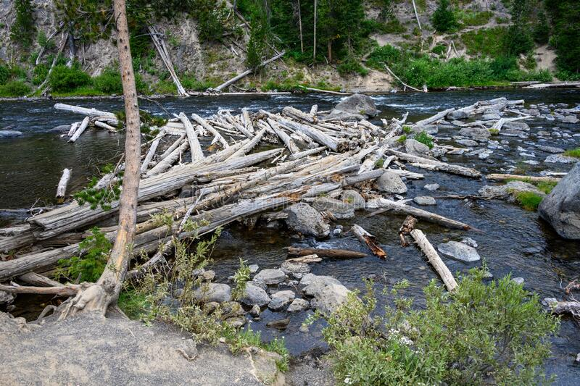
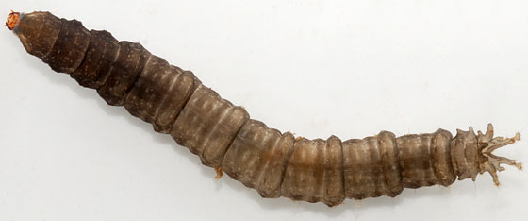
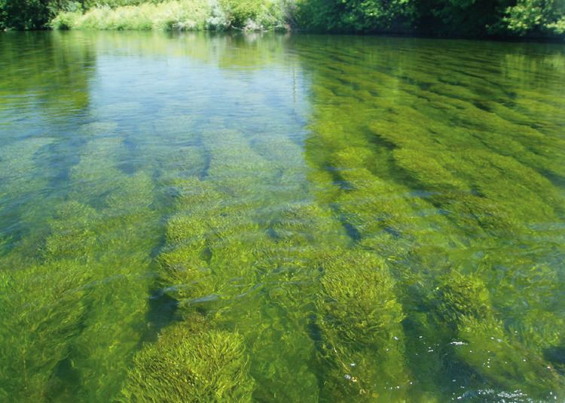
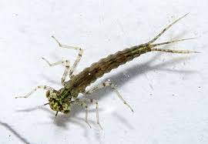
Organic Substrates
Logs and branches
Dead leaves and sticks
Living macrophytes
Habitat and food resources for fish and invertebrate biota
Cranefly larva
Damselfly larva

Slide 39
Fine Sediments
Sand, silt, clay
Source: eroding soils (#1 water pollutant worldwide)
Accumulates on riverbed
Clogs substrate interstices
Reduces pool depths
Reduces invert abundance
Impacts fish spawning habitats (gravel)
Impedes respiration (clog gills)

Slide 40
Macrophytes
Increase habitat complexity
Diverse macrophyte community has greatest variety of plant architecture (growth forms)
“Underwater forests” provide numerous niches for invertebrates and fishes
Invasive plant species may homogenize community and simplify habitat and animal life

Slide 41
Wood
Plays many roles in rivers
Influences velocity, sedimentation, pool development, bank reinforcement
Provides habitat for fish, inverts, algae, bacteria, refuge from predators and high flows
Source: bank erosion
Often removed for flooding management and infrastructure protection

Slide 42
River Restoration
Return system to more “natural” conditions
More habitat elements
More habitat complexity
Alter flow and scour patterns to diversify habitats, improve species diversity and abundance

Slide 43
Water Temperatures
Key environmental variable affecting organism (ectotherms!) distribution, abundance, success
Natural seasonal, daily thermal regimes altered by many human activities (e.g., dams)
Summer cool, winter warm
Interfere with life cycle cues, growth rates, success

Slide 44
Upper Mississippi River Modifications
1878 to present
River shipping
4.5-foot channel
6-foot channel
9-foot channel
Started with wing dikes and closing dikes

Slide 45
Upper Mississippi River Modifications
Wing dikes: direct river flow down a single, narrow channel
Closing dikes: cut off flow in alternate channels
Combined effects: created a swift current in main channel that prevented deposition of sediments
Also required some shoreline protection, auxiliary dredging
Sand accumulated on downstream side of wing dikes

Slide 46
The 9-foot Channel
Authorized in 1930, construction on dams began in 1933
29 lock and dams (L & Ds) between Minneapolis and St. Louis
1 through 27 (no 23, but 5A, plus upper and lower St. Anthony L & Ds)
Most built during the 1930s

Slide 47
Lock and Dams
Transformed a former braided river channel into “a series of large, well-fertilized silted impoundments” (Fremling)
Each impoundment – 3 distinct ecological areas
Tailwaters: deep sloughs and wooded islands similar to pre-L & D system
Mid-pool areas: productive marsh habitats
Lower pool areas: deeper open water, heavily silted

Slide 48
Dredging Required to Maintain Channel
Channels maintained by regular dredging in problem areas
Minimum 9-feet deep, 400-feet wide
Deposition in slow-flow areas, also downstream from larger tributaries
What to do with the dredged sediments?

Slide 49
Dredging Required to Maintain Channel
Dredged materials previously used to fill wetlands, backwaters
Became illegal in 1970s
Some dredged materials used to “restore” some river habitats
Create new island habitats, reduce erosion due to wind fetch
Most now removed from river for use in construction, winter road sanding

Slide 50
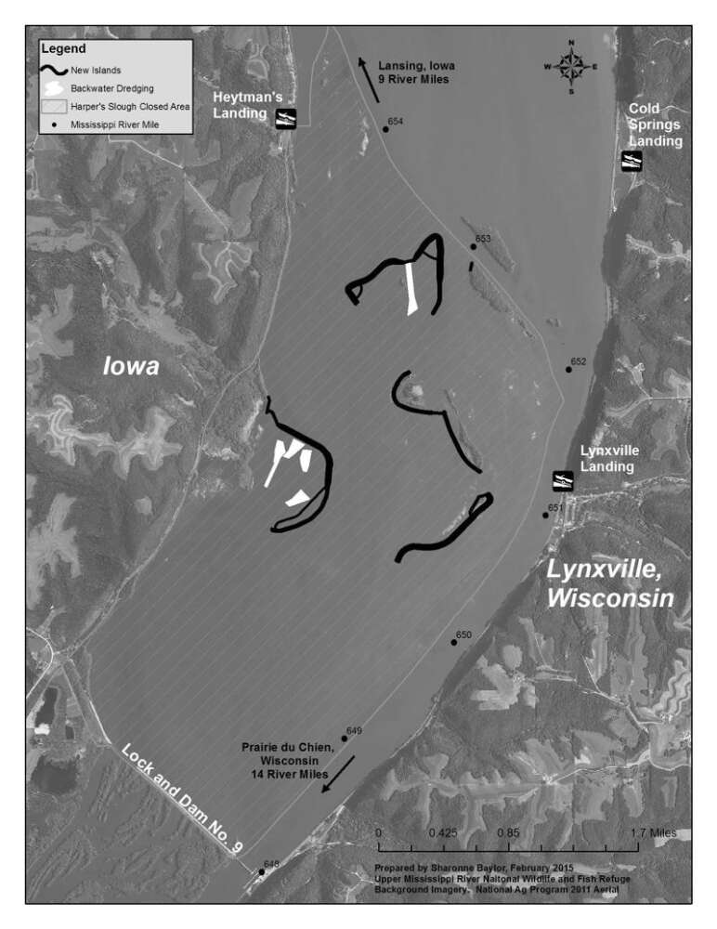
$11.9 million project to improve fish and wildlife habit on Pool 9 of the Mississippi River

