Slide 1
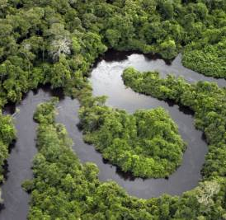
Ecology of Large Rivers
Lotic Communities

Slide 2
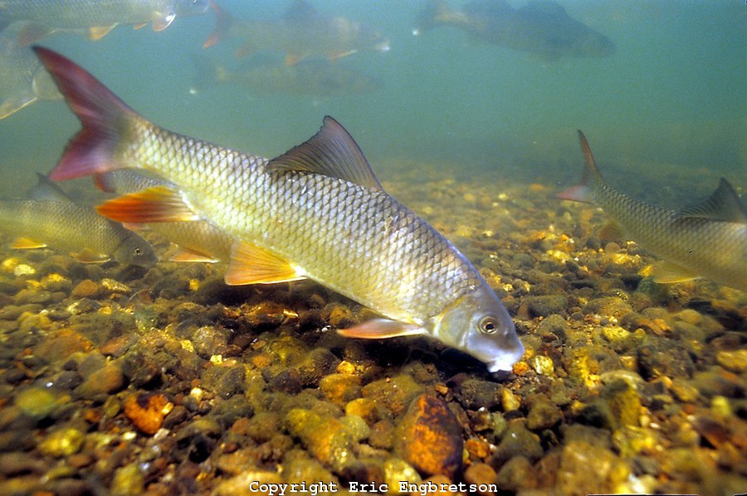
Zoogeography of Fishes
Patterns and processes in the distribution of fishes (i.e., what causes certain fish species to be where they are?)
  Global
  Regional
  Local
Successively smaller “sieves” or filters that determine fish distribution
Predictability of fish assemblages

Slide 3
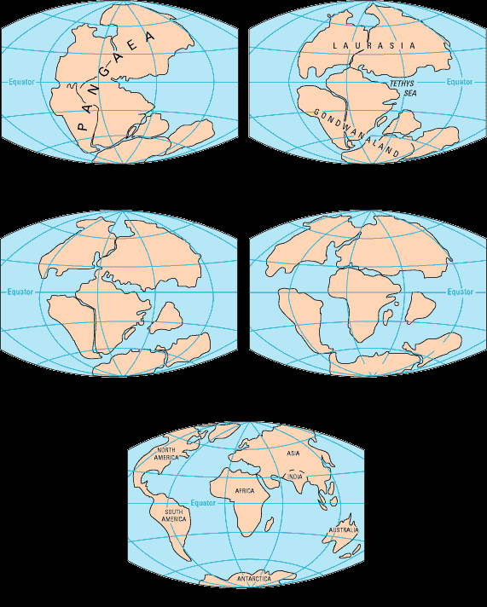
Global
Plate tectonics
Rearrangement of land masses

Slide 4
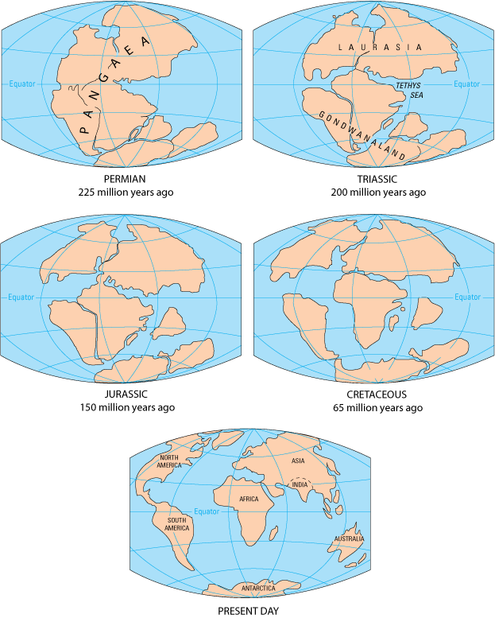
Interpretation of distribution patterns requires:
Geological information - continental drift

Slide 5
Interpretation of distribution patterns requires:
Geological information - continental drift
  a single continent (Pangaea) existed as recently as Triassic (200 mybp)
  Pangaea split into two continents at end of Triassic (180 mybp):
    Northern continent - Laurasia (modern Eurasia & North America
    Southern continent - Gondwana (modern Africa, South America, Australia, Antarctica, India)

Slide 6
Interpretation of distribution patterns requires:
Geological information - continental drift
  Gondwana split in Jurassic & Cretaceous
    Australia broke off first
    South America broke off later

Slide 7
Interpretation of distribution patterns requires:
Geological information - continental drift
  Laurasia split in Jurassic (120 mybp)
    North America separated from Eurasia
  Several fish taxa are present only on northern continents:
    Cyprinids (also have moved into Africa recently)
    Percids - Holarctic (in N. America & Eurasia)
    Catostomids - Nearctic (largely in N. America)
    Centrarchids - Nearctic (only in N. America)
    Cobitids - Palearctic (only in Eurasia)

Slide 8
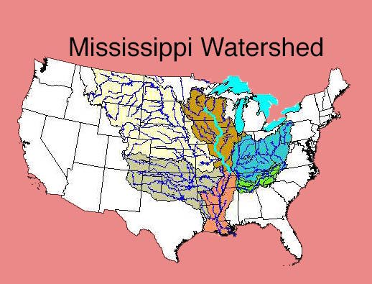
Regional - Historic
Drainage Divides
  Broad drainages isolate aquatic communities (Mississippi vs. Atlantic Slope)

Slide 9

Regional - Historic
Drainage Divides
  Drainage rearrangement (stream capture)
  Populations of Mississippi R. fishes on Atlantic slope
  Etheostoma blennioides (Potomac captured Mississippi)

Slide 10
Regional—Historic
Glaciation
  Mississippi Drainage oriented N – S
    Fish disperse south
  Atlantic Drainage oriented E – W
  Teays R was the major N-W flowing river
    Ice sheets dams caused it to flow S through the small Mississippi R.
    Melt water cut through central highlands making Mississippi R the major river
  Ancient Teays River Valley near present-day New and Kanawha Rivers

Slide 11
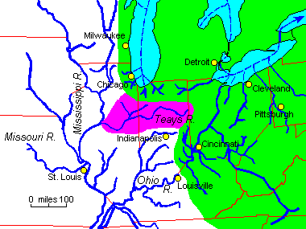
Pre-Pleistocene

Slide 12
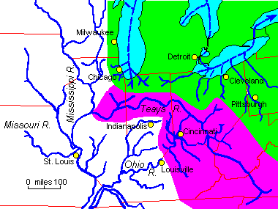
Pleistocene

Slide 13
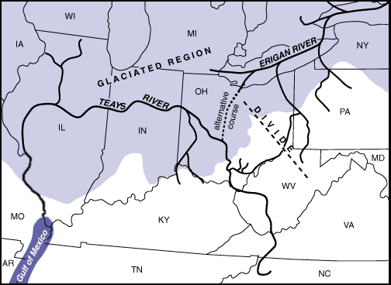

Slide 14
Regional - Local
Geology (regional characteristic that influences local conditions)
  Habitat
  Water Flow
  Chemistry
    Alkalinity - Hardness
    Productivity

Slide 15
Regional - Local
Spatial Position
  The position of a stream segment in a stream network influences species found there (distance from a species pool).

Slide 16
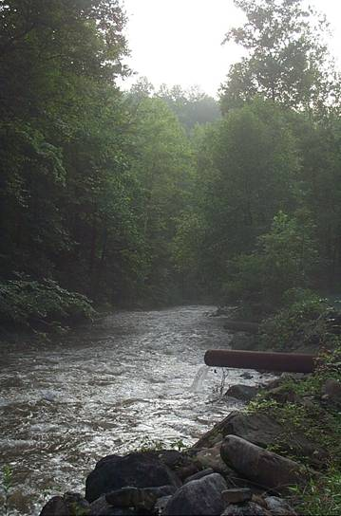
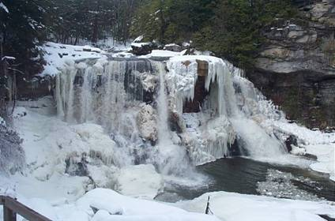
Influence of Barriers

Slide 17
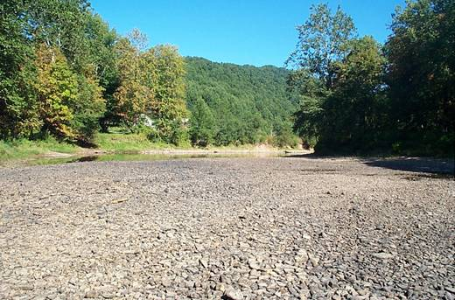
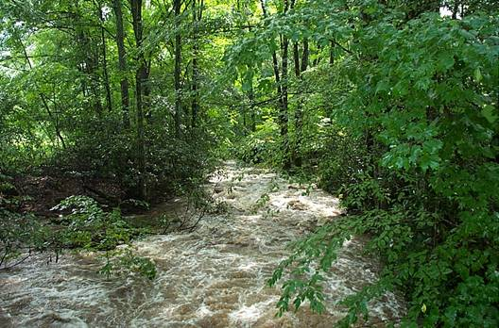
Influence of Stochastic Events

Slide 18
Local
Competition / Predation
Water Chemistry
Water Flow
Productivity
Habitat
Gradient
Stream Size
Species Richness = -5.16 + 4.6 x (Basin Area) + 0.39 x (Link Order Diff)
R² = 0.79
df = 17
p < 0.0001

Slide 19
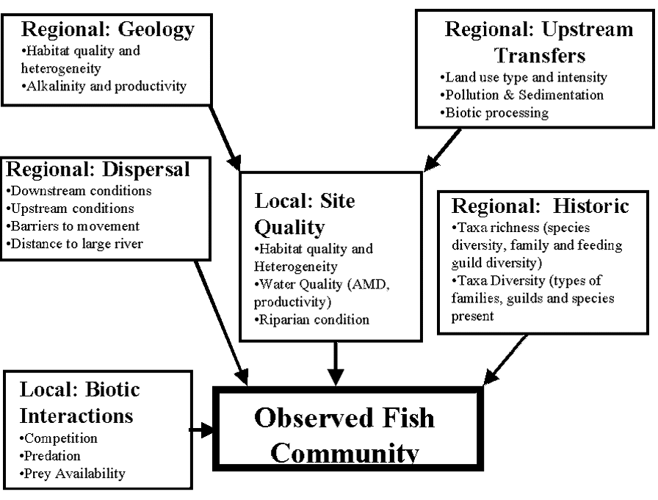

Slide 20
Mississippi Basin Fauna illustrate these patterns well
Contains ~ 330 species, 13 families
Basin is ancient - present arrangement since Rocky Mtns. formed in Tertiary (~65 mybp)
Ancient relics are extant today - have benefited from persistence of the basin:
  Chondrosteans - sturgeons, paddlefish
  gars, bowfins
  mooneyes, pirate perch, cavefishes - only found here

Slide 21
Mississippi Basin Fauna illustrate these patterns well
New taxa originated and/or flourished here:
  Notropis/Cyprinella minnows (shiners)
  Etheostoma/Percina percids (darters)
  ictalurids (catfishes), especially Noturus - madtoms
  centrarchids, especially Lepomis (sunfishes)
  catostomids, especially Moxostoma (redhorses)

Slide 22
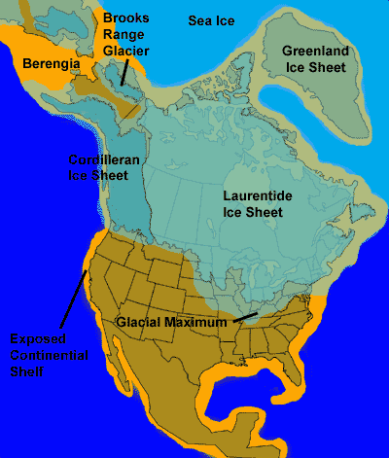
Why is the Mississippi fauna so diverse?
Provided a refuge from glaciers, due to north-south axis
Taxa could retreat south as glaciers moved south

Slide 23
Why is the Mississippi fauna so diverse?
Provides a diversity of habitats:
  Different stream types:
    Coastal plain (Gulf of Mexico margin)
    Interior highlands
      Ozarks
      Tennessee/Kentucky plateau
    Interior lowlands
      Western (Missouri River basin)
      Central (Upper Mississippi River basin)
      Eastern (Ohio River basin)

Slide 24
Why is the Mississippi fauna so diverse?
Provides a diversity of habitats:
  Speciation requires isolation - offered by these diverse AND separated habitat types
    e.g., Ozark fauna is unique from the Tennessee/Kentucky fauna, even though the habitats are similar - the Mississippi River valley separates them - no passage possible between for small taxa like darters, minnows, madtoms

Slide 25
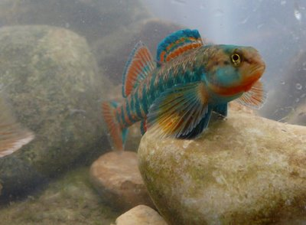
Why is the Mississippi fauna so diverse?
Provides a diversity of habitats:
  Species dependent on small, headwater streams are more easily isolated, and therefore are the most diverse groups
    shiners
    darters
    madtoms

Slide 26
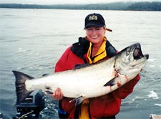
The Fishery
Cold large rivers
Game fish - predominantly salmonids
Salmon, trout

Slide 27
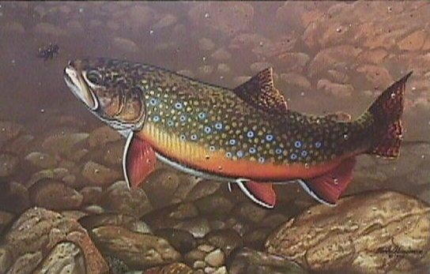
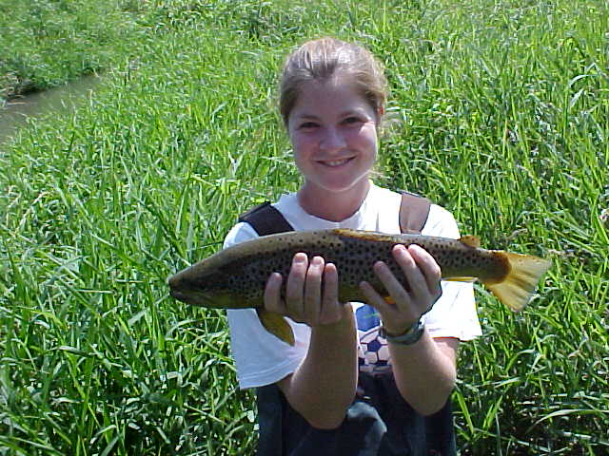
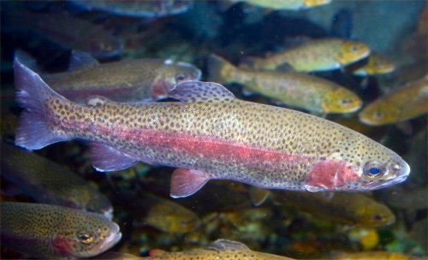
Coldwater Rivers & Streams
Anadromous – born in freshwater, migrate to sea, return to freshwater to spawn
Pacific, Atlantic salmon
Residents - spend entire life in stream
Brook, brown, rainbow

Slide 28
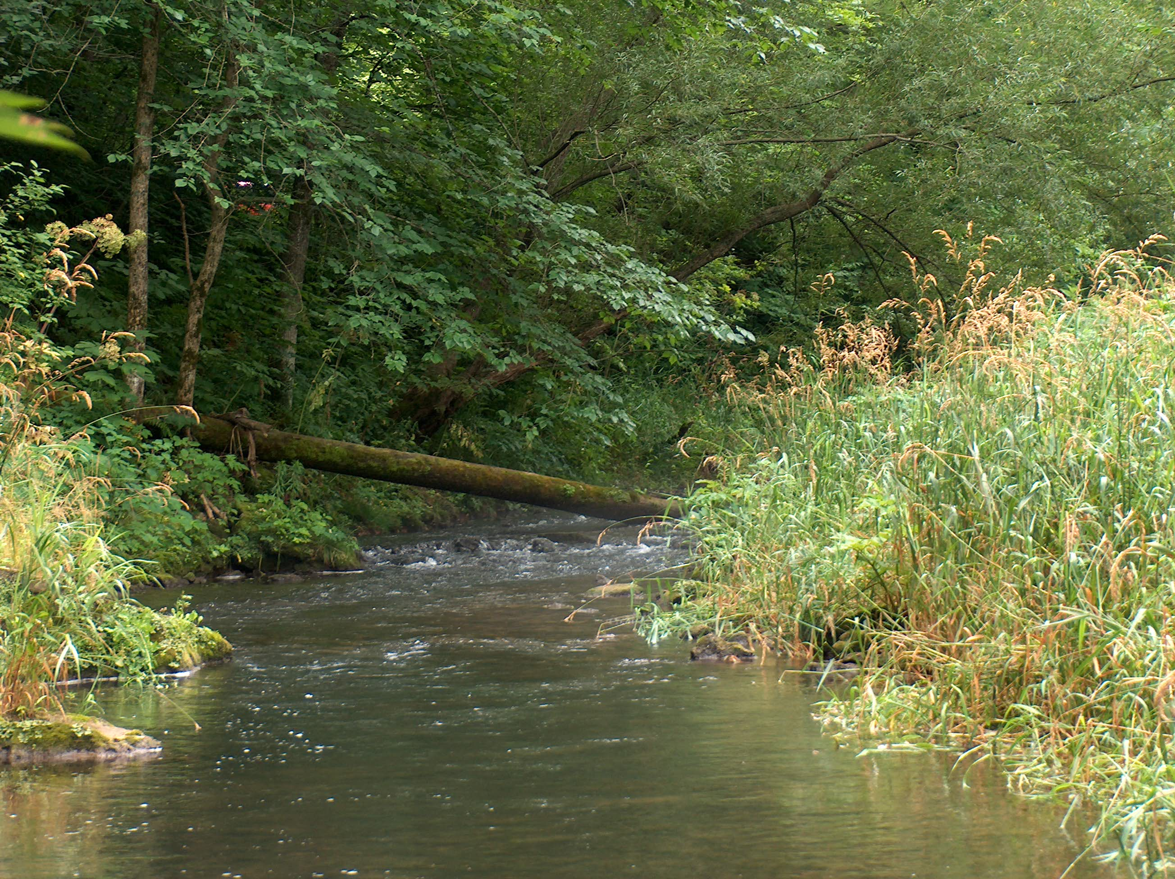
Coldwater Systems - sustain spawning and rearing
Physical conditions
  Water temperature <22°C
  Dissolved oxygen >8 ppm
  Stream size - greatest abundance, diversity of trout, salmon in 4th-5th order streams
  Stream gradient - best 0.6-6.0%
  Hydrograph -variable

Slide 29
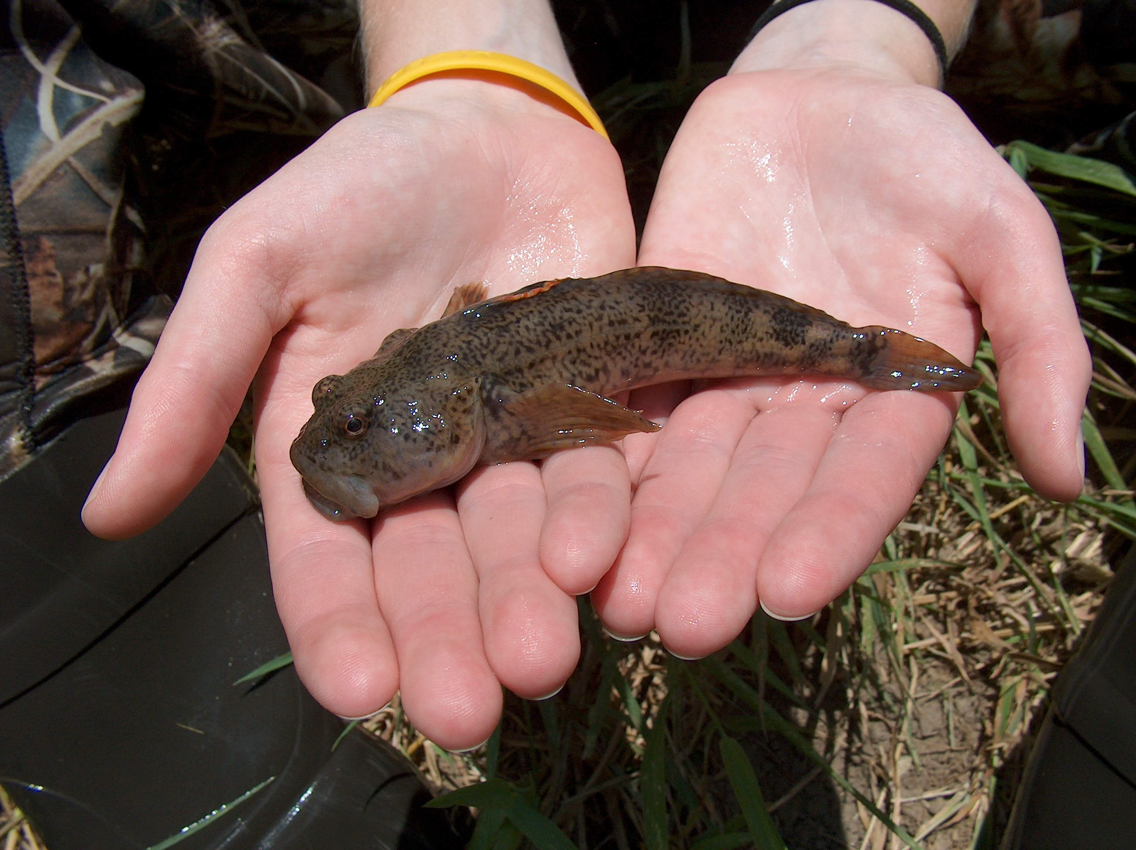
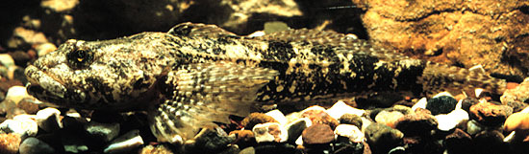
Other Coldwater Fish Species
Cottids - sculpins – Cottus
Slimy sculpin
Mottled sculpin

Slide 30
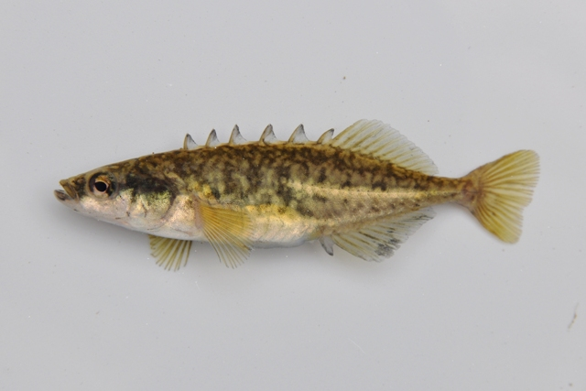
Other Coldwater Fish Species
Gasterosteids – Sticklebacks - Culaea
Brook stickleback

Slide 31
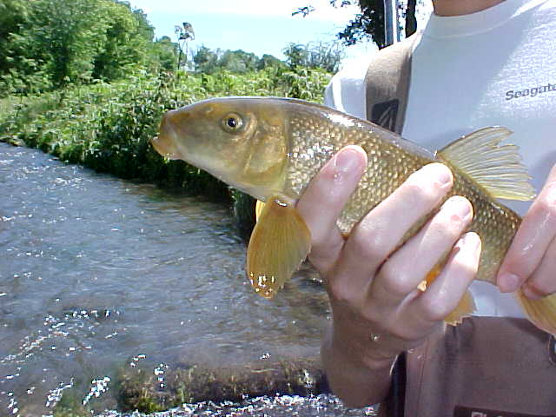
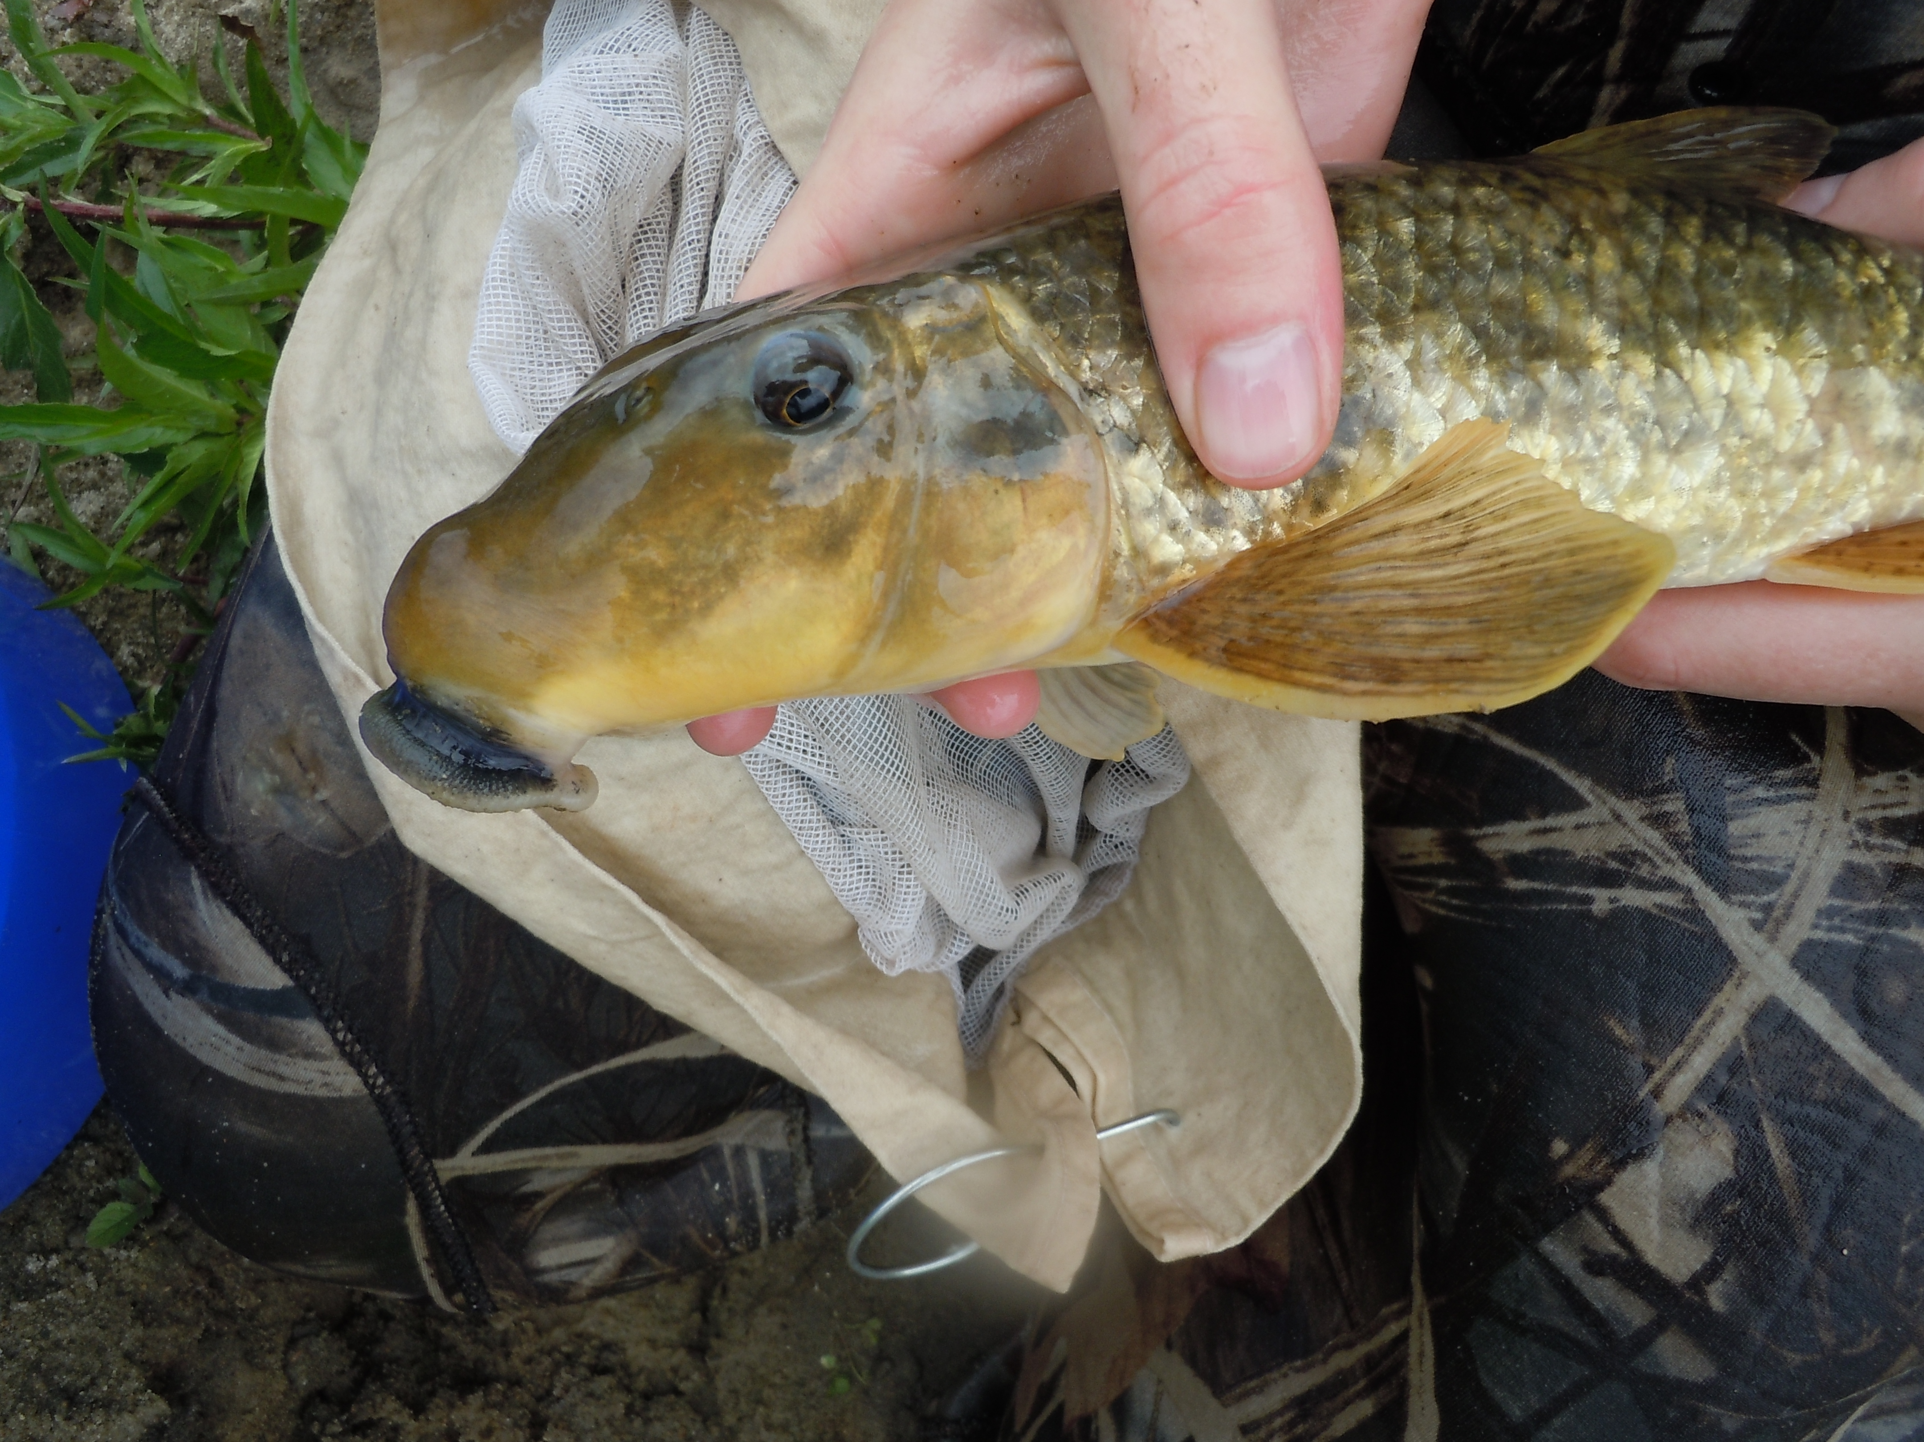
Other Fish Species
Coldwater-Coolwater Transition
Catostomids - suckers – Catostomus, Hypentilium
White sucker
Northern hogsucker

Slide 32
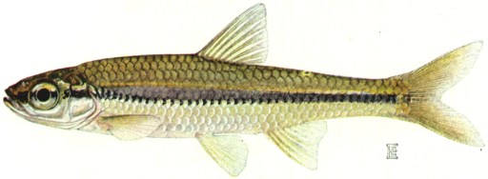
Other Fish Species
Coldwater-Coolwater Transition
Cyprinids – minnows and shiners - Notropis

Slide 33
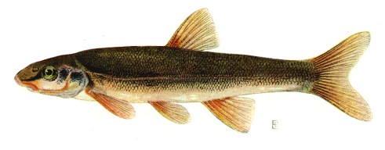
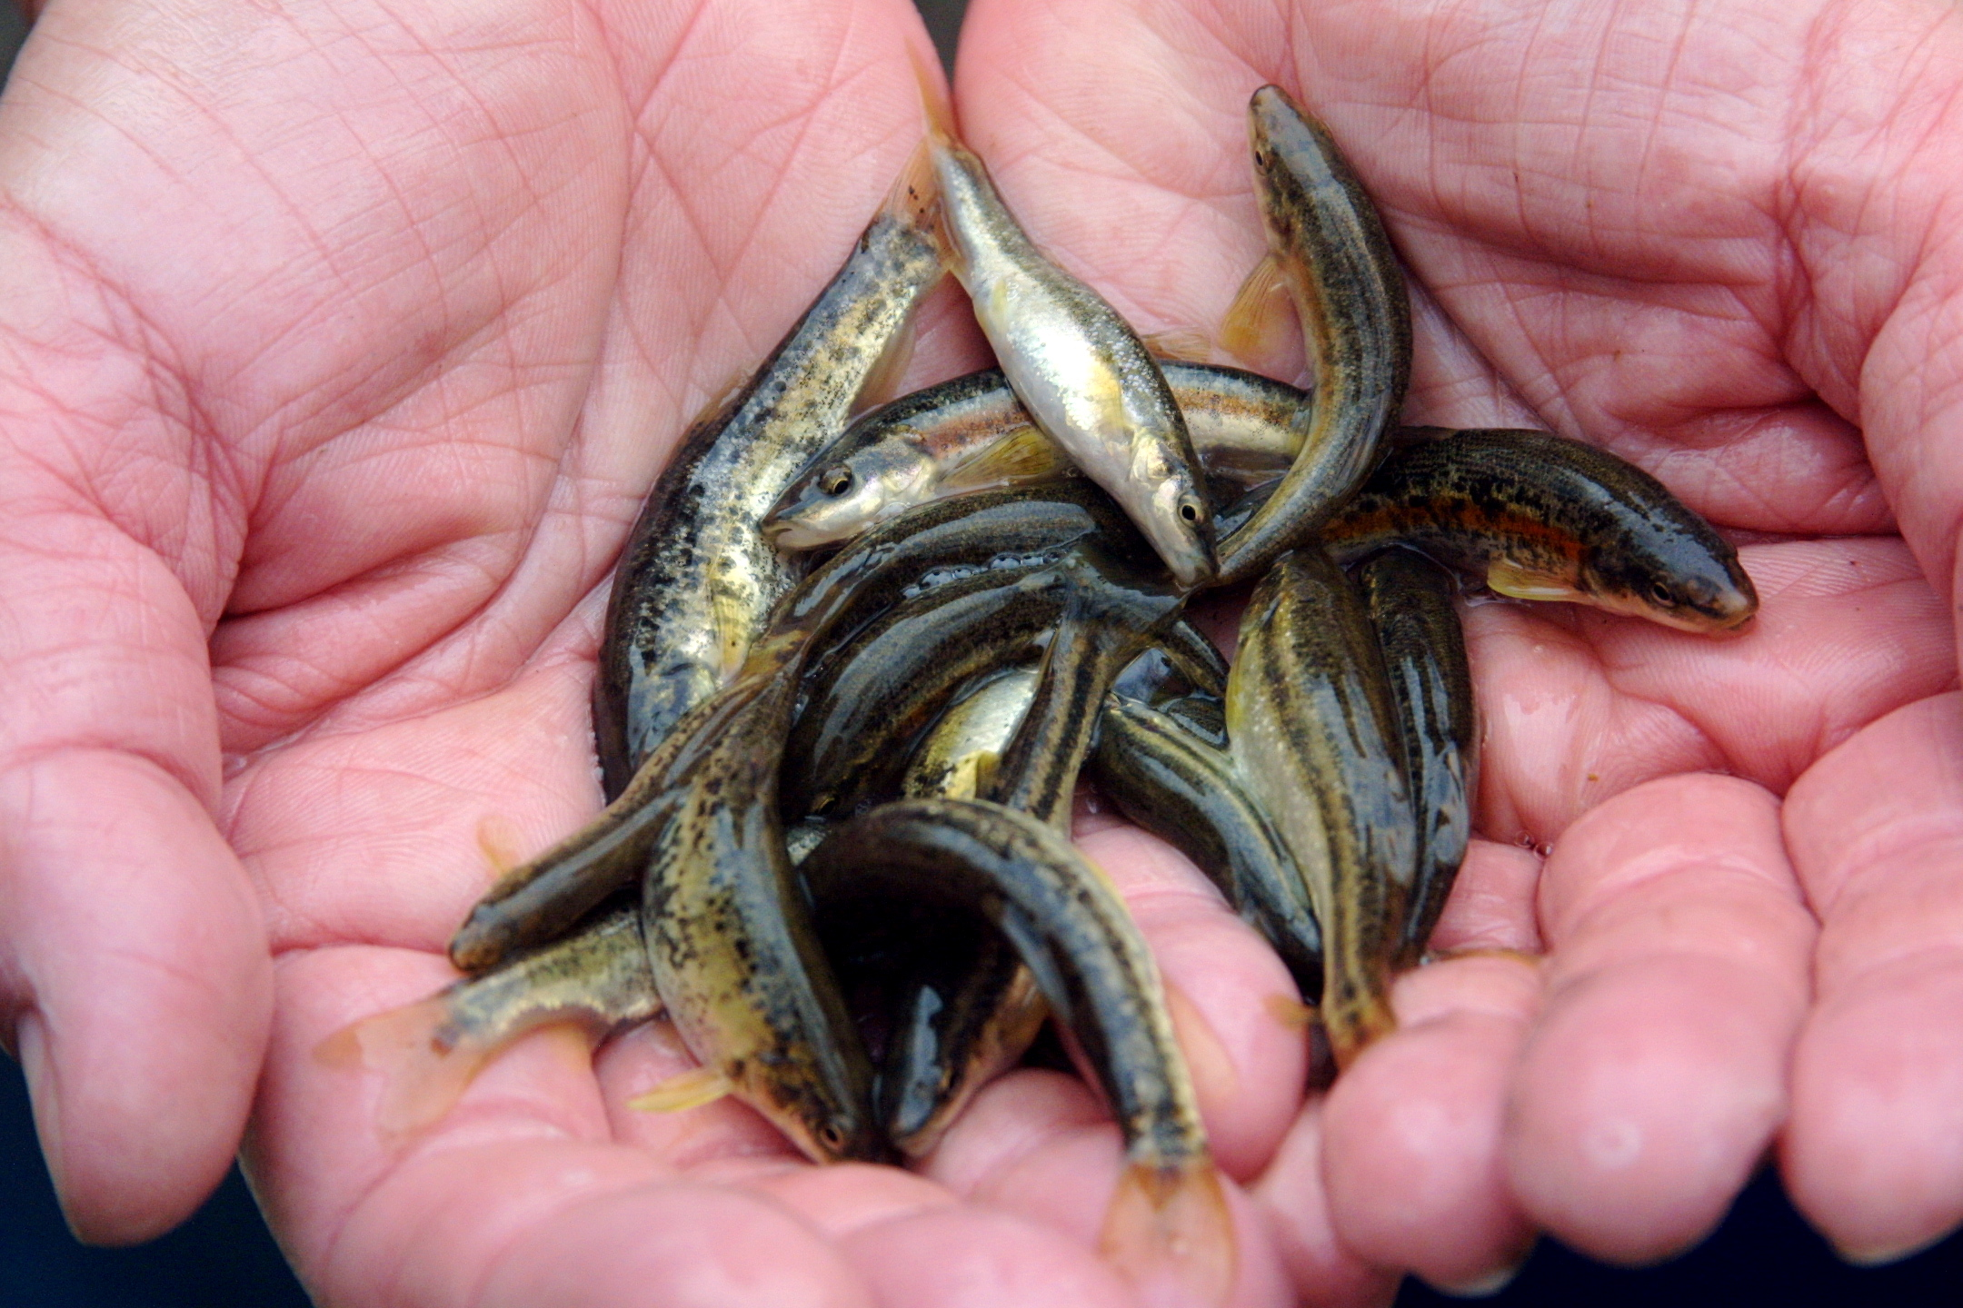
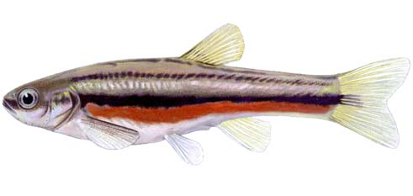
Other Fish Species
Coldwater-Coolwater Transition
Cyprinids - dace
Rhinichthys, Phoxinus
Longnose dace
Blacknose dace
Redbelly dace

Slide 34
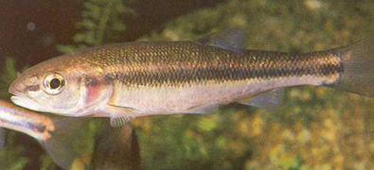
Other Fish Species
Coldwater-Coolwater Transition
Cyprinids - chubs – Semotilus
Creek chub

Slide 35
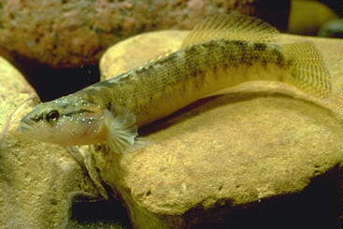
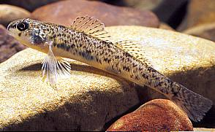
Other Fish Species
Coldwater-Coolwater Transition
Percids - Darters – Etheostoma
Fantail darter
Johnny darter

Slide 36
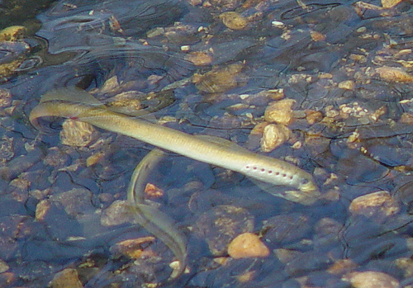
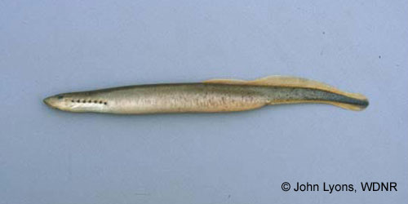
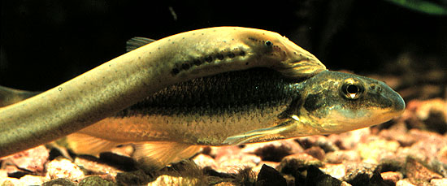
Other Fish Species
Coldwater-Coolwater Transition
Lampreys– Lethenteron, Ichthyomyzon, Petromyzon
American brook lamprey
Northern brook lamprey
Chestnut, silver lampreys
Pacific lamprey (west)
Sea lamprey (east)

Slide 37
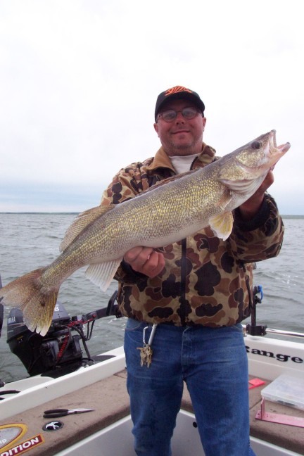
The Fishery
Cool large rivers
Game fishes typically include Walleye, Smallmouth Bass, Northern Pike
Maximum summer water temperatures between 22° and 25° C

Slide 38
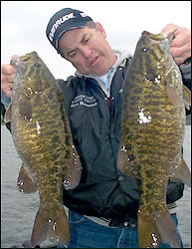
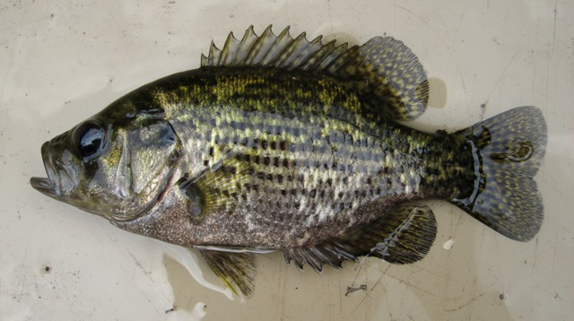
Typical Coolwater River Species
Bass – Centrarchidae
Smallmouth bass
Rock bass

Slide 39
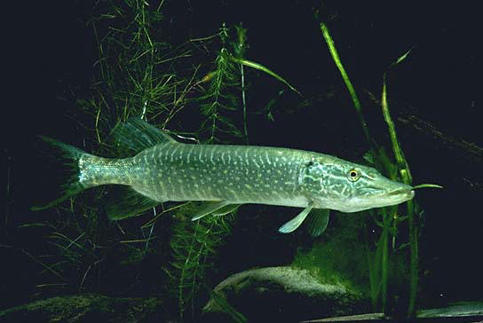
Typical Coolwater River Species
Pike – Esocidae
Northern pike

Slide 40
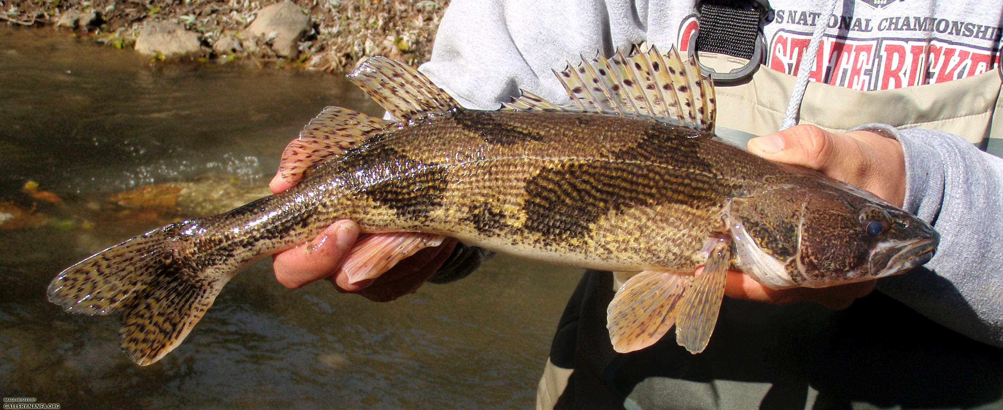
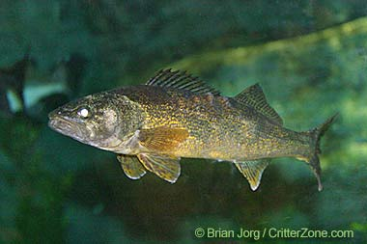
Typical Coolwater River Species
Perch family– Percidae
Sauger
Walleye

Slide 41
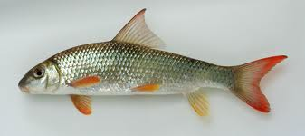
Other Coolwater River Fish Species
Catostomids - suckers – Catostomus, Hypentilium, Moxostoma
White sucker
Northern hogsucker
Shorthead redhorse
Golden redhorse
River redhorse
Buffalo (bigmouth, smallmouth)

Slide 42
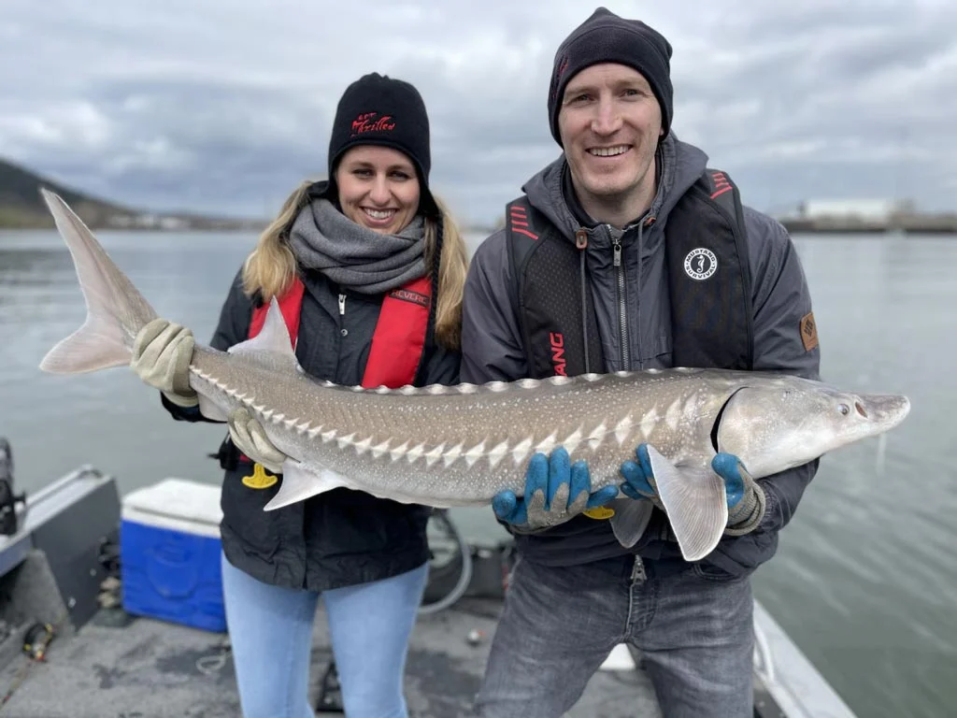
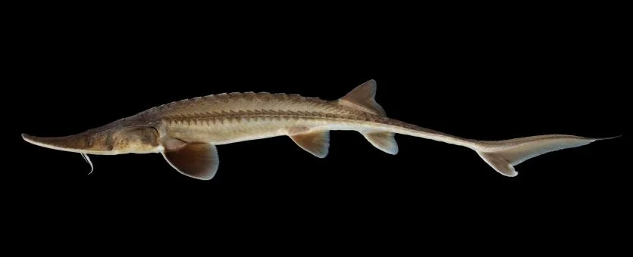
Other Coolwater River Fish Species
Sturgeons – lake, shovelnose, white, green, Atlantic, pallid

Slide 43
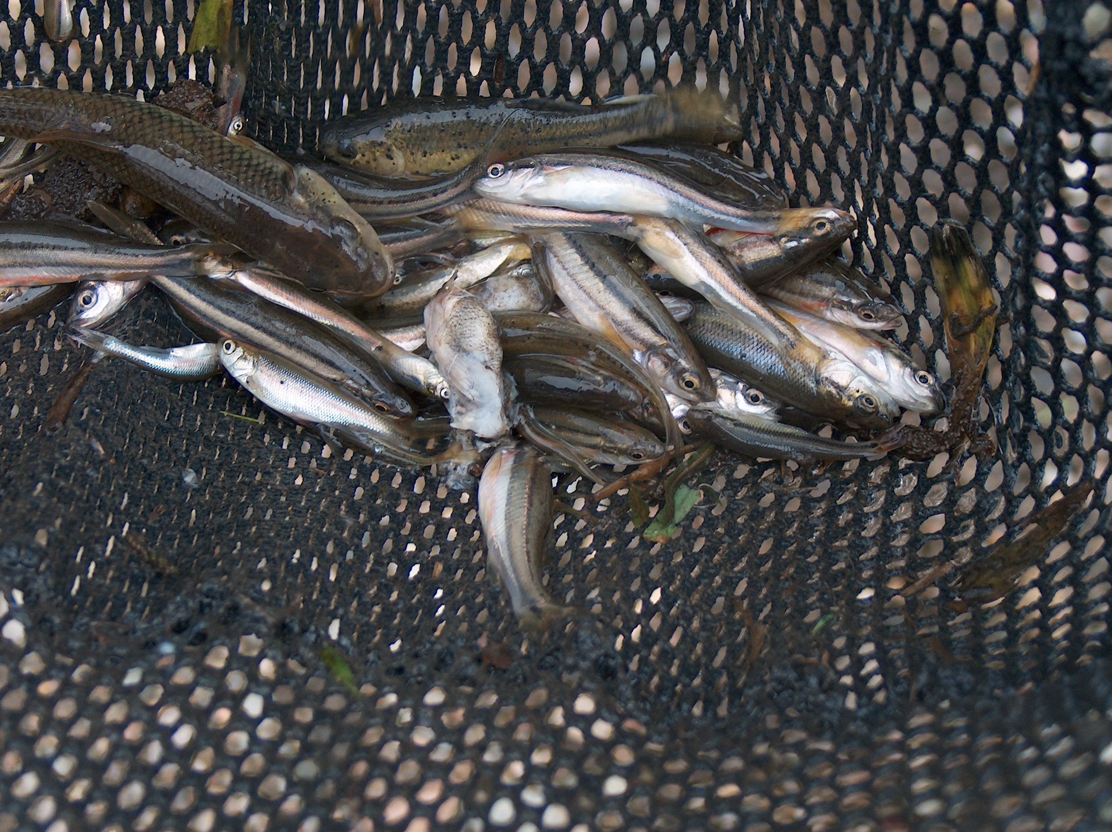
Other Coolwater River Fish Species
Cyprinids of many types
Minnows (native, nonnative)
Shiners (emerald, river, spotfin)
Smaller rivers/streams
  Chubs
  Dace
  Stonerollers

Slide 44
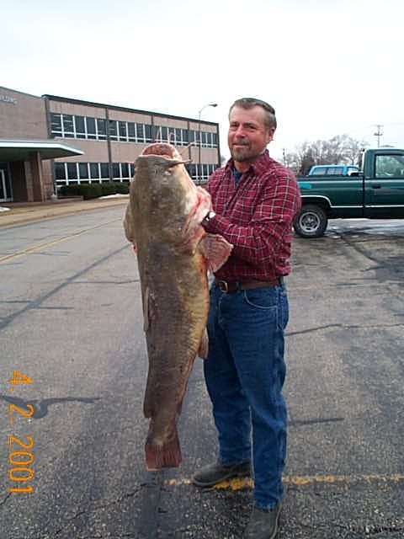
The Fishery
Warm large rivers
Bluegill, crappie, largemouth bass, catfishes

Slide 45
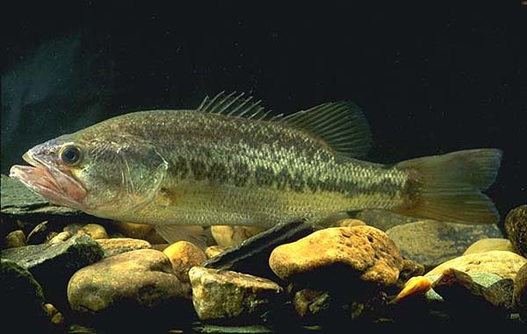
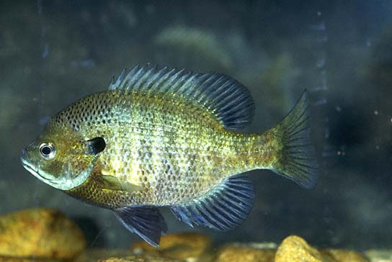
Typical Warmwater River Species
Bass family – Centrarchidae
Largemouth bass
Bluegill

Slide 46
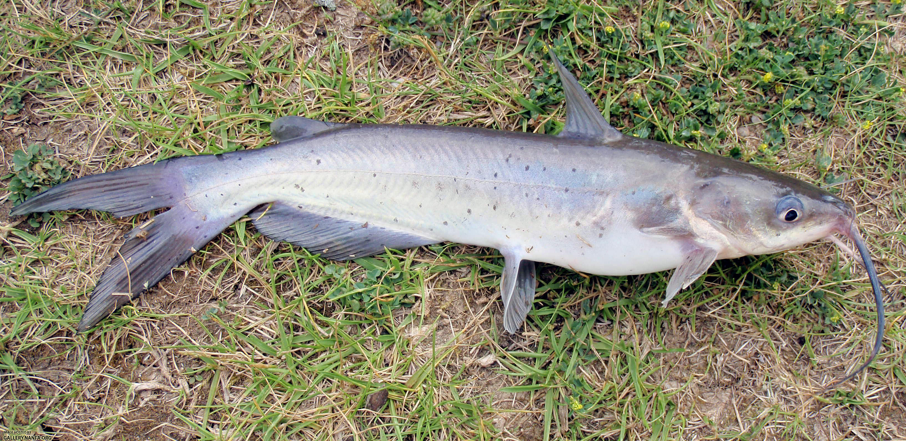
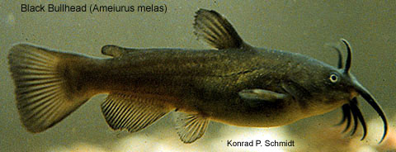

Typical Warmwater River Species
Catfish family – Ictaluridae
Channel, flathead catfish
Black bullhead
Brown bullhead

Slide 47


Other Warmwater River Species
Suckers and redhorses
Minnows and shiners
Darters
Mudminnows

Slide 48

The Large River Sport Fishery
Best in unmodified reaches
e.g., Missouri River - 2 to 2.5 X more productive

Slide 49

Unmodified vs. Modified

Slide 50

The Large River Sport Fishery
Modified reaches
Best in tailwaters (walleye, sauger), main channel border (sunfish, bass, pike)

Slide 51

Modified Mississippi River

Slide 52

The Fishery - Commercial Fish
Often same as sport fish in many major river systems
Conflict created between user groups as sport fishing pressure increases

Slide 53
The Fishery - Commercial Fish
Typical catch in Upper Mississippi River:
  Common carp
  Catfishes
  Freshwater drum
  Buffaloes

Slide 54

Mississippi River Catch

Slide 55
The Fishery - Commercial Fish
Problem - benthophagic fish
Uptake of contaminants from sediments
PCBs, other river contaminants
Management concern

Slide 56

PCBs in the Mississippi River – 1994 Consumption Advisories

Slide 57

PCBs, PFOS, Mercury in the Mississippi River – Present Day Consumption Advisories

Slide 58
Freshwater Ecology
substrate
light
temperature
Physical
current
pH
photosynthesis
Biological
Chemical
DO
macrophytes
[nutrients]
macroinvertebrates
fish
alkalinity

Slide 59




The Importance of Macroinvertebrates
Macroinvertebrates are an essential component of freshwater ecosystems
They serve as food for
other organisms (fish, amphibians and waterfowl)
Are essential to the breakdown and cycling of organic matter and nutrients
Macroinvertebrate diversity is vital to a properly functioning ecosystem

Slide 60



Why Study Macroinvertebrates?
Macroinvertebrates are used to assess the health of freshwater environments
Some macroinvertebrates are sensitive to stress produced by pollution, habitat modification, or severe natural events
Sampling and identifying macroinvertebrates can reveal whether a body of water is healthy or unhealthy and may reveal the cause of the problem

Slide 61

Why are macroinvertebrates biological indicators of stream health?
Spend up to one year (or more) in the stream
Have little mobility
Generally abundant
Primary food source for many fish
Good indicators of local conditions
Diversity = healthy stream
Easy to sample
Adult Caddisfly

Slide 62



Slide 63

Stream Benthic Macroinvertebrates:
Standard Habitat Samples from Iowa Streams

Slide 64





Common Macroinvertebrates
Mayflies (Ephemeroptera)
Ephemerellidae
Heptageniidae
Ephemeridae (Hexagenia)
Baetidae
(Adult)

Slide 65




Common Macroinvertebrates
Stoneflies (Plecoptera)
Pteronarcydiae
Perlidae
Perlodidae
(Adult)

Slide 66






Common Macroinvertebrates
Caddisflies (Trichoptera)
Brachycentridae
Phryganeidae
Hydropsychidae
Philopotamidae
Case
(Adult)

Slide 67







Common Macroinvertebrates
Damselflies and Dragonflies (Odonata)
True Bugs (Hemiptera)
Dobsonflies, Alderflies and Fishflies (Megaloptera)
Beetles (Coleoptera)

Slide 68




Common Macroinvertebrates
True Flies (Diptera)
Midge (Chironomidae)
Blackfly (Simuliidae)
Midge adult
Cranefly (Tipulidae)

Slide 69






Common Macroinvertebrates
Crayfish and Amphipods(Crustacea)
Snails/Mussels (Mollusca)
Worms and Leeches (Oligochaeta)
Planarians (Platyhelminthes)

Slide 70

Macroinvertebrate Biology
Habitat
Movement
Feeding
Life History
Stress Tolerance
Use in Biomonitoring

Slide 71

Habitat
The place where an organism lives
Running waters – lotic – seeps, springs, brooks, branches, creeks, streams, rivers
Standing waters – lentic –marshes, swamps, backwater lakes
erosional (riffles, wave action) or depositional areas (point bars, pools)
Mineral
bedrock, boulders, cobbles, pebble, gravel, sand, silt, clay
Organic
live plants, detritus

Slide 72
Movement
Locomotion, habits, or mode of existence
Clingers – maintain a relatively fixed position on firm substrates in current
Climbers – dwell on live aquatic plants or plant debris
Crawlers – have elongate bodies with thin legs, slowly move using legs
Sprawlers – live on the bottom consisting of fine sediments
Burrowers – dig down and reside in the soft, fine sediment
Swimmers – adapted for moving through water
Skaters – adapted to remain on the surface of water

Slide 73
Feeding
Macroinvertebrates are described by how they eat, rather than what they eat
Functional Feeding Groups – categories of macroinvertebrates based on body structures and behavioral mechanisms that they use to acquire their food

Slide 74


Shredders
Chew on intact or large pieces of plant material
Material is usually >1 mm, referred to as Coarse Particulate Organic Matter (CPOM)
Shredder-herbivores feed on living aquatic plants that grow submerged in the water (northern casemaker caddisflies)
Shredder-detritivores feed on detritus, or dead plant material in a state of decay (giant stoneflies)

Slide 75




Collectors
Acquire and ingest very small particles (<1 mm) of detritus, often referred to as fine particulate organic matter (FPOM)
Collector-gatherers – eat fine detritus that has fallen out of suspension that is lying on the bottom or mixed with bottom sediments
Collector-filterers- use special straining mechanisms to feed on fine detritus that is suspended in the water

Slide 76


Piercers
Mouthparts, or sometimes their entire head, protrude as modifications to puncture food and bring out the fluids contained inside
Piercer-herbivores – penetrate the tissues of vascular or aquatic plants or individual cells of filamentous algae and suck the liquid contents (crawling water beetles, microcaddisflies)
Piercer-predators – subdue and kill other animals by removing their body fluids

Slide 77


Scrapers/Grazers
Adapted to remove and consume the thin layer of algae and bacteria that grows tightly attached to solid substrates in shallow waters
Jaws of scrapers have sharp, angular edges (function like using a putty knife or paint scraper)
(flathead mayflies, water pennies, snails)

Slide 78

Engulfer-Predators
Feed upon living animals, either by swallowing the entire body of small prey or by tearing large prey into pieces that are small enough to consume
Common stoneflies and hellgrammites

Slide 79
FFG | Examples | Diet | Characteristics
Predators | Dragonflies, damselflies, stoneflies | Other insects | Toothy jaws, larger in size
Shredders | Stoneflies, beetles, caddisflies | CPOM, leaves, woody debris | Streamlined, flat
Grazers / Scrapers | Mayflies, caddisflies, true flies, beetles | Periphyton, diatoms | Scraping mandibles
Gathering Collectors | Mayflies, worms, midges, crayfish | FPOM, settled particles, bacteria | Filtering hairs, hemoglobin
Filtering Collectors | Black flies, net-spinning caddisflies, mayflies | FPOM, phytoplankton, floating particles | Some build cases (caddisflies)

Slide 80








Macroinvertebrates as Indicators
Pollution Sensitive (“Clean Water”) Benthos
Stonefly Water Penny Beetle Mayfly Dobsonfly
Alderfly Mussel Snipe Fly Riffle Beetle

Slide 81






Macroinvertebrates as Indicators
Somewhat Pollution Tolerant Benthos
Damselfly Dragonfly Crayfish Amphipod
Blackfly Caddisfly Isopod Cranefly

Slide 82


Macroinvertebrates as Indicators
Pollution Tolerant (“Polluted Water”) Benthos
Pouch Snail Midgefly Worm Leech

Slide 83

The Tolerance Index
0 - 10
0
10
most pollution sensitive
e.g. Stoneflies
most pollution tolerant
e.g. Midges & Leeches
contain hemoglobin, tolerate lower DO, prefer soft substrate, less sensitive to toxins
require high DO, clear water, rocky cobble substrate

