Slide 1
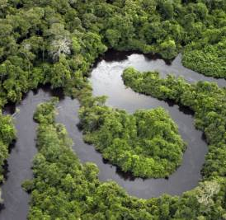
Ecology of Large Rivers
Organic Matter, Microbes,
And Energy

Slide 2
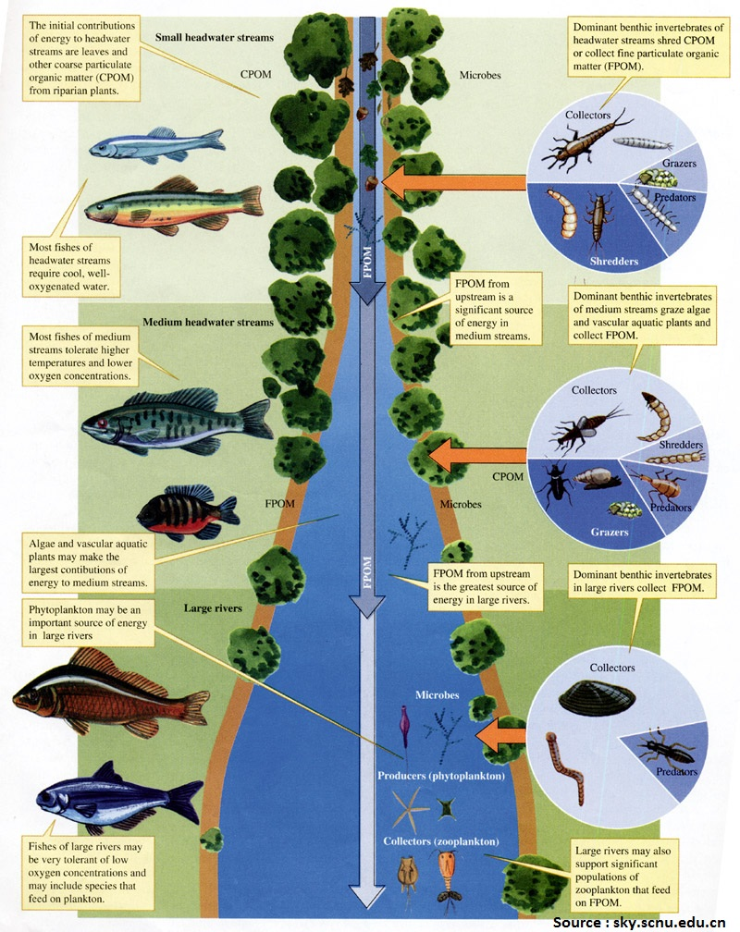
Organic Matter Sources
Riverine organic matter originates from within and outside of rivers
Autochthonous
Allochthonous
Basal resources for riverine food webs

Slide 3
Organic Matter Sources
CPOM – coarse particulate organic matter
FPOM – fine particulate organic matter
VFPOM – very fine particulate organic matter
Often termed detritus

Slide 4
Organic Matter Sources
CPOM from leaves, fruits, other plant parts
Also carcasses, feces of insects, larger animals

Slide 5
Organic Matter Sources
FPOM/VFPOM from fragmentation of larger particles, especially terrestrial vegetation
Can be transported to the channel, or produced by processes within the channel

Slide 6
Organic Matter Sources
Dissolved organic matter – DOM
Main source – water filtered through soil
Highly variable in bioavailability to to heterogenous mixture of possible molecules

Slide 7
Organic Matter Sources
Lability – ability to break down easily and be useful as food and as a source of energy
Depends on presence of bacteria and fungi associated with OM
Degradative activities alter palatability, accessibility of OM to consumers
Microorganisms are critical mediators (access and energy)
Processing POM
Uptake of DOM

Slide 8
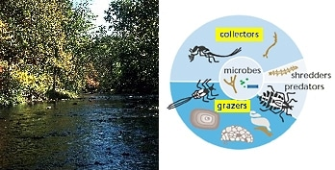
Leaf Breakdown
Deciduous leaves – primary CPOM input to forested streams in temperate regions
Wetted leaves quickly release DOM
Soon colonized by microorganisms and invertebrate shredders
Enhance fragmentation, mineralization

Slide 9
Leaf Breakdown
Leaf transformed into:
Microbial, shredder biomass
FPOM
DOM
Nutrients
CO₂
Breakdown rates highly variable, influenced by:
Temperature
Oxygen supply
Nutrient supply

Slide 10
Leaf Breakdown
Decomposition dependent on:
Colonization by microbiota (especially fungi)
Nutritional value of leaf
Role of bacteria increases as particle size decreases
Presence of invertebrate shredders speeds up the process

Slide 11
FPOM
Amorphous mix of particles <1 mm
Instream CPOM breakdown
Sloughed algal cells
Invert fecal pellets
Conversion of DOM into biofilm, subsequent sloughing
Fragments from terrestrial environs

Slide 12
FPOM
Not as well studied, or as well understood, as CPOM breakdown
Greater diversity of sources complicates different pathways, processes involved in breakdown
Small size → bacteria likely more important than fungi in the breakdown processes

Slide 13
DOM
Largest pool of organic carbon in rivers and streams
Incorporated into POM due to uptake by microbiota, conversion into particulate forms
DOM transport from terrestrial veg and wetlands into rivers via soil water, groundwater
Instream sources: leaf leachate, extracellular release from algae, macrophytes

Slide 14
DOM
Contains mix of:
Bioavailable compounds
Recalcitrant compounds (resistant to decomposition)
Inhibitory compounds
Consequently, total DOM is poor predictor of microbial activity
DOM removed from rivers by biotic and abiotic processes

Slide 15
Organic Matter in Rivers
POM and DOM are key energy sources in rivers
Frequently more important than primary producers
Detritus, associated microbes, algae, macrophytes form basal resources for riverine food webs

Slide 16
Microbial Communities
Microbes are present in or on all surfaces in rivers, and in the water column
Depend on both autochthonous and allochthonous sources of energy, nutrients
Bacteria, fungi convert POM and DOM into microbial tissue that is available to micro-consumers (e.g., protozoans)

Slide 17
Microbial Communities
Microbes may lead to higher trophic levels by passing through multiple, microscopic consumer levels
Or microbes can contribute directly to higher trophic levels when consumed along with detritus by invert and fish detritivores

Slide 18
Microbial Communities
Complex linkages → microbial loop

Slide 19
Biofilms
What is a biofilm?
Diverse aggregation of:
Algae
Bacteria
Fungi
Protists
Detrital particles
Various exudates
Exoenzymes
Metabolic products
Polysaccharide matrix

Slide 20
Biofilms
Form an organic microlayer – 3-dimensional
Grow on channel bottoms, all submerged surfaces
High taxonomic, functional diversities
Complex networks of multi-species interactions
Sites for organic matter processing, nutrient cycling
Rapid responses to fluctuating environmental conditions

Slide 21
Bacterioplankton
Autotrophic and heterotrophic bacteria in the water column
Community shaped by dispersal from instream and surrounding habitats
Headwater streams have greater diversity than higher-order rivers
Headwaters dominated by taxa associated with soil and sediments
Runoff from terrestrial systems

Slide 22
Bacterioplankton
Growth and functioning influenced by:
Amount of dissolved organic carbon (DOC)
Lability of DOC
Availability of nutrients
pH

Slide 23
Benthic or planktonic – more important?
New research suggests that benthic microbes (biofilms) have greater influence on river-system-wide biogeochemistry
But other studies have all shown that bacterioplankton can respond more quickly to changing conditions (biofilms “insulated” by polysaccharide matrix – reduces diffusion from water column)
Both groups important to overall functioning of river systems

