Slide 1
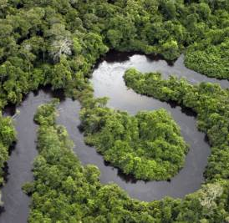
Ecology of Large Rivers
River Metabolism

Slide 2
Carbon Dynamics and Energy
Carbon/energy supplied to river ecosystems via autochthonous, allochthonous pathways
Heterotrophs utilize and transport carbon/energy throughout system
Some storage in sediments, riparian zone, floodplain
Considerable transport of carbon/energy downstream

Slide 3
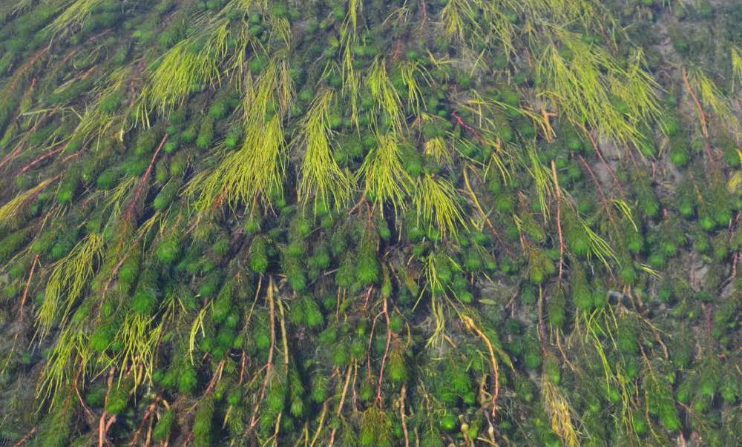
River Metabolism
River metabolism encompasses:
1) Photosynthesis/primary production (carbon fixation) and respiration (cellular release of CO₂)
2) Biological forces that influence carbon fluxes from/to sources/fates of allochthonous organic matter
Provides insight into relative contributions of internal, external sources

Slide 4
River Metabolism
Landscape constraints on physical structure of river determine which processes are most important
High lateral connectivity → strong influence by floodplain
High vertical connectivity → strong influence by hyporheos
Poor lateral and vertical connectivity → strong influence by upstream processes, and interruptions by lakes and/or dams

Slide 5
River Continuum Concept (RCC)
Often used to examine trophic interactions, primary production, and respiration worldwide
Portrays an integration of stream order, energy sources, and food webs into a longitudinal model of energy flow
Originally developed to depict patterns in temperate-zone forested river systems

Slide 6
River Continuum Concept (RCC)
Headwaters (stream orders 1-3)
Heavily shaded
Receive abundant leaf litter
Algal growth light-limited (shading)
P/R < 1
Mid-reaches (orders 4-6)
Wider, less shaded
Support more algae, macrophytes
Also receive organic matter from upstream
P/R > 1

Slide 7
River Continuum Concept (RCC)
Lower reaches (orders 7+)
Too wide to be primarily supported energy-wise by riparian leaf fall
Too deep to be primarily supported energy-wise by benthic algae, macrophytes
Greater energy support from organic inputs from upstream, floodplain, plus phytoplankton
P/R < 1

Slide 8
Real vs. Idealized River Systems
Interrupted versus continually flowing systems
Habitat fragmentation
Changes to flow and thermal regimes
Altered transport of sediments, nutrients, organic matter
Alternative models?
Seasonal connections to floodplain may dominate energy inputs that drive river systems (Flood Pulse Concept: FPC)
Shift conditions from lotic to lentic (both temperate and tropical rivers)
Lock and Dam 5A
Upper Mississippi River

Slide 9
Flood Pulse Concept (FPC)
Annual flood pulse → organic matter from floodplain + algae/organic matter from secondary channels and floodplain lakes contribute substantially to annual energy budget of the main river channel
FPC advocates assert that annual animal biomass in large, undammed rivers is supported primarily by floodplain organic inputs rather than by organics transported from upstream

Slide 10
Flood Pulse Concept (FPC)
Support for FPC derives from fish production studies
The most productive freshwater fisheries are located in large rivers with extensive floodplains
Recruitment of young fishes positively correlated with flooding intensity
Growth correlated with hydrological seasonality

Slide 11
Flood Pulse Concept (FPC)
Contribution of floodplain organics/energy to fish diets decline with period of floodplain inundation
Also, studies (stable isotopes) in some rivers have shown that diets of fish and invertebrates during flooding were dominated by carbon from phytoplankton and periphyton, even though floodplain-derived detritus represented >95% of carbon available to consumers
Flood-plain derived organics may be a microbial dead-end, not reaching higher-level consumers

Slide 12
Riverine Productivity Model (RPM: Thorp and Delong!)
Proposes that secondary production depends on autochthonous organics/energy produced in river channel, riparian zone
Less abundant but more labile than allochthonous organics transported from upstream
Allochthonous organics dominate transported forms, contributes to microbial respiration, but contributes little to higher food web

Slide 13
What About the Hyporheos?
Groundwater entering river channels (shallow, deep)
Physical/chemical conditions (e.g., presence/absence of O₂) important to carbon, nutrient cycling
Quality, quantity of organic matter in hyporheos can influence CO₂ production/release in/from sediments
May account for up to 1/3 of total channel respiration

Slide 14
River Metabolism
NEP = GPP + ER
NEP = net ecosystem productivity (or metabolism)
GPP = gross primary production
ER = ecosystem respiration
GPP → by autotrophs (measured by O₂ production)
ER → autotroph + heterotroph respiration (negative or loss of O₂)

Slide 15
Net Ecosystem Production (NEP)
Represents contribution of autochthonous production in supporting heterotrophic production
Internal versus external organic carbon inputs to a river reach

Slide 16
Net Ecosystem Production (NEP)
When NEP << 0 (or P/R < 1), GPP contributes little energy to the river system
System requires organic matter subsidies to maintain respiration
When NEP > 0 (or P/R > 1), GPP contributes more energy than needed for heterotrophic production
This excess can be transported downstream

Slide 17
NEP in Upper Mississippi River
2006 study of main channel and backwater habitats
Main channel metabolism among highest ever reported for large rivers
Mean daily GPP = 10 g O₂/m²/day
ER = 6 g O₂/m²/day
NEP = 4 g O₂/m²/day
Net export of organic matter

Slide 18
NEP in Upper Mississippi River
GPP was negatively correlated with discharge in the main channel
GPP was positively correlated with temperature in the backwaters
Maximum chlorophyll concentrations were observed in the main channel rather than the backwaters
GPP exceeded ER in main channel during summer, producing persistent O₂ supersaturation

Slide 19
Organic Carbon/Energy Budgets
Based on an estimation of all inputs, losses, and standing stocks of carbon/energy within a river reach
Demonstrate roles of climate and terrestrial biome in determining relative roles of auto- versus allochthonous inputs
Also, landscape and longitudinal position play important roles

Slide 20
Organic Carbon/Energy Budgets
Rivers draining prairies and arid lands have budgets dominated by autochthonous production
Rivers in forested biomes mostly have budgets dominated by external, allochthonous inputs
Yearly budgets seldom show a balance between inputs and outputs, often due to difficulty in measuring certain components (e.g., DOM, or storm transport of POM)

Slide 21
OM/Energy – Storage versus Transport?
Storage versus transport similar to nutrients
Uptake lengths, turnover lengths
Depends on breakdown rates of different “particles” (leaves, branches)
Spiraling lengths shorter in summer than in winter
Rivers draining agricultural regions less retentive than those draining forested watersheds

Slide 22
OM/Energy – Storage versus Transport?
Temporary storage on streambanks, burial in channel sediments
Ultimately transported downstream, or respired as CO₂ by biota out into atmosphere
General patterns of transport related to stream order
Low-order stream inefficient, export large quantities downstream
Large rivers typically opposite – high metabolism: use more, transport less

