Slide 1
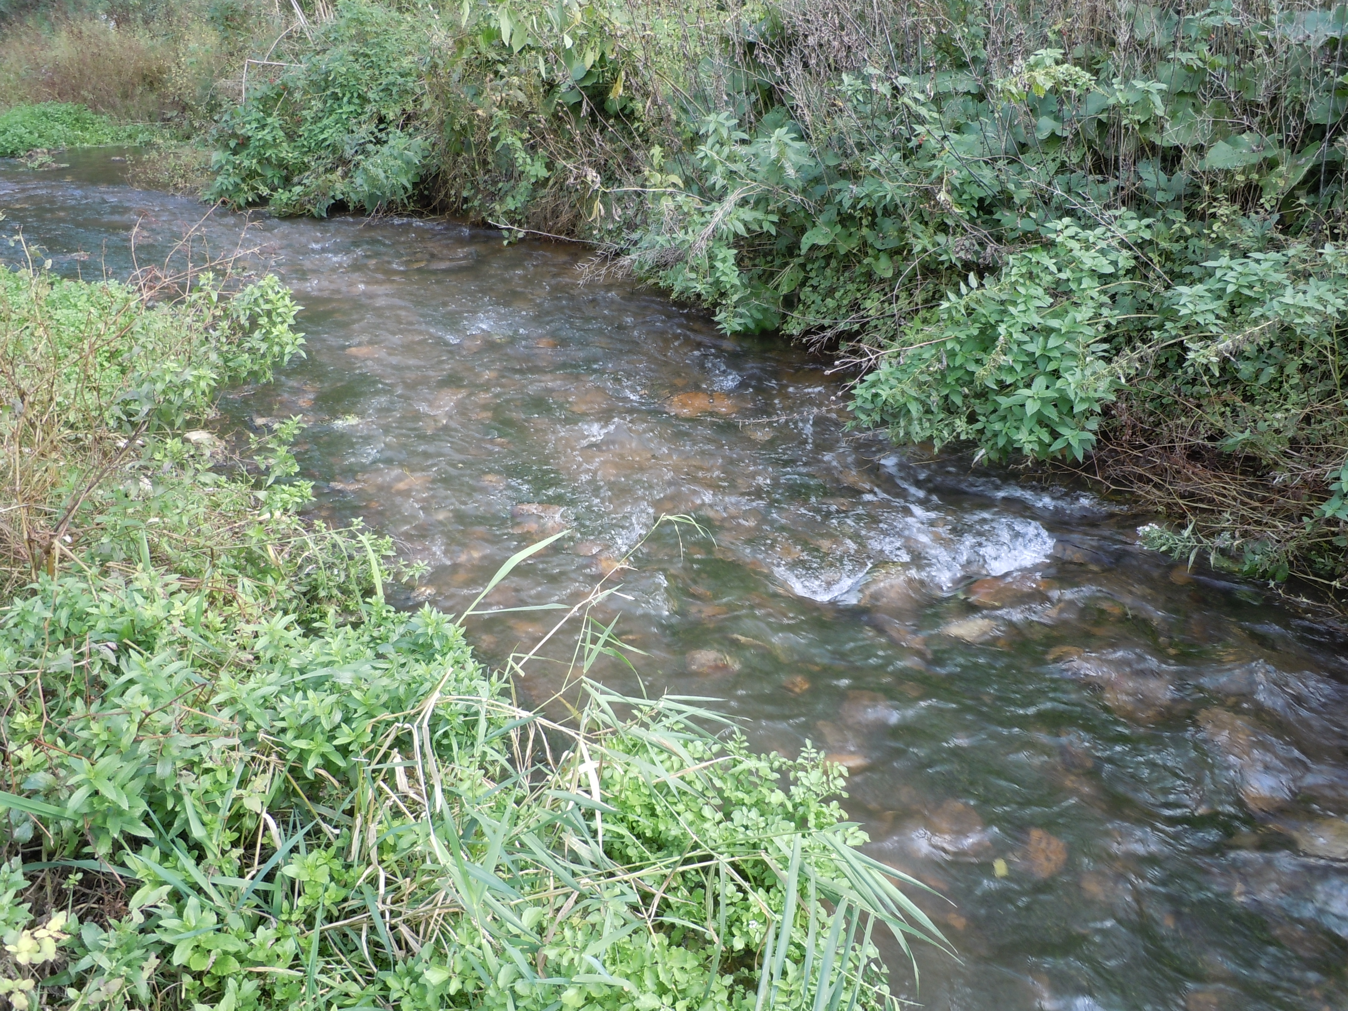
Biology & Ecology of SE MN Karst Region Streams

Slide 2
Outline for Today
Segment 1: Stream Dynamics and Nutrients
  geology, chemistry, biology
Segment 2: Macroinvertebrate Ecology and Bioassessments
  Life histories, feeding, tolerances
Segment 3: Fish Ecology and Bioassessments
  cold/cool/warm, tolerances

Slide 3
Biology & Ecology of SE MN Karst Region Streams
Stream Dynamics & Nutrients

Slide 4
Segment 1 Outline
Karst and temperature, water chemistry, connectedness
Nutrients (cycles, spiraling), plant growth, ecosystem effects
River continuum concept

Slide 5
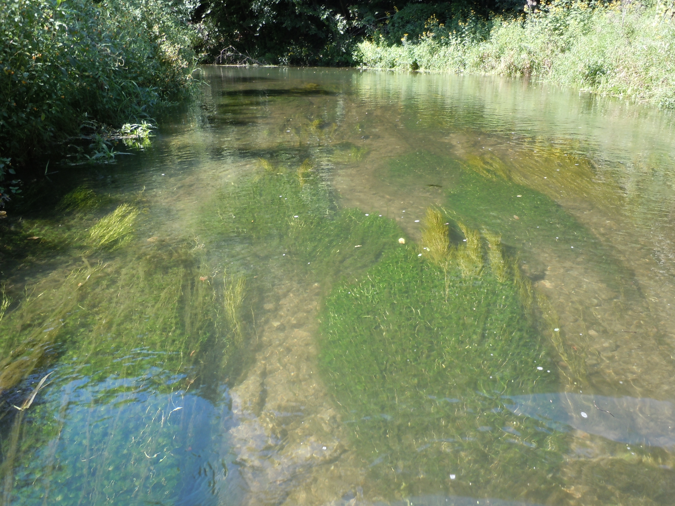

Slide 6
Freshwater Ecology
substrate
light
temperature
Physical
current
pH
photosynthesis
Biological
Chemical
DO
macrophytes
[nutrients]
macroinvertebrates
fish
alkalinity

Slide 7
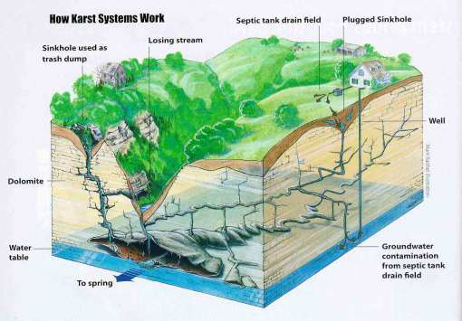
Karst Geology

Slide 8
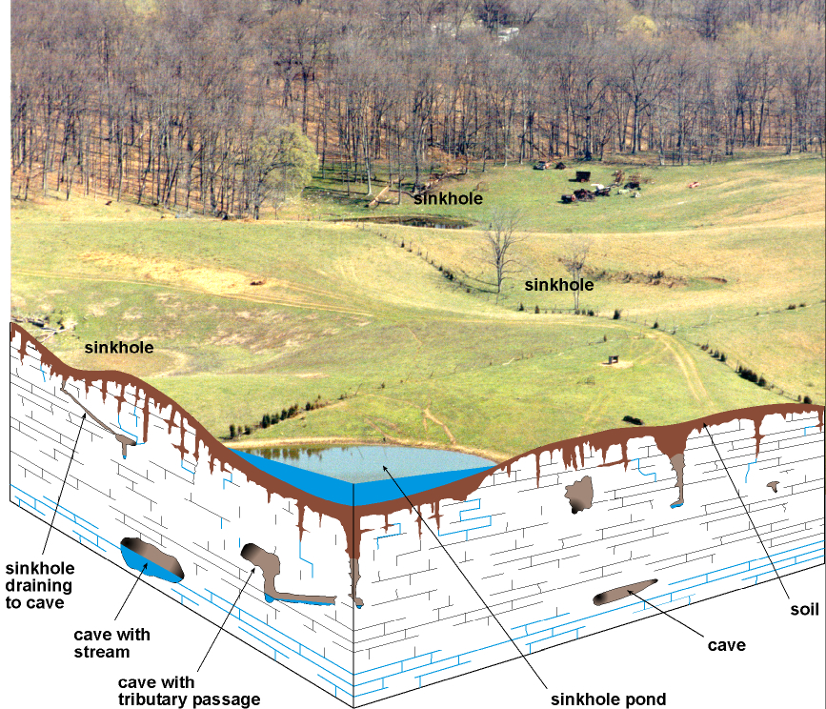

Slide 9
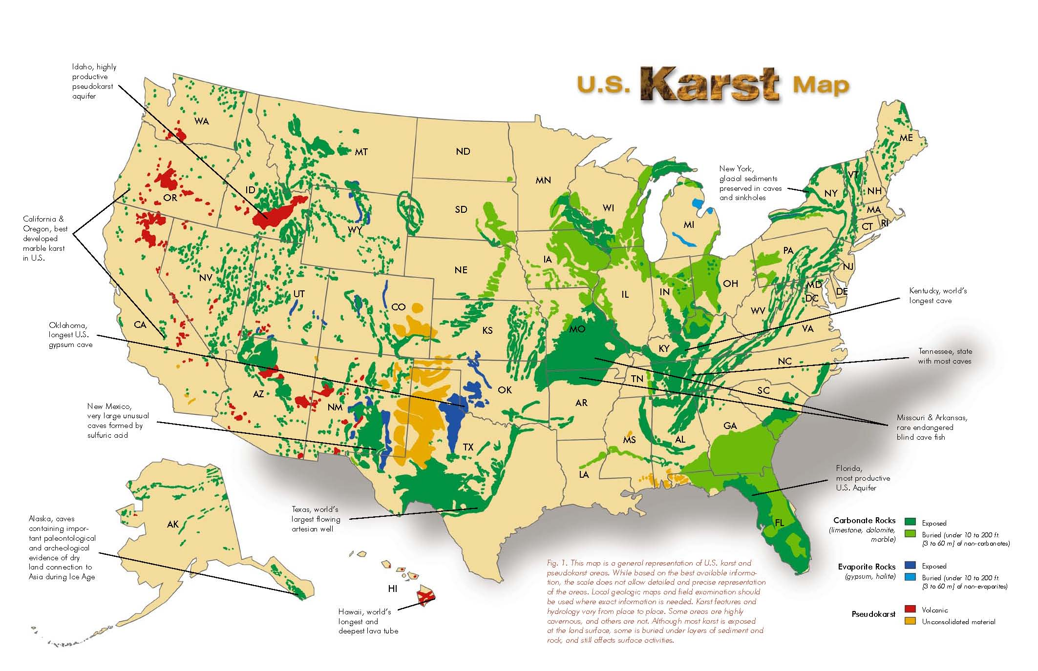
Karst in the United States

Slide 10
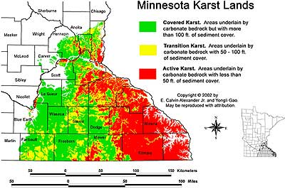
Karst In Minnesota

Slide 11
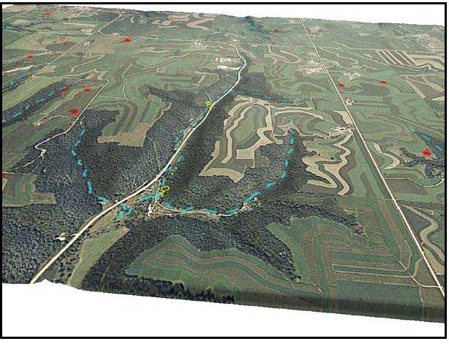
Winona County near Altura

Slide 12


Slide 13
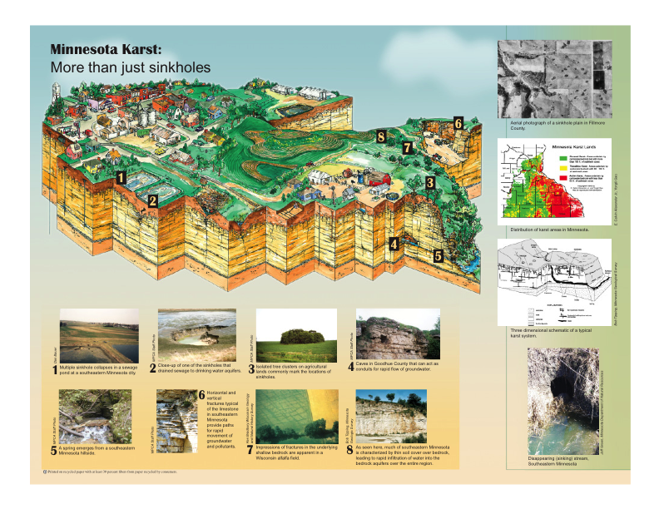

Slide 14
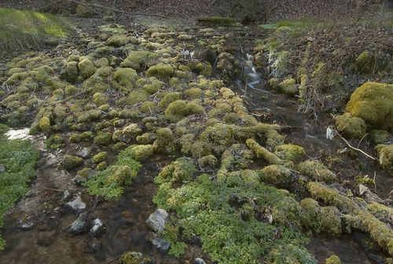
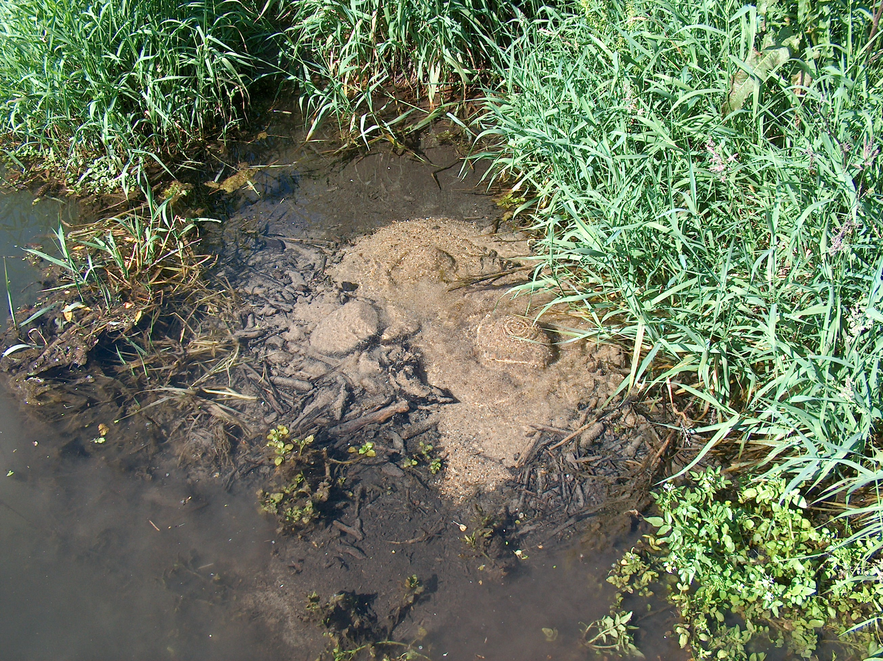
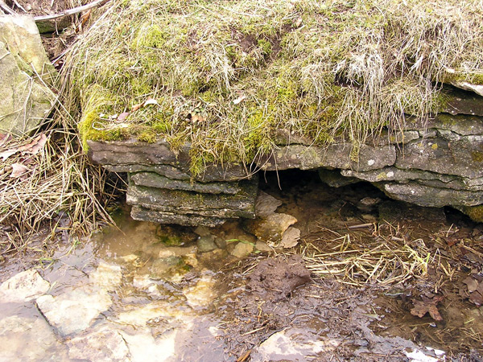
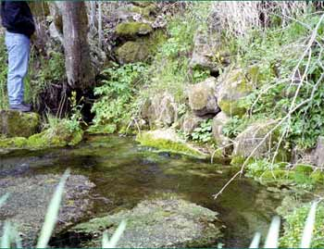
Springs are typical features

Slide 15
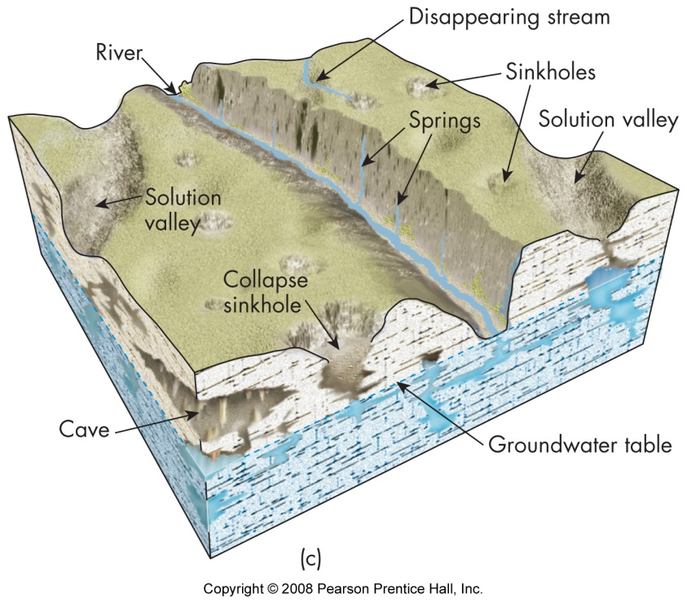

Slide 16
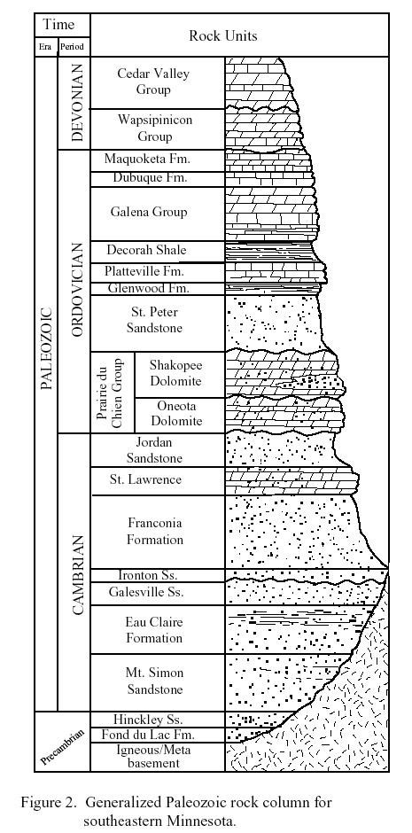
Springs & streams
drain different limestone or sandstone formations throughout the SE MN region

Slide 17
Different geolgy produces different stream temperature, chemistry, varying degrees of connectedness with surface

Slide 18
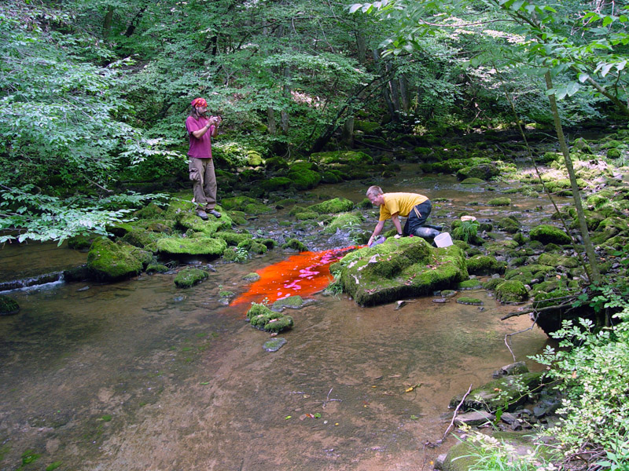
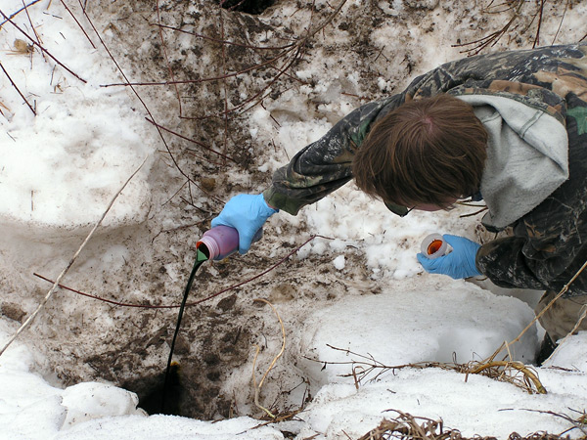
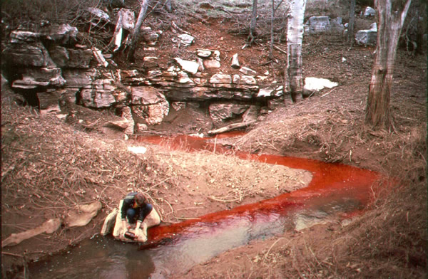
Dye
Tracing

Slide 19
Stream Temperature
Cold
  Heavy groundwater component
Cool
  Intermediate groundwater component
Warm
  Run-off, surficial soils drainage

Slide 20
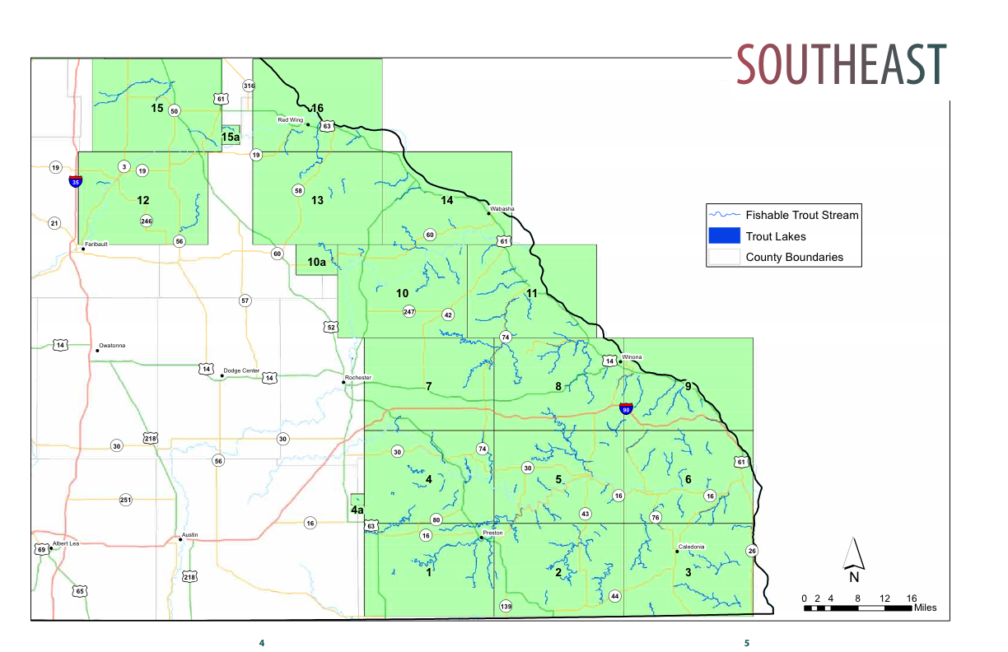
Coldwater Trout Streams

Slide 21
Stream Chemistry
Hardwater streams of SE MN
Calcium bicarbonate
High alkalinity
Buffers effects of acid rain
Accelerates recycling of nutrients by decomposer bacteria, increasing productivity

Slide 22
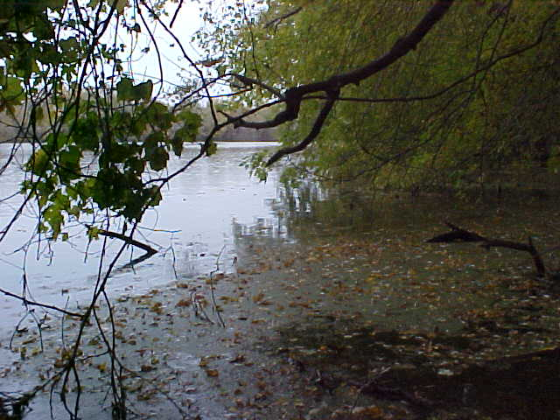
Confusing, interrelated terms
Alkalinity
Hardness
Salinity

Slide 23
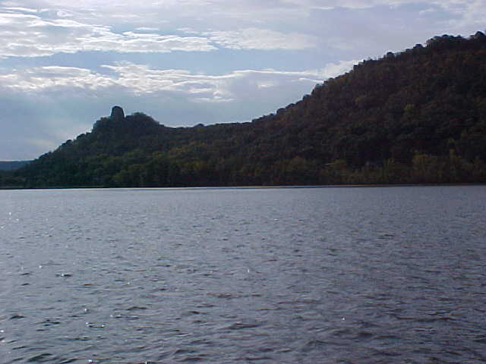
Alkalinity
Measure of buffering capacity of water
Carbonates and bicarbonates of alkali metals

Slide 24
Hardness
Calcium and magnesium salt content
Temporary hardness - carbonates and bicarbonates, can be removed by boiling
  Precipitation of CaCO₃
  Ca(HCO₃)₂ = CaCO₃ + H₂O + CO₂
Permanent hardness - sulfates, chlorides, other anions

Slide 25
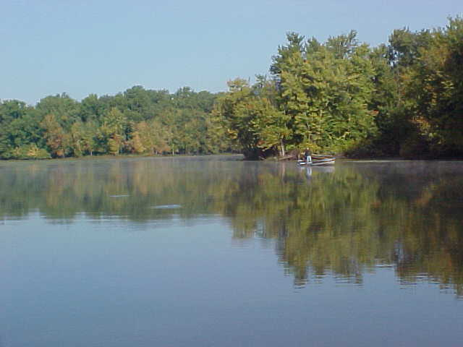
Salinity
Concentrations of Ca²⁺ Mg²⁺ Na⁺ K⁺ and HCO₃⁻ CO₃²⁻ SO₄²⁻ Cl⁻
Plus other ionized components of other elements

Slide 26
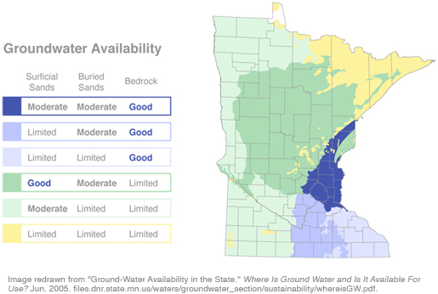

Slide 27
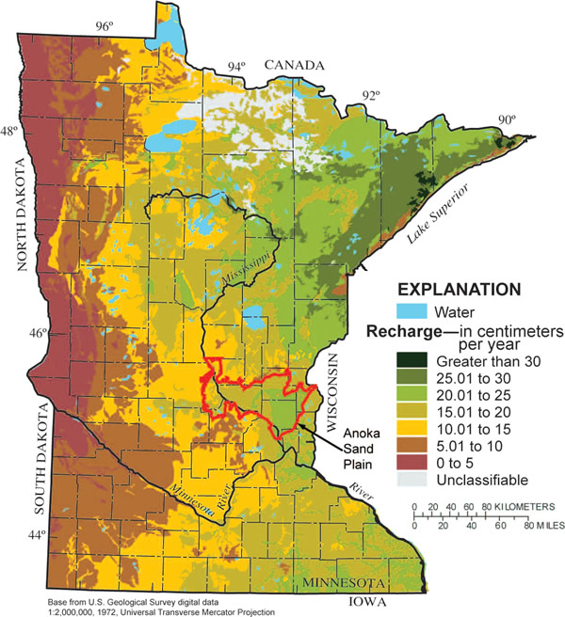

Slide 28
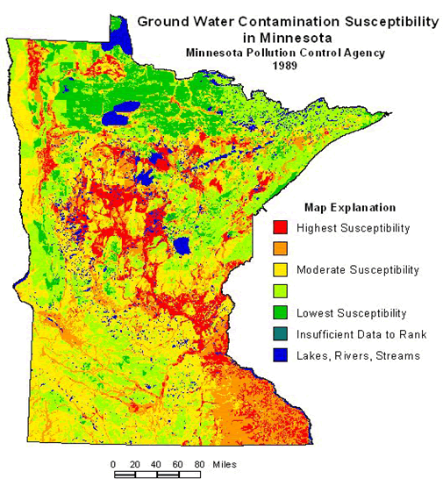

Slide 29
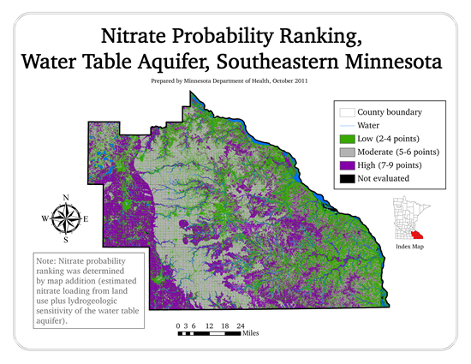
Drinking Water Concerns

Slide 30
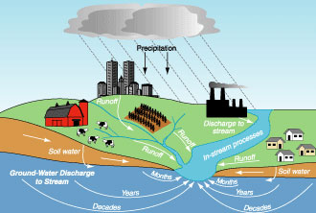
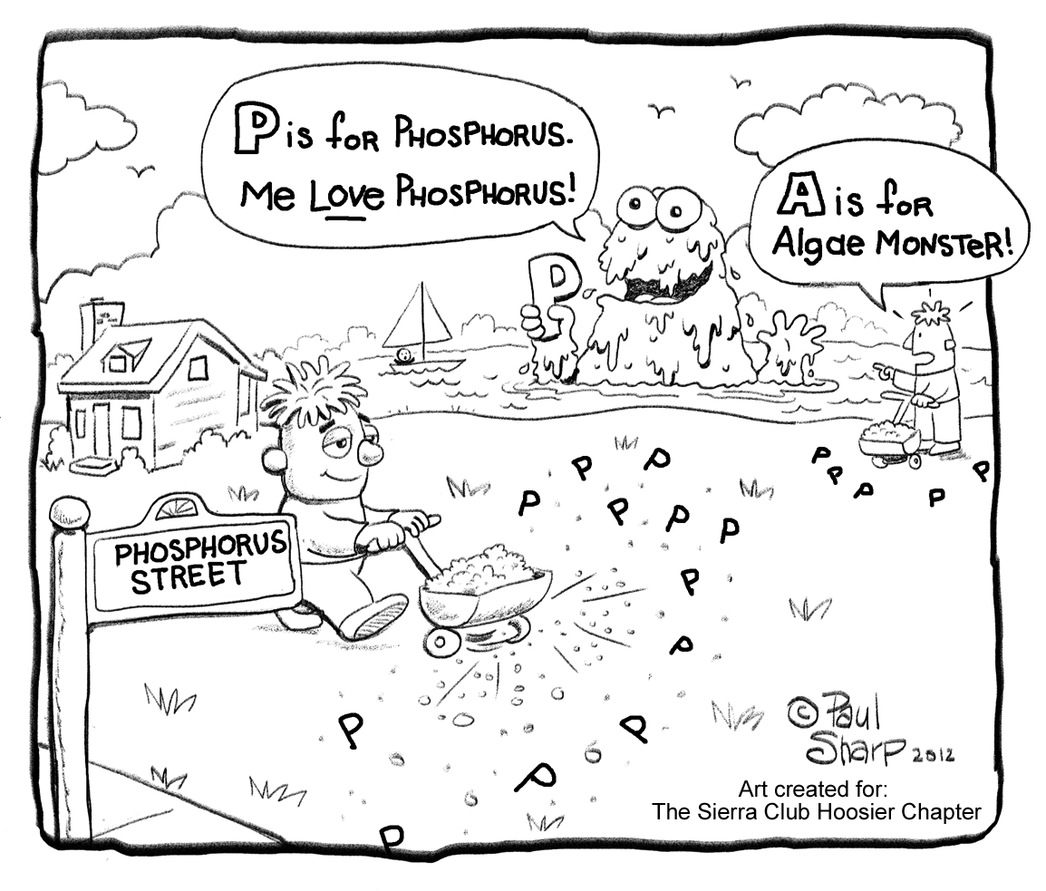
Nutrient Sources

Slide 31
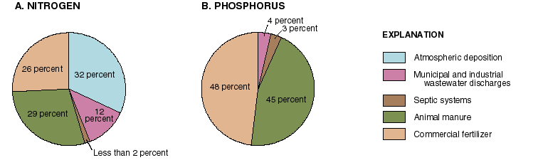
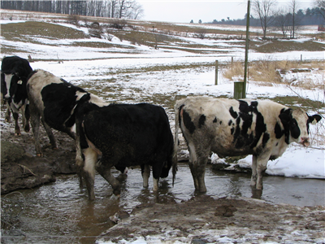
Rural Nutrient Loading

Slide 32
Nitrogen and Phosphorus Needed in Streams
Essential macronutrients
Drive biological productivity in freshwater ecosystems
Base of food chain

Slide 33
N & P in Surface Waters
Total N & Total P
Dissolved Particulate
Inorganic Organic Inorganic Organic
Biologically Available Nutrients
N₂ (some Cyanobacteria), NH₄⁺, NO₃⁻, PO₄⁻⁻⁻

Slide 34
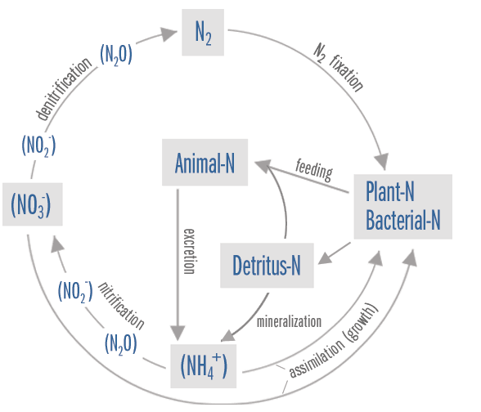
Nitrogen Cycle

Slide 35
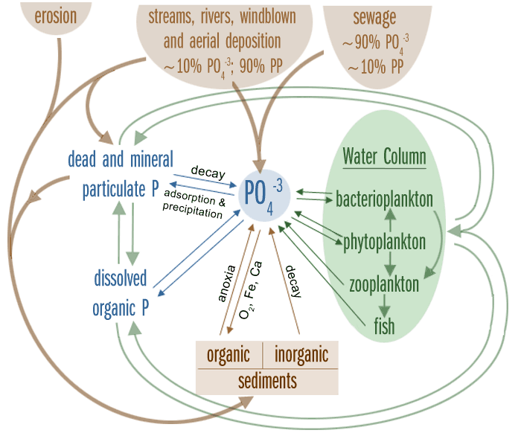
Phosphorus
Cycle

Slide 36
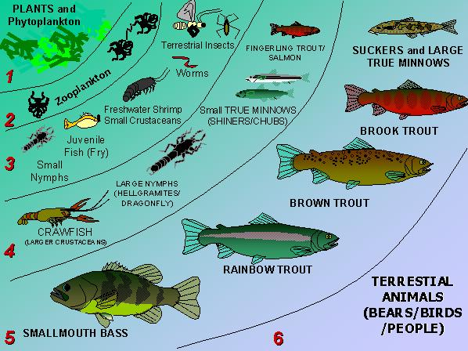
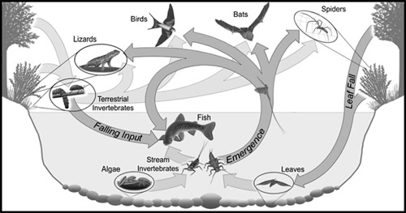
Ultimate fate of those nutrients
- food web

Slide 37
Nutrient Cycling in Streams
Nutrients in streams are subject to downstream transport
  Little nutrient cycling in one place
    Nutrient Spiraling
  Spiraling Length is the length of a stream required for a nutrient atom to complete a cycle
    Related to rate of nutrient cycling and velocity of downstream nutrient movement

Slide 38
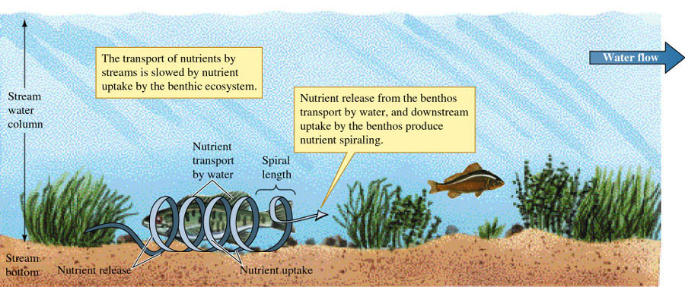
Nutrient Spiraling in Streams

Slide 39
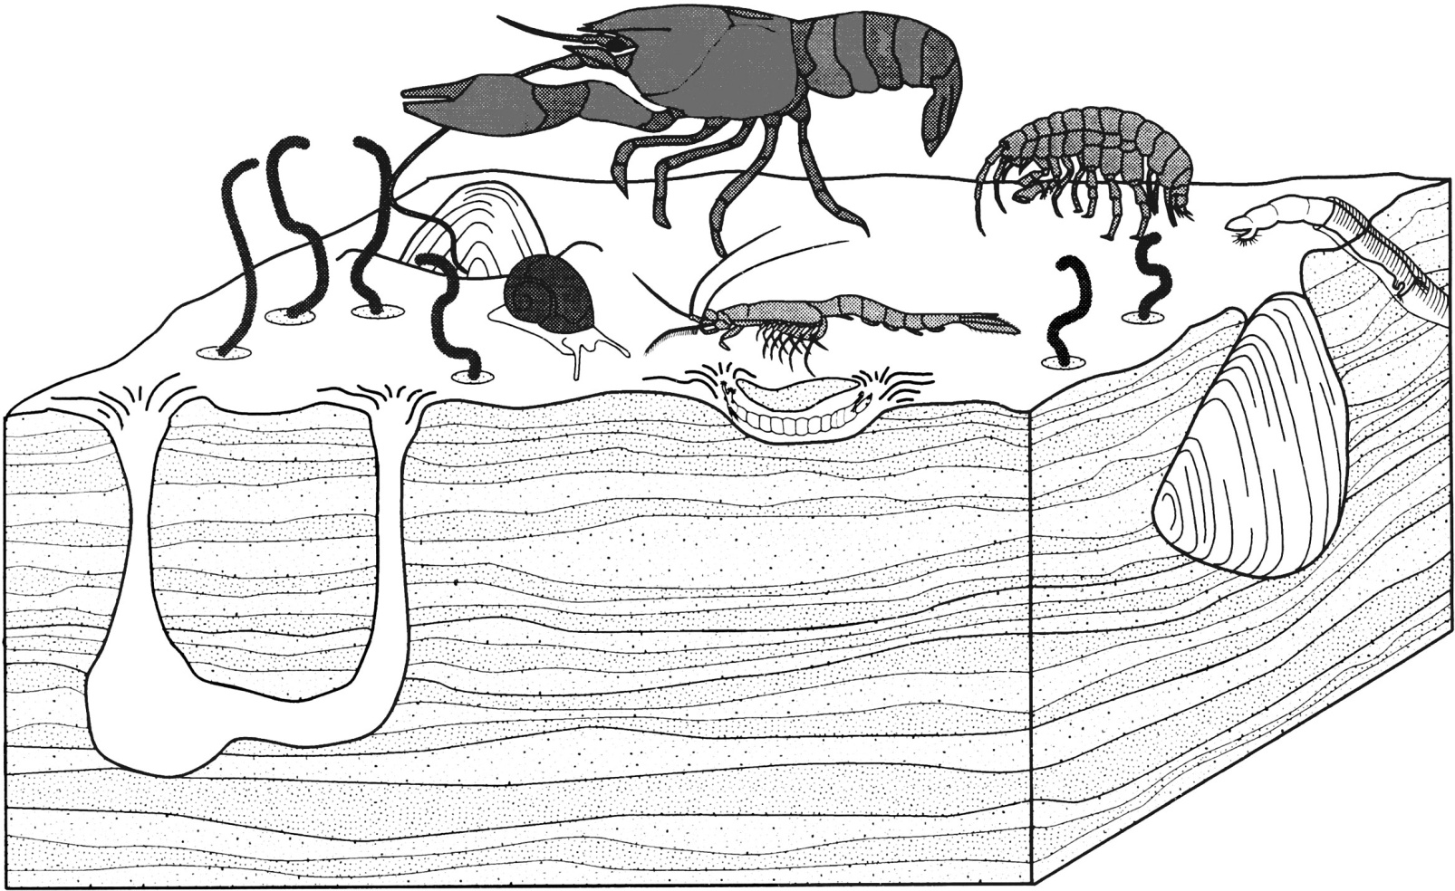
Stream Invertebrates and Spiraling Length
Aquatic invertebrates significantly increase rate of N cycling.
  Suggested rapid recycling of N by macroinvertebrates may increase primary production.
    Excreted and recycled 15-70% of nitrogen pool as ammonia.

Slide 40
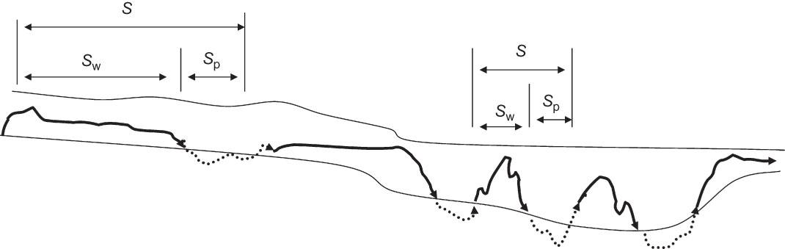
Spiral Length: Riffle vs. Pool
A diagram of nutrient spiraling in streams. S is the total spiral length, S_{p} is the time spent in particulate form in water column or the benthic zone and S_{w} is the average time spent in the water. Average velocity is greater in the riffle on the left, so spiral length is greater than in the pool at the right.

Slide 41
Stream Nutrient Enrichment Impacts
Primary Effect = Excessive Algae/Plant Growth
Aesthetically objectionable blooms/growths
Interference with water uses (drinking water, fishing, swimming)
Ecological (food web /aquatic community) alterations
Associated water quality problems

Slide 42
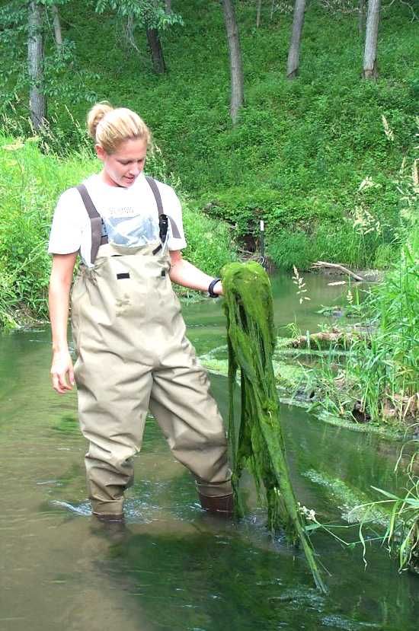
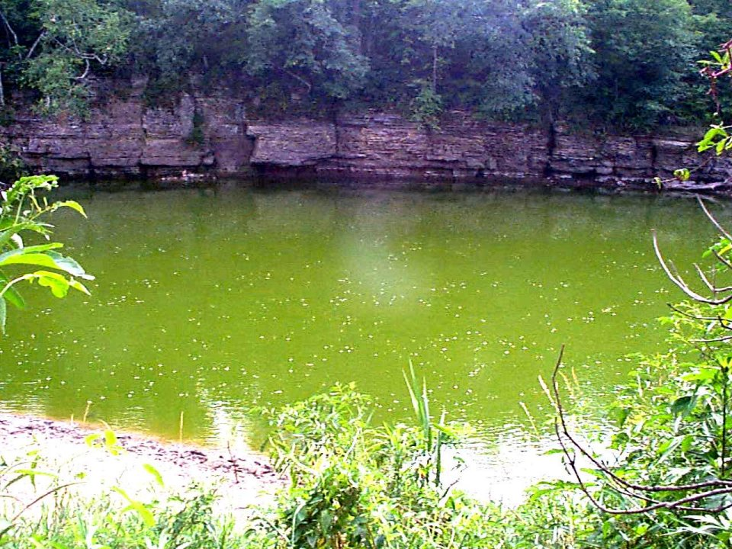
Nutrients / Algae / Macrophytes
Main Types of Growth:
Benthic
Seston (water column)
Macrophytes

Slide 43
Plant Growth
Environmental Factors Controlling Growth:
Light availability
Flow fluctuation
Nutrient availability
Temperature
Water retention time

Slide 44
Seston Chlorophyll A
Positive relationship
with phosphorus

Slide 45
Periphyton Chlorophyll A
Negative relationship
with phosphorus
- Shading by seston

Slide 46
Seston Chlorophyll A
3.0
2.4
Seasonal change
in Chl A and N
1.8
Log10 Chl A (ug/L)
1.2
0.6
0.0
1
2
3
4
5
6
7
8
9
10
11
12
Month
3726 samples (Oct.'99-Sept.'03)
Total Nitrogen (calculated)
35
28
TN (mg/L)
21
14
7
0
1
2
3
4
5
6
7
8
9
10
11
12
Month
3735 samples (Oct.'99-Sept.'03)

Slide 47
Chl A: Spring-Summer Peaks
Iowa River - Gifford
1000
3500
ChlA
3000
Flow
2500
100
ChlA (ug/L)
2000
Stream Flow (cfs)
1500
10
1000
500
1
0
Oct-99
Jan-00
Apr-00
Jul-00
Oct-00
Jan-01
Apr-01
Jul-01
Oct-01
Jan-02
Apr-02
Jul-02
Oct-02
Jan-03
Apr-03
Jul-03
Oct-03
Jan-04

Slide 48
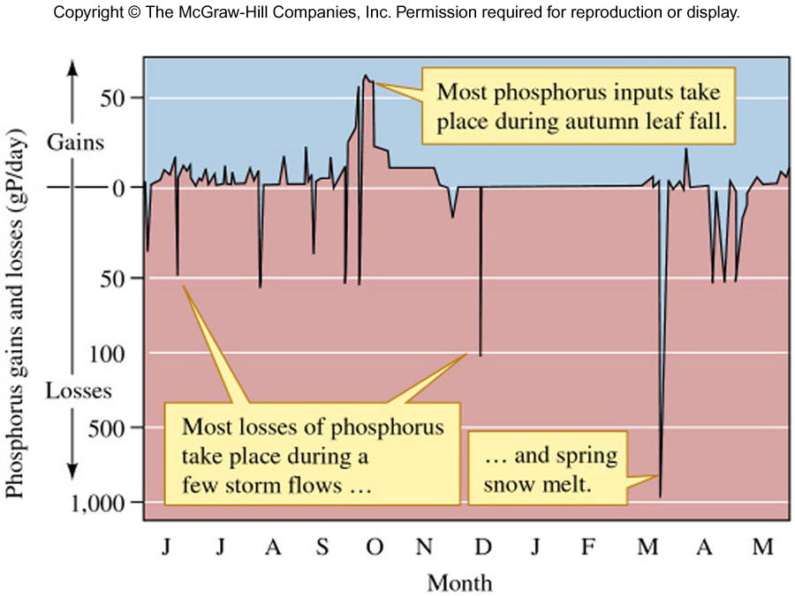
Phosphorus Gains/Losses

Slide 49
Nitrate+Nitrite-N vs. Fish Index of Biotic Integrity (FIBI)
100
Nitrate > 4 mg/L
90
2
Nitrate < 4 mg/L
Excellent
R
= 0.03
(p<0.05)
Median Concentration (4 mg/L)
80
Linear (Nitrate > 4 mg/L)
Linear (Nitrate < 4 mg/L)
70
Good
60
FIBI
2
50
R
= 0.10
(p<0.001)
Fair
40
30
20
Poor
10
0
0
2
4
6
8
10
12
14
16
Nitrate + Nitrite - Nitrogen (mg/L)

Slide 50
Total Phosphorus vs. Benthic Macroinvertebrate Index of Biotic Integrity (BMIBI)
100
Excellent
90
80
70
Good
60
BMIBI
50
Fair
40
30
R
2
= 0.07
20
(p<0.001)
Poor
10
0
0.01
0.10
1.00
10.00
Total Phosphate as P (mg/L)

Slide 51
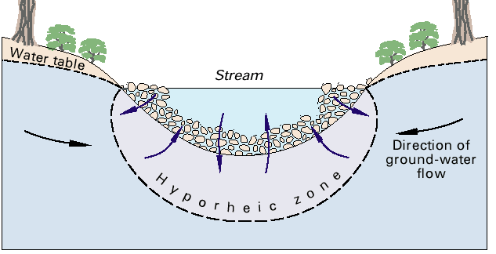
The hyporheic zone
Continual exchange of water, solutes between stream and groundwaters

Slide 52
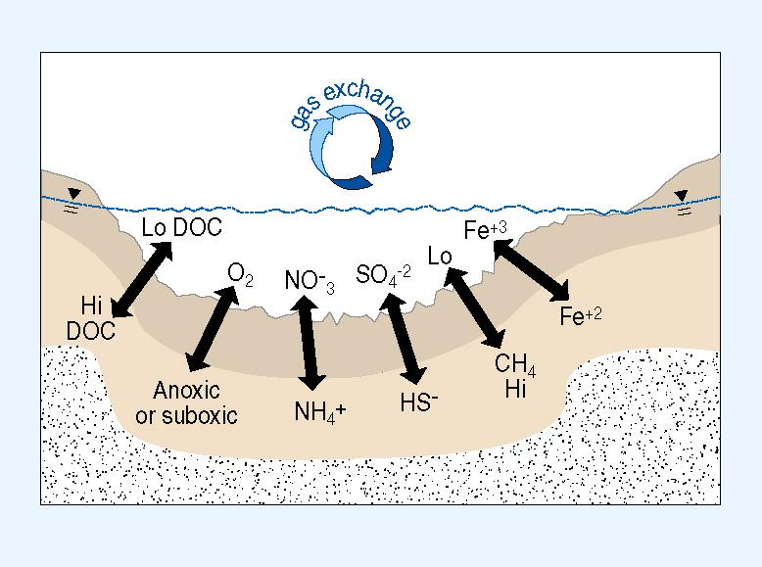
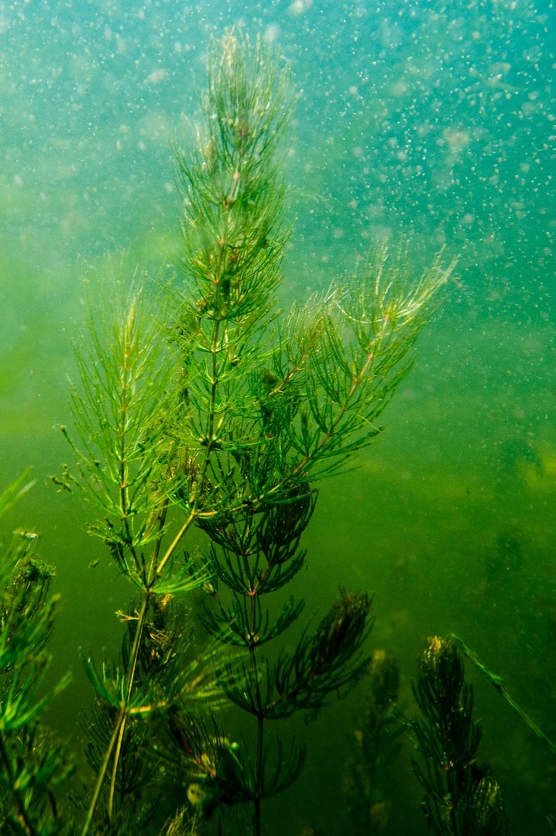
Nutrient Upwelling Stimulates Plant Growth
Upwelling water from hyporheic zone brings nutrients to plants, encourages macrophyte and algal growth in these areas

Slide 53
Low [Nutrient] in Streams
Macrophyte production higher than can be supported by stream nutrients
  Significantly higher [nutrient] in root zones

Slide 54
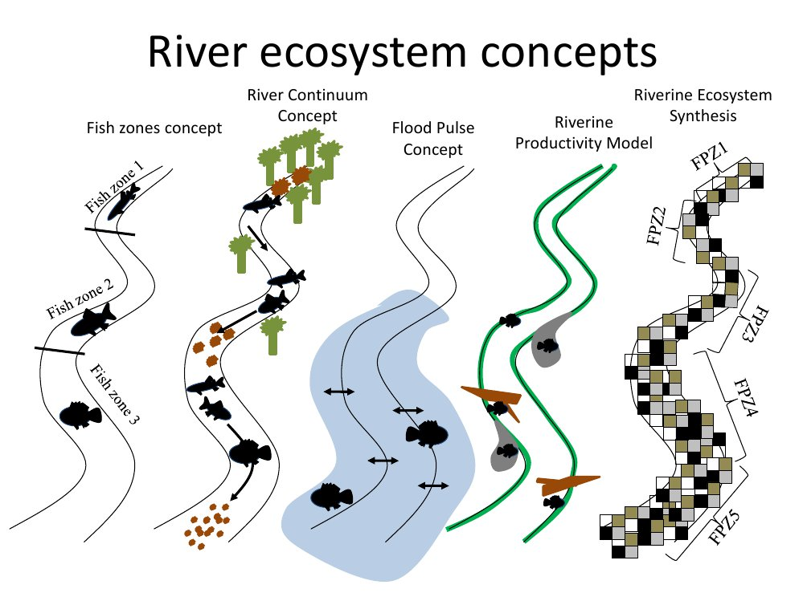

Slide 55
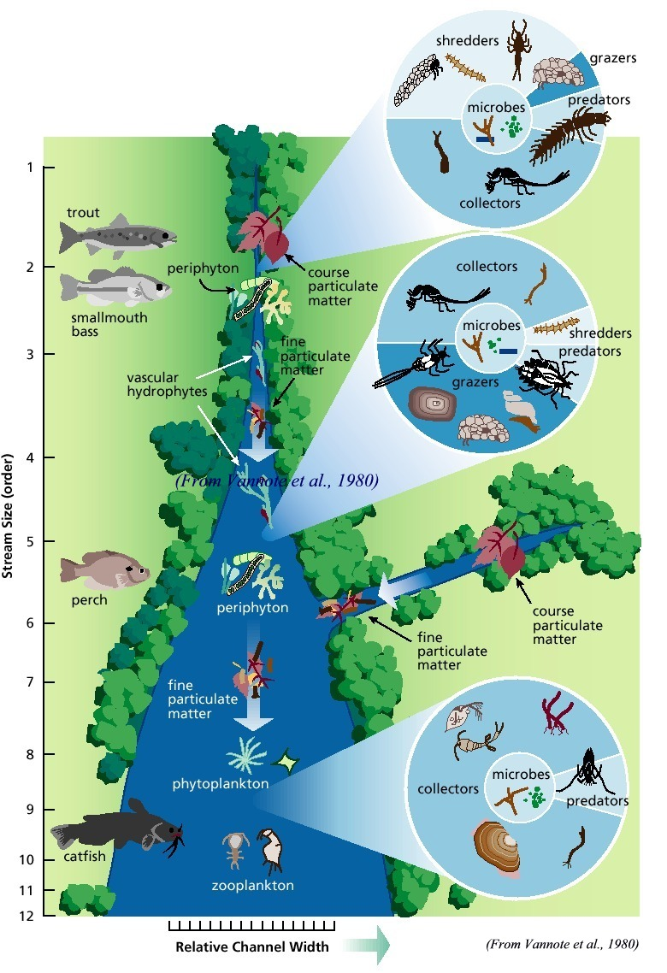
River
Continuum
Cencept

Slide 56
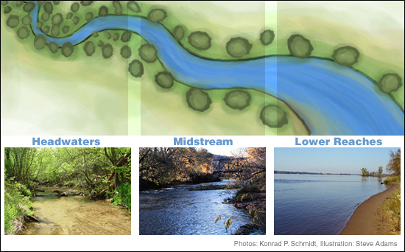
Changing Systems

Slide 57
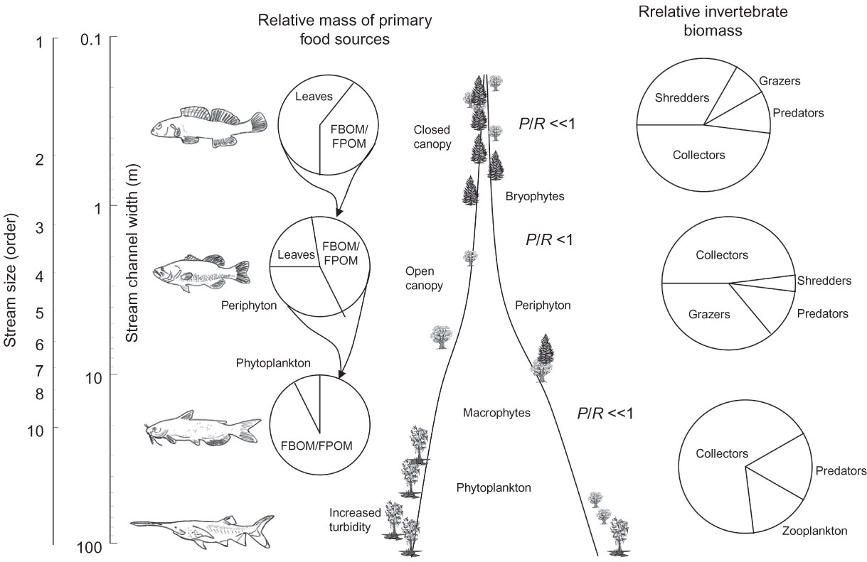
River Continuum Concept

