Slide 1
Describing Quantitative Distributions
By: Student x

Slide 2
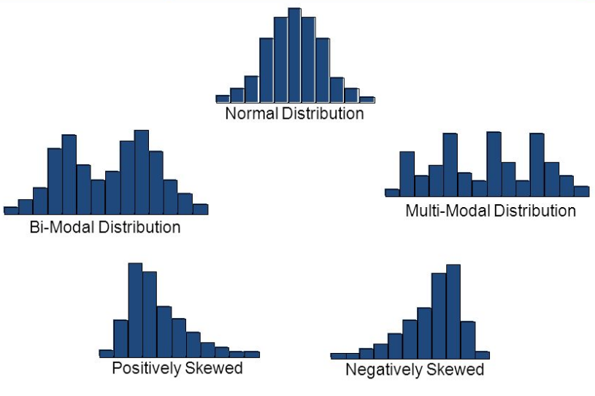
Shape
Symmetric
Skewed
Right: has a long tail on the right side of the data
Left: has a long tail on the left side of the data
“Catch a tiger by the tail”
http://images.slideplayer.com/24/6205849/slides/slide_36.jpg
https://image.slidesharecdn.com/symmetryskewppt-130903152132-/95/symmetry-and-skew-14-638.jpg?cb=1378221735

Slide 3
OUTLIERS
Data that doesn’t seem to fit in
How to find them?
Find: Q1 – 1.5(IQR) anything less than that is an outlier and anymore more than Q3 + 1.5(IQR) is an outlier
https://taps-graph-review.wikispaces.com/file/view/outlier_box_plot.gif/73782697/outlier_box_plot.gif

Slide 4
CENTER
Mean (average) used when data is symmetric
Affected by extreme values
Median (middle) used any other time
Resistant, not affected by extreme values
http://researchhubs.com/uploads/skewness-vs-measures-of-center.png

Slide 5
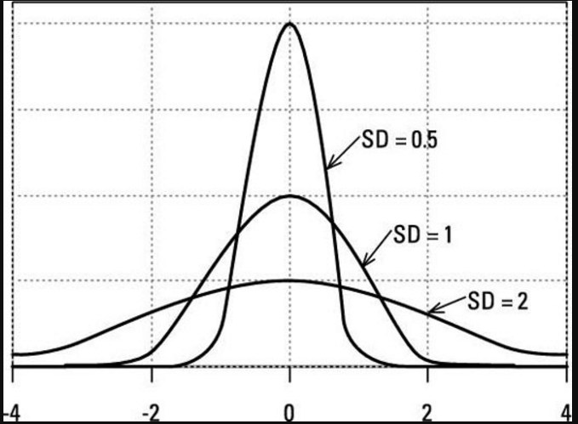
SPREAD
Range of the data
Interquartile range (IQR)
Used when distribution is skewed
Resistant
Standard Deviation
Average distance of observation to their mean
Used when distributions are mostly symmetric
Not resistant
http://sphweb.bumc.bu.edu/otlt/mph-modules/bs/bs704_summarizingdata/Interquartile-Even.png
http://d2r5da613aq50s.cloudfront.net/wp-content/uploads/437066.image2.jpg

Slide 6
SOCS
S- Shape
O- Outliers
C- Center
S- Spread

Slide 7
EXAMPLE 1
Price of Grandfather Clocks

Slide 8
Example 1
Shape? Skewed to the right.
Outliers? IQR = 536.25, IQR*1.5 = 804.375 add to Q3, subtract from Q1. 2386.625 > 2131, 244.625 < 729. There are no outliers.
Center? The median price of grandfather clocks is $1257.50
Spread? According to the range the spread of the data is $1402 but according to the IQR the spread is only $536.25

Slide 9
EXAMPLE 2
Housefly Wing Lengths (mm)

Slide 10
EXAMPLE 2
Shape? Symmetric.
Outliers? No outliers.
Center? The mean length of housefly wings are 45.5mm.
Spread? The range of this data is 19 and the standard deviation is 3.72.

Slide 11
EXAMPLE 3
Number of Siblings

Slide 12
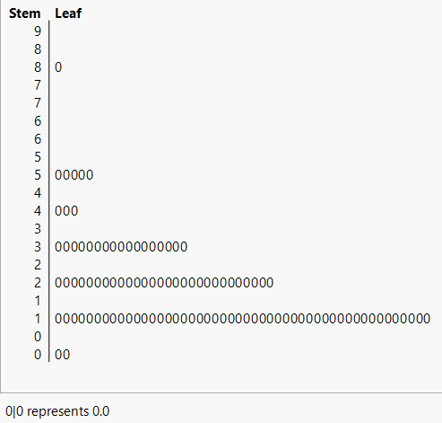
EXAMPLE 3
Shape? Data is skewed to the right.
Outliers? There is an outlier at 8.
Center? The median number of siblings is 2.
Spread? The range of the data is 8 and the IQR is 1.75.

Slide 13
CONCLUSION
How to describe a basic quantitative distribution
When to use mean vs median for the center and standard deviation vs IQR for the spread
Don’t forget your SOCS
https://pbs.twimg.com/media/CqUk3EpUEAAELGi.jpg

