Slide 1
Ways to prove Pythagoras theorem

Slide 2
What is Pythagoras theorem?
a fundamental relation in Euclidean geometry among the three sides of a right triangle
It states that the square of the hypotenuse (the side opposite the right angle is equal to the sum of the squares of the other two sides[Wikipedia]

Slide 3
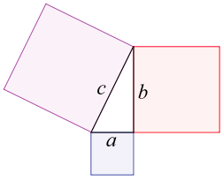
The theorem can be written as an equation relating the lengths of the sides a, b, and c

Slide 4
There’re about ways to prove this theorem

Slide 5
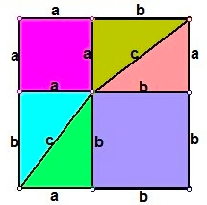
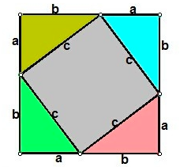

Slide 6
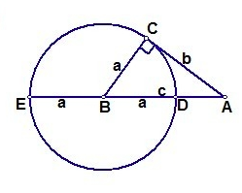
According to Secant Theorem

Slide 7
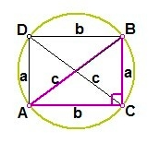
According to Ptolemy's theorem

Slide 8
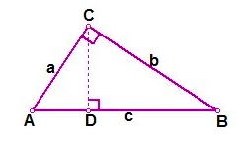
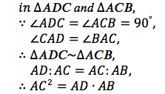
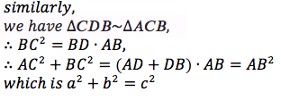
according to the properties of similar triangles

Slide 9
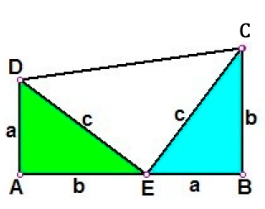
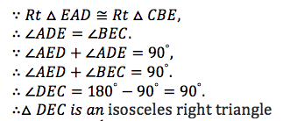
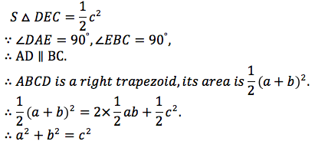
In 1876, the US president Garfield also found a way to prove this theorem

Slide 10
Conclusion
There’re many ways to prove the Pythagoras theorem, the more ways we could think of, the more familiar we will be with this interesting theorem.

