Slide 1
Significance Test
Student X

Slide 2
What are Significance Tests?
Method of Inference
Allows us to support or reject claims about sample data
Example of why we would do a significance test:
General: Salary is influenced by gender.
Direction: Males are paid more than females in the workplace.

Slide 3
Null Hypothesis and Its Importance
H_{0,} Null Hypothesis
Used as a basis argument for what the test is built around
Example H₀ : There is no difference between a new clinical drug and the current drug, on average

Slide 4
Alternative and Importance
H_{a,} Alternative Hypothesis
Gives us a statement that our test is made to establish
Example H_{a} : The new drug is better than the current drug, on average

Slide 5
More about Alternative Hypotheses
One-sided:
H₀ μ = k
H_{a} μ > k
H₀ μ = k
H_{a} μ < k
Two-sided:
H₀ μ = k
H_{a} μ ≠ k

Slide 6
Hypotheses with Real World Example
High school mean test score = 74
Random sample 25 females test score = 76
H₀ μ = 74
H_{a} μ > 74
Question to ask: Does this provide enough evidence to say the overall mean for females is higher than the entire student population?

Slide 7
Test Statistic
$t= \frac{\overline{x}− μ}{s/\sqrt{n}}$ = $\frac{76−74}{6/\sqrt{25}}$ = $\frac{2}{1.2}$ = 1.67
Greater the size of t, the greater the evidence against the null
The closer t is to 0, the less likely there is a significant difference
T from table = 1.318, according to degrees of freedom
1.67>1.31, reject null

Slide 8
P-Values
Level of significance in a statistical hypothesis test, showing the probability of a certain event occurring
Smallest level significance at which the null would be rejected
Smaller p, more evidence for alternative
Usual values: 0.1, 0.05, 0.01, show significance
The t-table gives us the p-value using our test-statistic
P-value from t-table <0.05

Slide 9
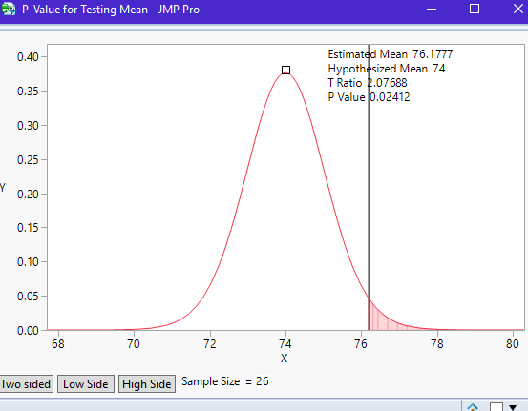
Right-tailed t-curve
Observing a sample mean greater than or equal to that which was observed in the study, assuming H₀ is true
Ex: In this case, observing a mean >=76

Slide 10
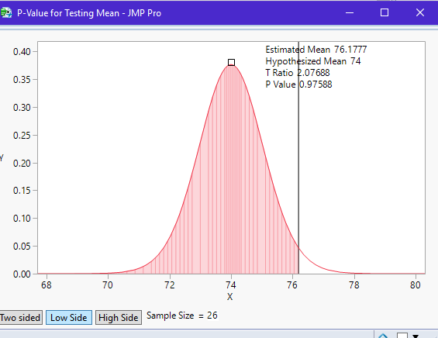
Left-tailed t-curve
Observing a sample mean less than or equal to that which was observed in the study, assuming H₀ is true
Ex: In this case, observing a mean of <=76

Slide 11
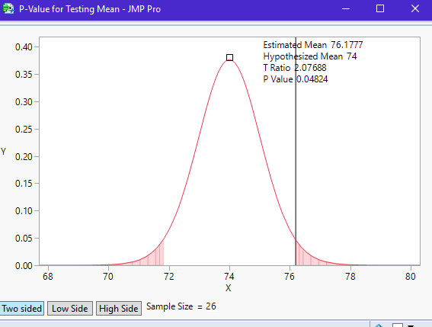
Two-tailed t-curve
Observing a sample mean different from that of which was observed in the study, assuming H₀ is true
Ex: In this case, observing a mean not equal to 76

Slide 12
Significance of our test
Right-tailed
P-value = 0.02
Significant at a 0.05 level
There is enough evidence to reject the null (H₀ = 74), and say that Females overall mean is higher than the entire student populations

Slide 13
T-value
T-value = 2.08
Provides strong evidence to reject the null and say that females overall mean score is higher than the entire student population
T and P are correlated, the higher the absolute value of T the lower P will be

Slide 14
Type I Error
Suppose we want to study if there is a difference between two medicines
Type I Error would be:
H₀ true, but rejected as false
Medicines do not differ, but are said to be different

Slide 15
Type II Error
Again, suppose we want to study if certain medicines differ from one another
Type II Error would be:
When H_{a} is true but not enough evidence to support
Medicines differ, but are said to be the same

Slide 16
Conclusion
Significance tests are important because they allow us to assess evidence in favor of some claim about a population
Purpose of H₀: Basis argument which assumes there is no effect
Purpose of H_{a}: The theory we are trying to establish which says there is a difference

Slide 17
Conclusion
Test-statistic gives the extremeness and helps get the p-value
P-value gives us the probability that a value at least as extreme as the value that occurred in the study would be observed under the null hypothesis
Type I Error – incorrect rejection of a true null
Type II Error – incorrectly retaining a false null

Slide 18
Sources
https://infocus.emc.com/william_schmarzo/understanding-type-i-and-type-ii-errors/
https://www.google.com/search?q=z+table&source=lnms&tbm=isch&sa=X&ved=0ahUKEwjuzLfS9fzRAhXp54MKHV0TDPAQ_AUICCgB&biw=1745&bih=841#imgrc=n_wEBM8lL0N6nM
http://www.stat.yale.edu/Courses/1997-98/101/sigtest.htm

