Slide 1
Unnumbered 15 p707

Slide 2
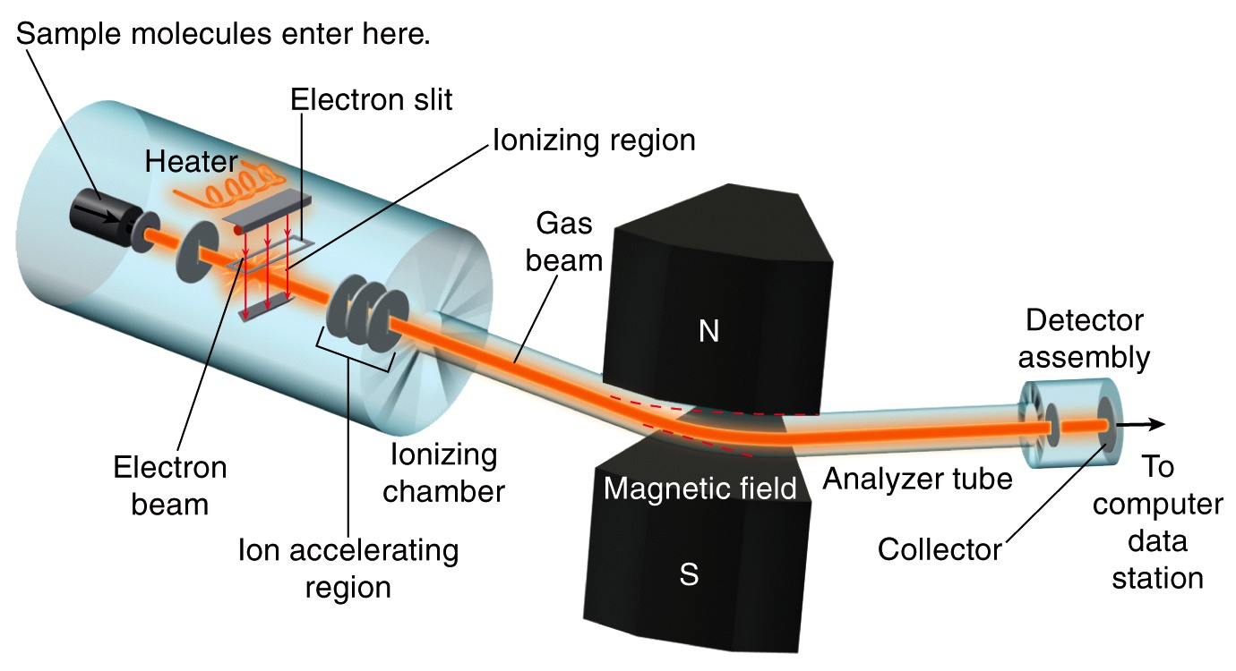
Figure 15.21

Slide 3
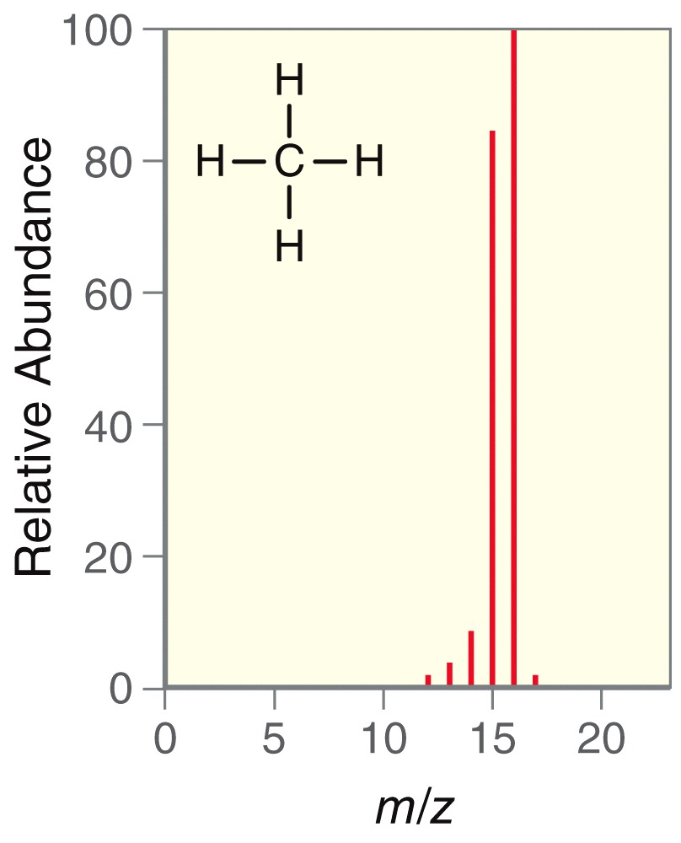
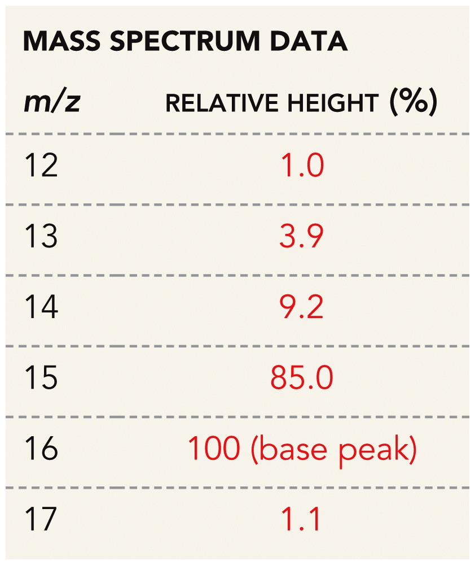
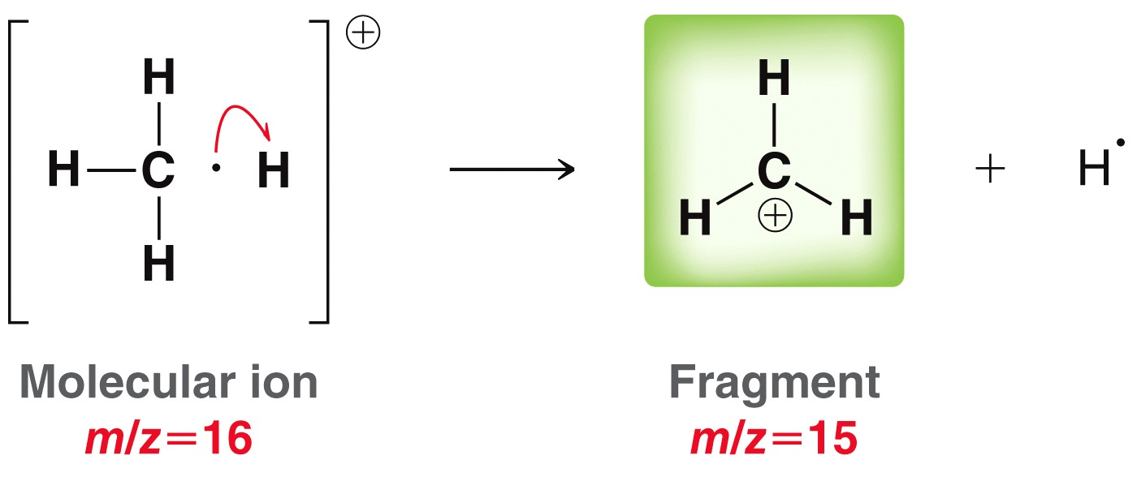
Figure 15.22a

Slide 4
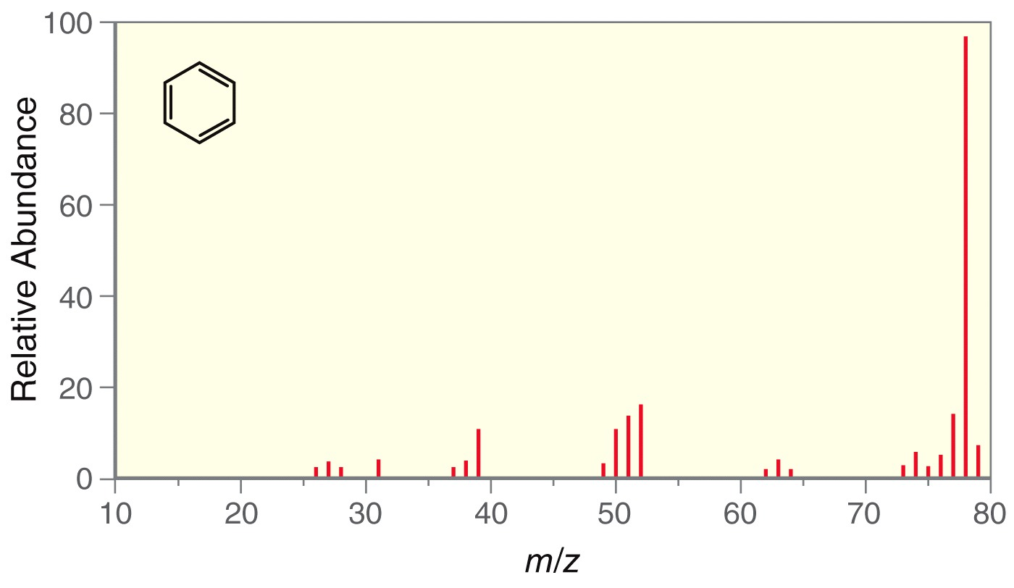
Figure 15.23

Slide 5
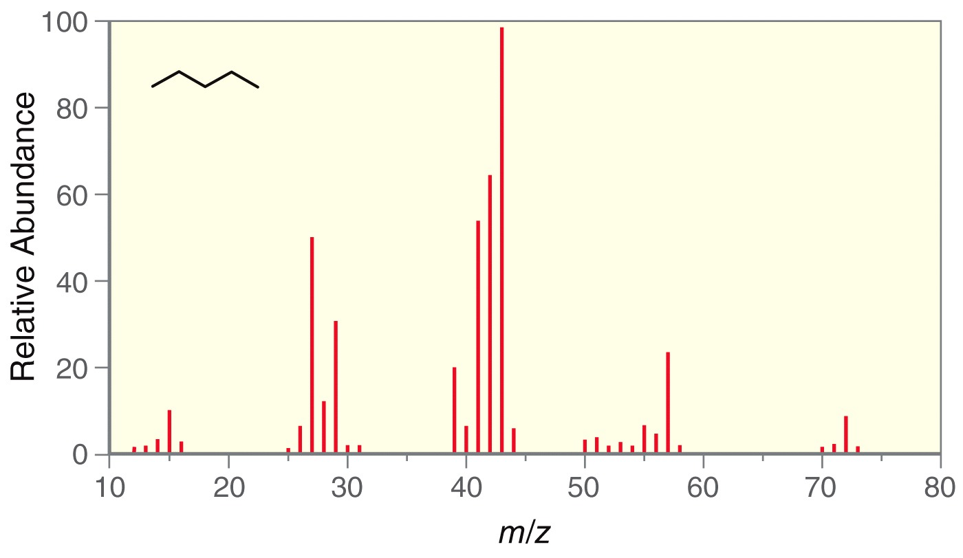
Figure 15.24

Slide 6
Unnumbered 15 p709

Slide 7
Unnumbered 15 p710

Slide 8
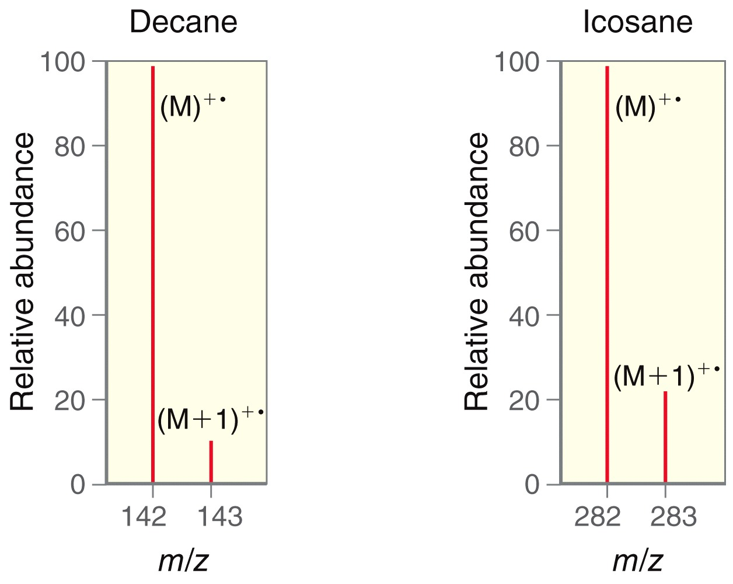
Figure 15.25

Slide 9
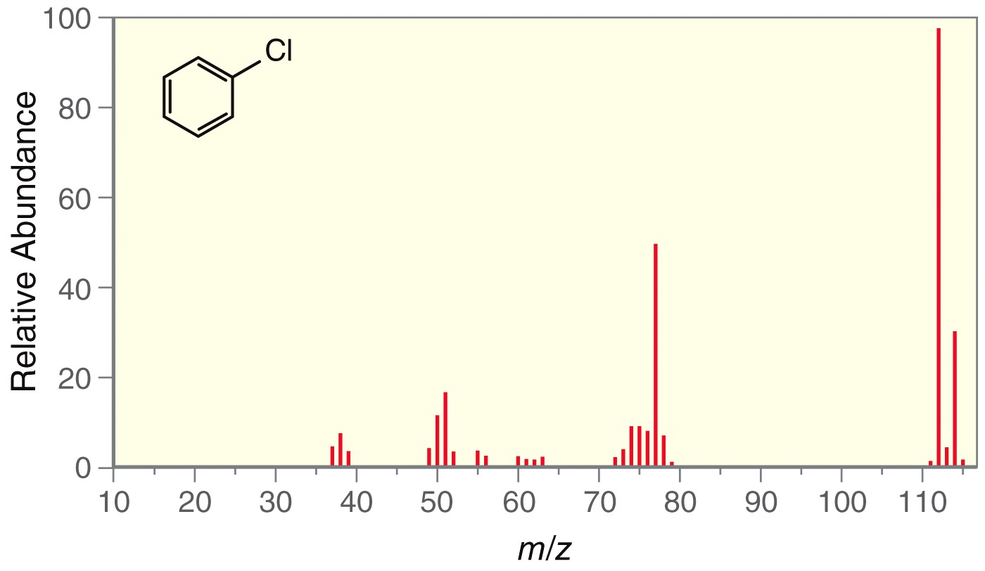
Figure 15.26

Slide 10
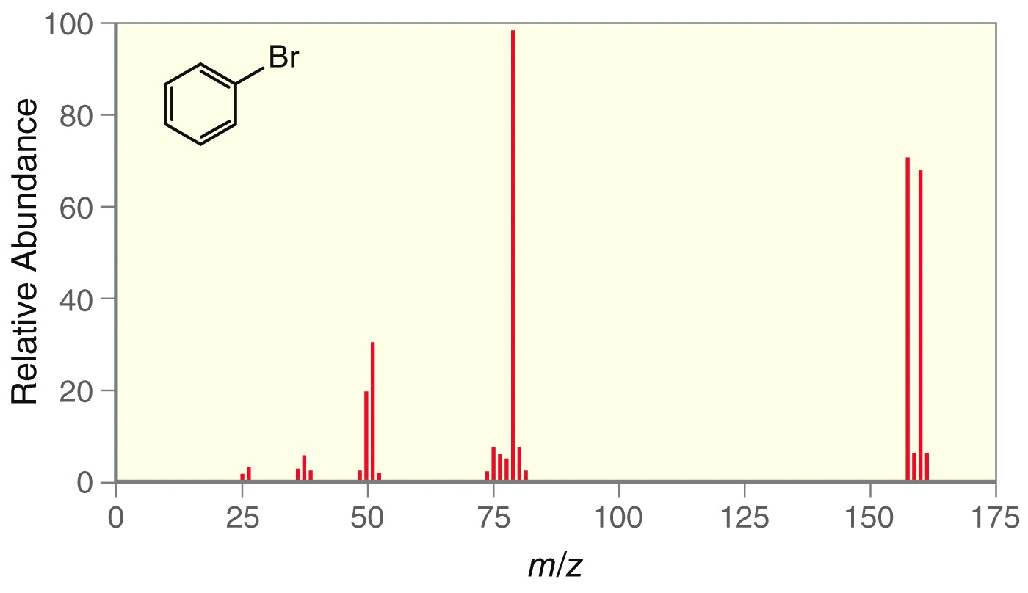
Figure 15.27

Slide 11
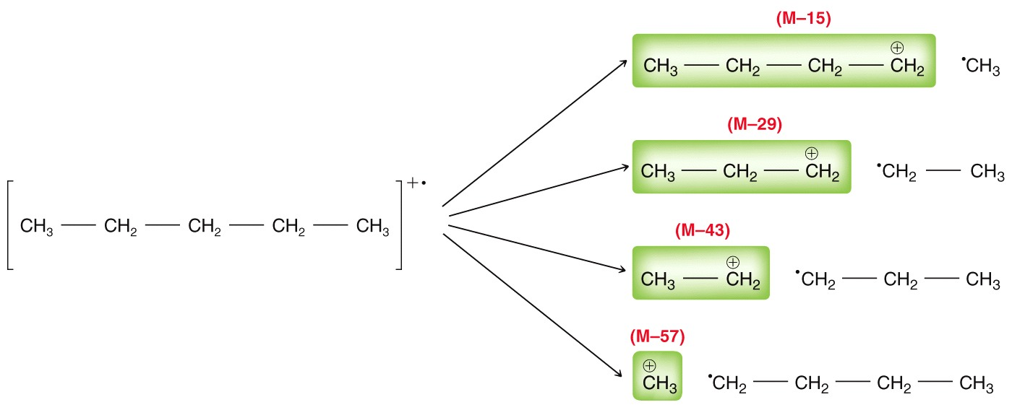
Figure 15.28

Slide 12
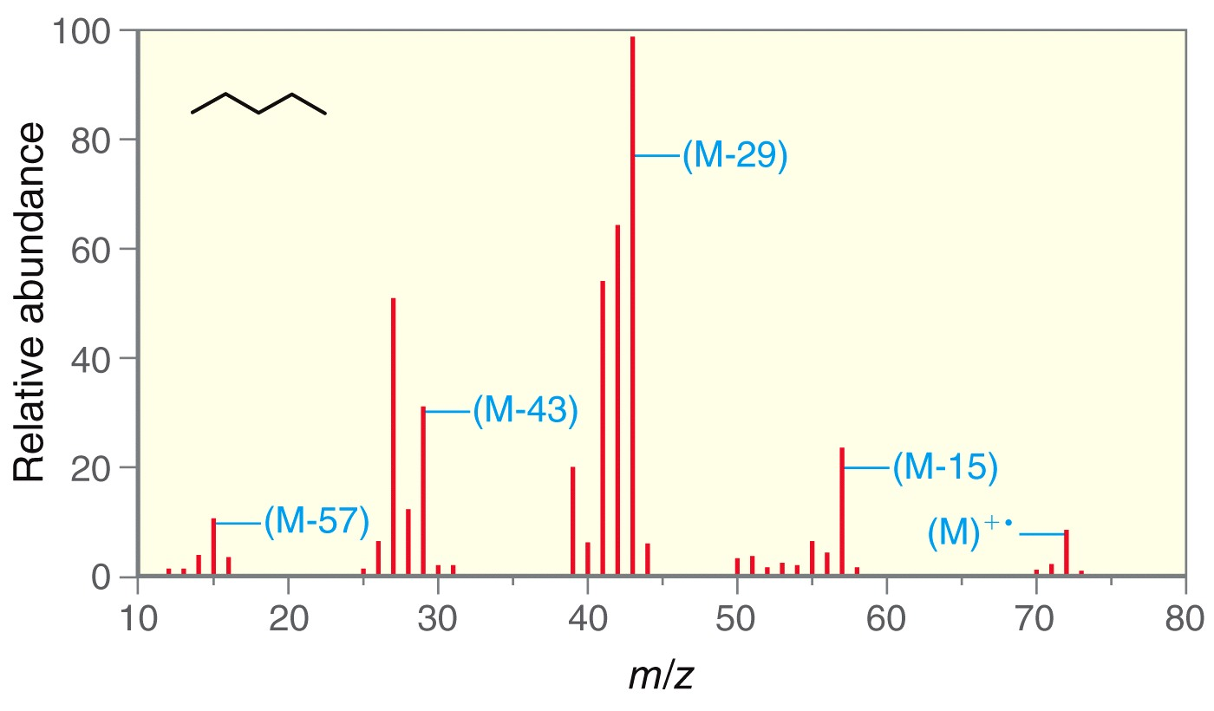
Figure 15.29

Slide 13
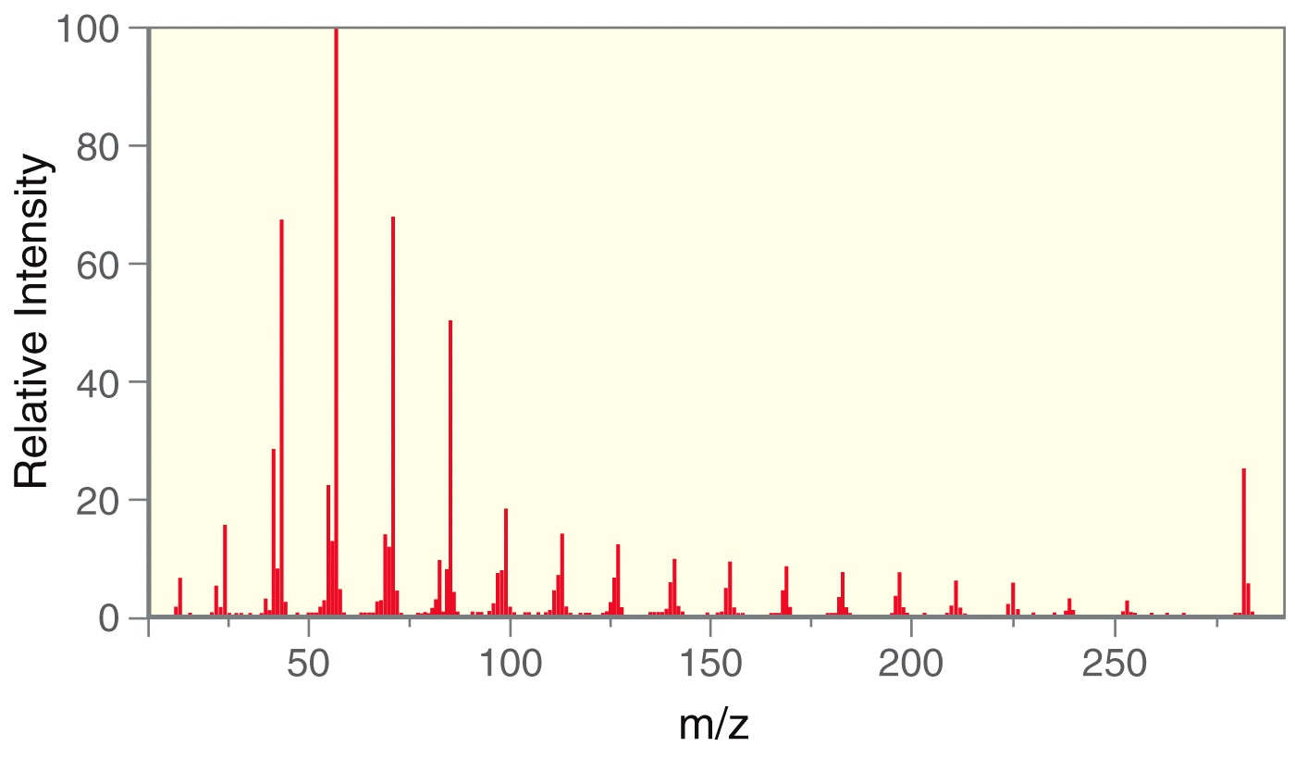
Figure 15.30

Slide 14
Unnumbered 15 p715

Slide 15
Unnumbered 15 p715

Slide 16
Unnumbered 15 p716

Slide 17
Unnumbered 15 p716

Slide 18
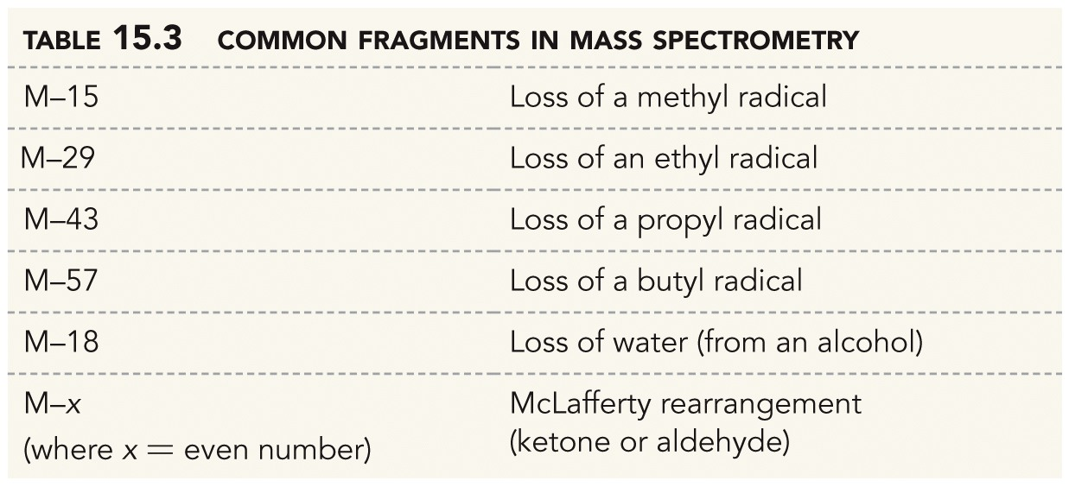
Table 15.3

Slide 19
Unnumbered 15 p717

Slide 20
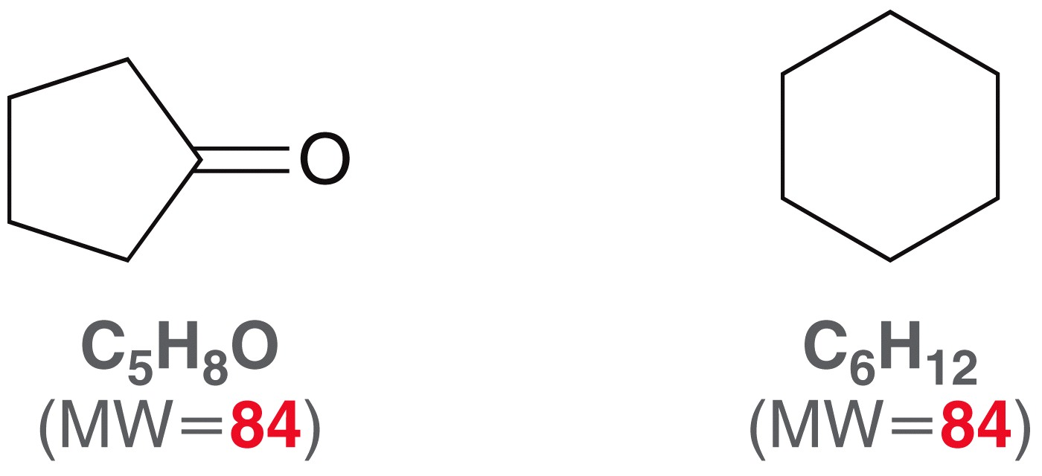
Unnumbered 15 p718

Slide 21
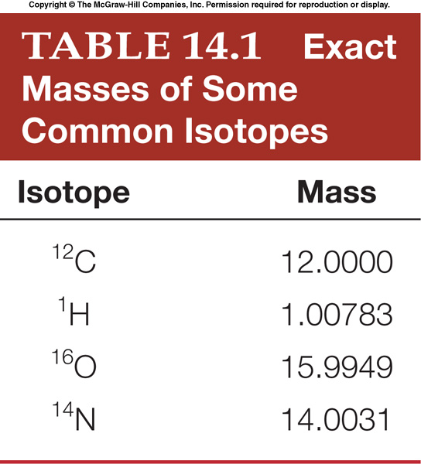
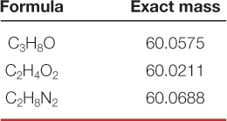
High Resolution MS (HRMS)
Low resolution mass spectrometers report m/z values to the nearest whole number. High resolution mass spectrometers measure m/z ratios to four (or more) decimal places.
This is valuable because no two molecular formulas have the same exact molecular weight.
Exact MWs can be calculated using exact isotope masses. Table 14.1
Thus HRMS is a way to determine chemical formula!

Slide 22
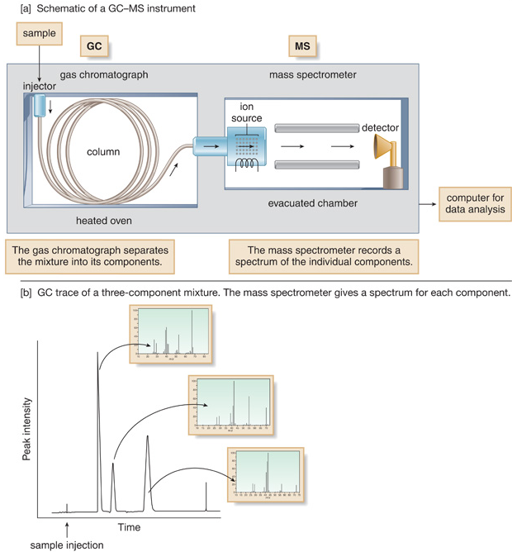
GC-MS

