Slide 1
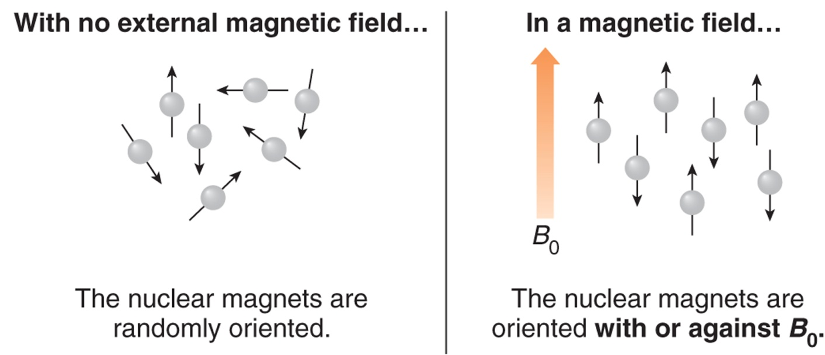
NMR Theory
From physics we know that a spinning charge has an associated magnetic field.
All nuclei have positive charge.
Some nuclei have “spin” and are “NMR active”. These spinning nuclei are, in essence, “nuclear magnets” that will align in the presence of a magnetic field.
  NMR active nuclei: ¹H, ¹³C, ¹⁹F, ³¹P, ²H
  NMR inactive nuclei: ¹²C, ¹⁶O

Slide 2
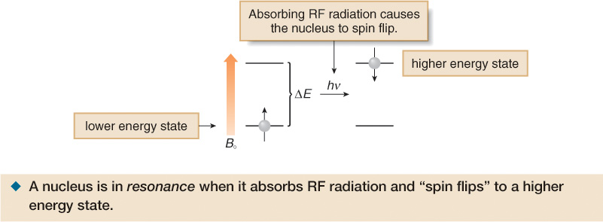
NMR Theory
There are 2 variables in NMR: the applied magnetic field (B₀) and the frequency (ν ) of radiation required for resonance, measured in MHz.

Slide 3
Effect of B₀ on resonance frequency
NMR spectrometers are designated according to the frequency required to make ¹H nuclei (protons) resonate. The modern standard is 300 MHz. Early instruments operated at 60 MHz. Top of the line research instruments go as high as 1000 MHz. Stronger magnets are being actively pursued.

Slide 4
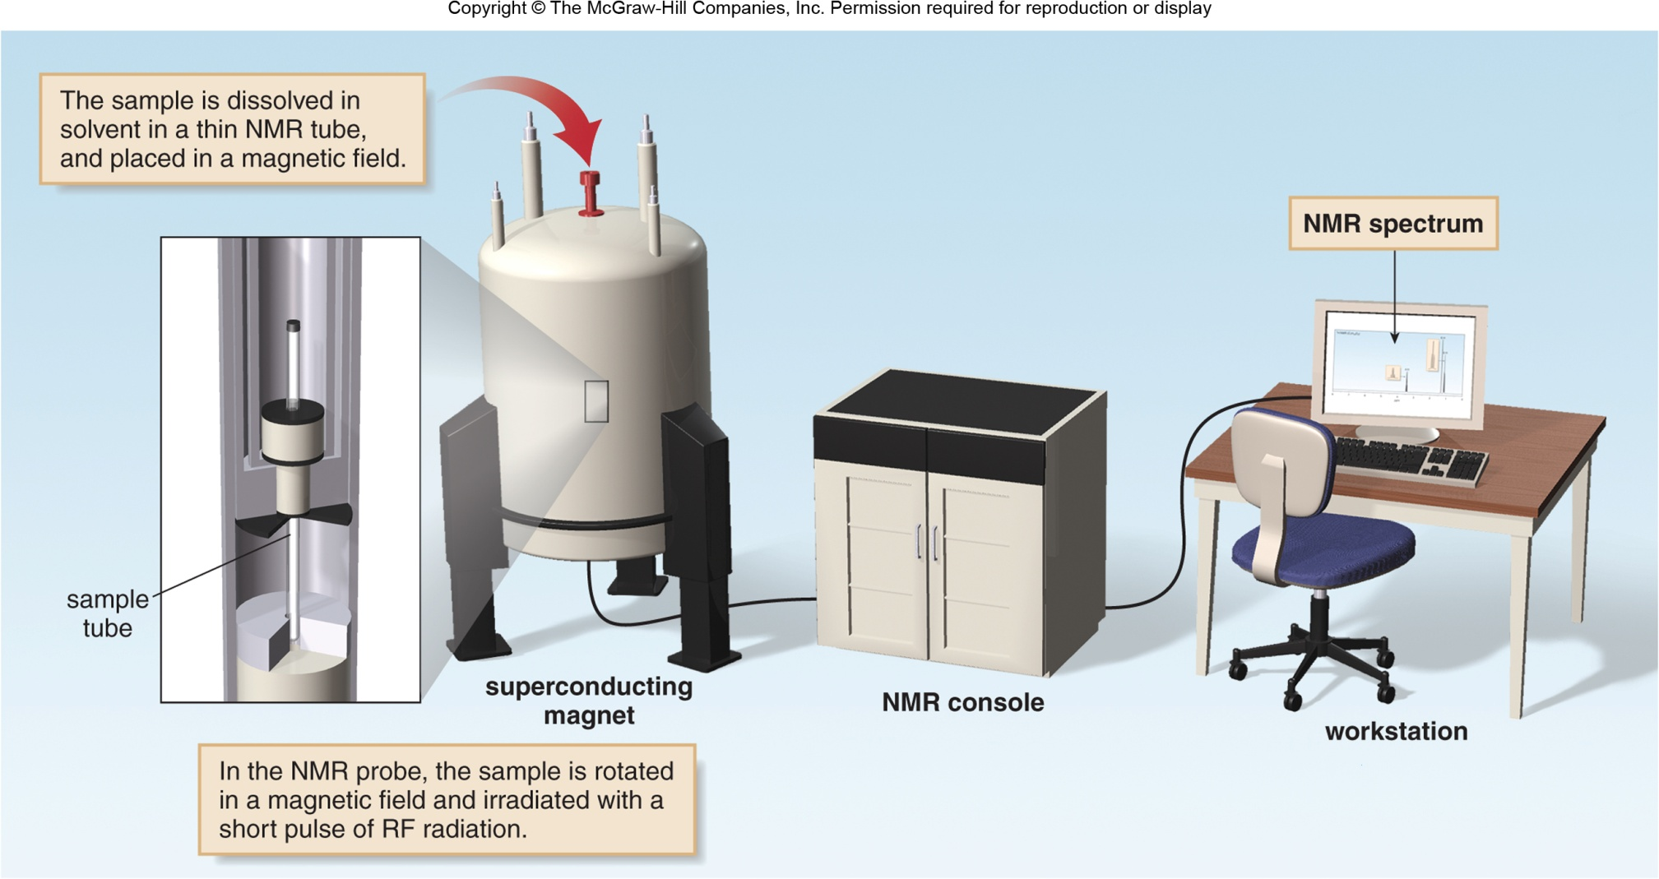
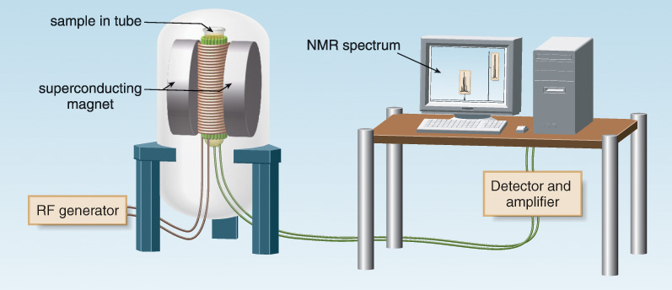
Schematic of an NMR

Slide 5
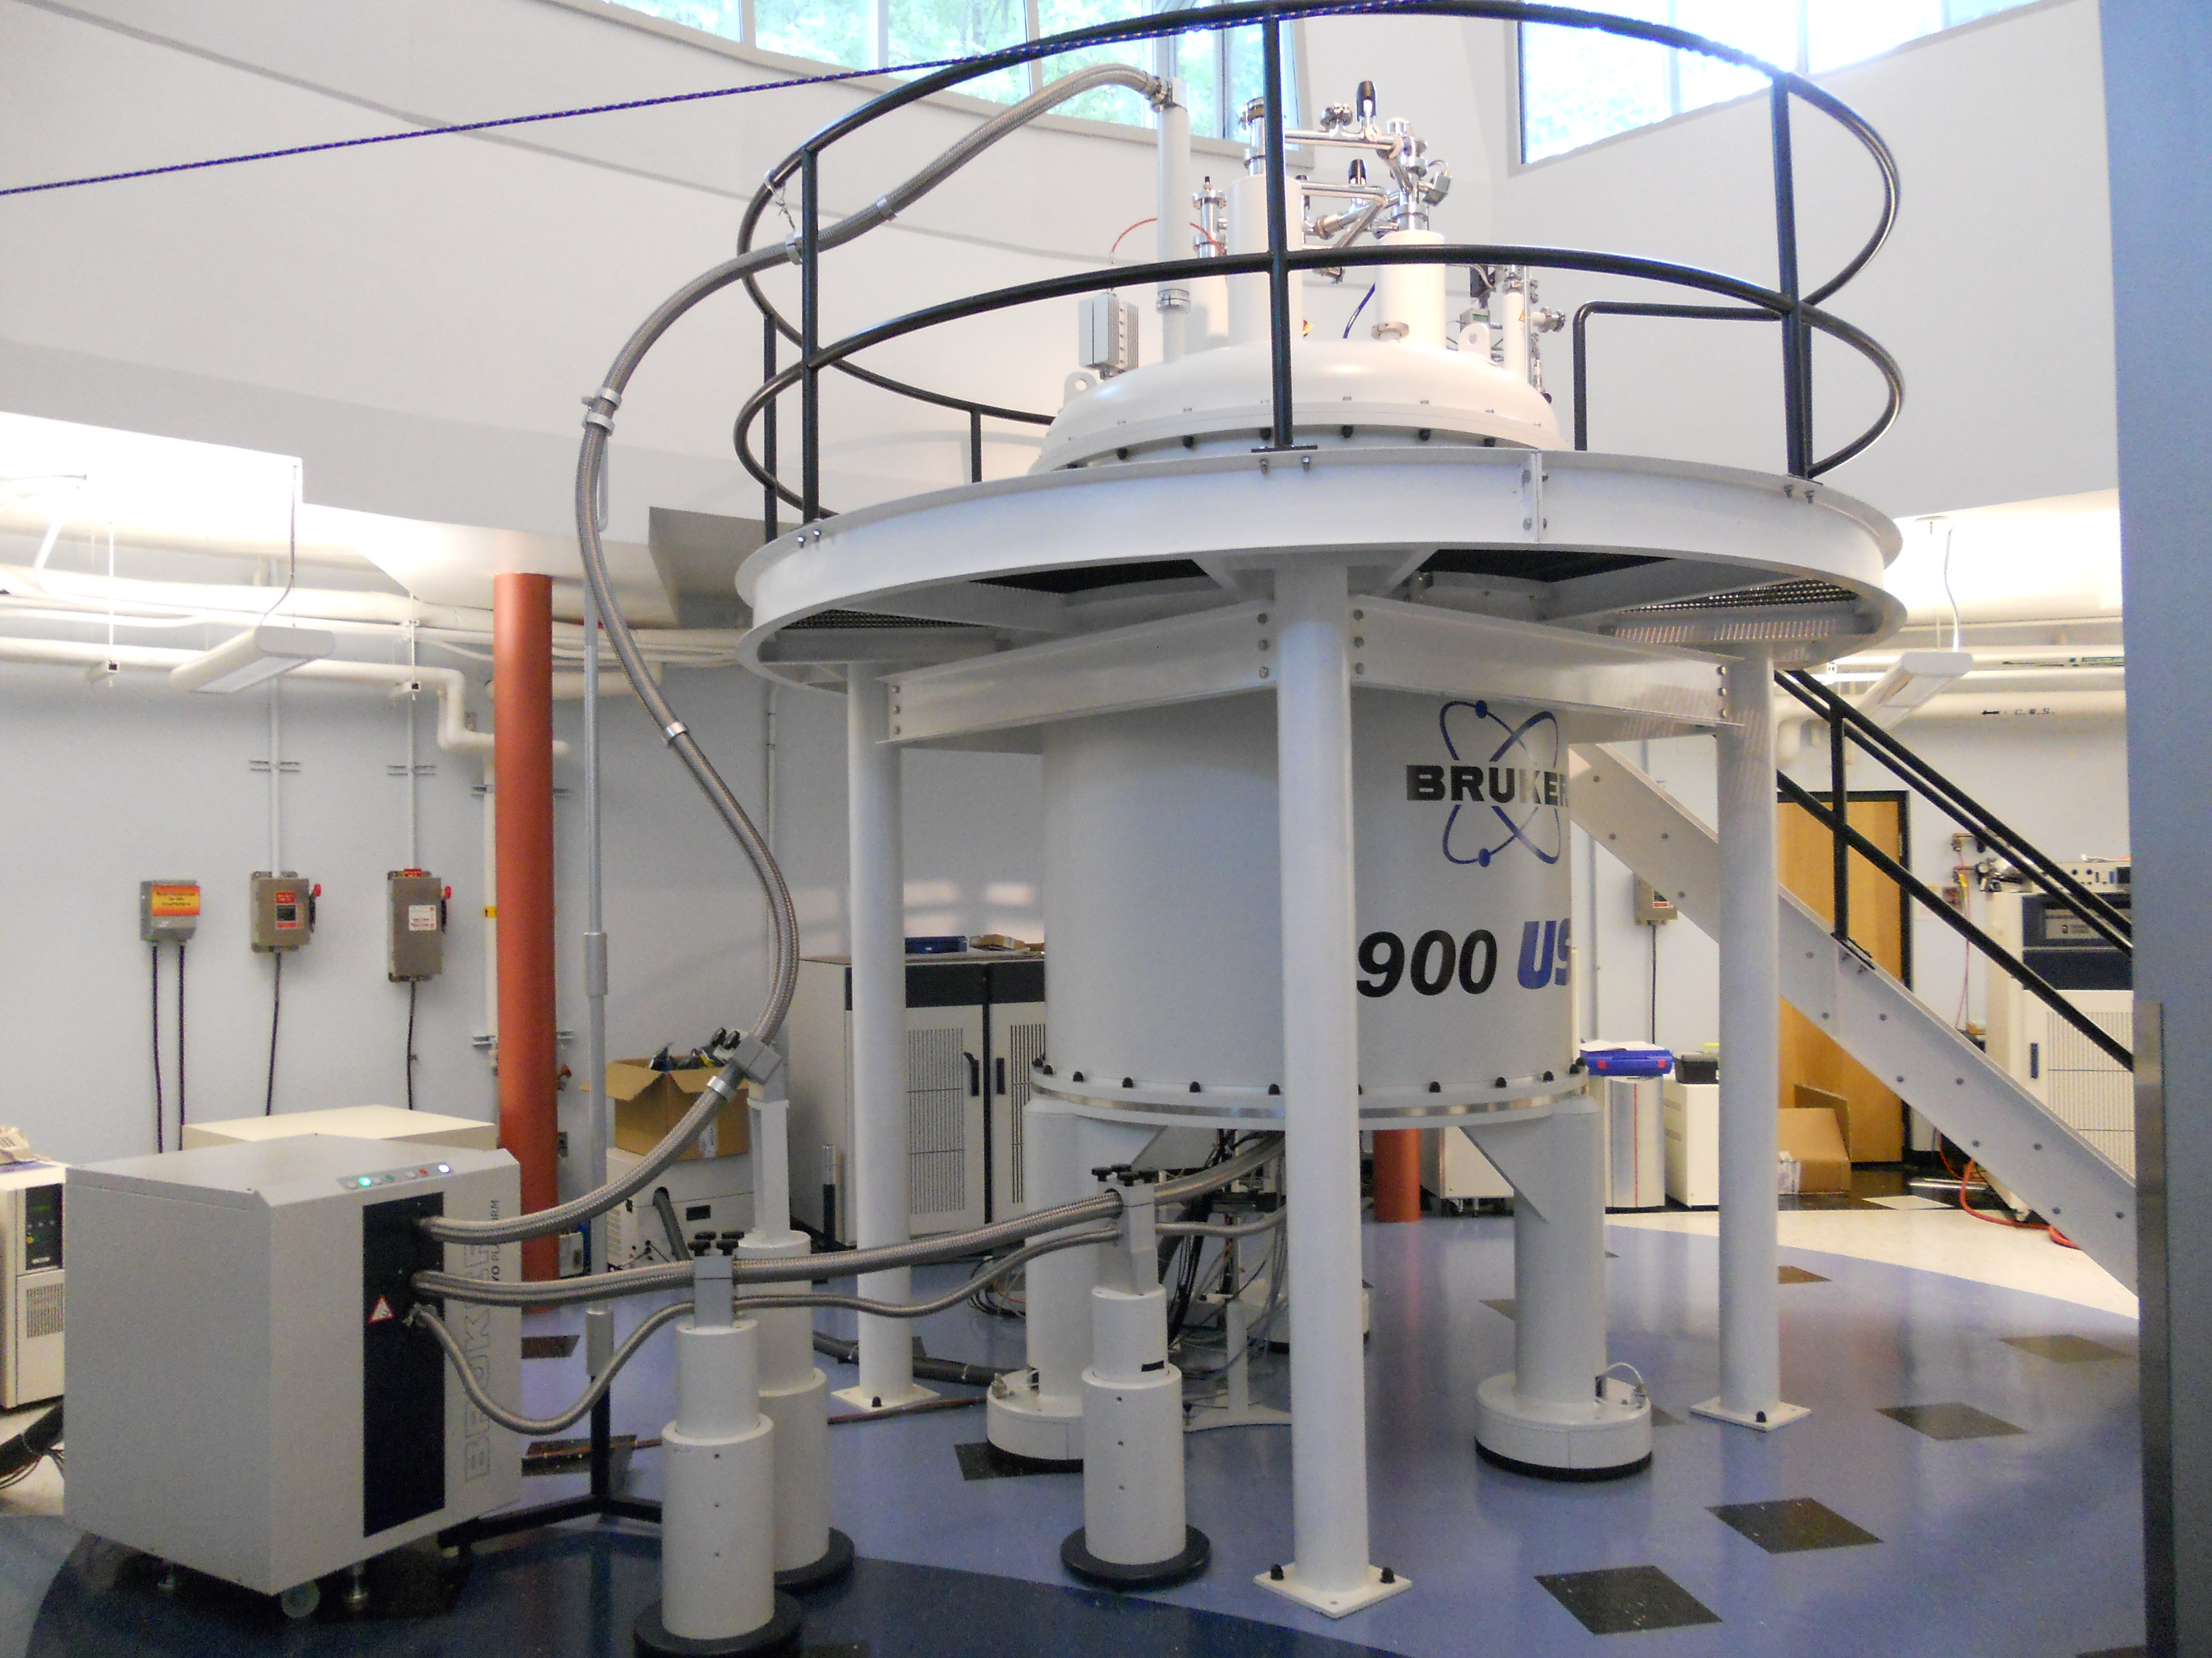
This is a nice NMR.

Slide 6
Resonance Frequency
Different nuclei resonate at greatly different ν : on a 300 MHz instrument (¹H = 300 MHz) ¹³C resonates at 75 MHz.
The same type of nucleus also absorbs at slightly different ν, depending on its chemical environment.
Exact frequency of resonance = “chemical shift”
The strength of the magnetic field actually felt by a nucleus (B_{eff}) determines its resonance frequency.
  Electron clouds shield the nucleus from the magnet
  Circulation of electrons in π orbitals can generate local magnetic fields that influence B_{eff}
Modern NMR spectrometers use a constant magnetic field strength B₀, and pulse a broad range of frequencies to bring about the resonance of all nuclei at the same time.

Slide 7
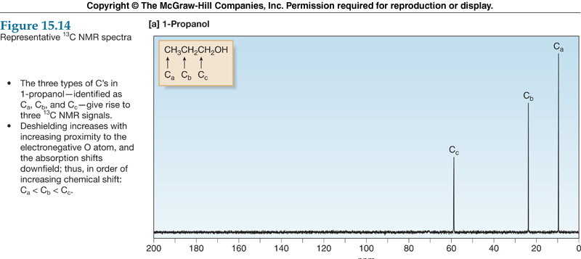
Example C-13 Spectrum

Slide 8
Chemical Shift
Peaks on NMR spectrum = “resonances “.
Chemical shift is measured in ppm
  ppm = ν in Hz relative to ref peak/instrument ν in MHz.
Reference peak = 0 ppm = (CH)₄Si = tetramethylsilane (TMS). TMS is an inert compound that gives a single peak at lower frequency than most typical NMR peaks.
Protons absorb between 0-10 ppm. C-13 nuclei absorb between 0-250 ppm.

Slide 9
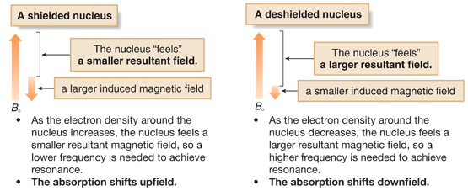
Electronic Shielding
More electron density = more shielding
Less electron density = less shielding

Slide 10
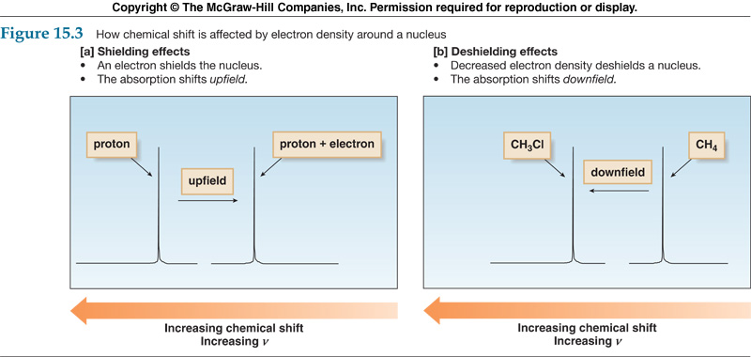
Shielding in Spectrum

Slide 11
Predicting the Number of C-13 Peaks
The most important aspect in interpreting a C-13 NMR spectrum is checking the number of resonances displayed against the number of resonances theoretically expected from the structure.
Nuclei that have the exact same chemical environment (because of symmetry in the molecule) are said to be chemically equivalent and give only one resonance.
(Rarely two or more nuclei may give a single peak even though they do not have the exact same chemical environment. In this case the nuclei are said to be coincidentally equivalent. In other words, the resonances overlap. This is more common in very large molecules and less common at high magnetic field strengths.)

Slide 12
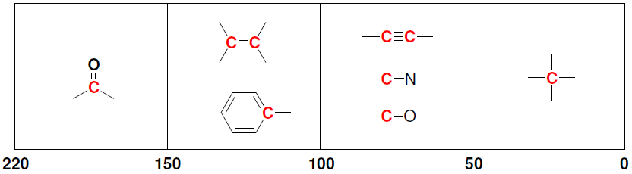
Chemical Shifts in ¹³C NMR
Practice with SkillBuilder 16.9

Slide 13
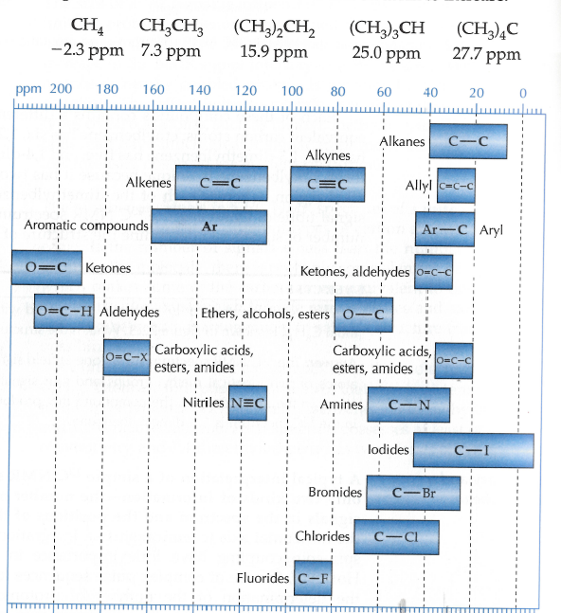

Slide 14
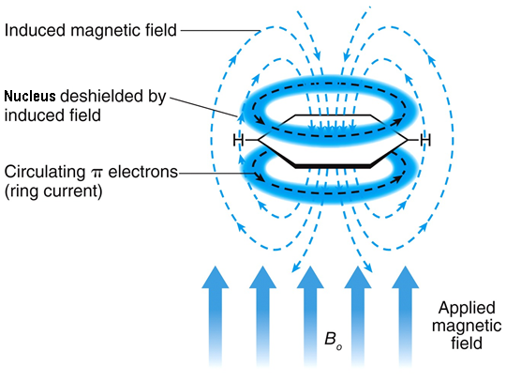
Chemical Shift
Induced Anisotropic Shielding - Benzene
In an external magnetic field (B₀), the six π electrons in an aromatic ring circulate around the ring creating a ring current, which induces a magnetic field, which points in the same direction as B₀ in the vicinity of the carbons and hydrogens. Thus, the nuclei are deshielded and resonate at relatively high frequencies.
Typical C-13 NMR shift is 130-160 ppm

Slide 15
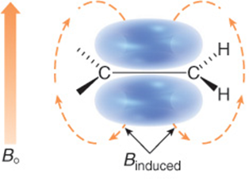
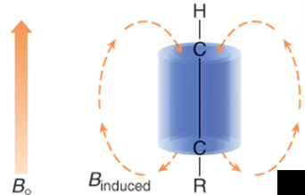
Chemical Shift
Induced Anisotropic Shielding – Alkenes and Alkynes
Double-bond carbons are also deshielded by the anisotropic effect of an induced ring current. Typical C-13 NMR shift is 110-140 ppm.
Triple-bond carbons are actually shielded by the anisotropic effect of an induced ring current, which circulates around the perimeter of the C-C triple bond. Typical C-13 NMR shift is 70-100 ppm.

Slide 16
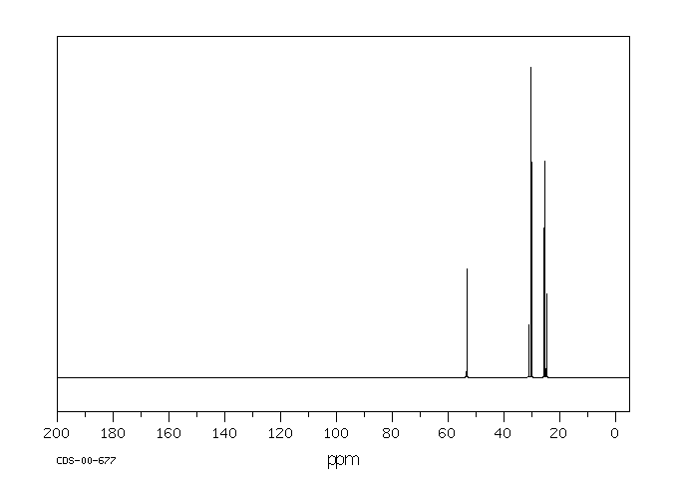
Peak Intensities in C-13 NMR
Because of the way a typical C-13 NMR data acquisition is set up the peak intensities (e.g. peak heights) observed depend on factors including:
  The number of equivalent carbons that are resonating.
    More carbons → stronger peak.
      Example, t-Bu CH₃ peaks are very strong
  The number of hydrogens attached.
    More H attached –> stronger peak
      CH₃ > CH₂ > CH > C
Because of this, peak intensities are generally not paid much attention to.
Example 1 2,2,4-trimethylpentane

Slide 17
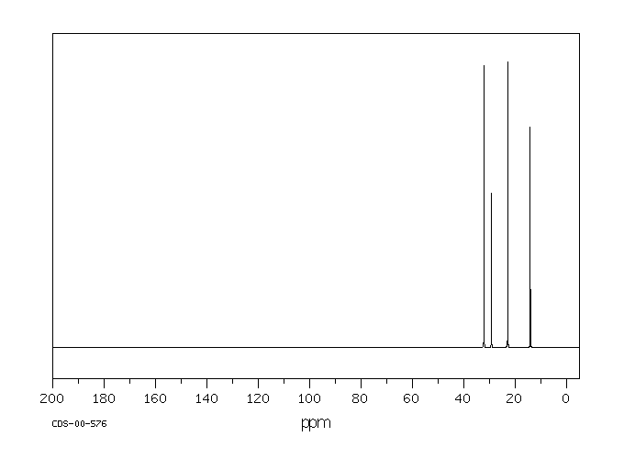
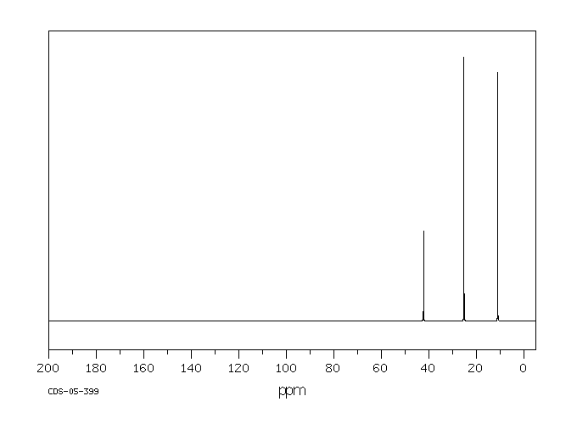
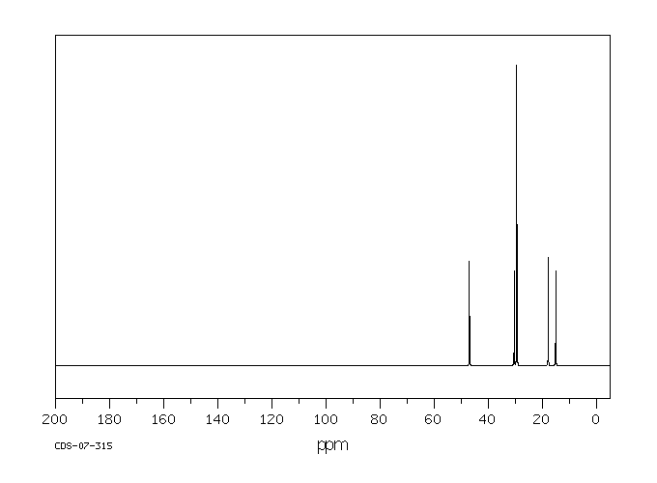
Peak Intensities in C-13 NMR
heptane
3–ethylpentane
2,2-dimethylpentaneane

Slide 18
16.13 DEPT ¹³C NMR Spectra
¹³C spectra generally give singlets that do not provide information about the number of hydrogen atoms attached to each carbon
Distortionless Enhancement by Polarization Transfer (DEPT) ¹³C NMR provides information the number of hydrogen atoms attached to each carbon
Full decoupled ¹³C spectrum: shows all carbon peaks
DEPT-90: Only CH signals appear
DEPT-135: CH₃ and CH give (+) signals, and CH₂ give (-) signals

Slide 19
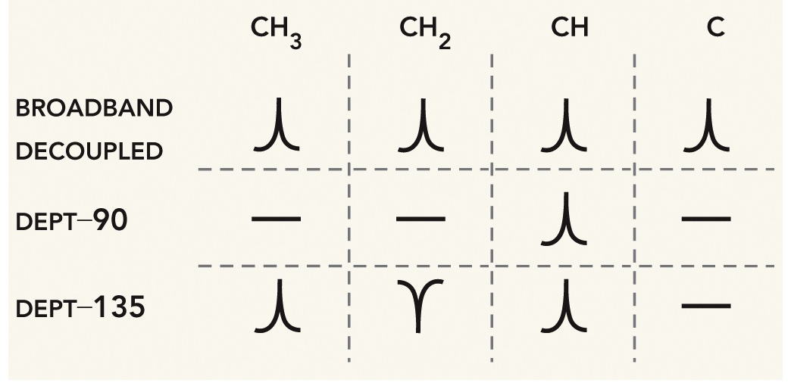
16.13 DEPT ¹³C NMR Spectra
Full decoupled ¹³C spectrum: shows all carbon peaks
DEPT-90: Only CH signals appear
DEPT-135: CH₃ and CH = (+) signals, CH₂ = (-) signals
Practice with SkillBuilder 16.10

Slide 20
16.13 DEPT ¹³C NMR Spectra
Explain how DEPT ¹³C spectra could be used to distinguish between the two molecules below

