Slide 1
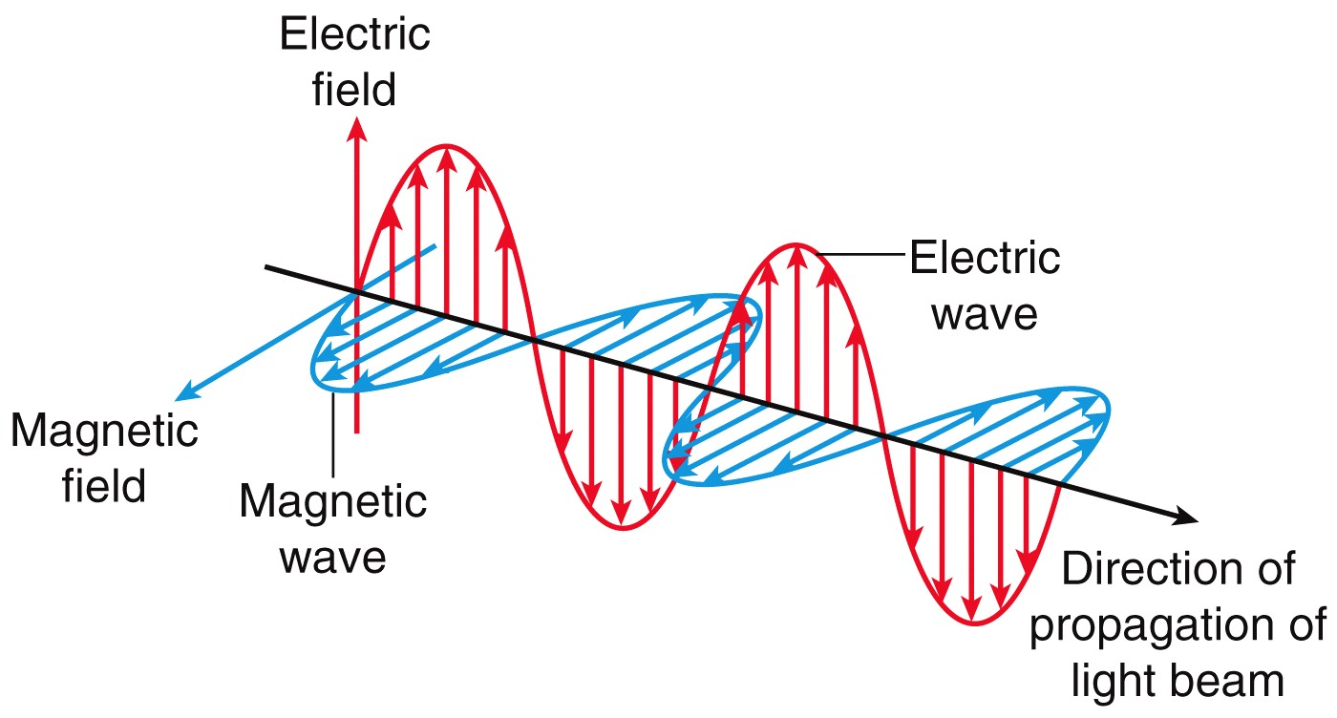
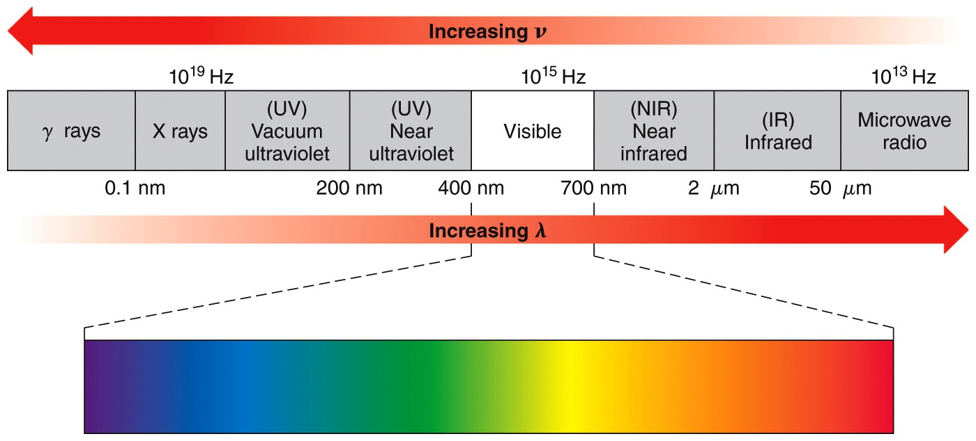
λν = c
E = hν
Figure 15.2

Slide 2
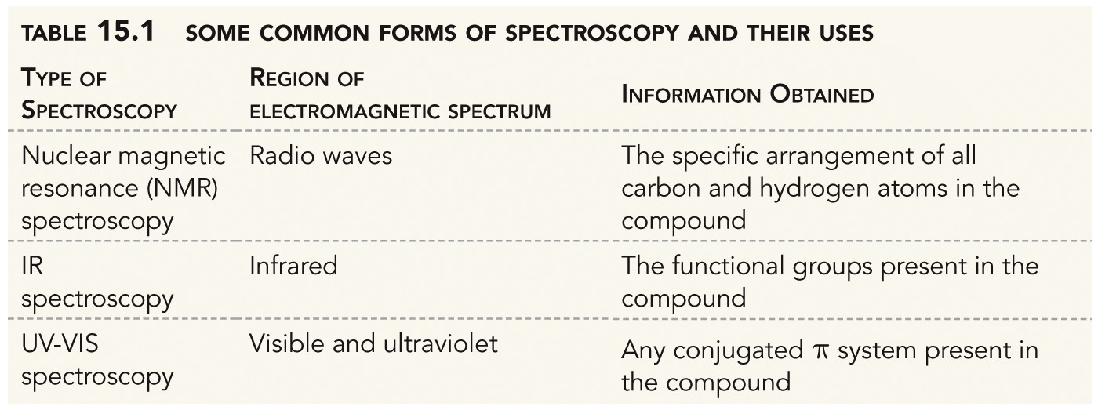
Spectroscopy is a measurement of the frequencies of electromagnetic radiation that are absorbed by a molecule.
For absorption to occur, the energy of the radiation must match the difference between two energy states in the molecule.
Table 15.1

Slide 3
Infrared Spectroscopy
Frequencies are reported in wavenumbers (cm^{–1})
~
ν = 1/λ
IR absorptions occur from 4000 cm^{–1} – 400 cm^{–1}.
IR absorption causes vibrational excitation.
IR peaks correspond to specific bond vibrations
Only bond vibrations that change the overall dipole moment of the molecule can be excited by IR radiation.
Organic chemists prefer to view IR spectra as a plot of the percent of transmitted light versus wavenumber.

Slide 4
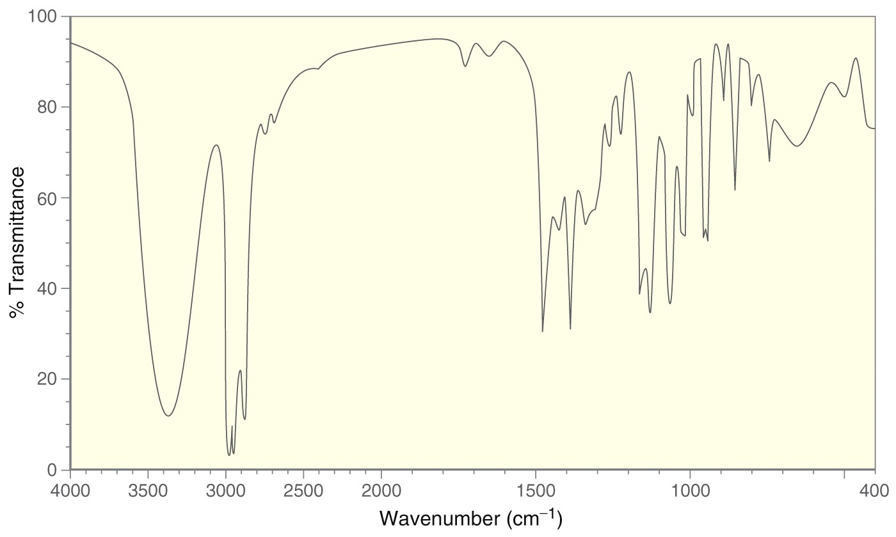
Figure 15.5

Slide 5
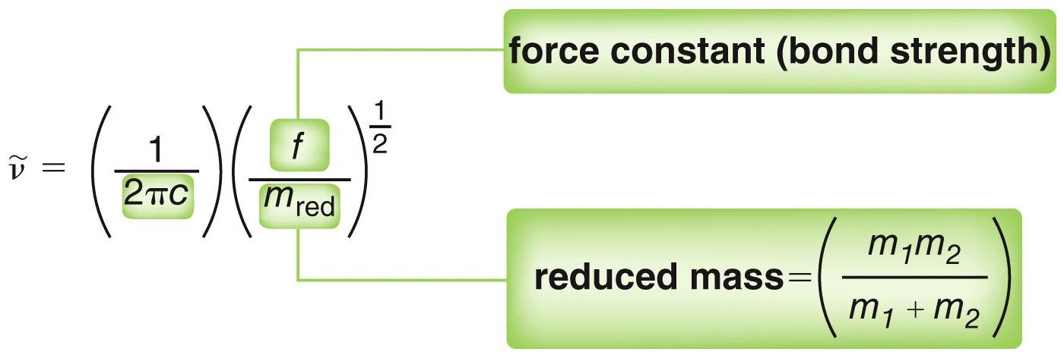
Frequency of Stretching Vibrations
The frequency of a bond stretching vibrations depends on the bond strength and the masses of the bonded atoms.
Stronger bonds vibrate at a higher frequency.
Bonds with lighter atoms vibrate at higher frequency.

Slide 6
Figure 15.6

Slide 7
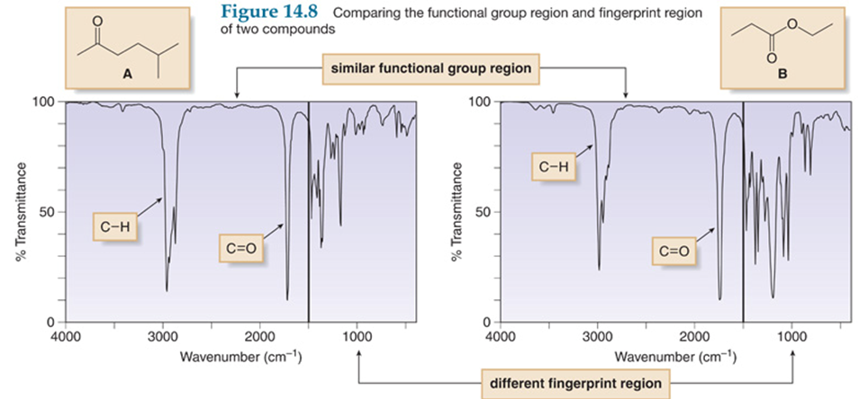
Fingerprint Region

Slide 8
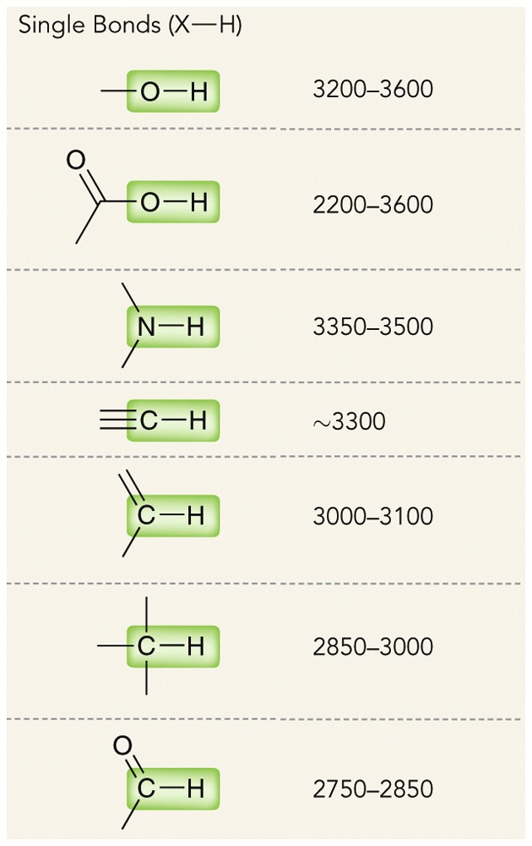
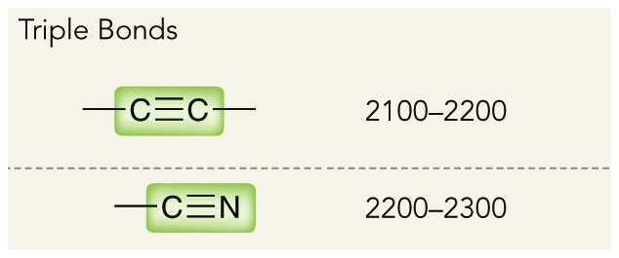
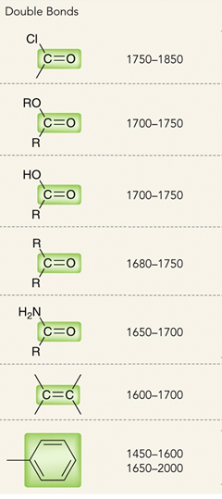
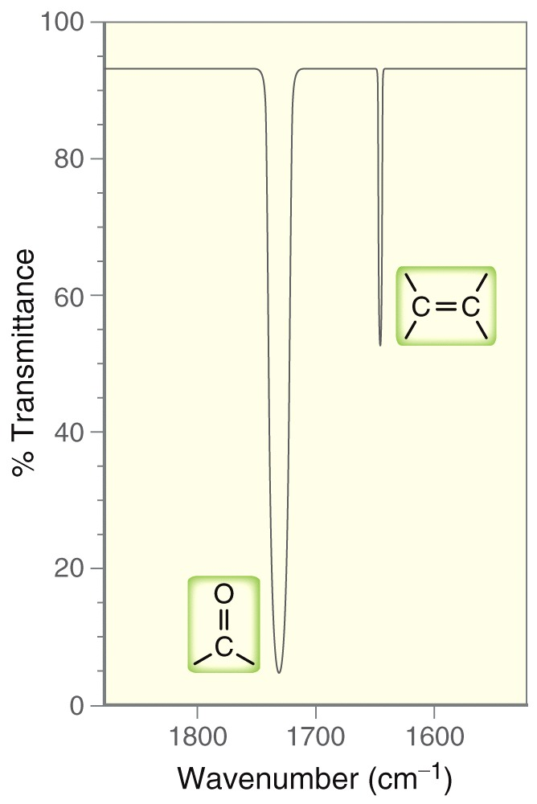
Table 15.2

Slide 9
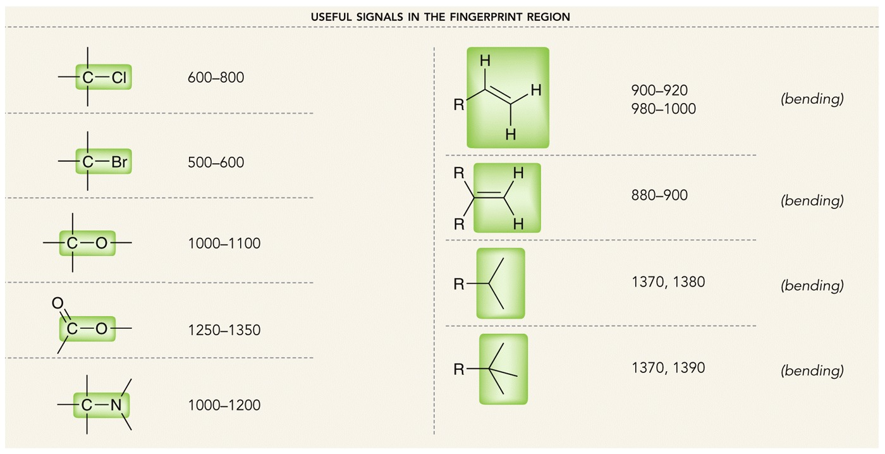
Table 15.2

Slide 10
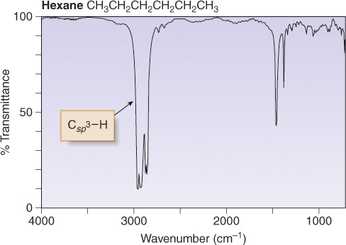
Alkanes
Hexane has only C-C single bonds and sp³ hybridized C atoms. Therefore it has only one major absorption at 3000-2850 cm⁻¹.

Slide 11
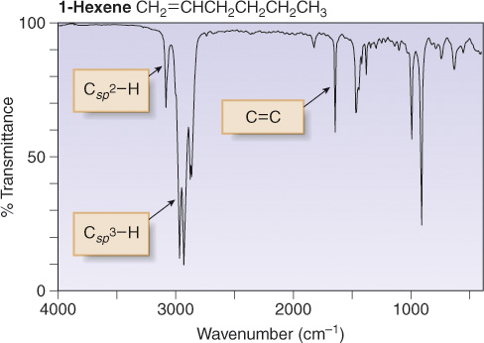
Alkenes
1-Hexene has a C=C and C_{sp}²-H, in addition to sp³ hybridized C atoms. Therefore, there are three major absorptions: C_{sp}²-H at 3150-3000 cm⁻¹; C_{sp}³-H at 3000-2850 cm⁻¹; C=C at 1650 cm⁻¹.

Slide 12
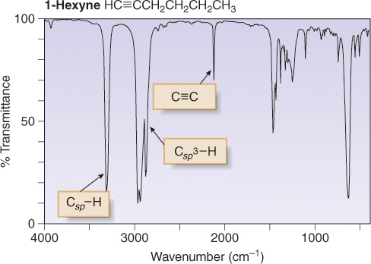
Alkynes
1-Hexyne has a C≡C and C_{sp}-H, in addition to sp³ hybridized C atoms. Therefore, there are three major absorptions: C_{sp}-H at 3300 cm⁻¹; C_{sp}³-H at 3000-2850 cm⁻¹; C≡C at 2250 cm⁻¹.

Slide 13
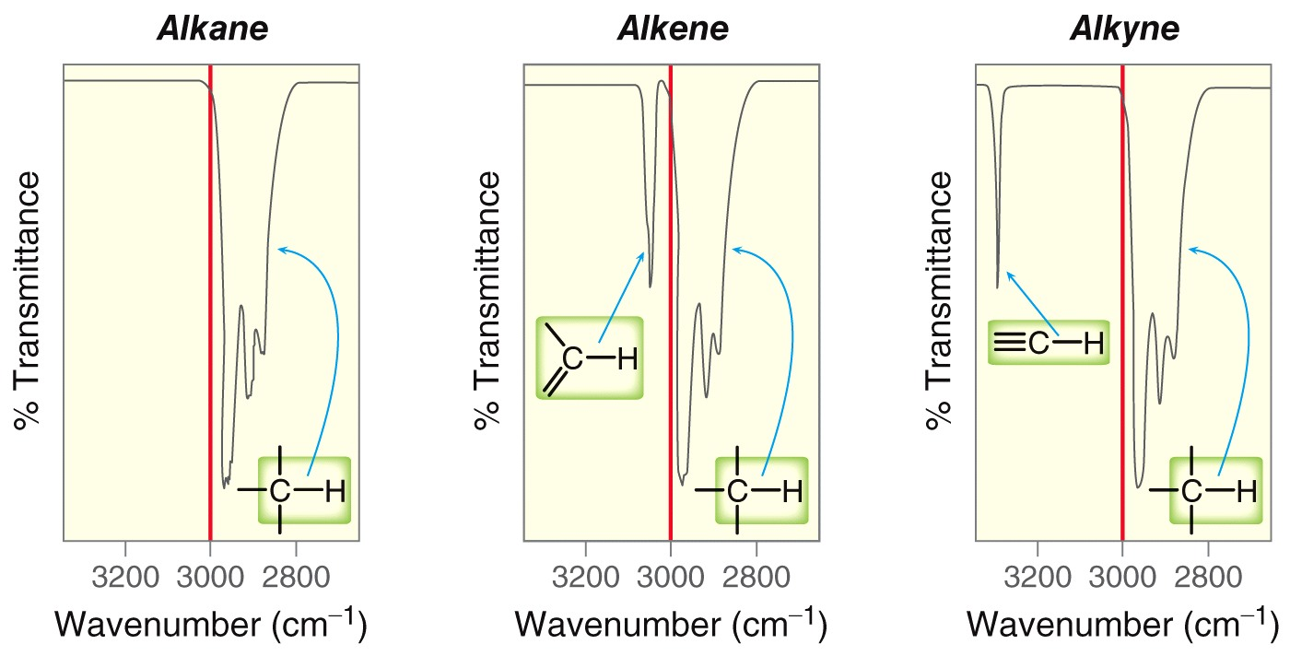
Unnumbered 15 p691

Slide 14
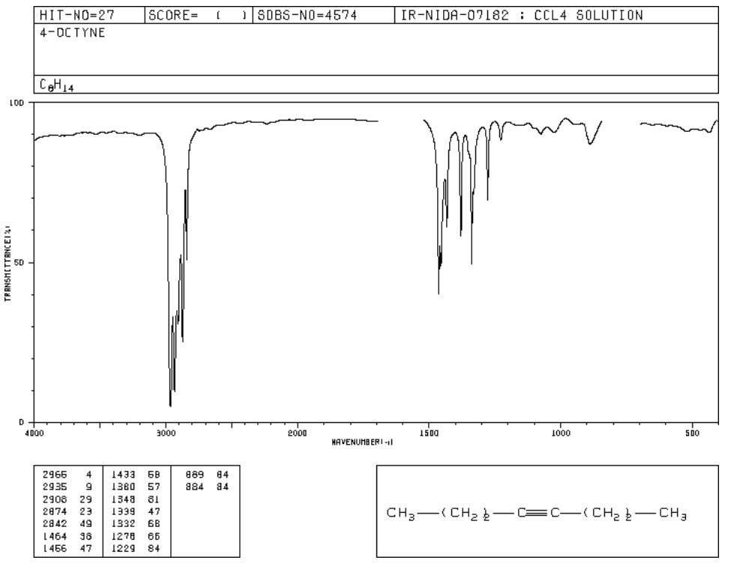
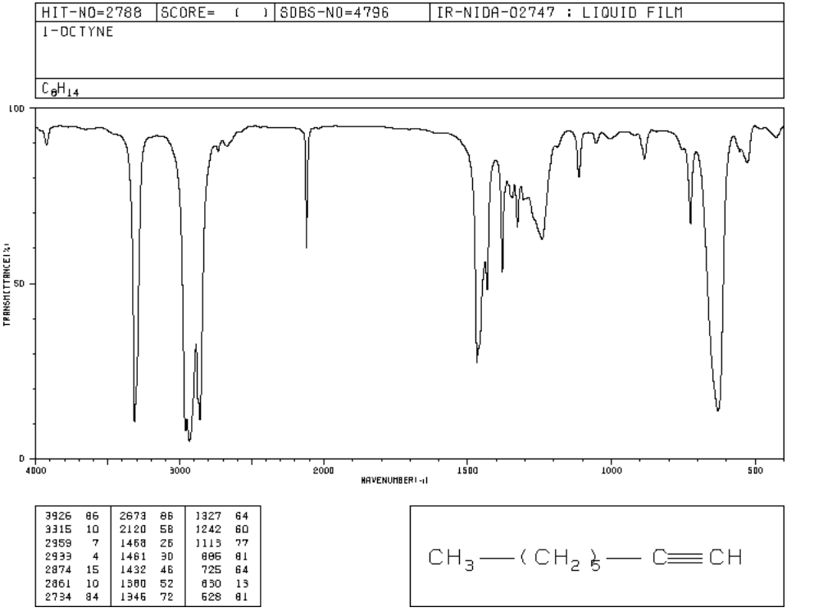
Remember that IR shows the types of bonds that are present and not the functional group family per se.
Figure 15.10

Slide 15
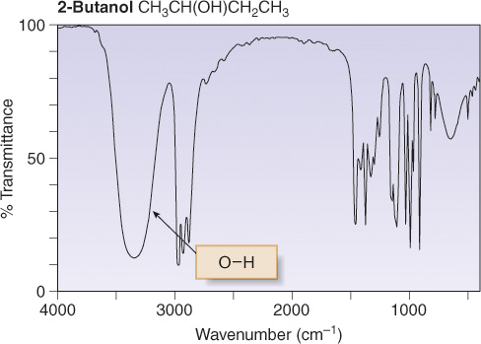
Alcohols
The OH group of the alcohol shows a strong absorption at 3600-3200 cm⁻¹.

Slide 16
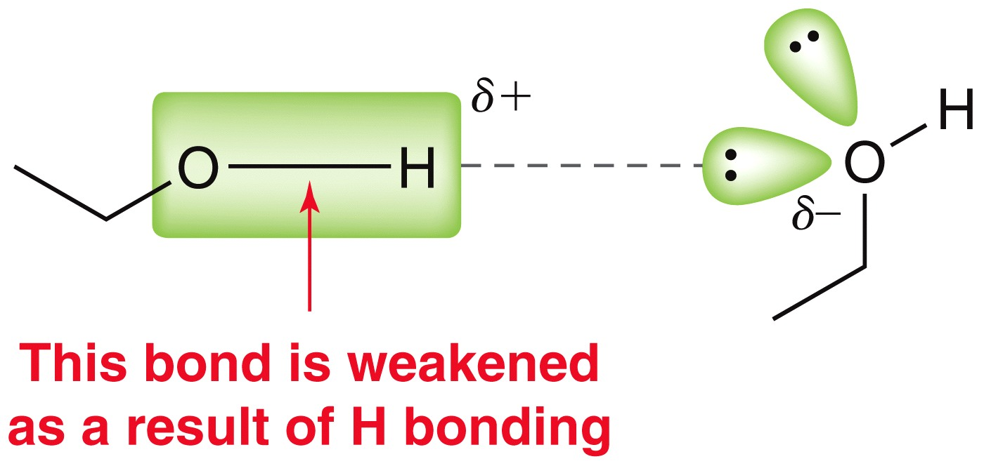
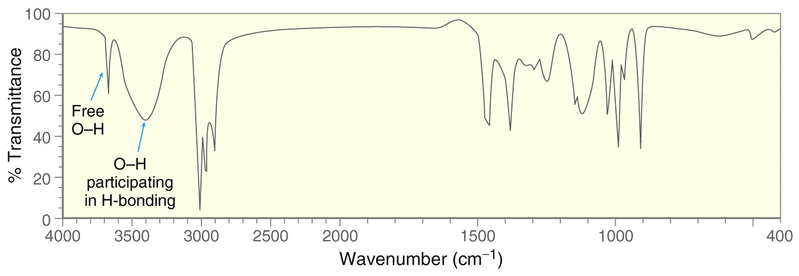
Unnumbered 15 p696

Slide 17
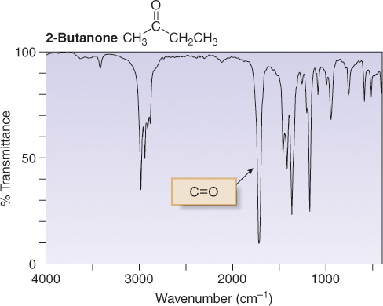
Carbonyl Compounds
The C=O group in the ketone shows a strong absorption at ~1700 cm⁻¹.

Slide 18
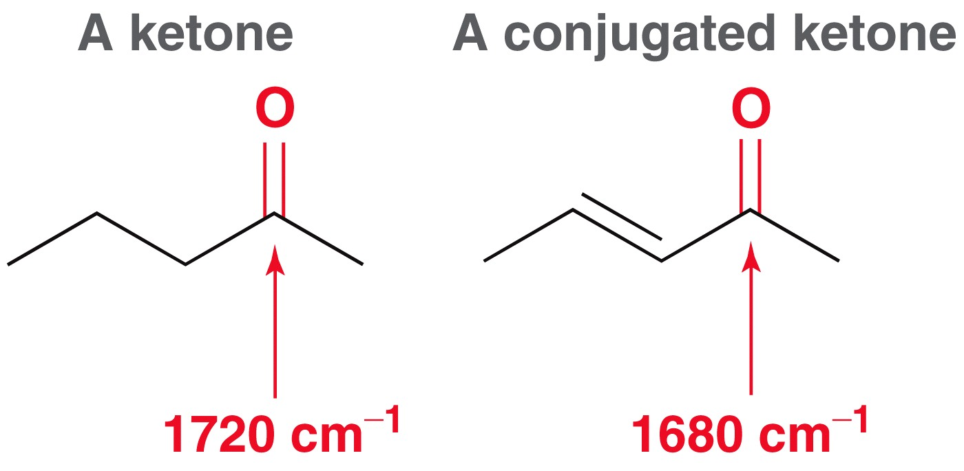
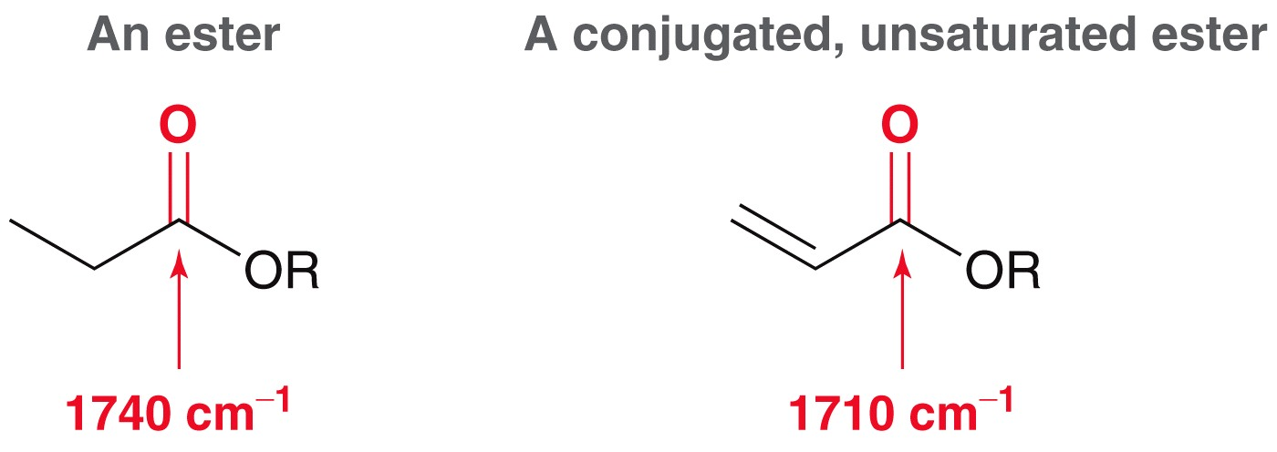
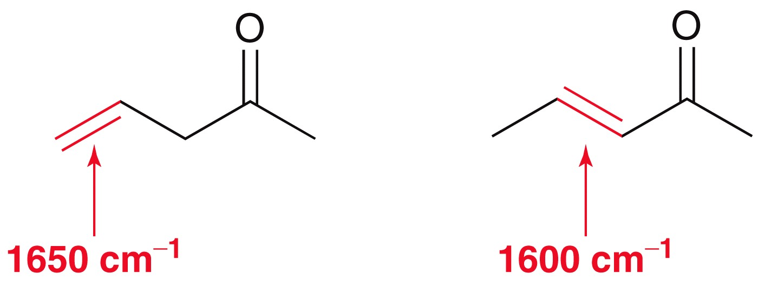
Resonance Effects
Unnumbered 15 p691

Slide 19
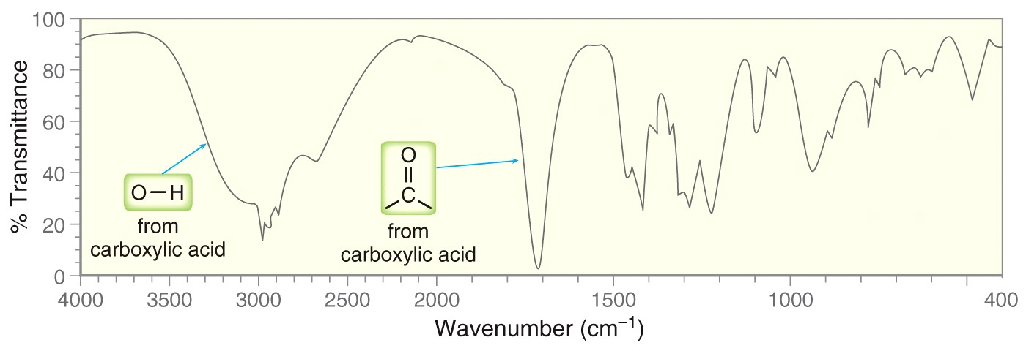
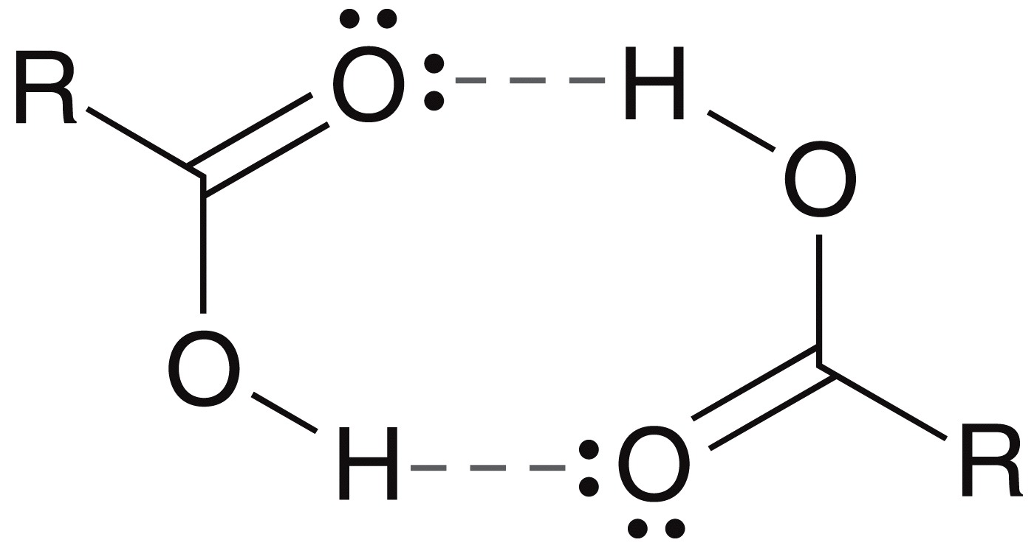
Figure 15.18

Slide 20
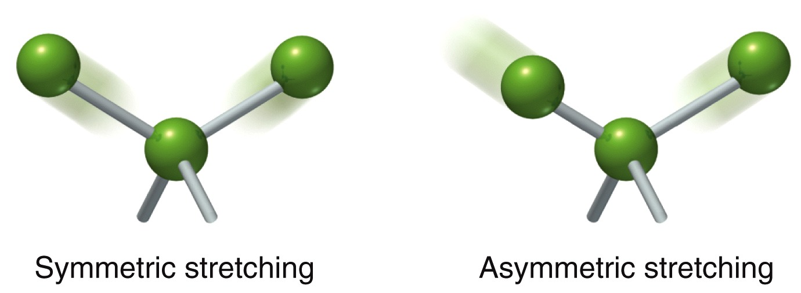
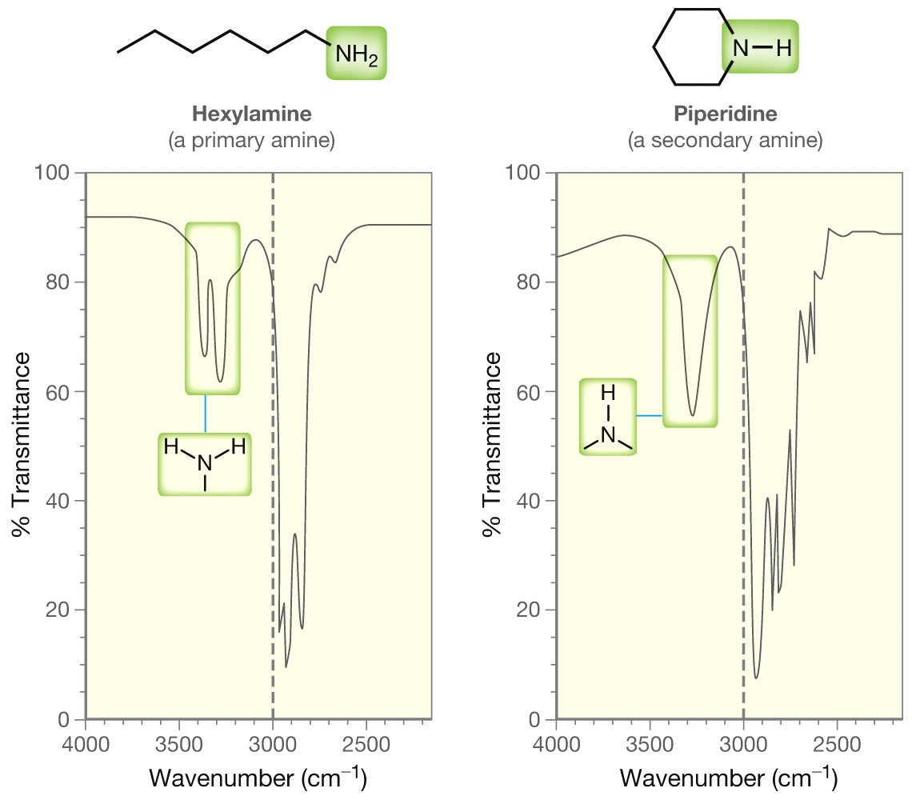
Figure 15.19

Slide 21
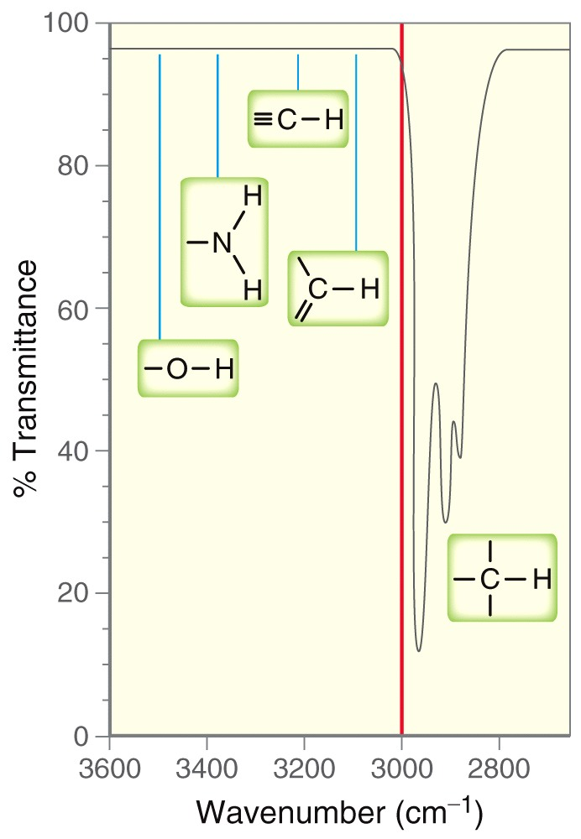
Figure 15.20

