Slide 1
Solving an NMR unknown
With a given formula and NMR spectra, you can determine a molecule’s structure by a 4-step process
Calculate the degree of unsaturation or hydrogen deficiency index (HDI).
Consider the number of C- 13 NMR signals to look for symmetry in the molecule
Analyze the proton NMR shifts, integrations and multiplicities draw out the molecular fragments that match.
Assemble the fragments into a complete structure like puzzle pieces.

Slide 2
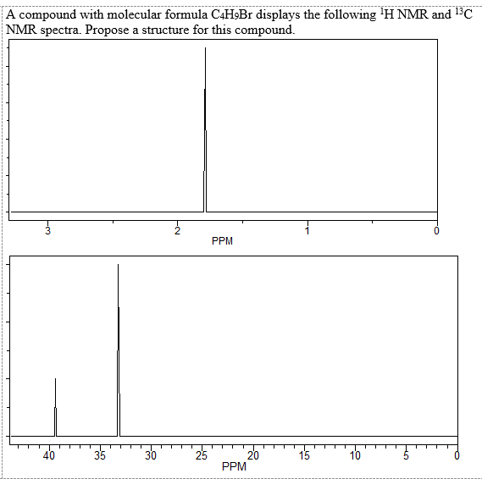

Slide 3
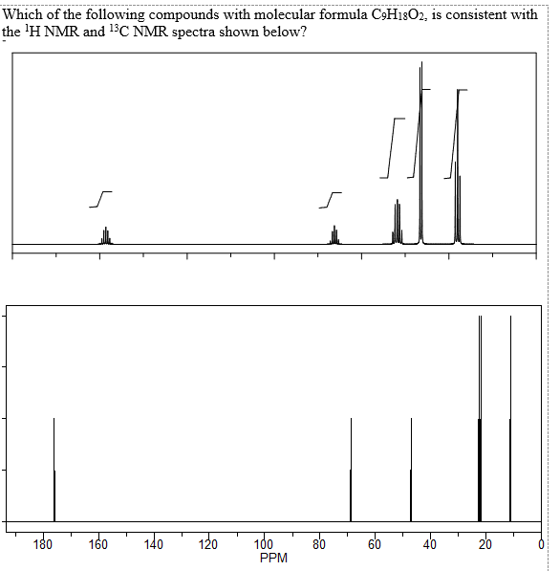

Slide 4
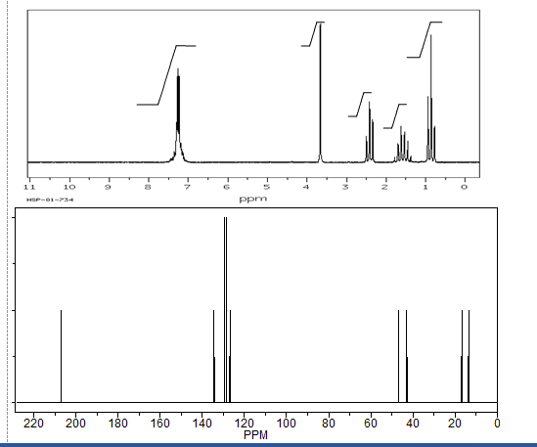
C₁₁H₁₄O

Slide 5
