Slide 1
X = Cl -5
X = Br +10
X = Cl -8
X = Br +7
This slide explains why radical bromination is much more selective than radical chlorination. For bromination, the H abstraction step is endothermic with a late (product–like) TS so the stability of the product radical strongly affects the rate. For chlorination, the H abstraction step is exothermic so the TS bears little resemblance to the radical products and their stabilities have little effect on the rate.

Slide 2
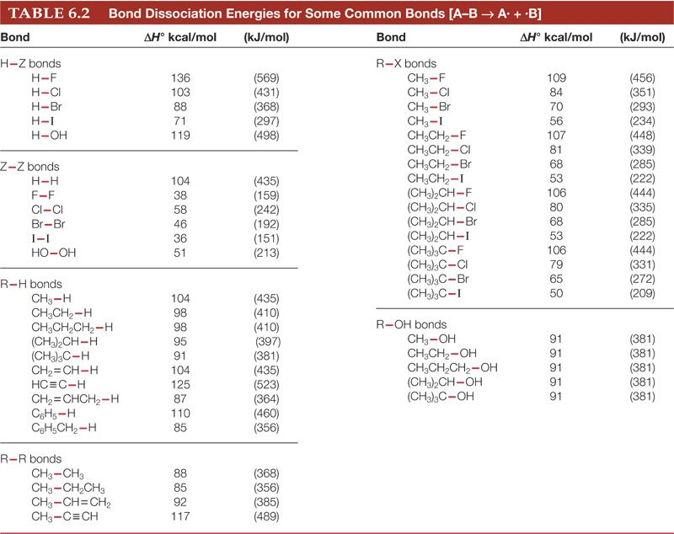
This slide explains why the peroxide effect on HX addition only is observed for HBr additions and not for HCl or HI.
C=C pi bond = 60
X = Cl -21 +8
X = Br -8 -7
X = I +7 -14
Step 2 is uphill the radical chain fails
Both steps are exothermic
Step 2 is uphill the radical chain fails

