Slide 1
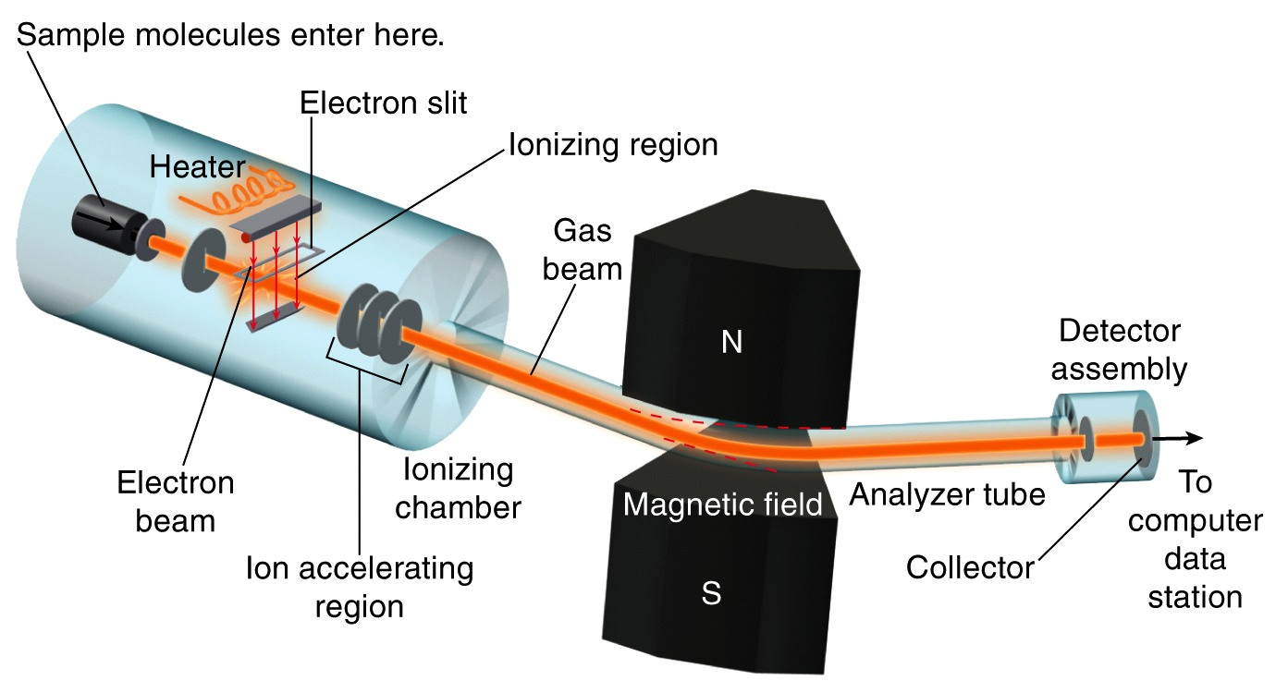
Electron Ionization - Mass Spectrometry
Figure 15.21

Slide 2
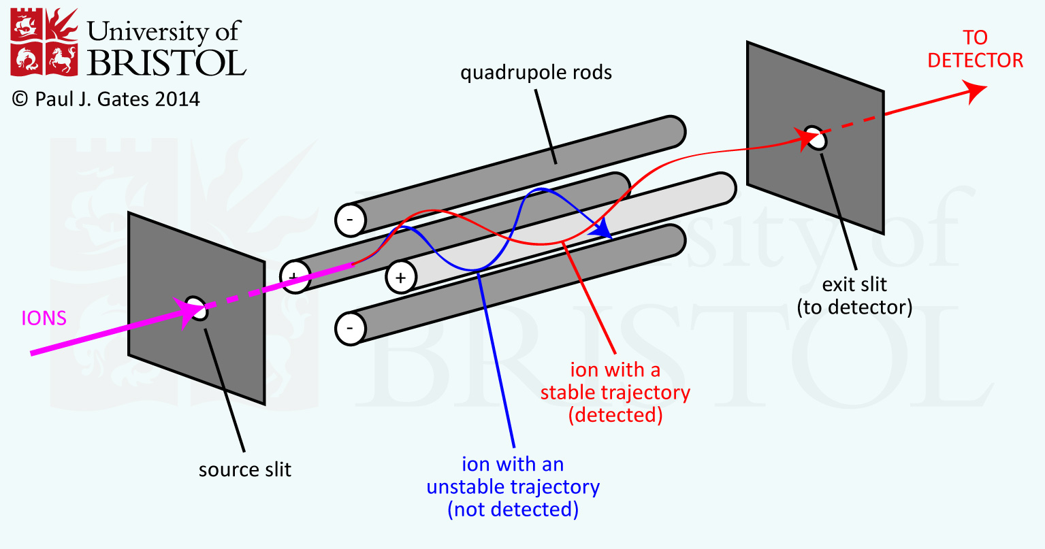

Slide 3
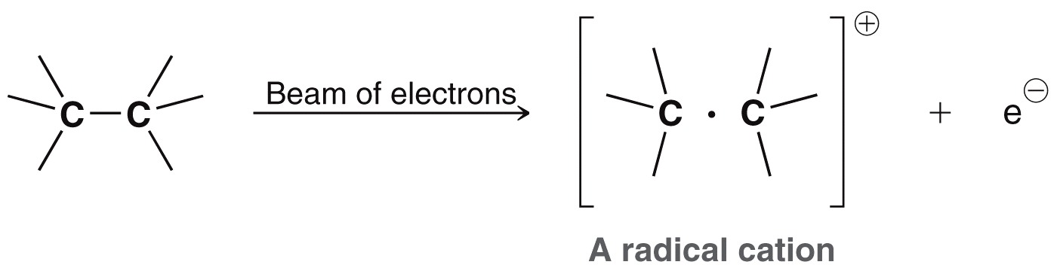
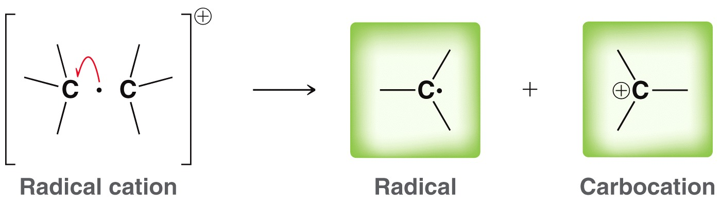
Unnumbered 15 p707

Slide 4
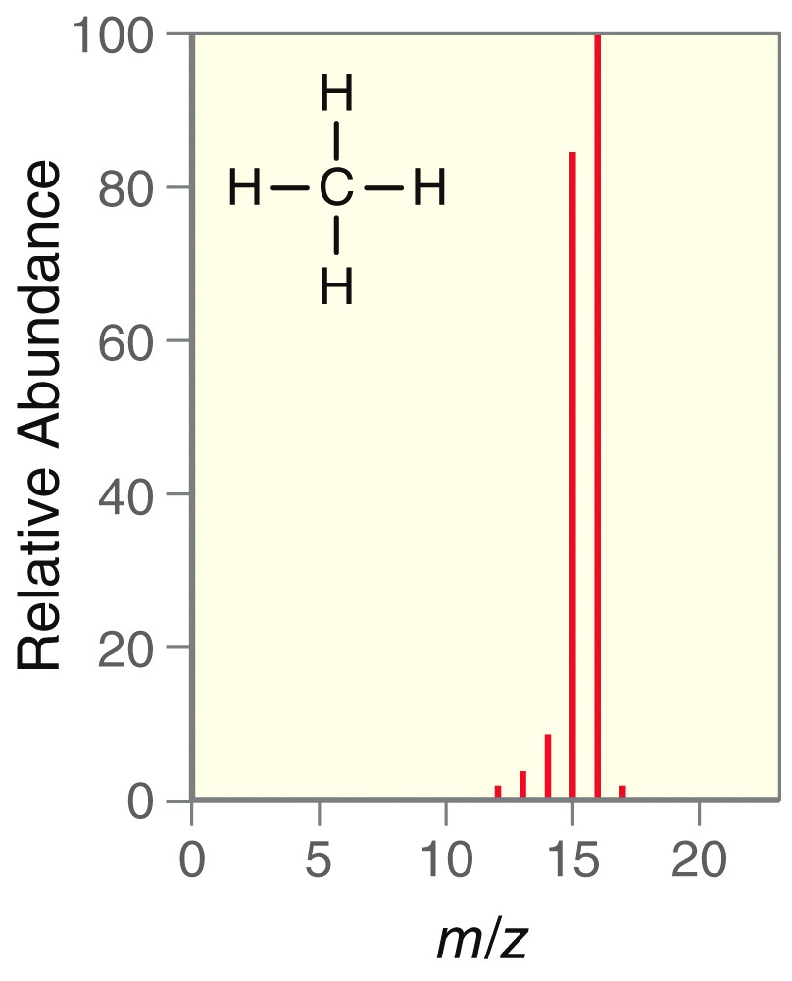
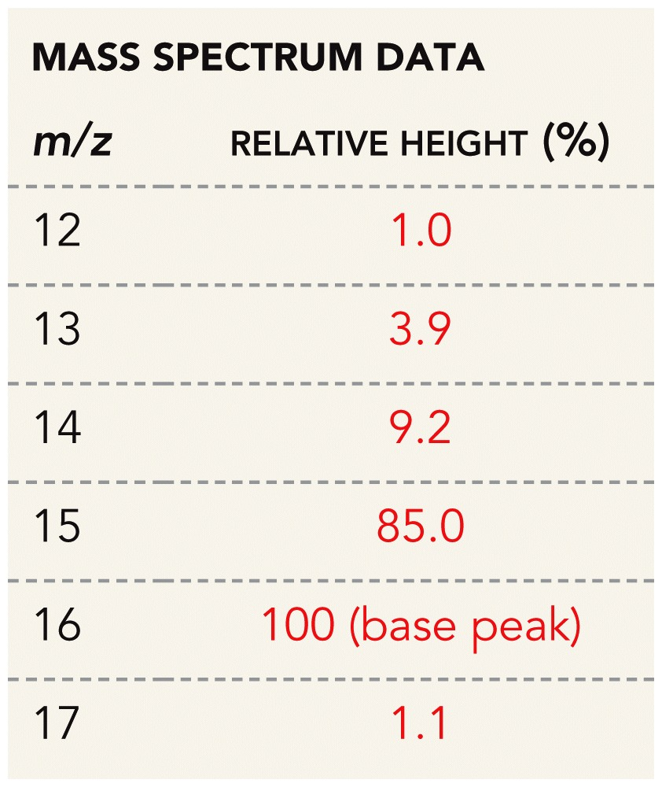
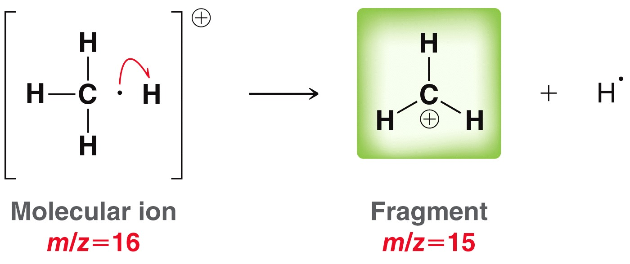
Figure 15.22a

Slide 5
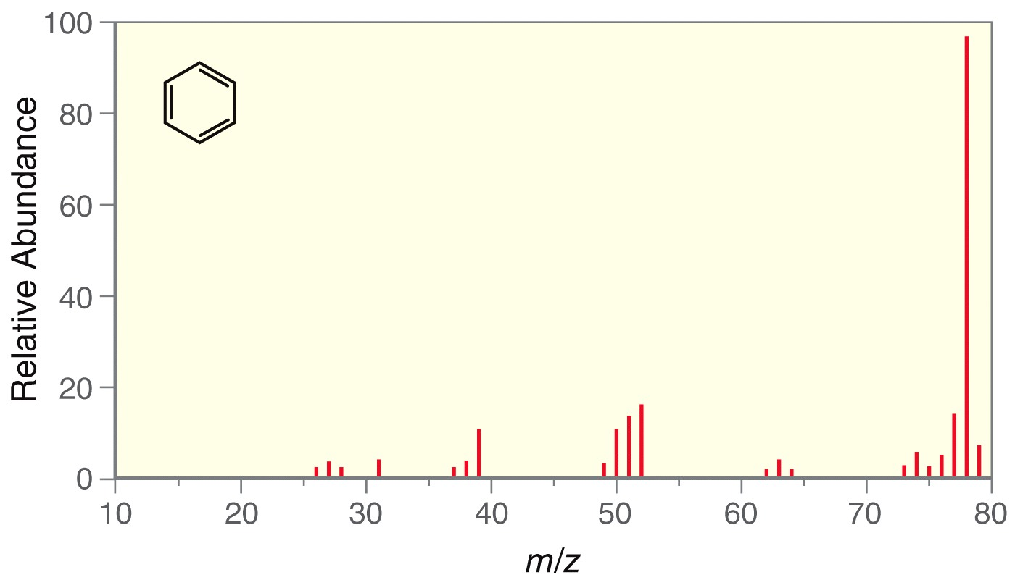
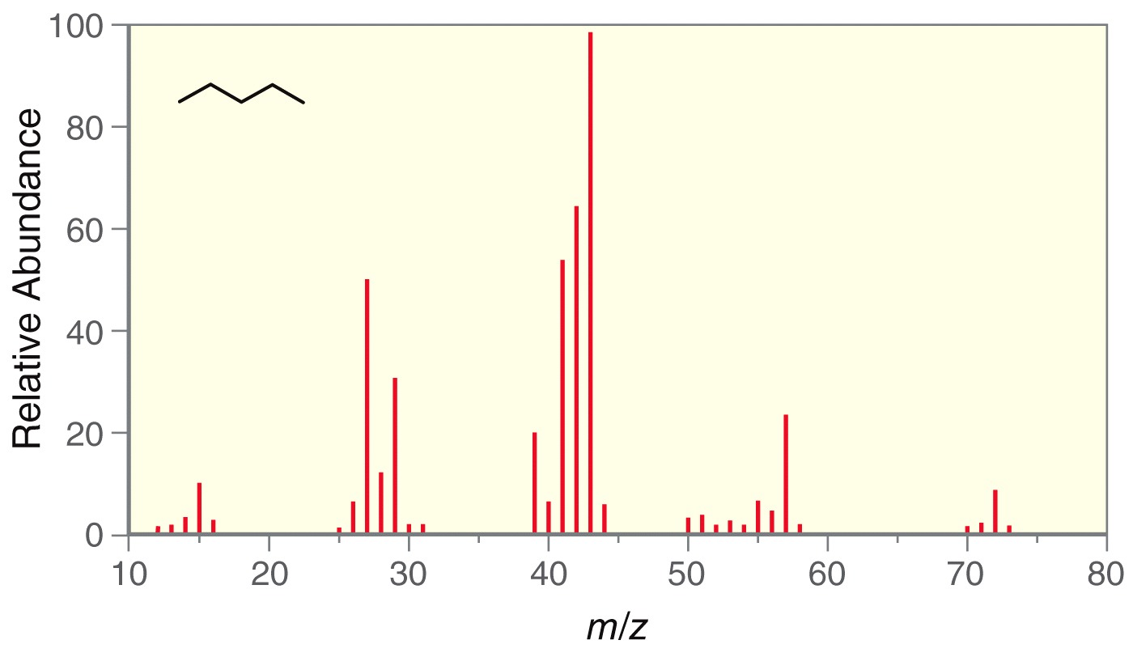
Figure 15.23

Slide 6
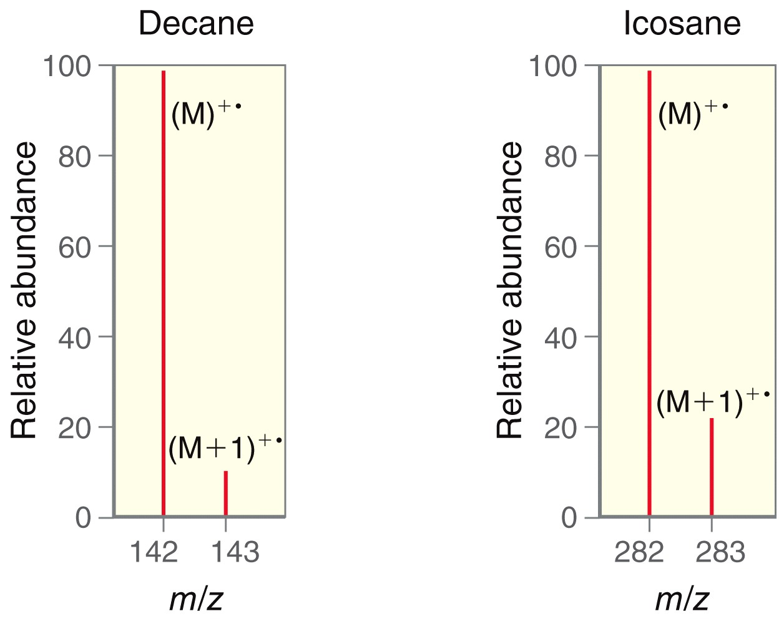
Figure 15.25

Slide 7
Unnumbered 15 p709

Slide 8
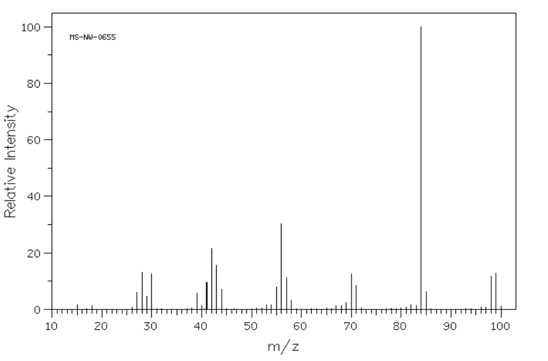

Slide 9
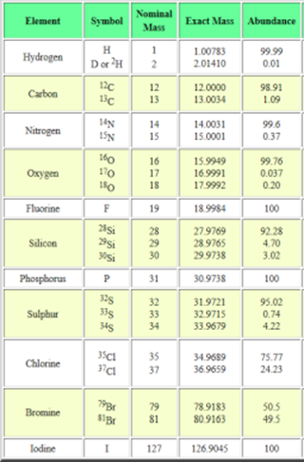
https://www2.chemistry.msu.edu/faculty/reusch/OrgPage/mass.htm

Slide 10
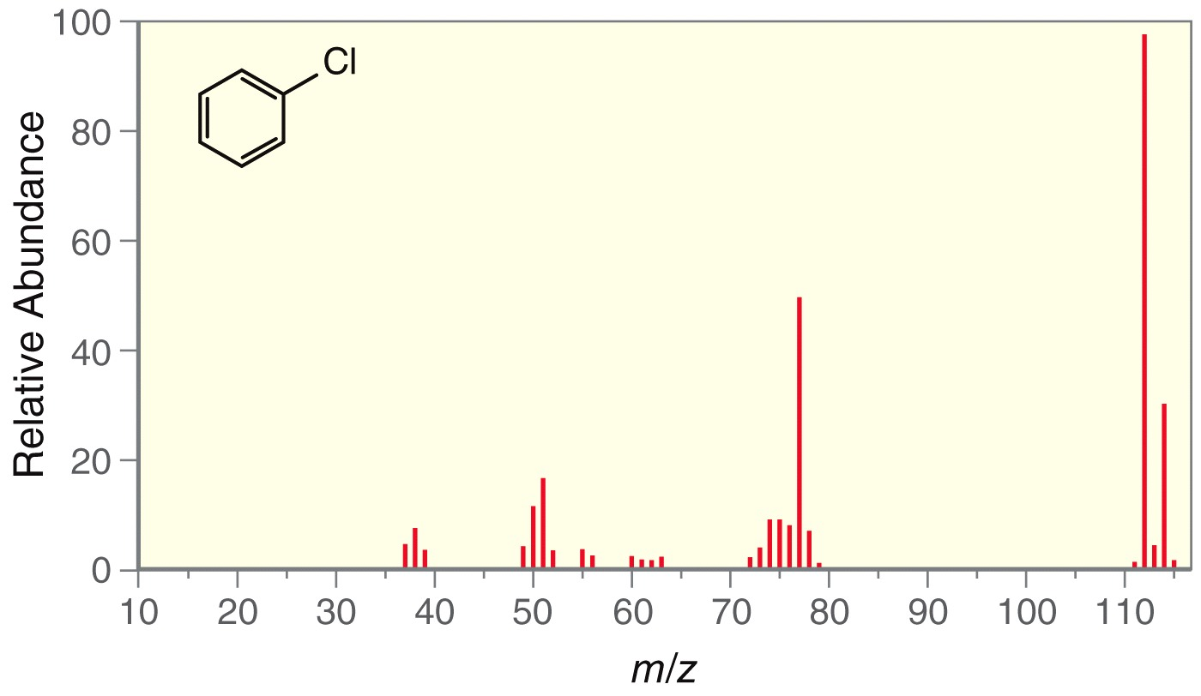
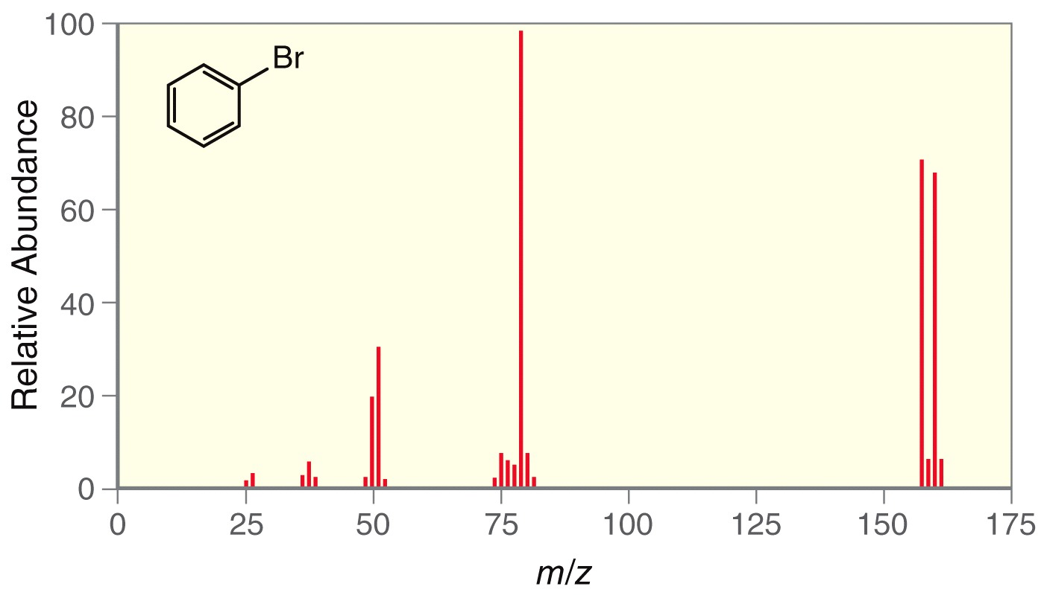
Figure 15.26

Slide 11
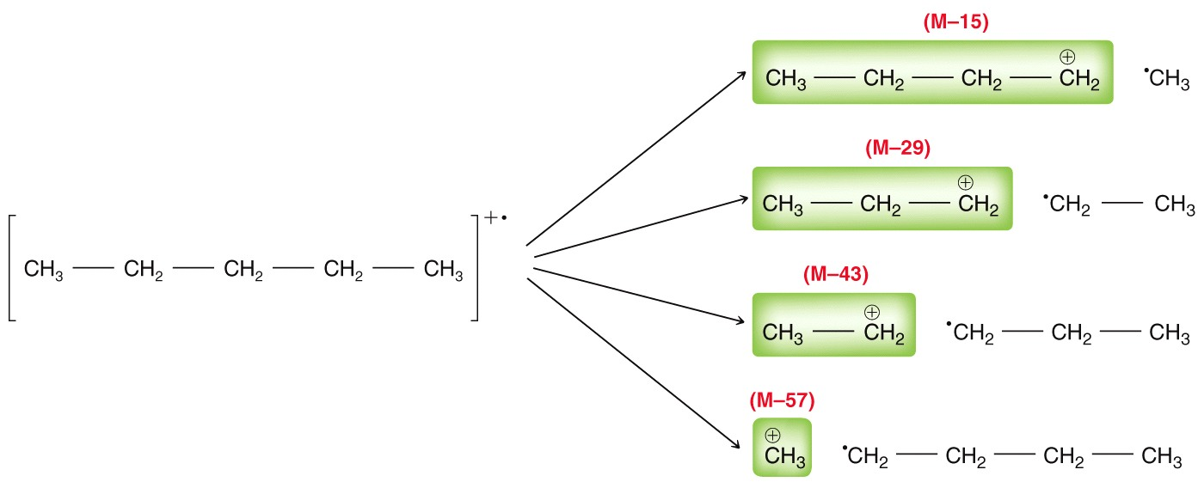
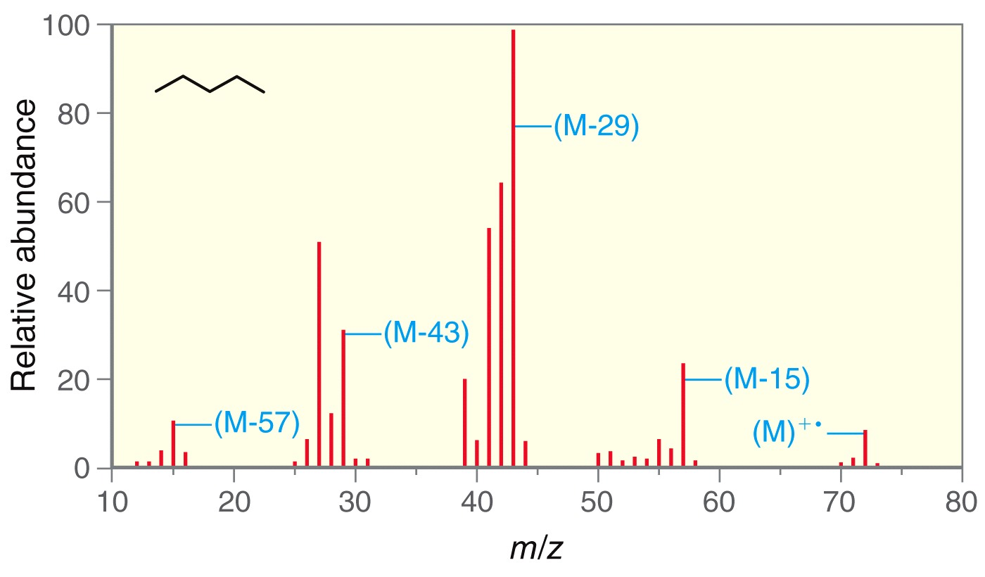
Figure 15.28

Slide 12
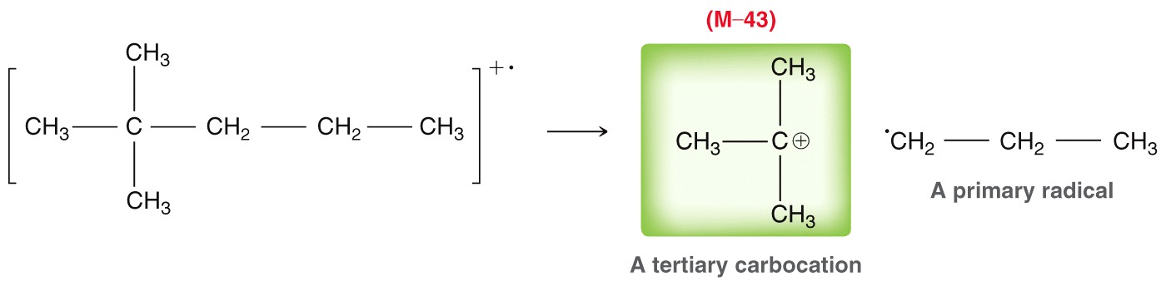
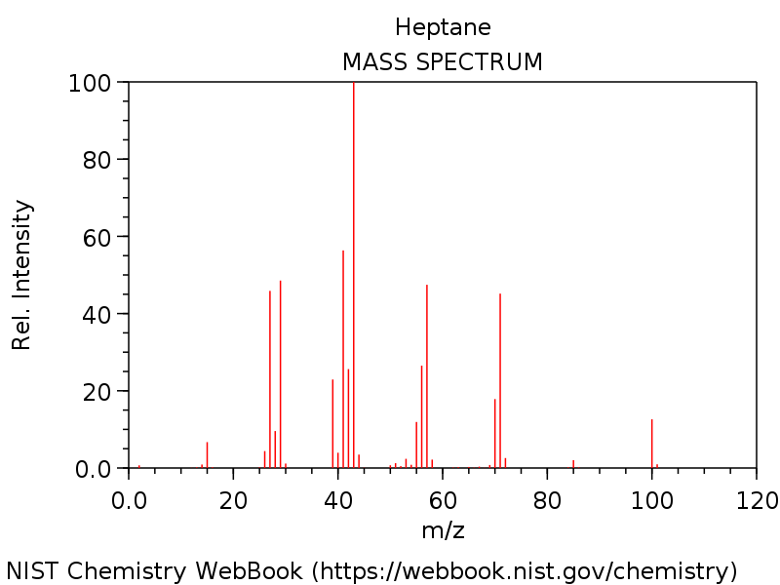
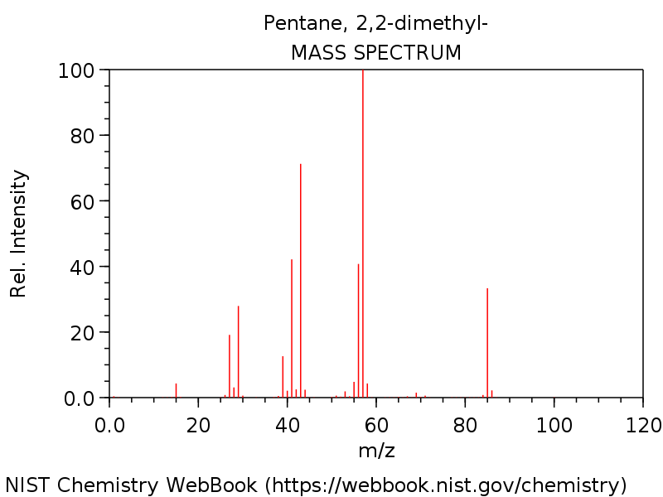
C₇H₁₆ M⁺ at m/z = 100
Unnumbered 15 p715

Slide 13
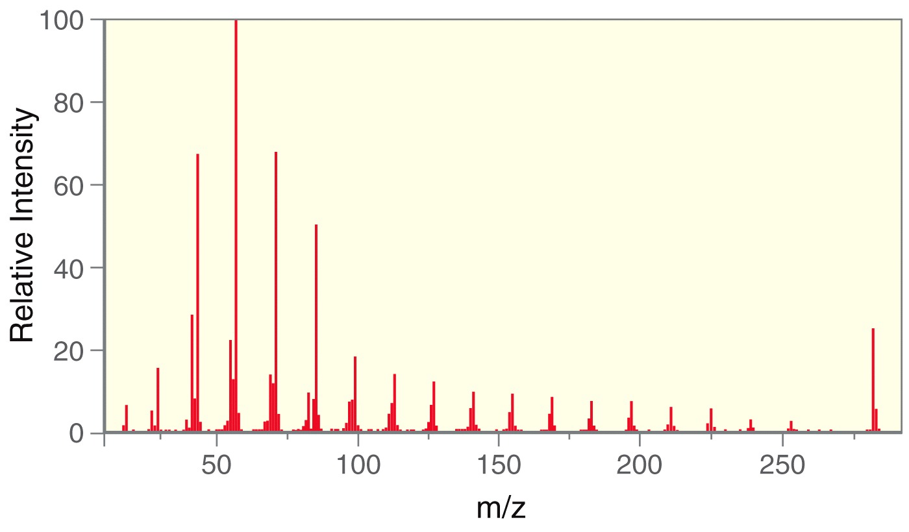
“Picket Fence” = straight chain alkane
Figure 15.30

Slide 14
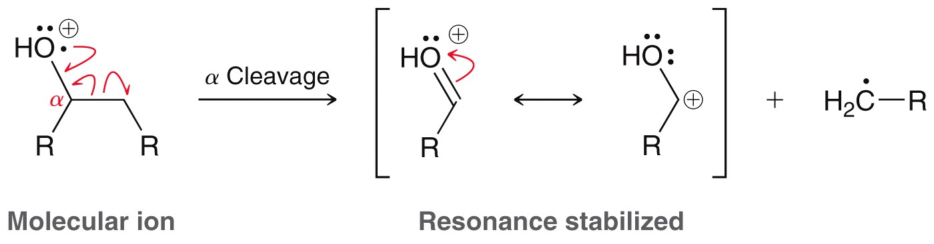
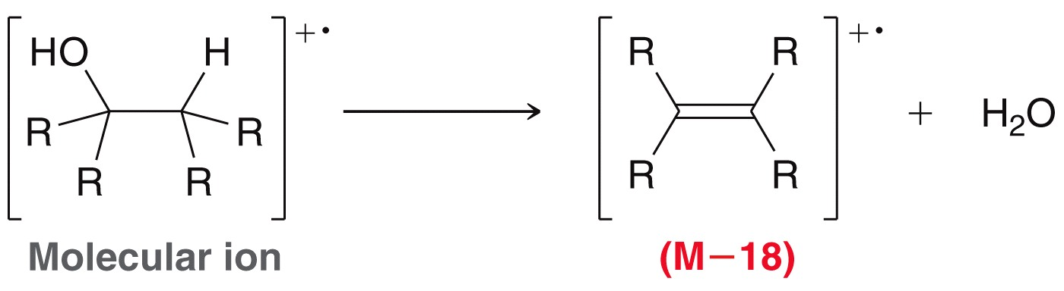
Cleavage of Alcohols
Unnumbered 15 p715

Slide 15
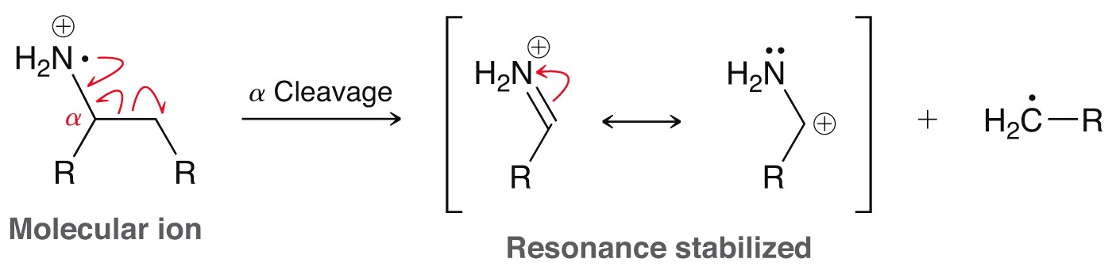
Amines
Unnumbered 15 p716

Slide 16
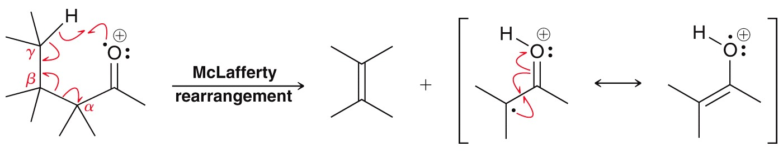
Carbonyls
M - alkene

Slide 17
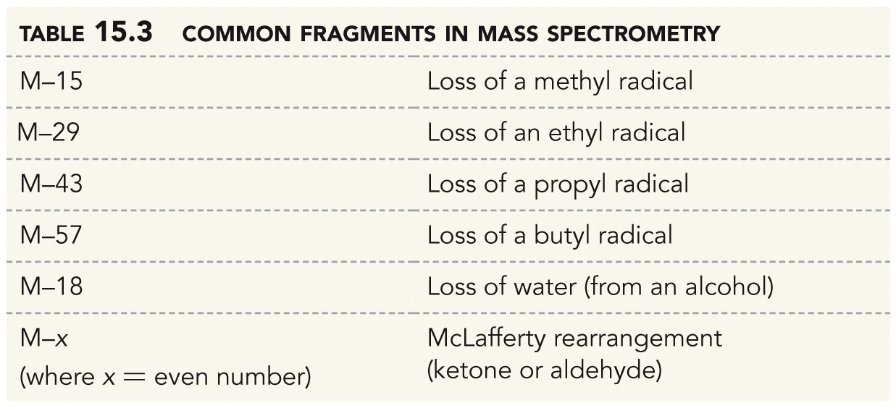
X = 28, 42, 56, 70 etc
Table 15.3

Slide 18
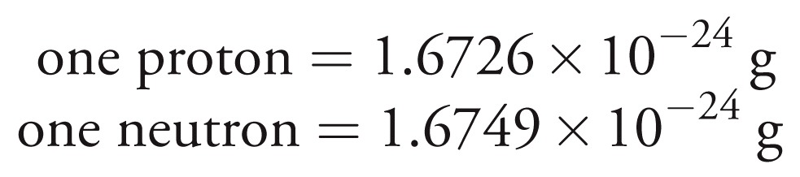
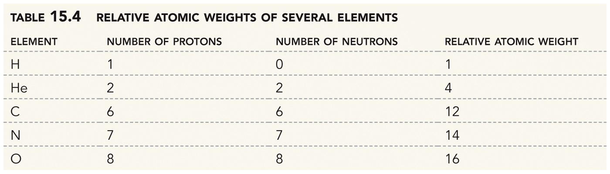
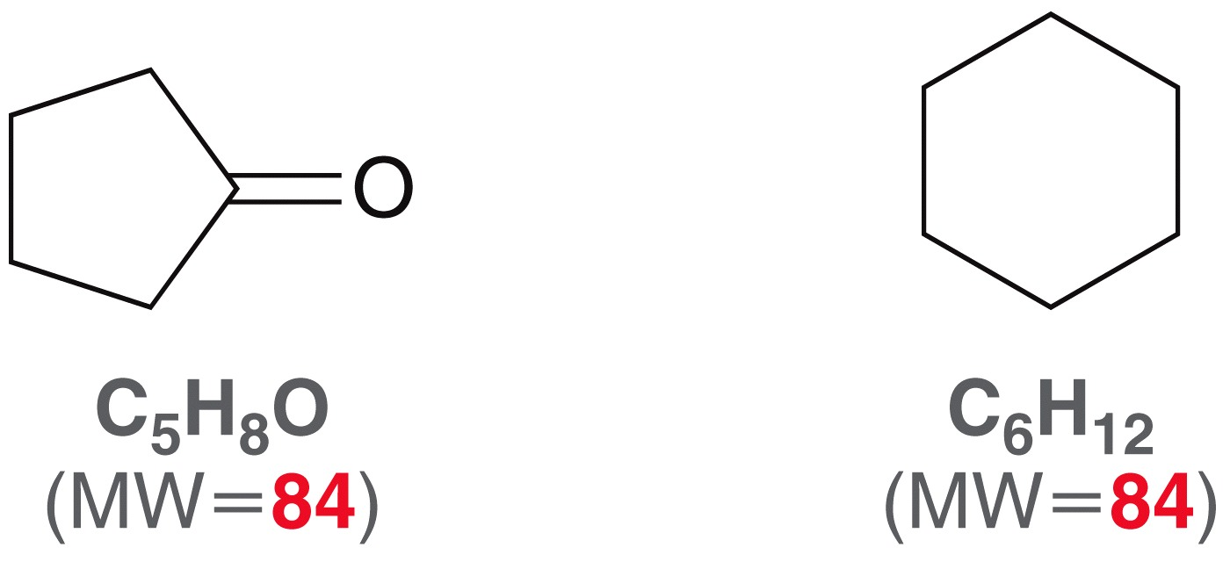
Unnumbered 15 p717

Slide 19
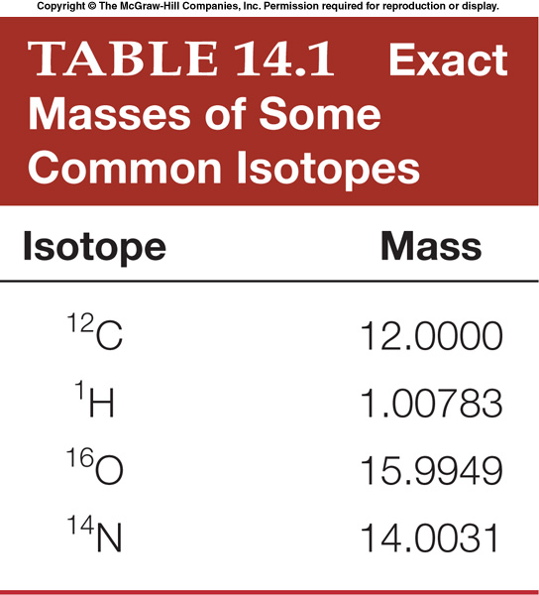
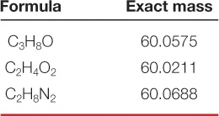
High Resolution MS (HRMS)
Low resolution mass spectrometers report m/z values to the nearest whole number. High resolution mass spectrometers measure m/z ratios to four (or more) decimal places.
  This is valuable because no two molecular formulas have the same exact molecular weight.
  Exact MWs can be calculated using exact isotope masses. Table 14.1
  Thus HRMS is a way to determine chemical formula!

Slide 20
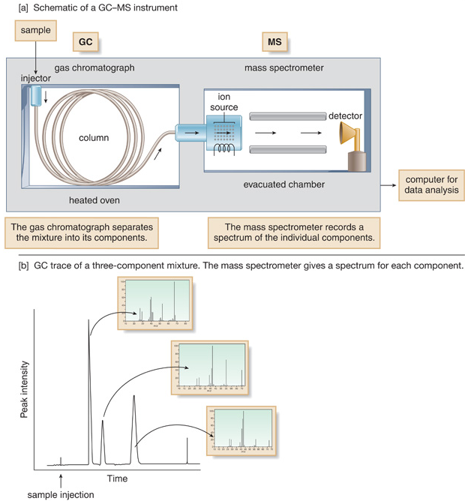
GC-MS

Slide 21
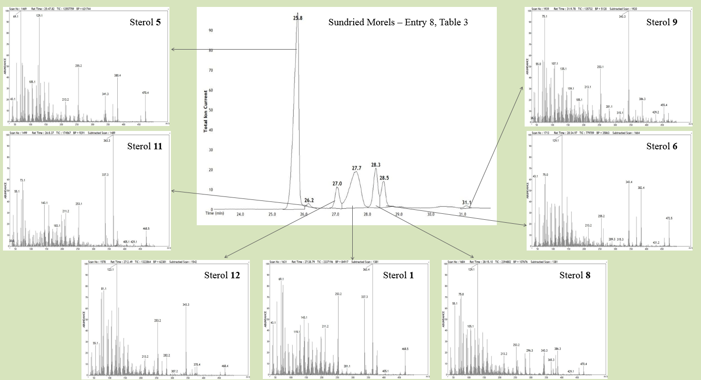

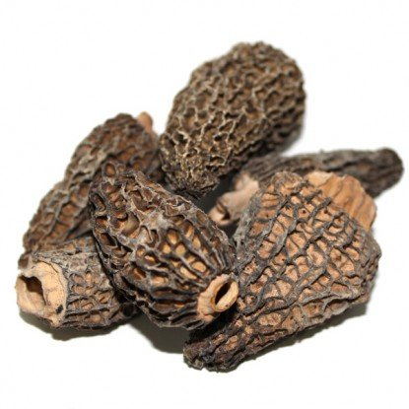

Slide 22
