Slide 1
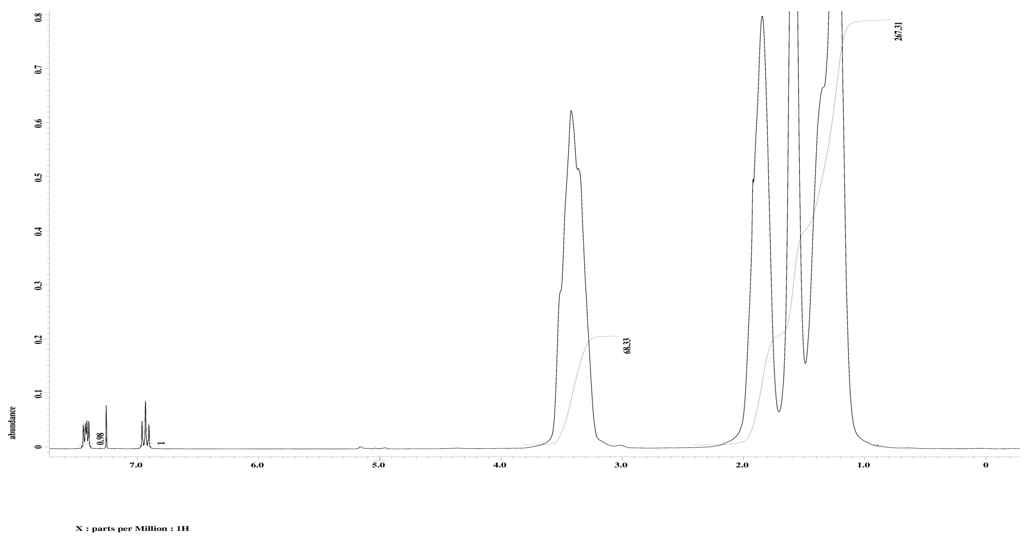
End Group Analysis of Poly(Cyclohexene Oxide) from Photoinitiated Cationic Polymerization using the Tris(2,2,2-trifluoroethyl)phosphite/Iodonium System
Steven A. Klankowski* and Thomas W. Nalli
Chemistry Department, Winona State University, Winona, Minnesota 55987-5838
Abstract
Various trialkyl phosphites (P(OR)₃) have been shown to start cationic polymerizations of cyclohexene oxide (CHO) through a radical chain mechanism with a diaryliodonium salt (Ar₂I⁺). Utilizing visible light photolysis of phenylazoisobutyronitrile (PAIBN) as the radical initiation step (eq 1), a propagation cycle represented by equations 2-4 has been proposed. Phenyl radicals (Ar•) attack the phosphite to produce the initial phosphoranyl radicals (eq 2). These radicals perform one-electron transfers with the iodonium salt to form the polymerization-starting aryltrialkoxyphosphonium salt (ArP⁺(OR₃)) (eq 3). The diaryliodine intermediate (Ar₂I•) generated in this redox step fragments producing iodoarene (ArI) and regenerating a phenyl radical that continues the chain (eq 4).
The use of tris(2,2,2-trifluoroethyl) phosphite (TFP) ((CF₃CH₂O)₃P) allows the polymerization of CHO to proceed with minimal chain-transfer (eq 8-9). This is due to the decrease in nucleophilicity of the phosphite, effectively reducing its interference with cationic polymerization.
In this poster we present evidence, in the form of polymer end group analysis by ¹⁹F NMR spectroscopy, that polymerization is indeed started by alkylation of the monomer by the aryltrialkoxyphosphonium salt (eq 6) as previously proposed.⁴
Mechanism
Proposed mechanism of PAIBN, iodonium Salt and TFP to produce arylphosphonium used in polymerization. R=CH₂CF₃ Ar = t-BuPh
Radical Chain
Ph-N=N-CMe₂CN → Ph• +N₂ + •CMe₂CN (1)(init)
Ar• + P(OR)₃ → ArP•(OR)₃ (2)(prop)
Ar₂I⁺ + ArP•(OR)₃ → Ar₂I• + ArP⁺(OR)₃ (3)(prop)
Ar₂I•→ Ar• + ArI (4)(prop)
Ar₂₋I⁺ + P(OR)₃ → ArI + ArP⁺(OR)₃ (5)(net)
Polymerization
ArP⁺(OR)₃ + → ArP(O)(OR)₂ + R—⁺ (6)
R—⁺ + n → R-(OCH₂CH₂)_{n} (7)
Polymerization Chain Transfer
Quantitation of End groups
Sample 2 – After three reprecipitations, the sample was dissolved in CDCl₃ along with a known mass of p-bromofluorobenzene as a standard. ¹H and ¹⁹F NMR spectra were obtained and integrated (Figures 2 and 3).
Experimental
General. A JEOL 300 MHz ECX spectrometer was used for obtaining spectra and backward linear interpolation (BLIP) was used to process the ¹⁹F spectra to remove the broad baseline disturbance caused by the Teflon (polyTFE) lining the probe.
Polymer Samples. Samples 1 and 2 were obtained from a previous polymerization study.⁴ Sample 1 was obtained from an experiment that used 0.02 M bis(4-tert-butylphenyl)iodonium hexafluorophosphate (BIH), 0.20 M TFP, and 0.02 M PAIBN as coinitiators dissolved in CHO. This yielded a 96% conversion of the monomer to polyCHO with M_{w} = 24,300. Sample 2 used 0.01 M BIH, 0.10 M TFP, and 0.02 M PAIBN yielding 65% conversion to polyCHO with M_{w} = 25,400.⁴ Both reactions were irradiated for one hour using a 65-W compact fluorescent lamp. Each sample had been purified once by being taken up in 10 mL CHCl₃ and treated with 10 mL of CH₃OH. The molecular weights had been determined by using HPLC with Multiple Angle Laser Light Scattering detector.
Polymer Purification. The polymer was dissolved a small amount of chloroform and reprecipitated by dropwise addition of methanol. Solvent was decanted, the precipitate was washed with methanol and then dried under vacuum. The purified polymers were taken up in CDCl₃ to obtain ¹H and ¹⁹F NMR spectra and would be reclaimed for further purifications. The amounts used for purification are listed in table below.
Polymer Sample 2 with Standard BrC₆H₄F
Proton NMR with Area Integrations
H_{α} -polyCHO
p-bromo-fluorobenzene
Sample 1 |  | Initial Mass: 0.345 g
Reprecipitation Order | Reprecipitated with CH₃OH (mL) | Recovered Mass (g) | Dissolved in CDCl₃ (mL)
1st | 6 | 0.224 | 2
2nd | 8 | -- | 2
3rd | 20 | -- | 2
Sample 2 |  | Initial Mass: 0.216 g
Reprecipitation Order | Reprecipitated with CH₃OH (mL) | Recovered Mass (g) |  | Dissolved in CDCl₃ (mL)
1st | 10 | 0.205 |  | 1
2nd | 35 | 0.157 |  | 1
3rd | 20 | 0.128 |  | 1
Figure 2
Polymer Sample 2 with Standard BrC₆H₄F
Fluorine NMR with Area Integrations
(backwards linear integration)
Background
Photoinitiated, cationic polymerization is of great importance in the development of selective curing polymer systems.¹ The use of trialkoxyphosphites have been shown to be good co-initiators for diaryliodonium salt-induced photoinitiation of cationic polymerizations. However, the selection of the alkyl groups upon the phosphite was found to directly affect the rate of polymerization due to its change in nucleophilicity. ^{2,3} If the phosphite is too nucleophilic, photopolymerization is also slow and gives low molecular weight polymers. This is due to the nucleophilic phosphite inhibiting polymerization and bringing about chain transfer by competing with the epoxy monomer for cationic sites (eq 8 and 9). ^{2,3,4}
Tris(2,2,2-trifluoroethyl)phosphite (TFP) was found to have a reduced nucleophilicity, but still capable of participate in the radical–chain chemistry.⁵ In recent results, irradiation with an inexpensive fluorescent light bulb gave good yields (65-95%) of polyCHO with molecular weights in the range of 20,000 to 25,400 in as little as one hour of irradiation time.⁴ If the proposed mechanism is followed, the polymer chain should include trifluoroethyl end groups capping the polymer (eq 6). Thus, investigation of the end-groups on the polymer chains should provide evidence necessary to confirm the proposed mechanism.
NMR Results
Proton and Fluorine NMR spectra were obtained after each sequential purification for poly CHO samples from previously reported polymerization experiments.⁴ The samples were purified by repeated reprecipitation from CHCl₃ by dropwise methanol addition.
Sample 1 – After three reprecipitations the sample was pure as confirmed by no further change in the ¹⁹F NMR spectrum (Figure 1).
p-bromo-fluorobenzene
End Group Quantitation. A quantitative NMR sample was prepared using the 3rd reprecipitation of Sample 2 with the addition of 2.0 μL p-bromofluoro-benzene as an internal standard. The polymer and standard were taken up in 1.0 mL of CDCl₃ and 5000-scan ¹H and ¹⁹F NMR spectra were obtained. Peaks were integrated and the end group to polymer ratio calculated using the known concentrations and number-average molecular weight of the polymer.
CF₃CH₂-CHO
Conclusions
After three successive reprecipitations, the polymer was found to have good purity and still show F-19 (-75.1 ppm) peaks that must be attributed to trifluoroethoxy endgroups on polymer, not impurities.
Addition of p-bromofluorobenzene allowed for easy integration of fluorine and hydrogen peaks to ascertain average molecular number and count of endgroups present in polymer.
End group analysis showed that 1 out of 5.3 polymer chains contains the trifluoroethyl group. These results show that alkylation of the monomer by the aryltrialkoxyphosphonium salt (eq 6) is a key mechanism step in the polymerization as proposed by our group previously.
Figure 3
Initial Polymer
Results and Discussion
The observed multiplet at -75.1 ppm is consistent with the chemical shift for –OCH₂CF₃ groups (literature values⁶ are in the range of -73 to -78 ppm) Thus we attribute this multiplet to the trifluoroethoxy polymer endgroups.
A quantitative experiment was conducted on Sample 2 using p-bromofluorobenzene as an internal standard (2.0 µL; 3:1 mole ratio of standard to polymer. ) The results in Figure 3 show a 1.0:6.2 integration ratio of polymeric F to standard F meaning that the purified polymer has one –OCH₂CF₃ endgroup for about every five polymer chains. (This assumes the MW of the material did not change as a result of purification.) The proton NMR (Figure 2) shows a 1:68 integration ratio of the standard compound hydrogens to monomer hydrogens, giving a calculated weight of polymer to be 0.121 g, (5.1% error), thus validating the measurement of the added standard.
1st Reprecipitation
References
Tasdelen, M.A.; Yagci, Y.; Kumbaraci, V.; etc. Macromolecules 2008, 41, 295-297
Muneer, R.; Nalli, T. W.; Macromolecules 1998, 31, 7976-7979
Nalli, T. W.; Stanek, L. G. Abstracts of Papers, 219th National Meeting of the ACS, San Francisco, CA, March 2000; ORGN 405.
Nalli, T.W.; Stanek, L.G.; Steidler, R. H.; etc. Trialkyl Phosphites and Onium Salts as Co-initiators in an Efficient System for Visible-Light-Induced Cationic Polymerization. Presented at the ACS 235th National Meeting, New Orleans, LA, Spring 2008, ORGN 125
Kampmeier, J. A,; Nalli. T. W. J. Org. Chem. 1993,58,943-949.
Everett, T.S. in Chemistry of Organic Fluorine Compounds II; ACS, Washington, DC.1995. pp 1037-1086.
2nd Reprecipitation
3rd Reprecipitation
Acknowledgments
Thanks to the Chemistry Faculty and Staff at WSU for their continuous hard work. We also acknowledge the National Science Foundation, CCLI Grant #0126470 (JEOL NMR).
Figure 1

