Slide 1
Fluid volume and blood pH Homeostasis: 4/13 and 4/15
Review of the three “A” hormones that help maintain fluid homeostasis. Don’t forget ANF!
What causes electrolyte imbalances?
How much fluid is present in the body compartments?
Water homeostasis as a balance of water input and output.
What are the causes and effects of dehydration?
What are the important renal and lung pH buffer systems?
Why does pH change often alter plasma electrolyte concentrations and cardiac function?
Compare and contrast compensated and uncompensated acidosis/alkalosis.
What are the typical body water volumes?
What is fluid volume homeostasis?
How does the body prevent dehydration?

Slide 2
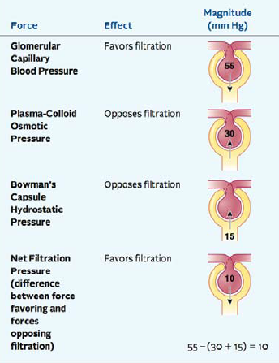
Review of how we create GFR in the capillaries of Bowman’s Capsule with hydrostatic and osmotic pressure
If Afferent Arteriole dilates→ hydrostatic P goes up--- GFR UP
If Afferent arteriole vasoconstricts →hydrostatic P goes down and GFR goes down
If ureter is blocked, pressure in capsule goes up and opposes capillary hydrostatic pressure→ GFR goes down
If plasma protein conc. Goes down, then colloid pressure goes down, less fluid pulled into blood and GFR goes up
If plasma protein leaks into capsule the protein draws fluid from blood and GFR goes up

Slide 3
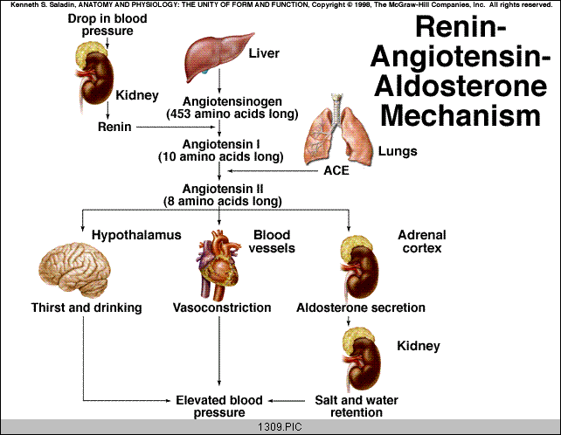
Review: Given the importance of blood pressure maintenance, it makes sense that angiotensin II improves blood pressure in three totally different way pathways (redundancy).
ACE Inhibitors Prevent block this step!

Slide 4
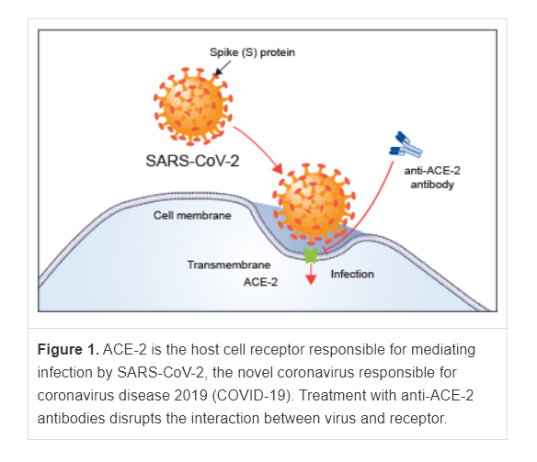
Why are persons with hypertension at greatly increased risk for death from COVID-19? They tend to express more ACE-2 in order to degrade their excess angiotensin-II. How does COVID-19 get into our cells so it can use our cellular machinery to replicate the virus and transmit the virus in mucus to others (cough or touch)? https://www.rndsystems.com/resources/articles/ace-2-sars-receptor-identified

Slide 5
Review: How does ADH (vasopressin) help prevent hypovolemia?
ADH MOVES AQUAPORIN MOVE TO PLASMA MEMBRANE
ALONG THE COLLECTING DUCT AND DCT
Aquaporin to Plasma Memb
High levels of ADH release can cause blood vessels to
vasoconstrict (increase blood pressure).

Slide 6
Review: How does aldosterone help prevent hypovolemia?
Negative Feedback
Sodium ions carry larger spheres of hydration than K+ ions, thus more water is associated with the Na+ in the blood and blood pressure increases.

Slide 7
ELECTROLYTE IMBALANCES RESULT FROM THE BODY’S ATTEMPT TO DUMP ACID OR BASE AND PRESERVE pH. THE IMBALANCES WE CREATE CAN ALSO BE FATAL.
COMPENSATED: physiologic buffers get pH back to 7.35
UNCOMPENSATED: plasma pH can’t get back to 7.35
How Would the Kidney Adapt to the Following:
Problem of Respiratory Acidosis
from Hypoventilation,Emphysema,Asthma
Problem of Respiratory Alkalosis:
From Hyperventilation, High Altitudes
Problem of Metabolic Acidosis:
from DIABETES!! Diarrhea or Excess organic acids
Problem of Metabolic Alkalosis:
from Vomiting or Excess Antacid use.
What are some classic Electrolyte disorders? See Table 24.4

Slide 8
What is important to think about what ions are kicked off, become available, or are lost in the urine during pH compensation. K+ is very important because of its HUGE impact on cellular membrane potential (mV) on cardiomyocytes or neurons.

Slide 9
What are some common electrolyte imbalances and the terminologies used to describe them?
Electrolytes are in solution in the blood plasma and I nthe intracellular fluids of cells (ICF)
Millimolar Concentrations of Selective Electrolytes:
Ion----[Plasma]---[ICF]----Deficiency Term-------Excess Term
↓↓ ↓↓
Na+-- 142--------- 10------Hyponatremia---------Hypernatremia
K+---- 5------ 141----Hypokalemia----------Hyperkalemia
Ca++ 5------------ <1------Hyopocalcemia--------Hypercalcemia
Cl----- 103--------- 4--------Hypochloremia--------Hypochloremia
PO4-- 4------------ 75-------Hyperphosphatemia-Hypophosphatemia
The plasma levels are often evaluated in a panel test:

Slide 10
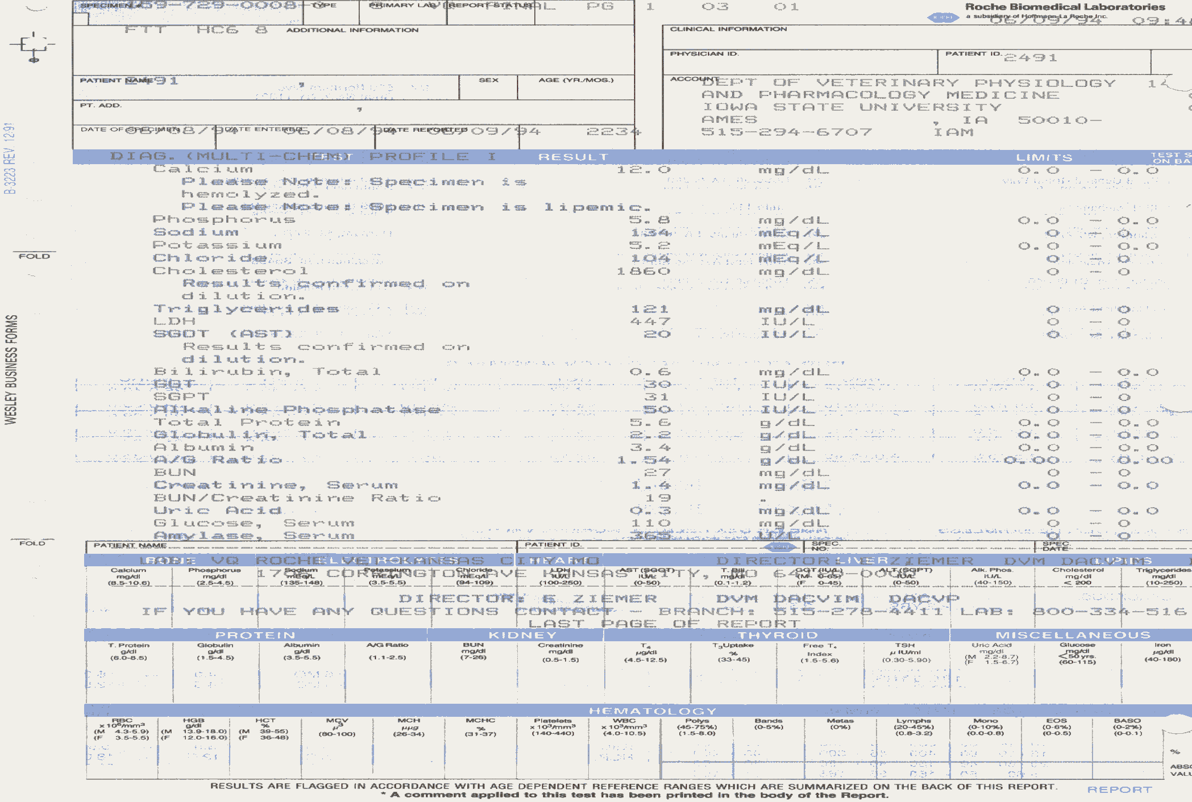
This does a typical electrolyte panel test looks like:

Slide 11
How does disruption of the electrolyte balance in the fluid compartments lead to disease in a dehydrated person?
What is isotonic? 0.9% NaCl 300 mM NaCl
What is “hypertonic”? What is “hypotonic”?
Normal Electrolytes Concentrations in Blood and Cytosol (T.Q):
Plasma: Na=142, K=5, Ca=5, Cl=103, PO₄=4mM
Intracellular: Na=10, K=141, Cl=4, Ca 4 or less, PO4=75mM
Salt gradients between intra- and extracellular sides are required to maintain membrane voltage potentials!
Volume Depletion (Hypovolemia): Change volume size!
Negative Water Balance (Dehyrdation): Change generally occurs in volume AND electrolyte concentrations.
Many diseases are a mix of both processes!

Slide 12
HOW IS THE FLUID VOLUME DETERMINED BY SALTS, H₂O, GFR AND DISTRIBUTION OF GFR IN THE KIDNEY?
How much water does our body contain (Total Body Water)?
Infant: 65-75% Young Adult: 55-60% Obese and Elderly: 40-50%
Your Total Body Water Content: 70 kg X 55% = about 40L
Where is this 40L of water distributed in your body?
Intracellular: 65% (40L X 0.65)= 26L
Extracellular: 35% (40L X 0.35)= 14L
25% Interstitial Water (between cells) (40L X 0.25)= 10L
8%Water in blood and Lymph (40L X 0.08)= 3.2L
2%Trancellular water (endoplymph, joints, cerebral spinal fluid, pericardial and pleural fluids) (40L X 0.02)= 0.8L
TQ: please memorize these numbers! VIP Clinical applications!
What are the Sources of the 2.5 L/day water you normally receive?
Preformed (2.3 L/day) vs. Metabolic water (0.2 L/day)
Drinks and Food Aerobic Respiration

Slide 13
HOW DOES OUR WATER EXIT THE BODY?
Water Loss Routes are varied:
Urine (1.5 L/day), Transpiration (0.4L/day), Sweat (0.1 L/day, Breathing (0.3 L/day), Feces (0.3 L/day or 10L/day diarrhea?), Vomiting (0-10 L/day??)
Insensible Water Loss: Not obvious or conscious loss
Obligatory Water Loss: Totally unavoidable loss
How can water loss (dehydration) become very severe very fast?
Consider Diarrhea or Vomiting (Water AND IONS can be lost!)
Consider Sweating on a hot dry day (up to 5 L/day or more lost!)
Consider Breathing rate and water loss when you are on top of Pike’s Peak CO (up to a 1.5 L/day)
The water volume is certainly NOT static, it changes constantly!
What happens if you do not adapt to the water loss?
What happens to kidney function under extreme conditions?
Why is maintenance of WATER HOMEOSTASIS so critical?

Slide 14
Water Homeostasis is one of the most important types of balance we must maintain. Each Day: 2,500 ml IN/ 2,500 ml OUT HOW IS THIS BALANCE ACCOMPLISHED?
A Rough Approximation for Water Needs in Athletes: If you are counting calories in a person, you use up about 1 gram of water for every calorie you burn.

Slide 15
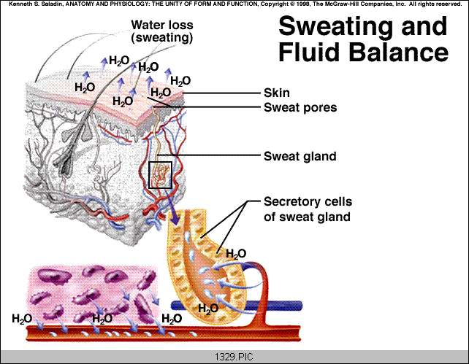
We also have to keep our body temperature stable at 37ºC
The Trick:
*Heat is lost when energy is used to change water from fluid to vapor on the skin.
*Sweat glands help move water to the skin.
*Heat is supplied to the skin when capillaries are dilated to improve blood flow.
*Dilated capillaries make the skin look red (blushing→heat loss).
Cost of Sweat: Why does it taste “salty”? How much water is lost?

Slide 16
Dehydration leads to hypovolemia which causes many potentially deleterious things to occur in the body.
When water is lost from the body, the reserves must be redistributed.
When the water is lost how does the body compensate?
Problems associated with dehydration are LEGION. What are a few?
If the blood becomes too viscous, clots may form→BAD
If blood pressure is low, nitrogenous waste can’t be removed→BAD
Electrolyte imbalances may cause poor reflex coordination→BAD
If the blood pressure is low, perfusion of vital organs is poor→BAD
If perfusion to vital organs stops then oxygen delivery comes to a grinding halt→BAD
If the brain is not perfused properly, you make poor decisions (i.e. drink salt water from the sea)→ Makes all the above WORSE
Potential Positive Feedback Loop→ Do conditions Worsen? ☹
Any of all of the above can lead to Hypovolemic Shock→VERY BAD
Potential Negative Feedback Loop→ Return to Homeostasis? ☺

Slide 17
What is Rehydration Therapy? Why is it the best medical treatment ever created on the Face of the Earth?
Infants and dehydration risk-
Elderly and dehydration risk-
Third World infants and water borne disease-
Diarrhea→Cl⁻ excretion into mucus→Solvent Drag→Dehydration
If you rehydrate effected person with an oral mix of NaCl/Glucose, you can use solvent drag in the intestine IN YOUR FAVOR as well as supplying energy (glucose) to sick person! (Na⁺-Glucose-Symport)
Classic Rehydration Therapies:
Isotonic Saline:
Total Parenteral Nutrition:
Pedialyte:
Salty rice (cheapest route in Third World):

Slide 18
Is it ever possible to get TOO MUCH water? YES!
Another Possible Problem: Fluid Excess/Water toxicity (RARE!)
If you have too much water enter you dilute the potassium and or flush it and sodium out in the urine causing hypokalemia or hyponatremia.
A problem with college hazing (why?
A problem with obsessive compulsives (why?
A solution for Picasso (why?)

Slide 19
REVIEW FROM CHEMISTRY: Buffers are chemicals that resist pH changes by temporarily bonding excess H+ or donating H+?
Basics of acid/base chemistry: pH = -log[H+]
Each pH unit is a X10 change in [H+]
If pH changes from 7 to 5, the proton concentration increased X100
If pH changes from 7 to 8, the proton concentration decreased X 1/10th
Acid=Proton Donor: Classics are H₂CO₃ and protein acetyl-groups.
Base=Proton Acceptor: Classic is ammonia (NH₃ + H⁺ →NH₄⁺)
Strong Acid or Base: gives up/takes up H+ readily: Changes pH
Weak Acid or Base: hesitant to take or give up H+: Less pH Change
pK is a term that describes the pH where the molecule is at 50% protonated and 50% deprotonated.
If the pK of bicarbonate is 4.5, then if the pH is 4.5 half is H₂CO₃ and half is HCO₃- + H⁺ If pH is 7.4 almost all is depototonated (HCO₃-)
pK is the pH where each molecule can do its best buffering or where it can best resist changes in the pH of the solution!

Slide 20
WHAT ARE THE TWO IMPORTANT BUFFER SYSTEMS? Take your pick: Physiological OR Chemical
There are 2 Physiological buffering systems: (vs Chemical Buffer)
Respiratory (lung): smaller impact but rapid reaction (requires a matter of minutes or less)
Renal (kidney): larger impact but slower reaction (requires a matter of hours to days)
There are 3 major CHEMICAL buffers: -COOH, -NH₃, H₂PO₄
1) Bicarbonate: mostly extracellular (pK=6.1) so the molecule is usually in deprotonated form at pH 7.35
2) Phosphate: mostly intracellular and in urine (pK=6.8) so molecule is typically 50/50
3) Amino-groups: (i.e. amino groups on amino acids or on proteins) Found all over the body with a pK in basic range (around 8), so mostly found protonated (-NH₃+ or NH₄+)
IT IS A “Chemical” Buffer if you can inject a chemical buffer into the blood and the pH will change, regardless of respiratory or renal function.

Slide 21
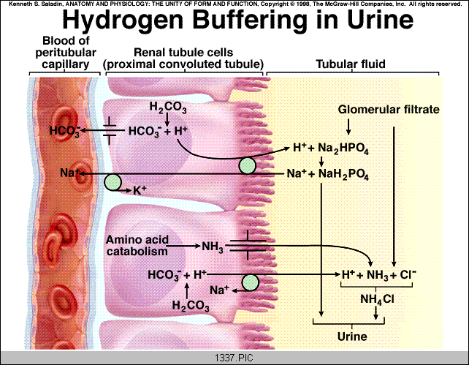
Our body likes to keep the blood pH at about 7.35. Phosphate makes a great buffer because its pK is near 7.4 and it is common in environment. Ammonia (oddly enough) is also nice because it is produced as amino acids are degraded any way, so waste in urine actually becomes useful. BUFFERS STABILIZE PROTONS UNTIL REMOVED IN URINE

Slide 22
HOW DOES THE LUNG PROMOTE RAPID pH ADJUSTMENTS?
Cardiac Output=5 l/min and Total Blood Volume is 8% of 70 kg or about 5.6 L>>>>So it only takes about 80 seconds for complete blood/lung cycling>>>Fast!!
Red Blood Cell: critical because they contain Carbonic Anhydrase that can interchange carbon dioxide and bicarbonate. The abundant hemoglobin also has plenty of amino- and carboxyl-groups on the abundant hemoglobin for chemical buffering.
Lung is a physiological buffer because the mechanisms take place as a part of normal physiological activity.
Remember that changes in pH also cause the respiratory centers to modify the breathing pattern based on acute changes in need.
What limits the lung is the amount of bicarbonate that
is available. You can only make So Much CO₂ because you only have so much bicarbonate in the blood.

Slide 23
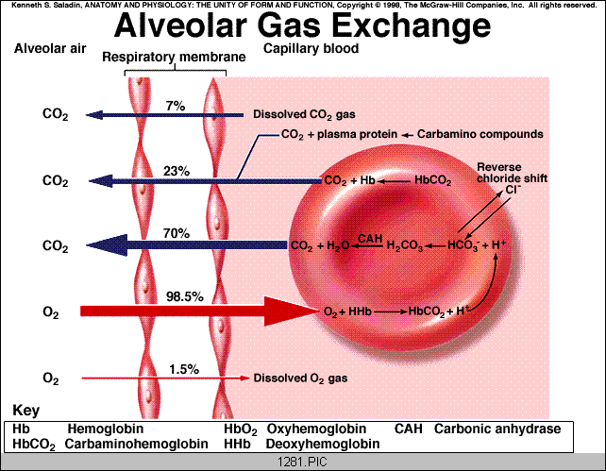
REVIEW OF PATHWAY FOR H+ TRANSPORT TO THE LUNG AS PART OF BUFFERING CAPACITY. Remember that when you exhale carbon dioxide you are removing protons from the blood!

Slide 24
Great Stuff you already know: What you memorized earlier
Cardiac output = about 5L/min
GFR= about 125 ml/min or 180 L/day
Renal Blood Flow = about 20-25% of CO
Urine formation is about 1-2 liters/day (lets assume 1L/day
Questions: What you can’t memorize but can figure out
1) What % of filtrate (GFR) is reabsorbed? (Total, PCT, Loop, DCT, CD)
2) What hormones have synergistic/antagonistic effects on in this?
3) How many liters of blood/min go to kidneys?
4) What percent of Renal Blood Flow is “filtered”?
5) If you had mild respiratory acidosis (pneumonia) how would the urine chemistry/contents change?
6) If the acidosis was severe (uncontrolled diabetes) how would the chemistry/contents of the urine change?
7) How and Why does the GFR change if your blood pressure is 60/40, 150/110, or 250/210 (at level of Afferent and Efferent arteriole radius)
8) How do ACE inhibitors protect some hypertensives from heart disease?
9) How might the diuretic furosemide help treat left side heart failure?

