Slide 1
Chapter 1 Stress

Slide 2
Mechanics of Materials
The study of the relationship between the external loads on a body and the intensity of the internal loads within the body

Slide 3
Equilibrium of a Deformable Body
External loads
Surface forces
Caused by the direct contact of one body with the surface of another
Concentrated force
Linear distributed load (if applied along a narrow area)
Body forces
Weight
Support reactions

Slide 4
Reactions Resulting from Some Common Connections

Slide 5
Equations of Equilibrium
In vector form
∑ F = 0
∑ M_{o} = 0
In 2-D scalar form
∑ F_{x} = 0, ∑ F_{y} = 0
∑ M_{O} = 0
In 3-D scalar form
∑ F_{x} = 0, ∑ F_{y} = 0, ∑ F_{z} = 0
∑ M_{x} = 0, ∑ M_{y} = 0, ∑ M_{z} = 0

Slide 6
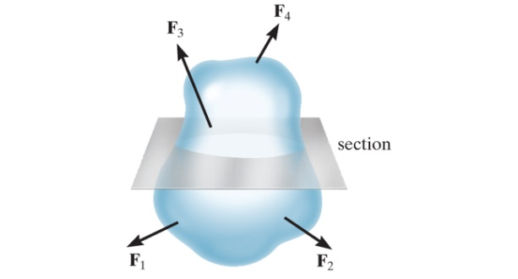
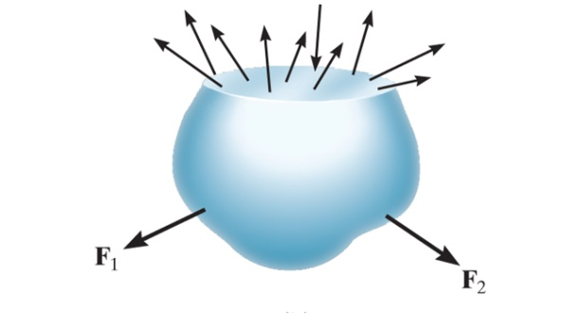
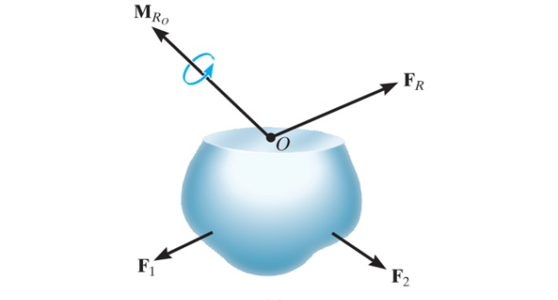
Internal Resultant Loadings
Method of sections (recall approach to truss problems)
Imaginary section or "cut" is made through the region where the internal loadings are to be determined
The two parts of the body are separated
A free-body diagram of one of the parts is drawn
Equations of equilibrium are used to relate the external forces on the body to a resultant internal force and moment, F_{R} and M_{Ro}
The actual internal loading is a distribution of forces as shown below (center) but can be represented by a force and moment (recall equivalent systems)
O is typically chosen at the centroid of the sectioned area

Slide 7
3-D Internal Resultant Loadings
Normal force, N
Acts perpendicular to the plane of the area
Develops when external loads tend to push or pull on the two segments of the body
Shear force, V
Lies in the plane of the area (usually determine two perpendicular components along coordinate axes, not shown in figure)
Develops when external loads tend to cause the two segments of the body to slide over one another
Torsional moment or torque, T
Develops when external loads tend to twist one segment of the body with respect to the other
Bending moment, M
Develops when external loads tend to bend the body about an axis lying within the plane of the area (usually determine two perpendicular components along coordinate axes, not shown in figure)

Slide 8
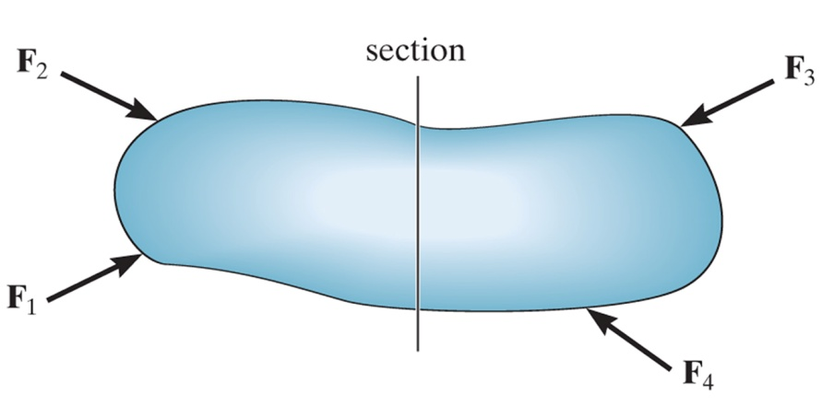
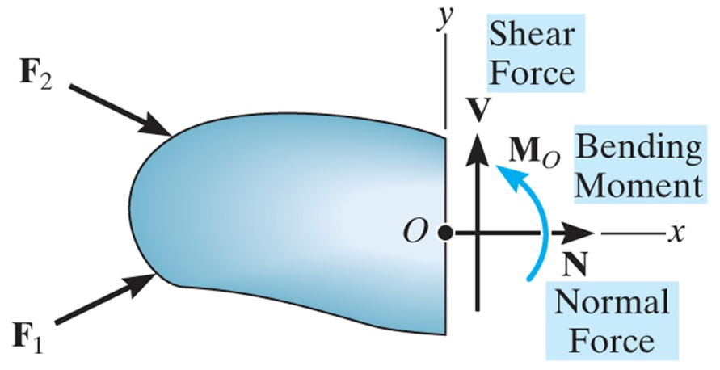
2-D (Coplanar) Internal Resultant Loadings
See pg 264 for M and V sign convention as specified for beam analysis
Problems, pg 17

Slide 9
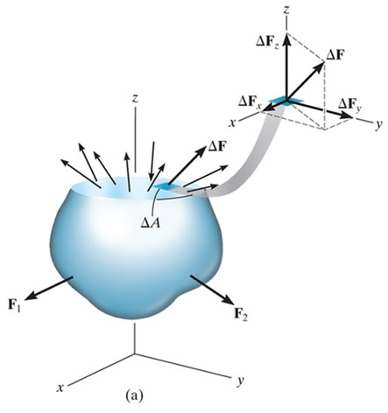
Stress
Consider sectioned area to be divided into small areas such as ΔA
Assume a typical finite yet very small force ΔF acting on ΔA
Replace ΔF, by its three components, ΔF_{x}, ΔF_{y}, and ΔF_{Z} (tangent and normal to the area respectively)
As ΔA approaches zero, so do ΔF and its components, but the quotient of the force over the area will, in general, approach a finite limit
This quotient is called stress → it describes the intensity of the internal force on a specific plane (area) passing through a point

Slide 10
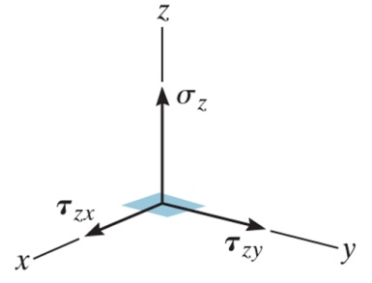
Normal and Shear Stress
The intensity of force (or force per unit area) acting normal to ΔA is defined as the normal stress, σ
If the normal force or stress "pulls" on the area element it is referred to as tensile stress, whereas if it "pushes" on the area element it is called compressive stress
The intensity of force (or force per unit area) acting tangent to ΔA is called shear stress, τ
Two subscripts are used for the shear stress components, the first subscript defines the plane on which the shear stress acts (as being perpendicular to the specified coordinate axis), and the second subscript refers to the direction of the shear stresses
In the SI system the units of stress are Pascals, Pa (one Pa is equivalent to one N/m²), kPa, MPa
In the English system the units of stress are psi (lb/in²), ksi (kip/in²), msi (million psi)

Slide 11
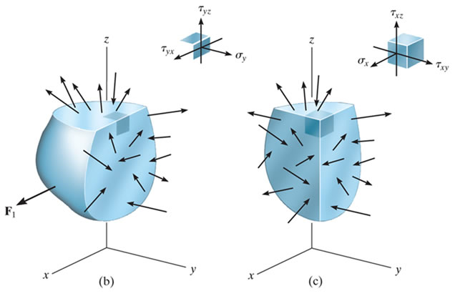
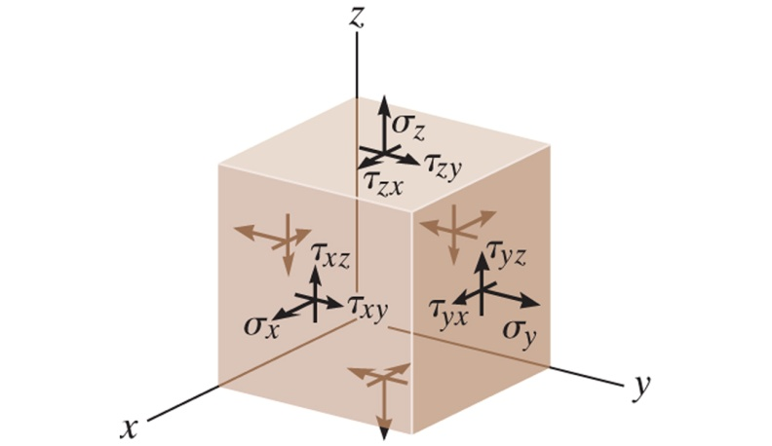
General State of Stress
The state of stress acting around the chosen point in the body

Slide 12
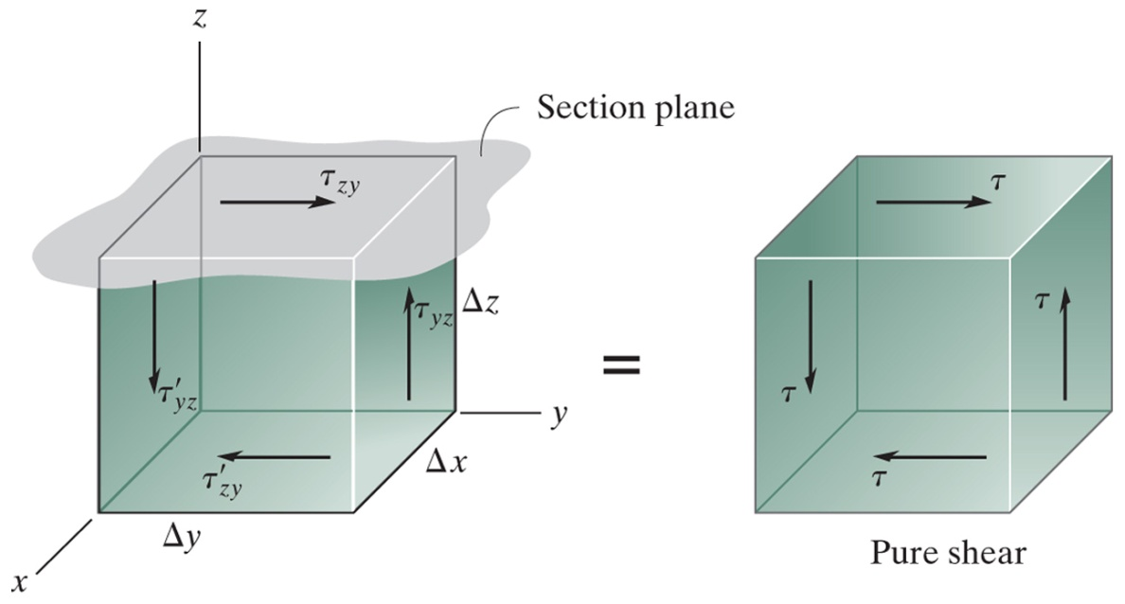
Equilibrium of a Volume Element
A volume element of material taken at a point located on the surface of any sectioned area on which the average shear stress acts
In order to satisfy equilibrium all four shear stresses must have equal magnitude and be directed either toward or away from each other at opposite edges of the element (referred to as the complementary property of shear)

Slide 13
Average Normal Stress on an Axially Loaded Bar
Under the applied axial load, it is assumed the bar undergoes uniform deformation
The bar remains straight, and the cross section remains flat or plane during deformation
Regions of the bar near the ends where the external loads are applied can cause localized distortions and are not considered here
For the bar to undergo uniform deformation
The load, P, must be applied along the centroidal axis of the cross section
The material must be homogenous (same material throughout its volume) and isotropic (same properties in all directions)
If the bar is subjected to a constant uniform deformation, then this deformation is the result of a constant normal stress, σ

Slide 14
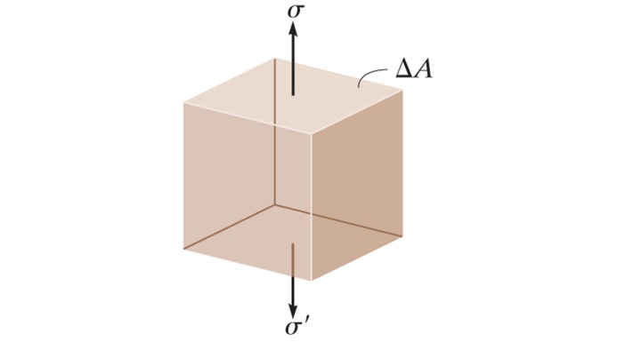
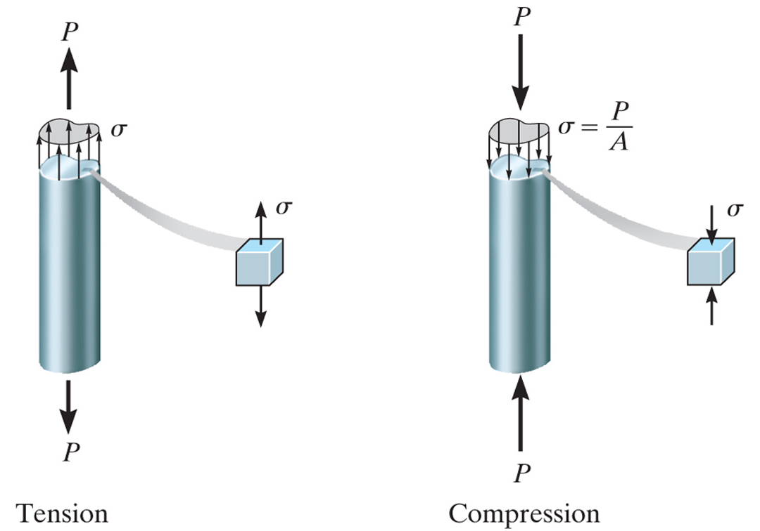
Equilibrium of a Volume Element
Only a normal stress exists on any volume element located at each point on the cross section of an axially loaded bar
Considering equation(s) of force equilibrium

Slide 15
Average Shear Stress
The average shear stress distributed over each sectioned area that develops the shear force shown is defined by,
τ_{avg} is in the same direction as V
Problems, pg 40

Slide 16
Factor of Safety and Allowable Stress
The factor of safety (F.S.) is a ratio of the failure load divided by the allowable load, F.S. = F_{fail}/F_{allow} or since the load is linearly proportional to stress, F.S. = σ_{fail}/σ_{allow} or F.S. = τ_{fail}/τ_{allow}
F.S. must be greater than one to avoid the potential for failure
Specific values depend on the types of materials to be used and the intended purpose of the structure or machine
Margin of safety is used in the aerospace industry, M.S. = F.S. -1

Slide 17
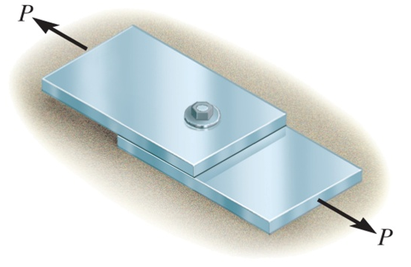
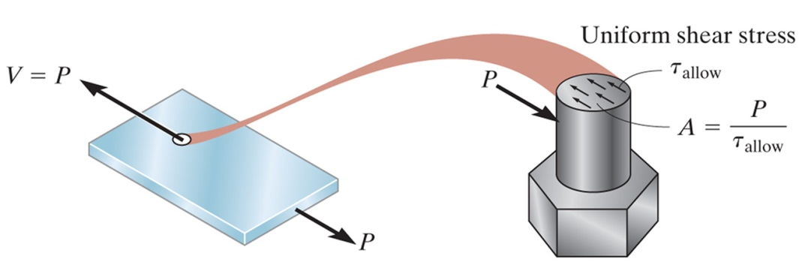
Sizing of Simple Connections
Simple connections can be designed/sized by using A=P/σ_{allow} or A=P/τ_{allow}
Area of a tension member
Area of a connector subjected to shear (properties of bolt materials)

Slide 18
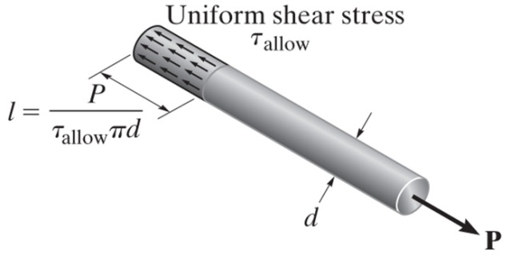
Sizing of Simple Connections (continued)
Area to resist bearing
Area to resist shear caused by axial load

Slide 19
Limit State Design, LSD (Load and Resistance Factor Design, LRFD)
Various types of loads, R, act on a structure or structural member
dead loads (weight of structure)
live loads (transient loads such as people, vehicles, wind, snow, earthquake)
load factor, γ, is applied to account for the variability in these loads (expect γ_{D} to be less than γ_{L})
building codes often define the types/combinations of loads to design for and specify what load factors to apply (i.e., R = 1.2D + 1.6L + 0.5S)
Resistance factors, Φ, are applied to the material strength values
Resistance factors reflect probability of material failure as it relates to the materials quality and consistency of its strength (i.e. concrete has smaller factor than steel)
Design Criteria: ΦP_{n} ≥ ∑ γ_{i}R_{i} (P_{n} is the nominal strength of the member)
Problems, pg 58

