Slide 1
Chapter 12 Deflection of Beams and Shafts

Slide 2
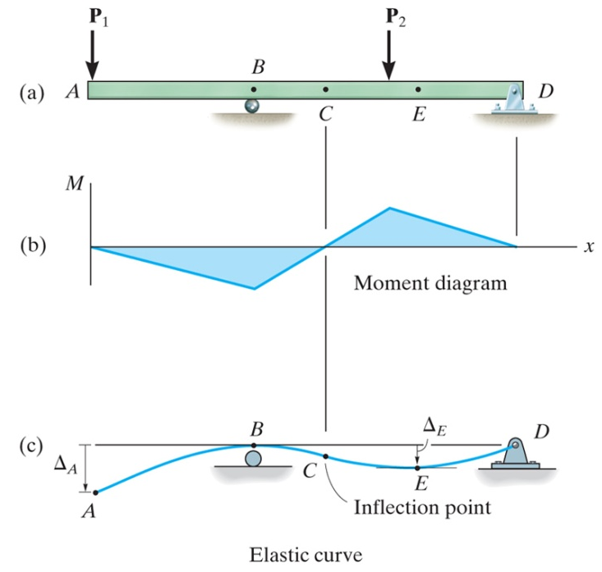
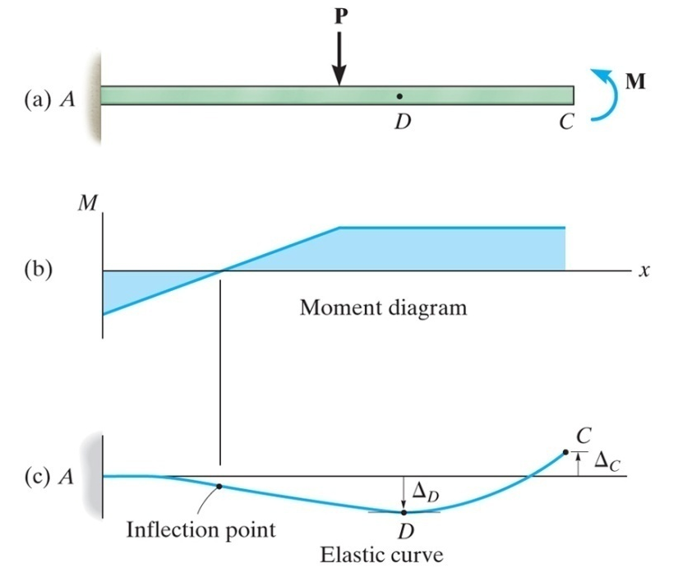
Elastic Curve
The deflection diagram of the longitudinal axis that passes through the centroid of each cross-sectional area of the beam is called the elastic curve
In order to sketch the elastic curve it is necessary to know how the slope or displacement is restricted at various types of supports
Can use the beam moment diagram to determine if beam is concave upward (positive moment) or concave downward (negative moment)

Slide 3
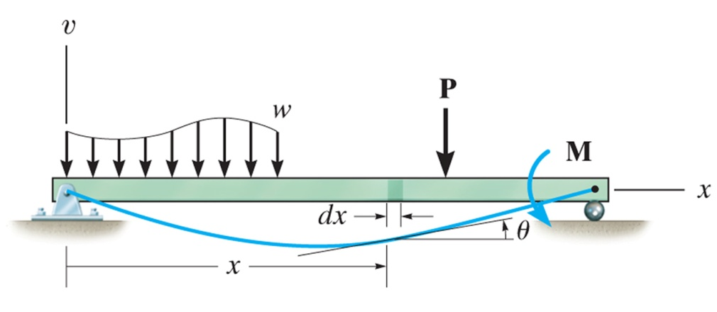
Beam Parameters
v, x, and "localized" y axes
Differential element having an undeformed width dx and ds at a distance y from the neutral surface

Slide 4
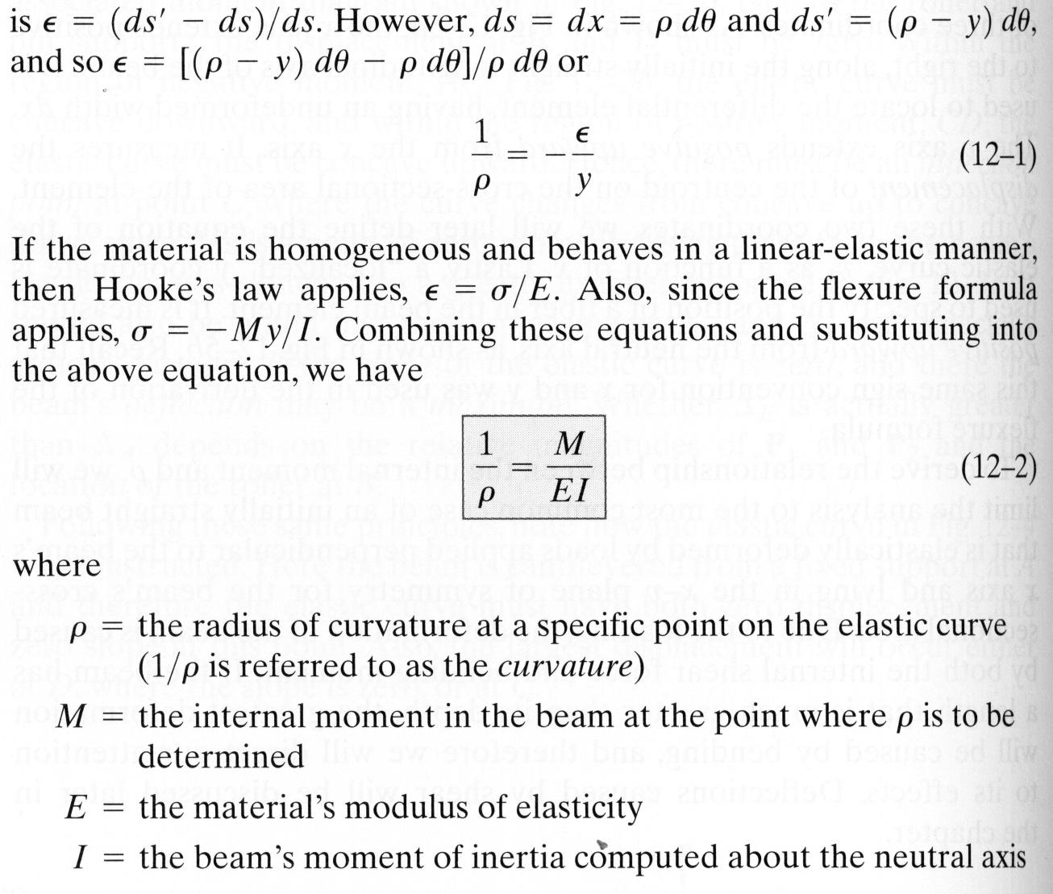
Moment-Curvature Relationship
Relationship between internal moment, M, and radius of curvature, ρ

Slide 5
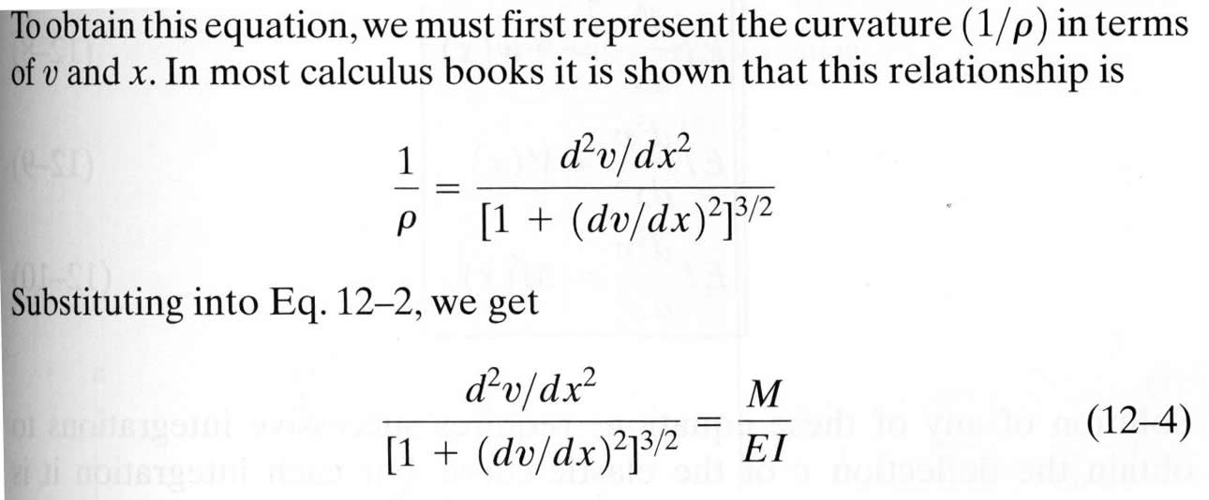
Slope and Displacement by Integration
The elastic curve for a beam can be expressed mathematically as v = f(x)
Recognizing that dv/dx will be very small, its square will be negligible compared to one

Slide 6
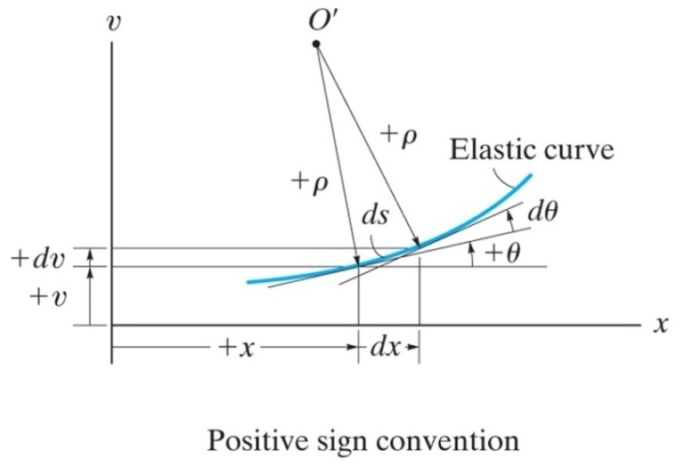
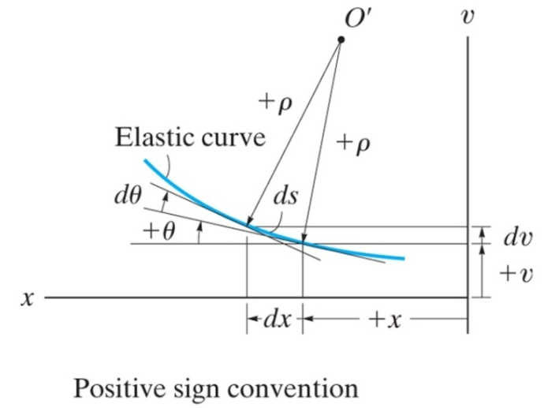
Sign Conventions
Positive deflection, v, is upward
Positive slope, θ, is measured counterclockwise when x is positive to the right (positive increases in dx and dv in x and v create an increased θ that is counterclockwise)
By assuming dv/dx to be very small, the horizontal length of the beam's axis and the arc of its elastic curve will be about the same, ds is approximately equal to dx - points on the elastic curve are assumed to displace vertically, and not horizontally
Since the slope angle will be very small, its value in radians can be determined directly from θ ≈ tan θ = dv/dx

Slide 7
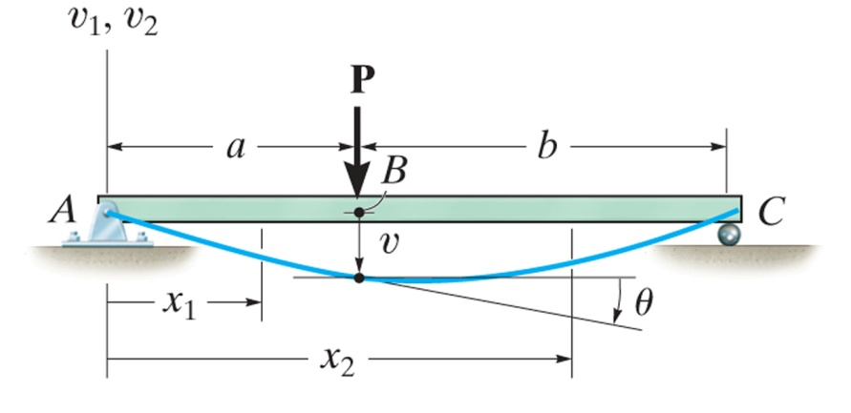
Boundary and Continuity Conditions
Boundary conditions must be evaluated in order to determine the constants of integration
If a single x coordinate cannot be used to express the equation for the beam's slope or the elastic curve, then continuity conditions must be used to evaluate some of the constants of integration
Problems, pg 594

Slide 8
Superposition
The differential equation EI d⁴v/dx⁴ = -w(x) satisfies the two necessary requirements for applying the principle of superposition
The load w(x) is linearly related to the deflection v(x)
The load is assumed not to change significantly the original geometry of the beam or shaft
As a result, the deflections for a series of separate loadings acting on a beam may be superimposed (added)
See Appendix C, Slope and Deflections of Beams, pg 814 and the FE Reference Handbook, pg 85 (in the Mechanics of Materials section)
Problems, pg 631

