Slide 1
Chapter 4 Axial Load

Slide 2
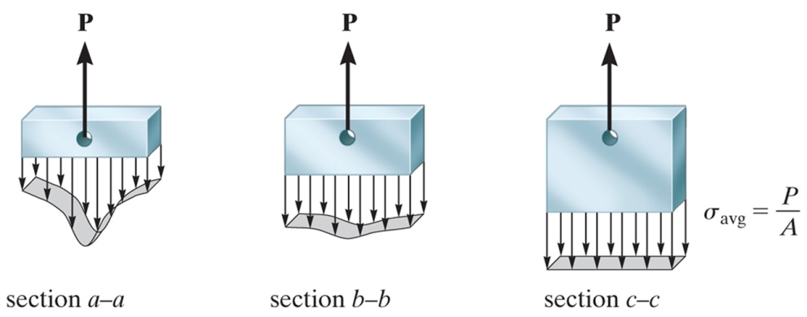
Saint -Venant's Principle
Saint-Venant's Principle claims that localized effects caused by any load acting on a body will dissipate or smooth out within regions that are at a sufficient distance from the point of load application
A general rule that applies to many cases of loading and member geometry, this distance can be considered to be at least equal to the largest dimension of the loaded cross section
The resulting stress distribution in these regions will be the same as that caused by any other statically equivalent load applied to the body within the same localized area

Slide 3
Elastic Deformation of an Axially Loaded Bar
Bar is assumed to have a cross-sectional area that varies along its length, external end loads (P₁ and P₂), and an external load that varies along its length (such as the weight of a vertically oriented bar)
Using the method of sections, a differential element (infinitesimally thin slice) of length dx and cross-sectional area A(x) is isolated from the bar at an arbitrary position x
Resultant axial force P(x) varies along its length due to the external loading
The relative displacement δ of one end of the bar with respect to the other end

Slide 4
Special Cases of Axially Loaded Bars
Constant load and cross-sectional area and homogeneous material (E is constant),
Abrupt changes in axial force, cross-sectional area, and/or modulus of elasticity from one region of the bar to the next
Can apply above equation to each segment of the bar where these quantities are all constant

Slide 5
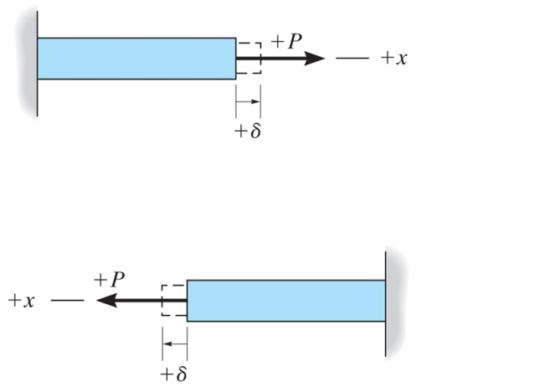
Sign Convention
Force and displacement are considered positive if they cause tension and elongation
Force and displacement are considered negative if they cause compression and contraction

Slide 6
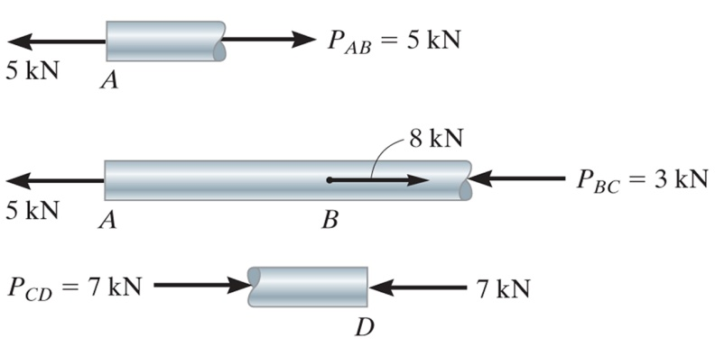
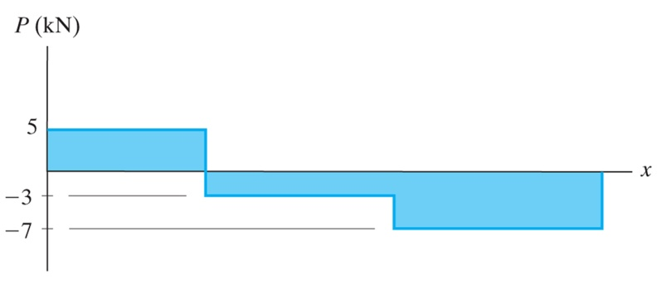
Relative Displacement and the Sign Convention
δ_{A/D} relative displacement (displacement of A with respect to D)
Problems, page 135

Slide 7
Principle of Superposition
Principle of superposition - the resultant stress or displacement at a point can be determined by first finding the stress or displacement caused by each component load acting separately on the member and then, algebraically adding the contributions caused by each of the components
The loading must be linearly related to the stress or displacement that is to be determined (i.e. σ = P/A and δ = PL/AE apply)
The loading must not significantly change the original geometry or configuration of the member (deformations are typically so small that changes in geometry or configuration can be considered to be insignificant, with one exception being the deformations anticipated in buckling analysis)

Slide 8
Statically Indeterminate Axially Loaded Member
See "Equilibrium of a Rigid Body" topic in Statics (see "Redundant supports" slide)
Equilibrium equation is insufficient to find all the reactions, F_{B} + F_{A} - P = 0
Compatibility or kinematic condition
Specifies conditions for displacement
δ_{A/B} = 0
Using

Slide 9
Force Method of Analysis for Axially Loaded Members
Flexibility or Force Method of Analysis
Choose any one of the two supports as "redundant"
Temporarily remove its effect from the member
Using principle of superposition, the actual member is equivalent to the one subjected to the external load (with redundant force removed) plus the member subjected only to the redundant force
Equilibrium equation can then be used to determine F_{A}
Problems, page 149

Slide 10
Thermal Stress
If the temperature increases, generally a material expands, whereas if the temperature decreases, a material will contract
The deformation equals δ_{T} = α ΔT L
δ_{T} = change in length of the member due to a temperature change
α = linear coefficient of thermal expansion (CTE)
ΔT = change in temperature of the member
L = length of the member
If the change in temperature or the CTE vary along the length then
Problems, page 159

Slide 11
Stress Concentrations
Stress concentrations occur at locations where the cross-sectional area abruptly changes (i.e. holes and transition regions)
Stress concentration factors, K
K = σ_{max} / σ_{avg} the ratio of the maximum stress to the average stress acting at the smallest cross section
K is determined empirically or
through application of the
theory of elasticity
K is commonly plotted as a
function of geometric features

Slide 12
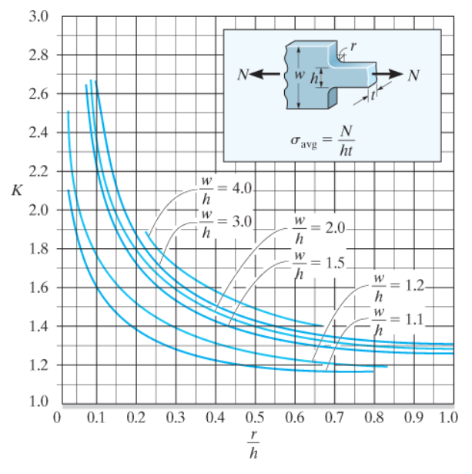
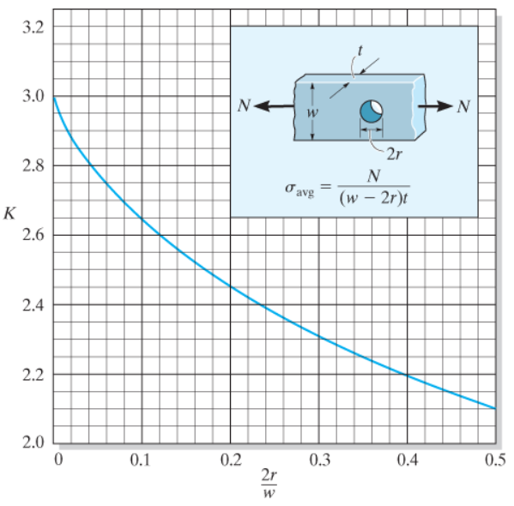
Stress Concentration Factors
Change in cross section Hole
Problems, page 172

