Slide 1
Chapter 5 Torsion

Slide 2
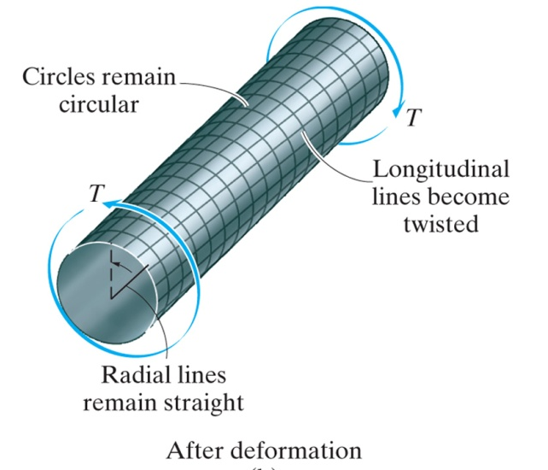
Torsional Deformation of a Circular Shaft
When a torque is applied to a circular shaft
The circles remain as circles
Each longitudinal grid line deforms into a helix that intersects the circles at equal angles
The cross sections at the ends of the shaft remain flat (do not warp or bulge in or out)
Radial lines on these ends remain straight during the deformation
If the angle of rotation is small, the length of the shaft and its radius will remain unchanged

Slide 3
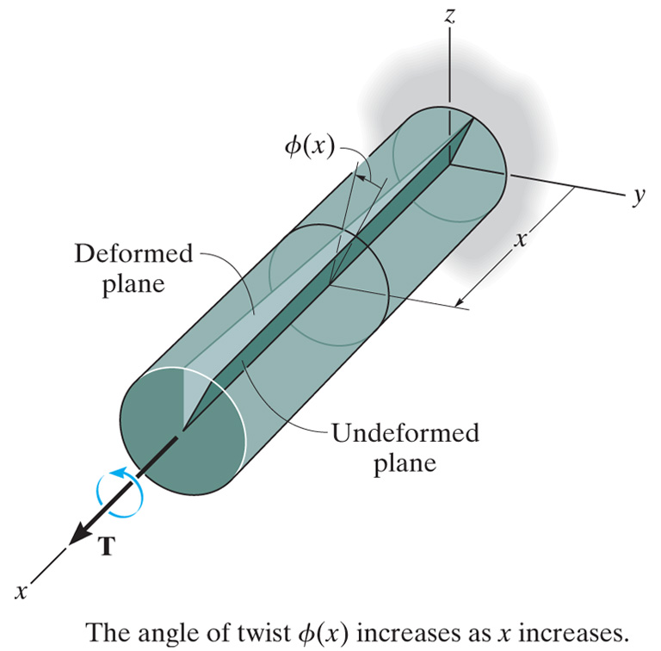
Angle of Twist
If the shaft is fixed at one end and torque is applied to its other end, a radial line located on the cross section at a distance x from the fixed end will rotate through an angle φ(x), the angle of twist

Slide 4
Strains Induced by Torsional Deformation
Isolate a small element located at a radial distance ρ from the axis of the shaft
Due to the deformation the front and rear
faces of the element will undergo a rotation -
the back face by φ(x), and the front face by
φ(x) + Δφ
The difference in these two rotations Δφ causes
the element to be subjected to a shear strain
(recall $γ=\frac{π}{2}− θ^{′}$)

Slide 5
Variation of Shear Strain Along a Radial Line
Since dx and dΦ are the same for all elements located at points on the cross section at x, dΦ/dx is constant over the cross section
The magnitude of the shear strain varies only with its radial distance ρ from the axis of the shaft - from zero at the axis of the shaft to a maximum γ_{max} at the outer boundary

Slide 6
Variation of Shear Stress Along a Radial Line
If the material is elastic, Hooke's Law applies τ = Gγ
The linear variation in shear strain leads to a corresponding linear variation in shear stress
The torque produced by the stress distribution
over the entire cross section must be equivalent
to the resultant internal torque T
Each element of area dA, located at ρ, is
subjected to a force of dF = τ dA and the
torque produced by this force is dT = ρ (τ dA)
For the entire cross section

Slide 7
Solid Shafts
Polar moment of inertia
Not only does the internal torque T develop a linear distribution of shear stress along each radial line in the plane of the cross-sectional area, but also an associated shear stress distribution is developed along an axial plane

Slide 8
Tubular Shafts
Polar moment of inertia
Problems, pg 199

Slide 9
Power Transmission
When shafts and tubes are used to transmit power from a machine, they are subjected to torques that depend on the power generated by the machine and the angular speed of the shaft
Power is defined as the work per unit of time
If during an instant of time dt an applied torque T causes the shaft to rotate dθ, then the instantaneous power is
In the SI system, power has units of watts when torque is measured in newton-meters (N-m) and ω is in radians per second (rad/s) (1 W = 1 N-m/s)
In the FPS (English) system
Power has units of foot-pounds per second (ft-lb/s)
Often horsepower (hp) is used, 1 hp = 550 ft-lb/s
For machinery, the frequency of a shaft's rotation, f, is often used
Frequency is a measure of the number of revolutions or cycles per second and is often expressed in hertz (1 Hz = 1 cycle/s) or rpm (rev/min)
Since 1 cycle (or 1 revolution) = 2π rad, then ω = 2π f and P = 2π f T

Slide 10
Shaft Design for Power Transmission
Knowing the power transmitted by a shaft and its frequency of rotation, the torque developed in the shaft can be determined
Knowing the torque T and the allowable shear stress for the material, the geometry of the shaft's cross section can be determined from the torsion formula
Problems, pg 199

Slide 11
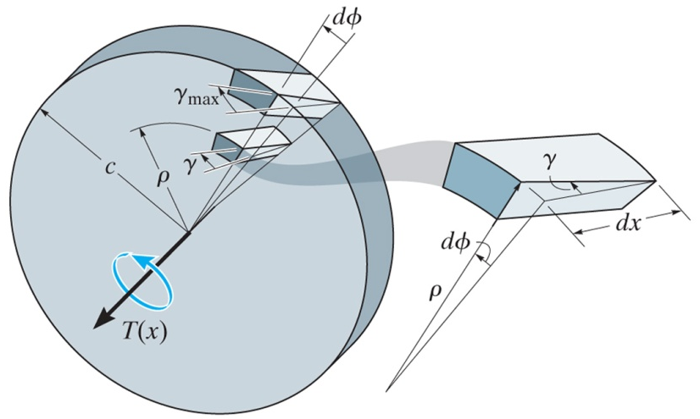
Angle of Twist
Due to the applied torque, T(x), the relative rotation of one face of the disk with respect to the other face will be dφ

Slide 12
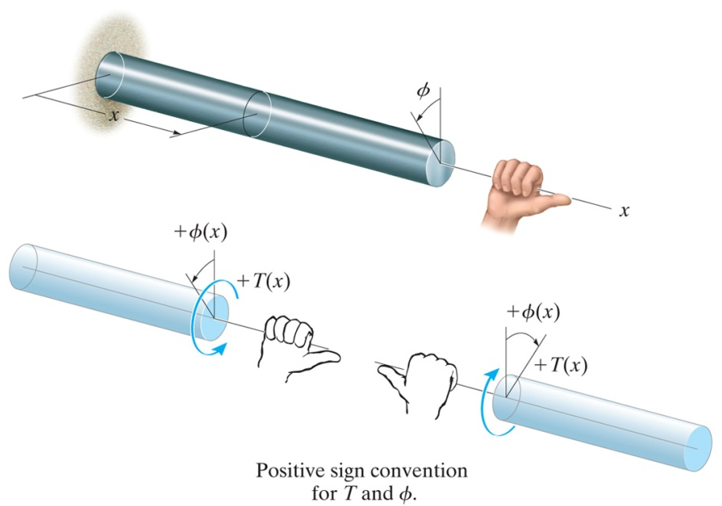
Angle of Twist for Shafts with Changes Along Its Length
If the shaft is subjected to different torques, or the cross-sectional area or shear modulus changes abruptly from one region of the shaft to the next
Sign convention - using the right-hand rule, both the torque and angle of twist are considered positive provided the thumb is directed outward from the shaft when the fingers curl to give the tendency for rotation
Problems, pg 216

