Slide 1
Chapter 6 Bending

Slide 2
Beams
Members that are slender (length dimension >> width dimension) and support loadings that are applied perpendicular to their longitudinal axis are considered beams
Beams develop internal shear force and bending moment that, in general, vary from point to point along the axis of the beam
To properly design a beam it is necessary to first determine the maximum shear and bending moment in the beam
σ_{max} = Mc/I (the flexure formula)
τ = VQ/It (the shear formula)

Slide 3
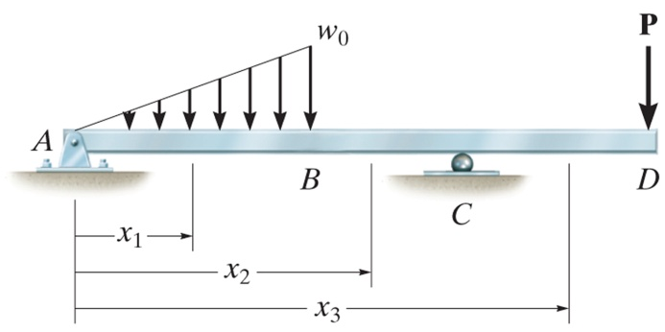
Shear and Bending Moment Functions and Diagrams
Method of sections is used to find the internal loading
The imaginary section or cut must be located at an arbitrary distance x from the end of the beam and V and M formulated in terms of x
Most often, the origin of x is located at the left end of the beam and the positive direction is to the right
The internal V and M obtained as functions of x will be discontinuous, or their slope will be discontinuous, at points where a distributed load changes or where concentrated forces or couples are applied
For this reason, V and M functions must be determined for each region of the beam located between any two discontinuities of loading

Slide 4
Beam Sign Convention
Positive directions assumed in the textbook (pg 264)
Distributed load acts upward on the beam
this is opposite that assumed in the FE Reference Handbook and prior editions of this textbook, (see figure)
These slides and my solutions will assume the convention found in the FE Reference Handbook, positive distributed load is downward on the beam
Internal shear force causes a clockwise rotation of the beam segment on which it acts
Internal moment causes compression in the top fibers of the beam segment (it bends the segment such that it holds water)
Loadings opposite to these are considered negative
Problems, pg 282

Slide 5
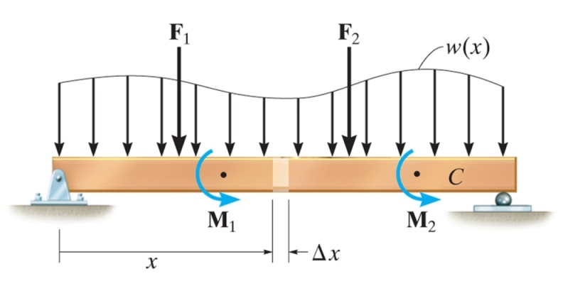
Relating the Magnitude and Slope of Distributed Load, Shear, and Bending Moment Diagrams
Consider the region of the beam subject to the distributed loading
Slope of shear diagram at each point =
- distributed load intensity at each point
Slope of moment diagram at each point =
shear at each point

Slide 6
Example Relating the Magnitude and Slope of Distributed Load, Shear, and Bending Moment Diagrams

Slide 7
Relating the Change in Shear and Bending Moment to the Areas Under the Distributed Load and Shear Diagrams
Previous equation relating slope of the shear diagram to the negative of the distributed load intensity can be rewritten
dV = - w(x) dx, where w(x) dx represents a differential area under the distributed loading diagram
ΔV = - ∫ w(x) dx
Change in shear = - area under the distributed loading
Previous equation relating slope of the bending moment diagram to the shear can be rewritten
dM = V dx, where V dx represents a differential area under the shear diagram
ΔM = ∫ V(x) dx
Change in bending moment = area under the shear diagram

Slide 8
Regions of Concentrated Force and Moment
When concentrated force, F, acts downward on the beam, ΔV is negative so the shear will "jump" downward. Similarly, if F acts upward, ΔV is positive so the shear will "jump" upward.
When M_{o} is applied clockwise (and letting Δx -> 0), ΔM is positive so the moment diagram will "jump" upward. Similarly, if M_{o} is applied counterclockwise, ΔM is negative so the moment diagram will "jump" downward.
Problems, pg 282

Slide 9
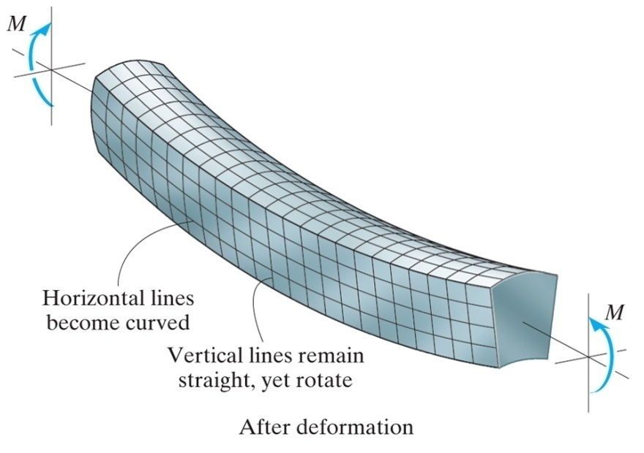
Bending Deformation of a Beam
Assumptions
The longitudinal axis, which lies within the neutral surface, does not experience any change in length (the neutral surface is the surface in which the longitudinal fibers do not undergo a change in length)
All cross sections of the beam remain plane and perpendicular to the longitudinal axis during the deformation
Any deformation of the cross section within its own plane will be neglected

Slide 10
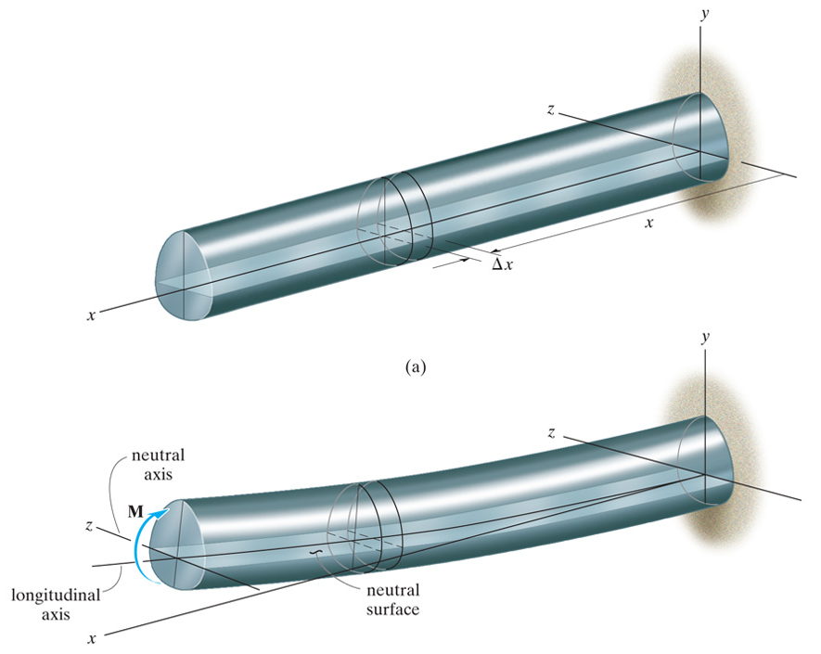
An Element from the Deformed Beam

Slide 11
Variation of Longitudinal Normal Strain and Stress
A linear variation of normal strain must be the consequence of a linear variation in normal stress

Slide 12
The Flexure Formula
The resultant force acting on the cross section must be equal to zero (there is no applied force)
The force acting on an arbitrary element dA is dF = σ dA
The stress in the beam can be determined from the requirement that the resultant internal moment M must be equal to the moment produced by the stress distribution about the neutral axis
Problems, pg 303

