Slide 1
Chapter 9
Stress Transformation

Slide 2
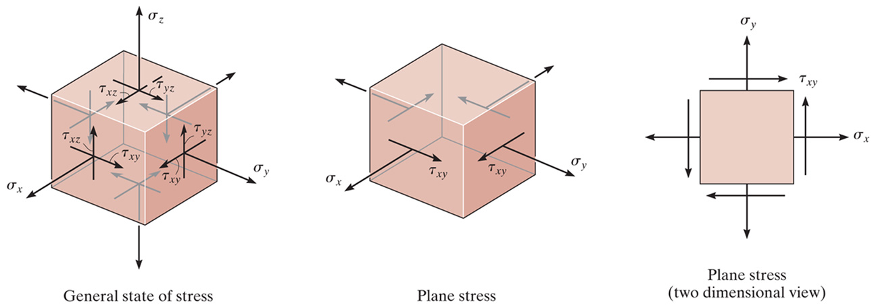
Plane Stress
General state of stress at a point is characterized by six independent normal and shear stress components
Approximations or simplifications of the loadings on a body are made so that the stress in a structural member or mechanical element can be analyzed in a single plane - the material is said to be subjected to plane stress (i.e. there is no load on two opposing (z) planes of the body)
The state of plane stress at a point is uniquely represented by three components on an element that has a specific orientation at the point

Slide 3
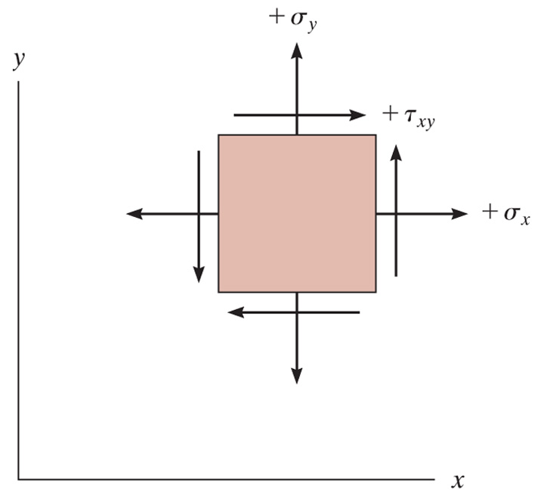
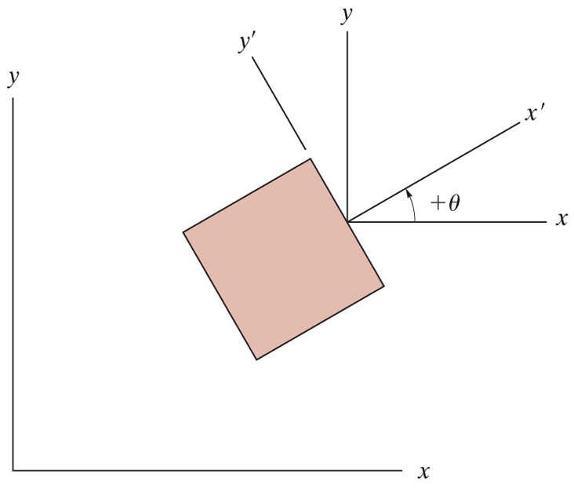
Plane Stress Sign Convention
Positive normal stress acts outward from all faces and positive shear stress acts upward on the right-hand face of the element
The angle θ is measured from the positive x to the positive x' axis. It is positive provided it follows the curl of the right-hand fingers (i.e. counterclockwise as shown)

Slide 4
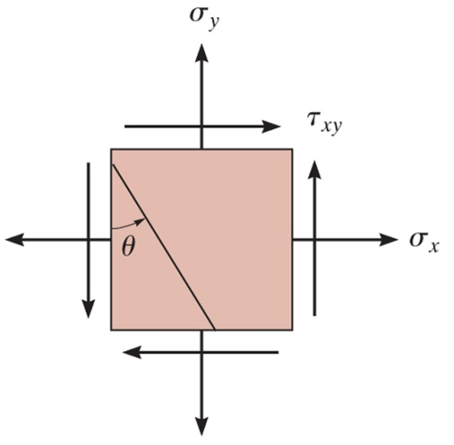
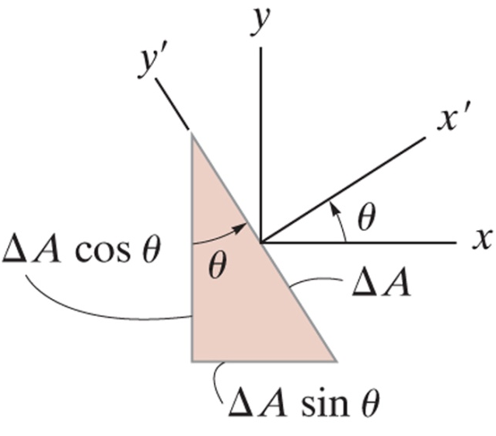
Stress Transformation Equations
Transforming the normal and shear stress components from the x, y to the x', y' coordinate axes

Slide 5
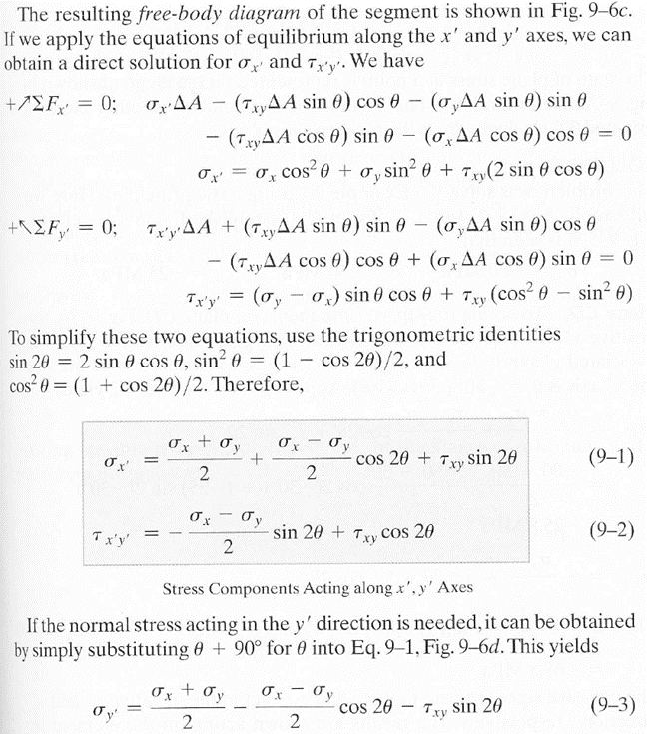
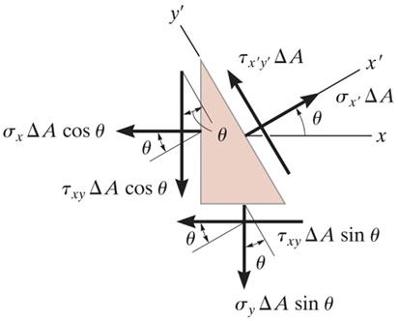
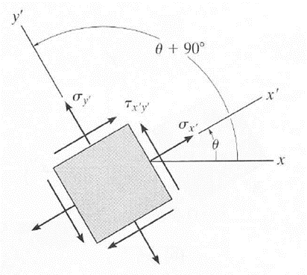
General Equations of Plane-Stress Transformation
Problems, pg 462

Slide 6
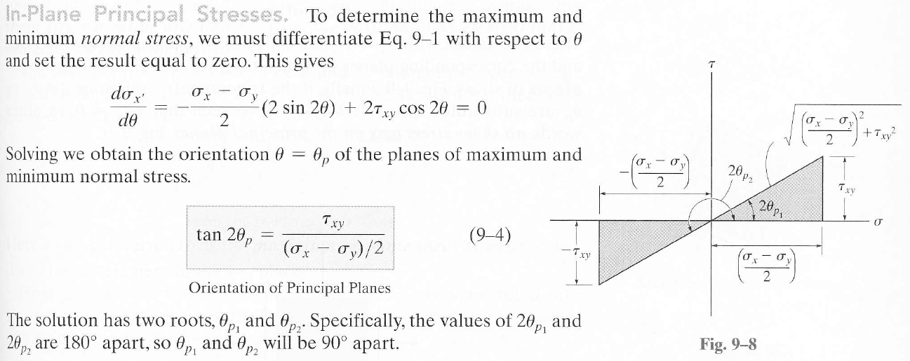
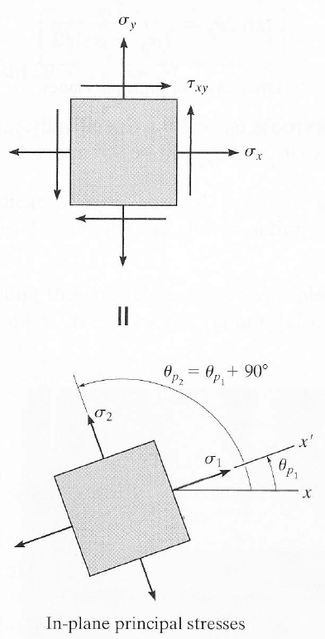
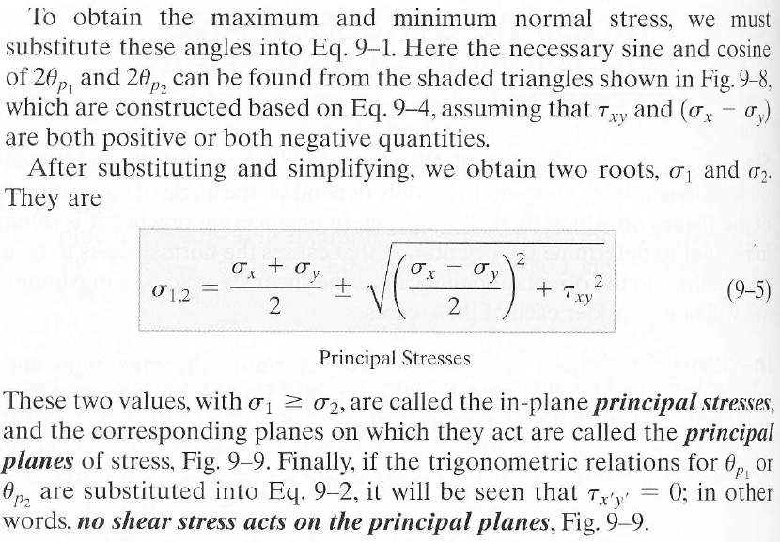
In-Plane Principal Stress

Slide 7
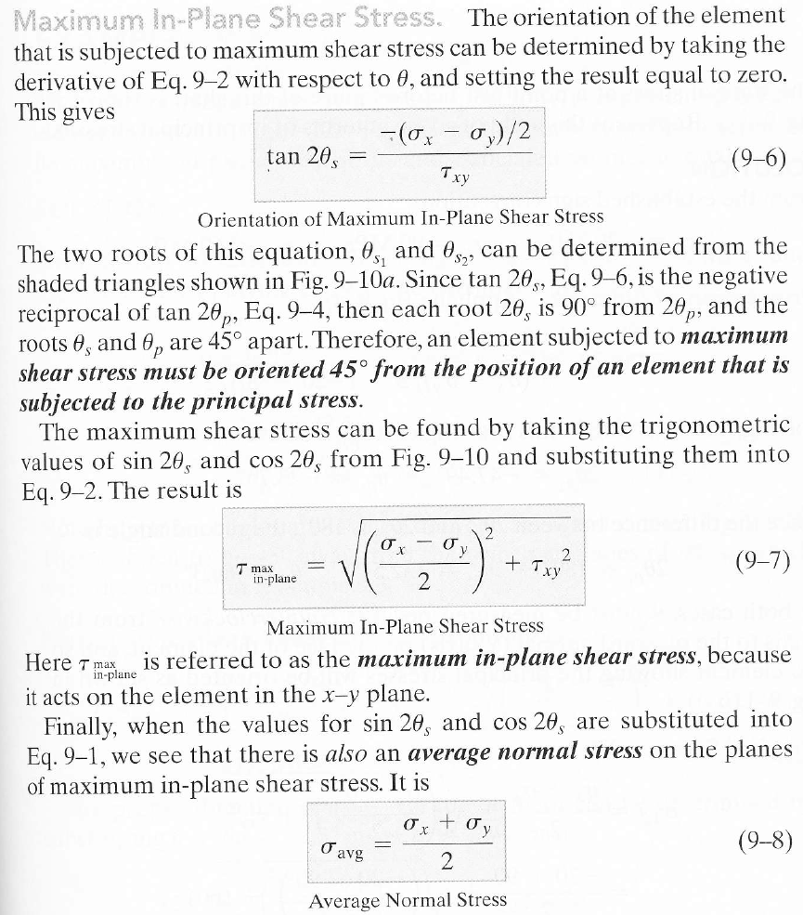
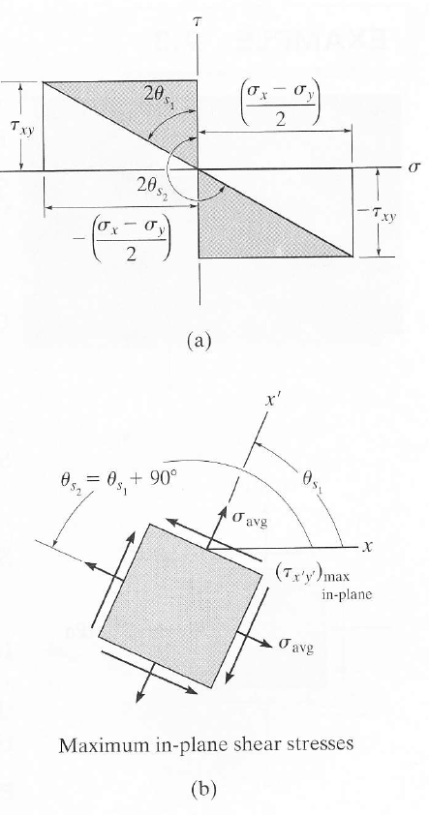
Maximum In-Plane Shear Stress

Slide 8

MOHR’S CIRCLE OF PLANE STRESS
A geometrical representation of equations 9.1 and 9.2; i.e.
Sign Convention:
σ is positive to the right, and τ is positive downward.
Copyright © 2011 Pearson Education South Asia Pte Ltd

