Slide 1
FILAMENT WINDING

Slide 2
FILAMENT WINDING PROCESS
fiber delivery system, traversing at speeds synchronized with the mandrel rotation, controls winding angles and the placement of the reinforcement
may be wound in adjacent bands or in repeating patterns which ultimately cover the mandrel surface
successive layers are added at the same or different winding angles until finished thickness is reached

Slide 3
FILAMENT WINDING APPLICATIONS
surfaces of revolution
cylinders, pipe or tubing
spherical or conical
pressure vessels or storage tanks (with the incorporation of end closures)

Slide 4
REINFORCEMENTS USED IN FILAMENT WINDING
fiber in roving form
E-glass, S-glass
carbon/graphite
aramid
hybrids (within layer and layer to layer)
roving yield (1/100 yards/lb) affects processing - higher yield roving facilitates wetting, but more layers required to meet specified thickness (longer winding times)

Slide 5
RESINS USED IN FILAMENT WINDING
wet or prepreg
epoxy
vinyl ester
polyester
viscosity and pot life of the catalyzed system are major processing considerations
low viscosity is critical for complete wetting of roving and for removal of entrapped air and volatiles
suitable viscosities 350 - 1000 cps at room temp
if viscosity too low problems in control and uniformity of resin content will result
if viscosity too high fiber fuzzing will occur in resin bath and delivery eye, uneven fiber wetting, excessive tension and air entrapment
pot life required of resin dependent on part (2 hours minimum)

Slide 6
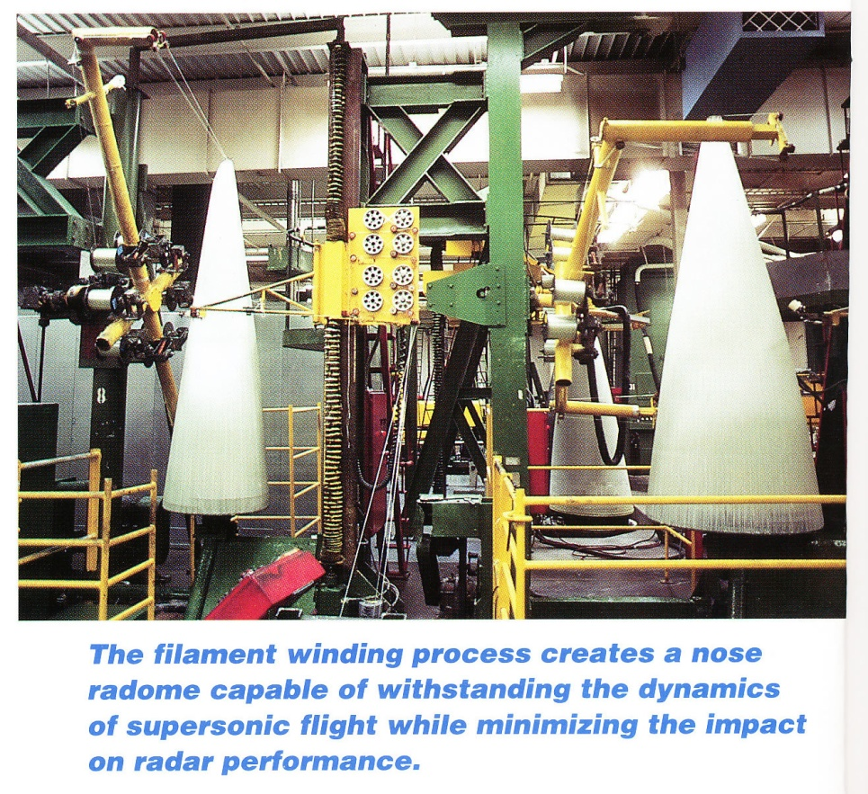
POLAR WINDING MACHINES
mandrel typically in vertical position
eliminates deflection due to weight
ability to wind 0° layers
simpler control of machine motions
rotation of feed arm is continuous and at uniform speeds (no inertial effects which can occur when speed varies or direction reverses)
limited to prepreg, wet winding system difficult to control

Slide 7
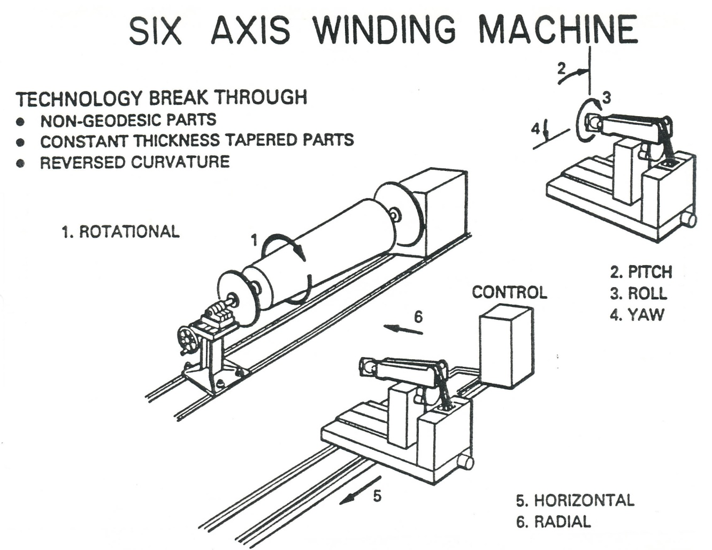
HELICAL WINDING MACHINES

Slide 8
MANDRELS
segmented collapsible metal
>> $
not warranted for less than 25 parts
polar openings must accommodate removal
eutectic salts
wash out to remove (one time use)
soluble or frangible (break-out) plasters
one time use
soluble easily washed out
frangible plaster mandrels difficult to remove and can cause damage
sand
dissolves readily in hot water
requires careful molding control
inflatables

Slide 9
FIBER DELIVERY SYSTEM
winding speed
upper limit 300 - 350 linear ft/min
precise winding 50 - 100 linear ft/min
provides means for controlling tension, resin content, bandwidth and layer thickness
roving spools may or may not travel with carriage
tension devices
impregnation tank (resin bath)
band former

Slide 10
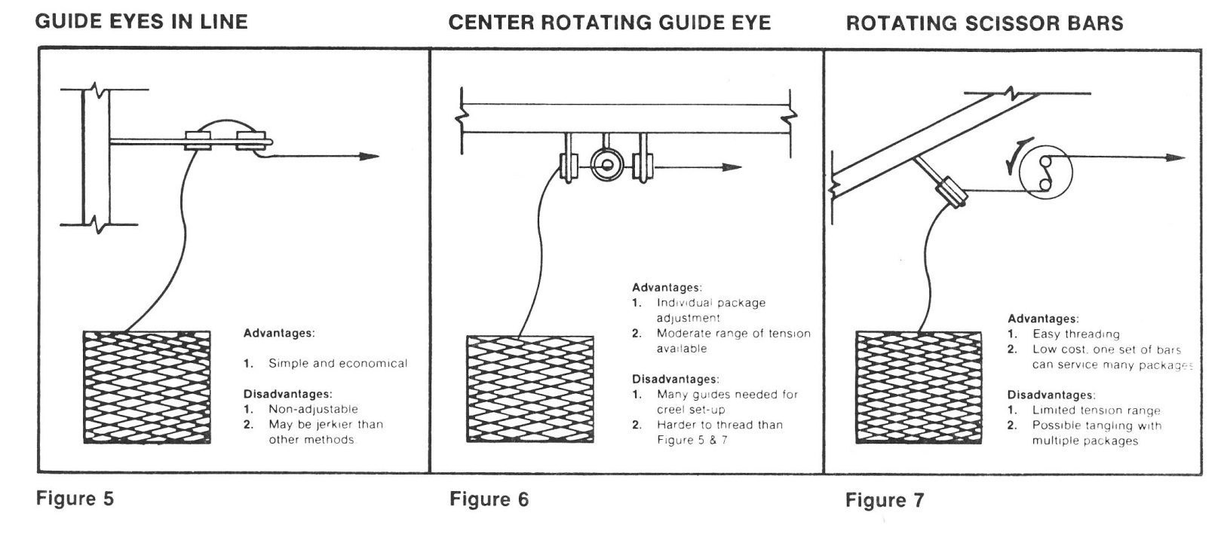
TENSION DEVICES
guide eyes (ceramic)
drum type brakes (outside pull roving spools)
scissors bars
series of horizontal bars
drag through resin tank

Slide 11
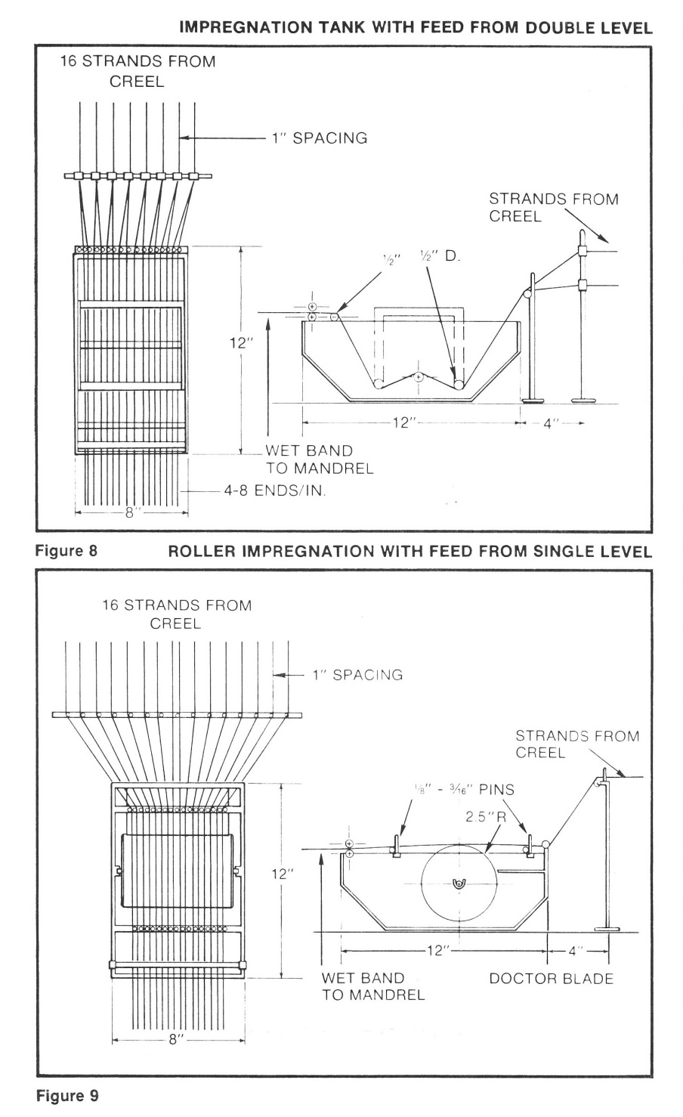
IMPREGNATION TANK (RESIN BATH)
design dependent on:
number and yield of rovings being processed
process speed
resin viscosity
resin gel time
whether or not the resin needs to be heated
pin combs to maintain roving separation
wiping device or doctor blade to remove excess resin

Slide 12
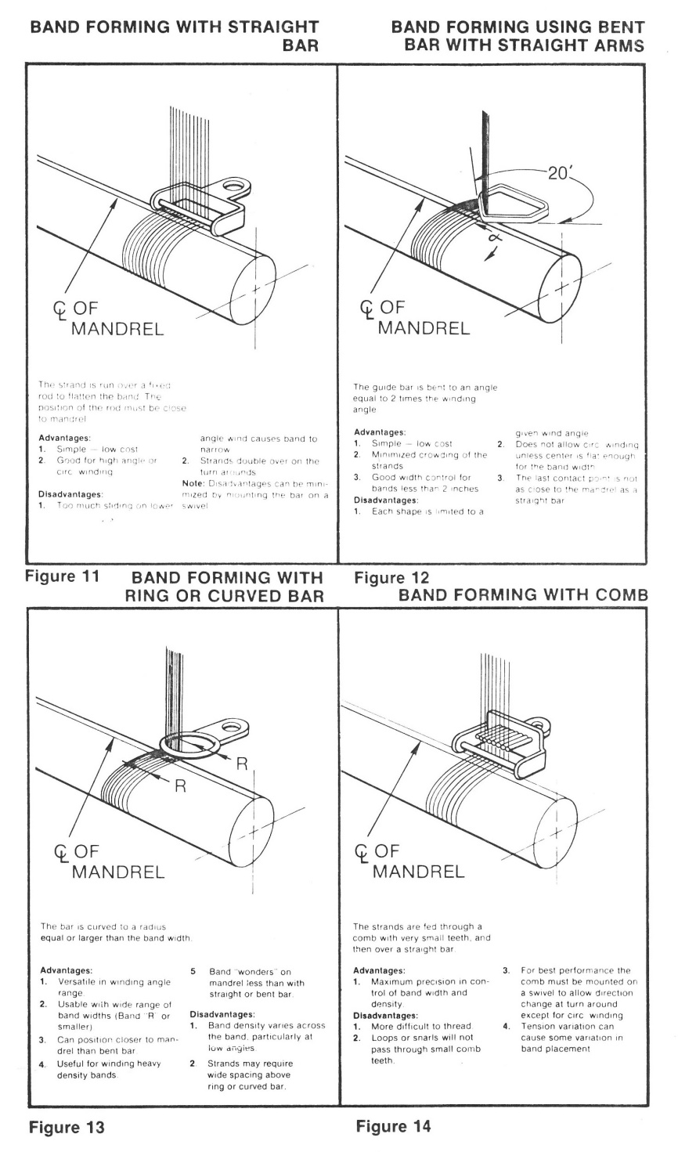
BAND FORMER
forms flat roving band (no roping or spreading of band)
swivel freely as the feed direction is reversed
feed head is controlled in path tangent to mandrel

Slide 13
ADVANTAGES OF FILAMENT WINDING
highly reproducible nature of the process (layer to layer, part to part)
continuous fiber over the entire part
high fiber volume is obtainable
ability to orient fibers in the load direction (10° minimum winding angle)
fiber and resin used in lowest cost form
autoclave not necessary
size of component not restricted by oven or autoclave size
process automation (particularly with high volume) results in cost savings

Slide 14
DISADVANTAGES OF FILAMENT WINDING
part configuration must facilitate mandrel extraction (no trapped tooling)
mandrel could be complex and expensive
inability to wind reverse curvature (“female” feature)
inability to easily change fiber path within one layer
as wound external surface may not be satisfactory for some applications

