Slide 1
HAND (WET) LAY-UP
COMBINING OF REINFORCING FIBER AND RESIN AT THE TIME OF PART FABRICATION

Slide 2
REINFORCING FIBER
E-glass, S-glass, Aramid, Carbon/Graphite
E-glass most common (process inherently produces lower "quality" composite laminate due to lack of tight resin content control and low compaction pressure)
mat material
randomly oriented chopped fibers or swirled continuous fibers which are held together loosely with a styrene-soluble binder
0.5 oz/sq ft - 3 oz/sq ft
woven fabric material
available on rolls in widths from 36 in. to 60 in. typically
terminology and basic weave patterns (reference JPS Technical Reference Handbook and plied yarn construction figure)
unidirectional fabric
very fine filling (stitching) yarn
biaxial fabric
Notes:
show sample of chopped mat material
woven fabric material form (have terminology and weave patterns been defined???)
refer to handout
show manufacturers book
define terminology
define basic weave patterns
work through definition with 120 woven fabric
compare 112 and 113 woven fabric, note count similarity, strand weight (yield) difference and effect on breaking strength
show sample of unidirectional fabric

Slide 3
RESINS
polyesters
vinyl esters
epoxies

Slide 4
MOLD/TOOL PREPARATION
procedure to some degree dependent on:
tooling material
whether tool is being used in first cycle or subsequent cycle
clean tool
scotch brite pad
wipe with a clean cloth dampened with solvent (i.e., acetone)
mold release agents
waxes (carnuba-based)
spray/liquid releases
release films (sheet, PVA)
internal releases (added to gel coat or resin system)

Slide 5
APPLYING A MOLD RELEASE AGENT
preheat mold
apply release agent
allow period of time for release agent to "set up" (for wax) or "flash off"
buff with clean cloth
repeat application (particularly for first cycle) alternating pattern
cure

Slide 6
THE WET LAY-UP PROCESS OFTEN BEGINS WITH A GEL COAT
typically polyester, mineral filled (clays and carbonates), pigmented (different than mold color), non-reinforced layer or coating
produces decorative, highly protective, glossy, colored surface
little or no additional finishing required
can paint on, roll on, or spray on
allow gel coat to set (gel) barely tacky, but not release to the finger

Slide 7
CUTTING THE FABRIC
cut desired pattern
tools: shears, rotary cutters, and/or utility knife

Slide 8
WEIGHING OUT THE RESIN
weigh out resin components in specified proportions to achieve desired resin content (desired fiber volume of finished part)
epoxy curing agents/hardeners often expressed in parts per hundred by weight (phr) of epoxy resin or parts by weight
see West System epoxy resin systems
resin content expressed as percent by weight
epoxy resins typically 25% - 35% by weight (part fiber volume?, dependent on ability to wet out fiber, amount of resin bleeding out during cure, etc.)
need to account for process waste
resin bleeding out, remaining on brushes, ...
dependent on size of part (i.e. the smaller the part the greater the proportion of process waste)
draw quantity of resin components, in separate containers
thoroughly mix resin components (combine resin into curing agent container, move from container to container)
tools: containers, stirrers

Slide 9
RESIN SYSTEM QUANTITIES FOR THE DEMONSTRATION PART
11 in x 11 in panel made of 16 plies of 120 E-glass cloth
resin system is West System 105/206 epoxy resin system
desired fiber volume in panel is 50%
account for process waste

Slide 10
APPLY RESIN TO FABRIC
apply resin to fabric on mold surface or, preferably, wet out fabric with resin on separate surface and transfer to mold
resin may be sprayed, poured or brushed on, and spread with brush and/or squeegee
applying resin on mold surface prior to laying of fabric facilitates removal of entrapped air during compaction process (resin is forced up through the fabric and the air is evacuated)
applying resin to fabric on separate surface prevents resin rich areas (concave, negative, female contours) and resin starved areas (convex, positive, male contours)
tools: paint brush, spray equipment, squeegee

Slide 11
COMPACTION
resin should be applied, and the plies compacted on mold surface from the center to the outside to facilitate removal of entrapped air, visually able to see air moving
pressure can be applied with a squeegee and/or serrated roller
bridging on female contours (radii) must be avoided
tools: squeegee, serrated rollers

Slide 12
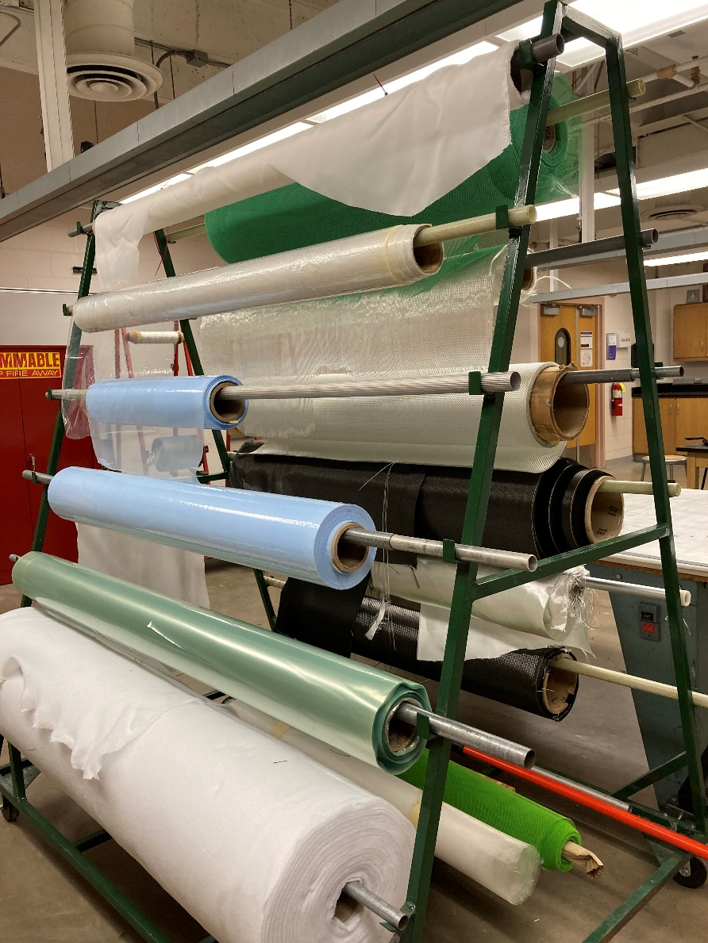
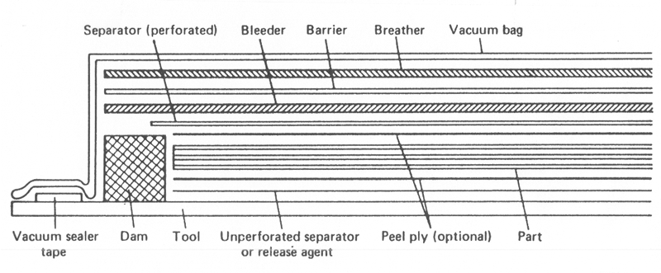
VACUUM BAGGING SEQUENCE (VERTICAL BLEED)

Slide 13
PEEL PLY
placed immediately on top of or under the composite laminate
removed just before bonding or painting operations to provide clean, bondable surface
woven fabric (nylon, polyester, or fiberglass) treated with nontransferable release agent

Slide 14
SEPARATOR (RELEASE FILM)
nonperforated film is placed between laminate (or peel ply, if used) and tool (tool surface preparation often makes this film unnecessary)
porous or perforated film is placed on top of laminate (and peel ply, if used, in some cases peel ply itself may serve as the porous film)
porous or perforated film allows volatiles to escape from laminate and excess resin to bleed from laminate into bleeder plies during cure
Spacing/size of perforations or porosity of material determines amount of resin flow from laminate surface

Slide 15
BLEEDER
absorb excess resin from laminate during cure (resulting in desired fiber volume)
fiberglass fabric or other absorbent materials or fabrics are used
amount of bleeder used is a function of
finished part fiber volume desired
resin content
absorbency of material

Slide 16
BARRIER
between bleeder plies and breather
nonperforated, nonadhering (release) film
resins which produce excessive volatile by-products during cure (must be vented) by using film with small perforations and large spacing to prevent breather from becoming clogged with resin

Slide 17
BREATHER
on top of barrier film to allow uniform application of vacuum pressure over laminate and removal of entrapped air or volatiles during cure
drapable, loosely woven fabric, or felt

Slide 18
CAUL PLATES
steel, aluminum, other
sometimes used to maintain same heating and cooling rate as mold
between barrier and breather
more uniform application of pressure
ensure a smooth, non-wavy surface

Slide 19
DAM
located peripherally to minimize edge bleeding
may be integral part of tool or rubber, metal bars, etc.

Slide 20
VACUUM BAGGING
vacuum bag
used to contain any vacuum pressure applied
application of the vacuum bag extremely critical
bag perforation must be prevented
no sharp edges on tool
properly sealed on edge
no bridging (requires folds in bag)
folds must be properly made, or undesirable wrinkles may occur in part
bag sealant tape
vacuum valves
vacuum hoses
vacuum source

Slide 21
CURING
follow cure schedule recommended by resin supplier
either room temperature or elevated temperature cure resin system

Slide 22
PREIMPREGNATED MATERIALS (PREPREGS)
reinforcements impregnated with metered amounts of uniformly distributed resin
processed to obtain optimum handling characteristics and reproducible cured laminate properties
thermoset (and thermoplastic) resin systems (specify by % resin content by weight)
reinforcing fiber (specify by type, form, areal weight)
e-glass, s-glass, aramid, carbon/graphite
unidirectional tape, woven fabric
limited out time and shelf life

Slide 23
HAND LAY-UP OF PREPREGS
mold preparation
ply (prepreg) cutting (and kitting)
allow prepreg to reach room temp (no condensation, min 2 hours)
film adhesive may be used against mold surface
release film is removed, ply is laid on mold using hand pressure, squeegee, and/or roller, then carrier sheet removed
heat gun may be used to improve tack
debulking (interim compactions)
process materials and sequence is similar to wet lay-up
cure
autoclave (applies heat and pressure)
cure cycle
temperature and pressure
ramp rates and holds
out-of-autoclave prepregs need oven/vacuum pressure only

